Slide 1


Human Activity Recognition
By: Karan Anand (E16CSE116)
Pawan Saxena (E16CSE148)
Notes:
Add Caption : Expect More

Slide 2
Human Activity Recognition
Human Activity Recognition is one of the most important and prospective areas of Computer vision research.
There are many applications of activity recognition, but most of them supports only offline action recognition from the video file.
The goal of this project is to recognize the action performed by the human in real time or from the video file.

Slide 3
Human Activity Recognition
In this project we propose human activity recognition system that takes input from devices like webcam or external camera or take input as video file and utilizes Deep Neural Network for recognition of different types of action.
We have added few activities as of now (such as Standing, Walking, Fall-Down etc.) Trial results show that different activities can be classified with a good accuracy on both webcam and video file.
We try to add more activity but as of now due to lack of training data we have trained on basic activities.

Slide 4
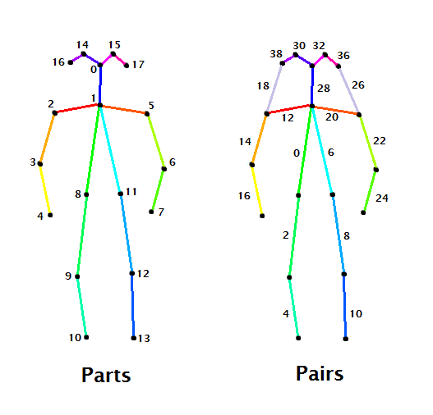
Working
We have used Open-pose in this project as pose estimation method in this action recognition system.
Open-pose used 17 points and 31 edges to estimate the pose of human on each frame of video.
We collect this data and annotate it with proper action.

Slide 5
Working
Now, we use this annotated data to train the model.
At the time of testing we use this pretrained model on the video file or using webcam to predict the action.

Slide 6
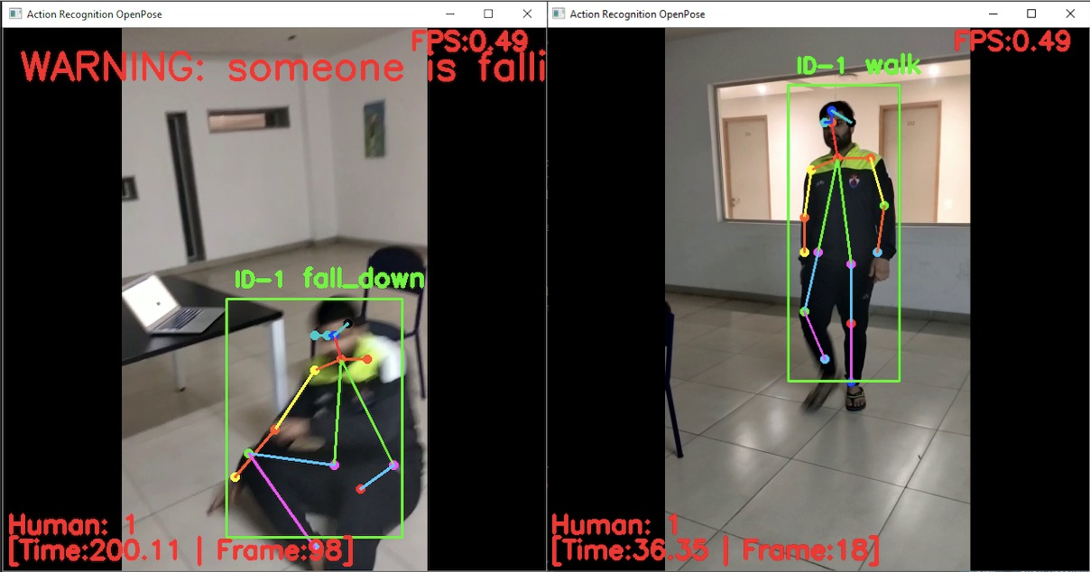
Result

Slide 7
Thank You

