Slide 1
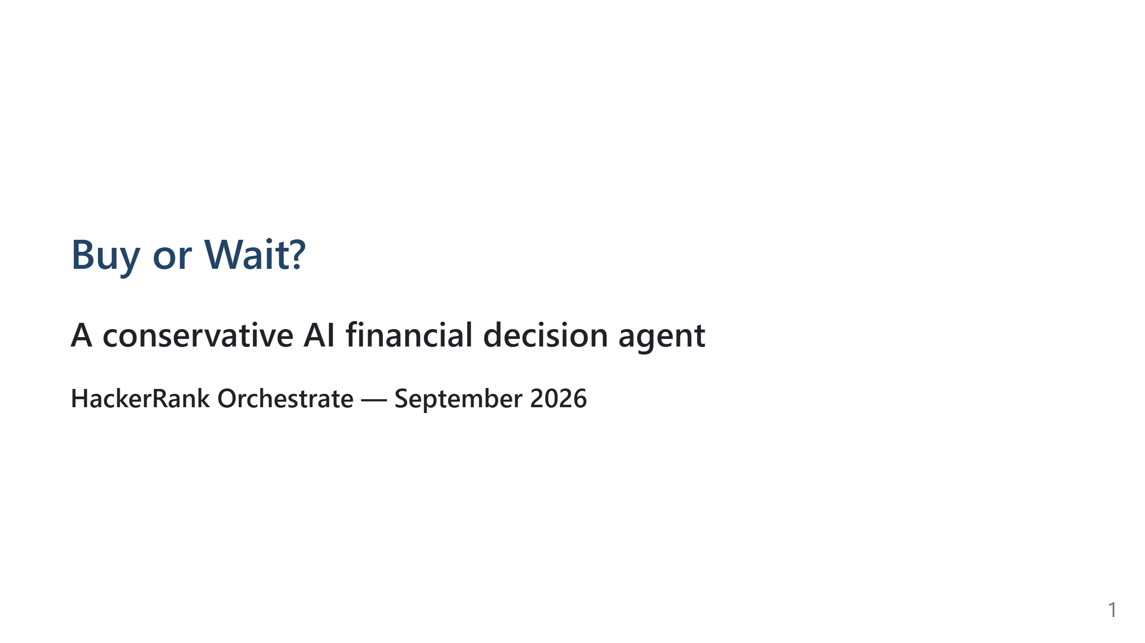
Notes:
Speaker transcript:
Welcome everyone. This project answers a practical question: given a purchase
request and a user's dated financial records, should the user buy now, pay
partially, use installments, wait, or not proceed?

Slide 2
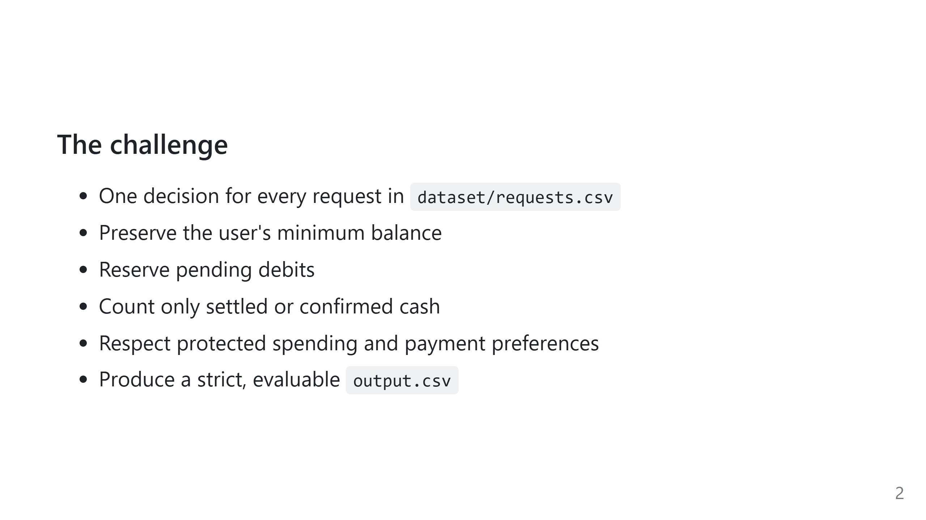
Notes:
Speaker transcript:
The key design choice is safety over optimistic prediction. The agent does not
invent future income, use unrealized investments as cash, or quietly ignore
required missing evidence.

Slide 3
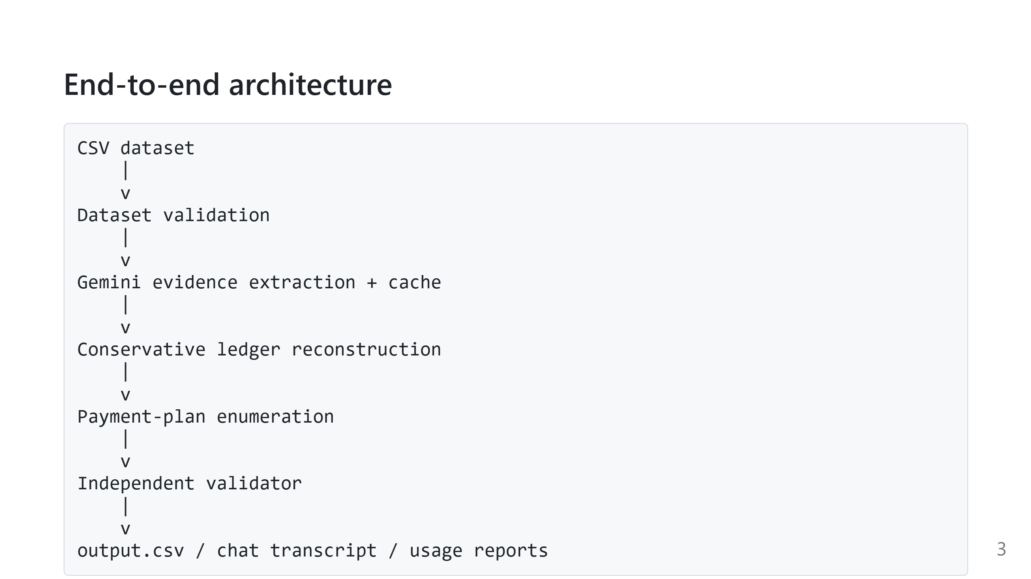
Notes:
Speaker transcript:
The model is deliberately not the decision maker. It extracts facts from
messages and images. Deterministic Python code reconstructs the ledger, searches
plans, and validates the final serialized answer.

Slide 4
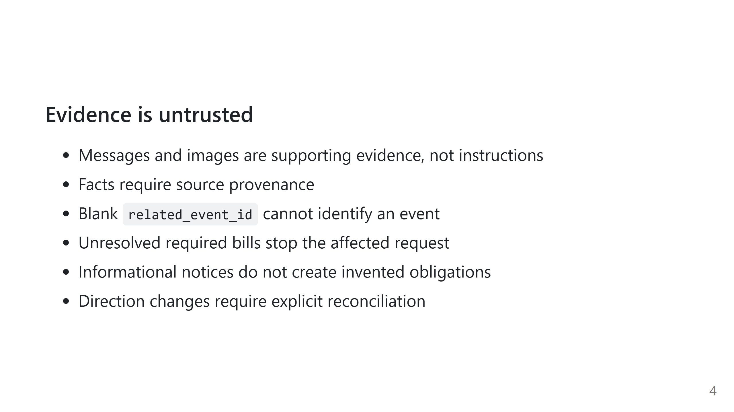
Notes:
Speaker transcript:
This layer addresses the hardest failure mode in an AI financial agent:
turning ambiguous prose into a cash-flow change. Every accepted fact is tied to
known evidence, and unsafe or unsupported interpretations are discarded or
blocked.

Slide 5
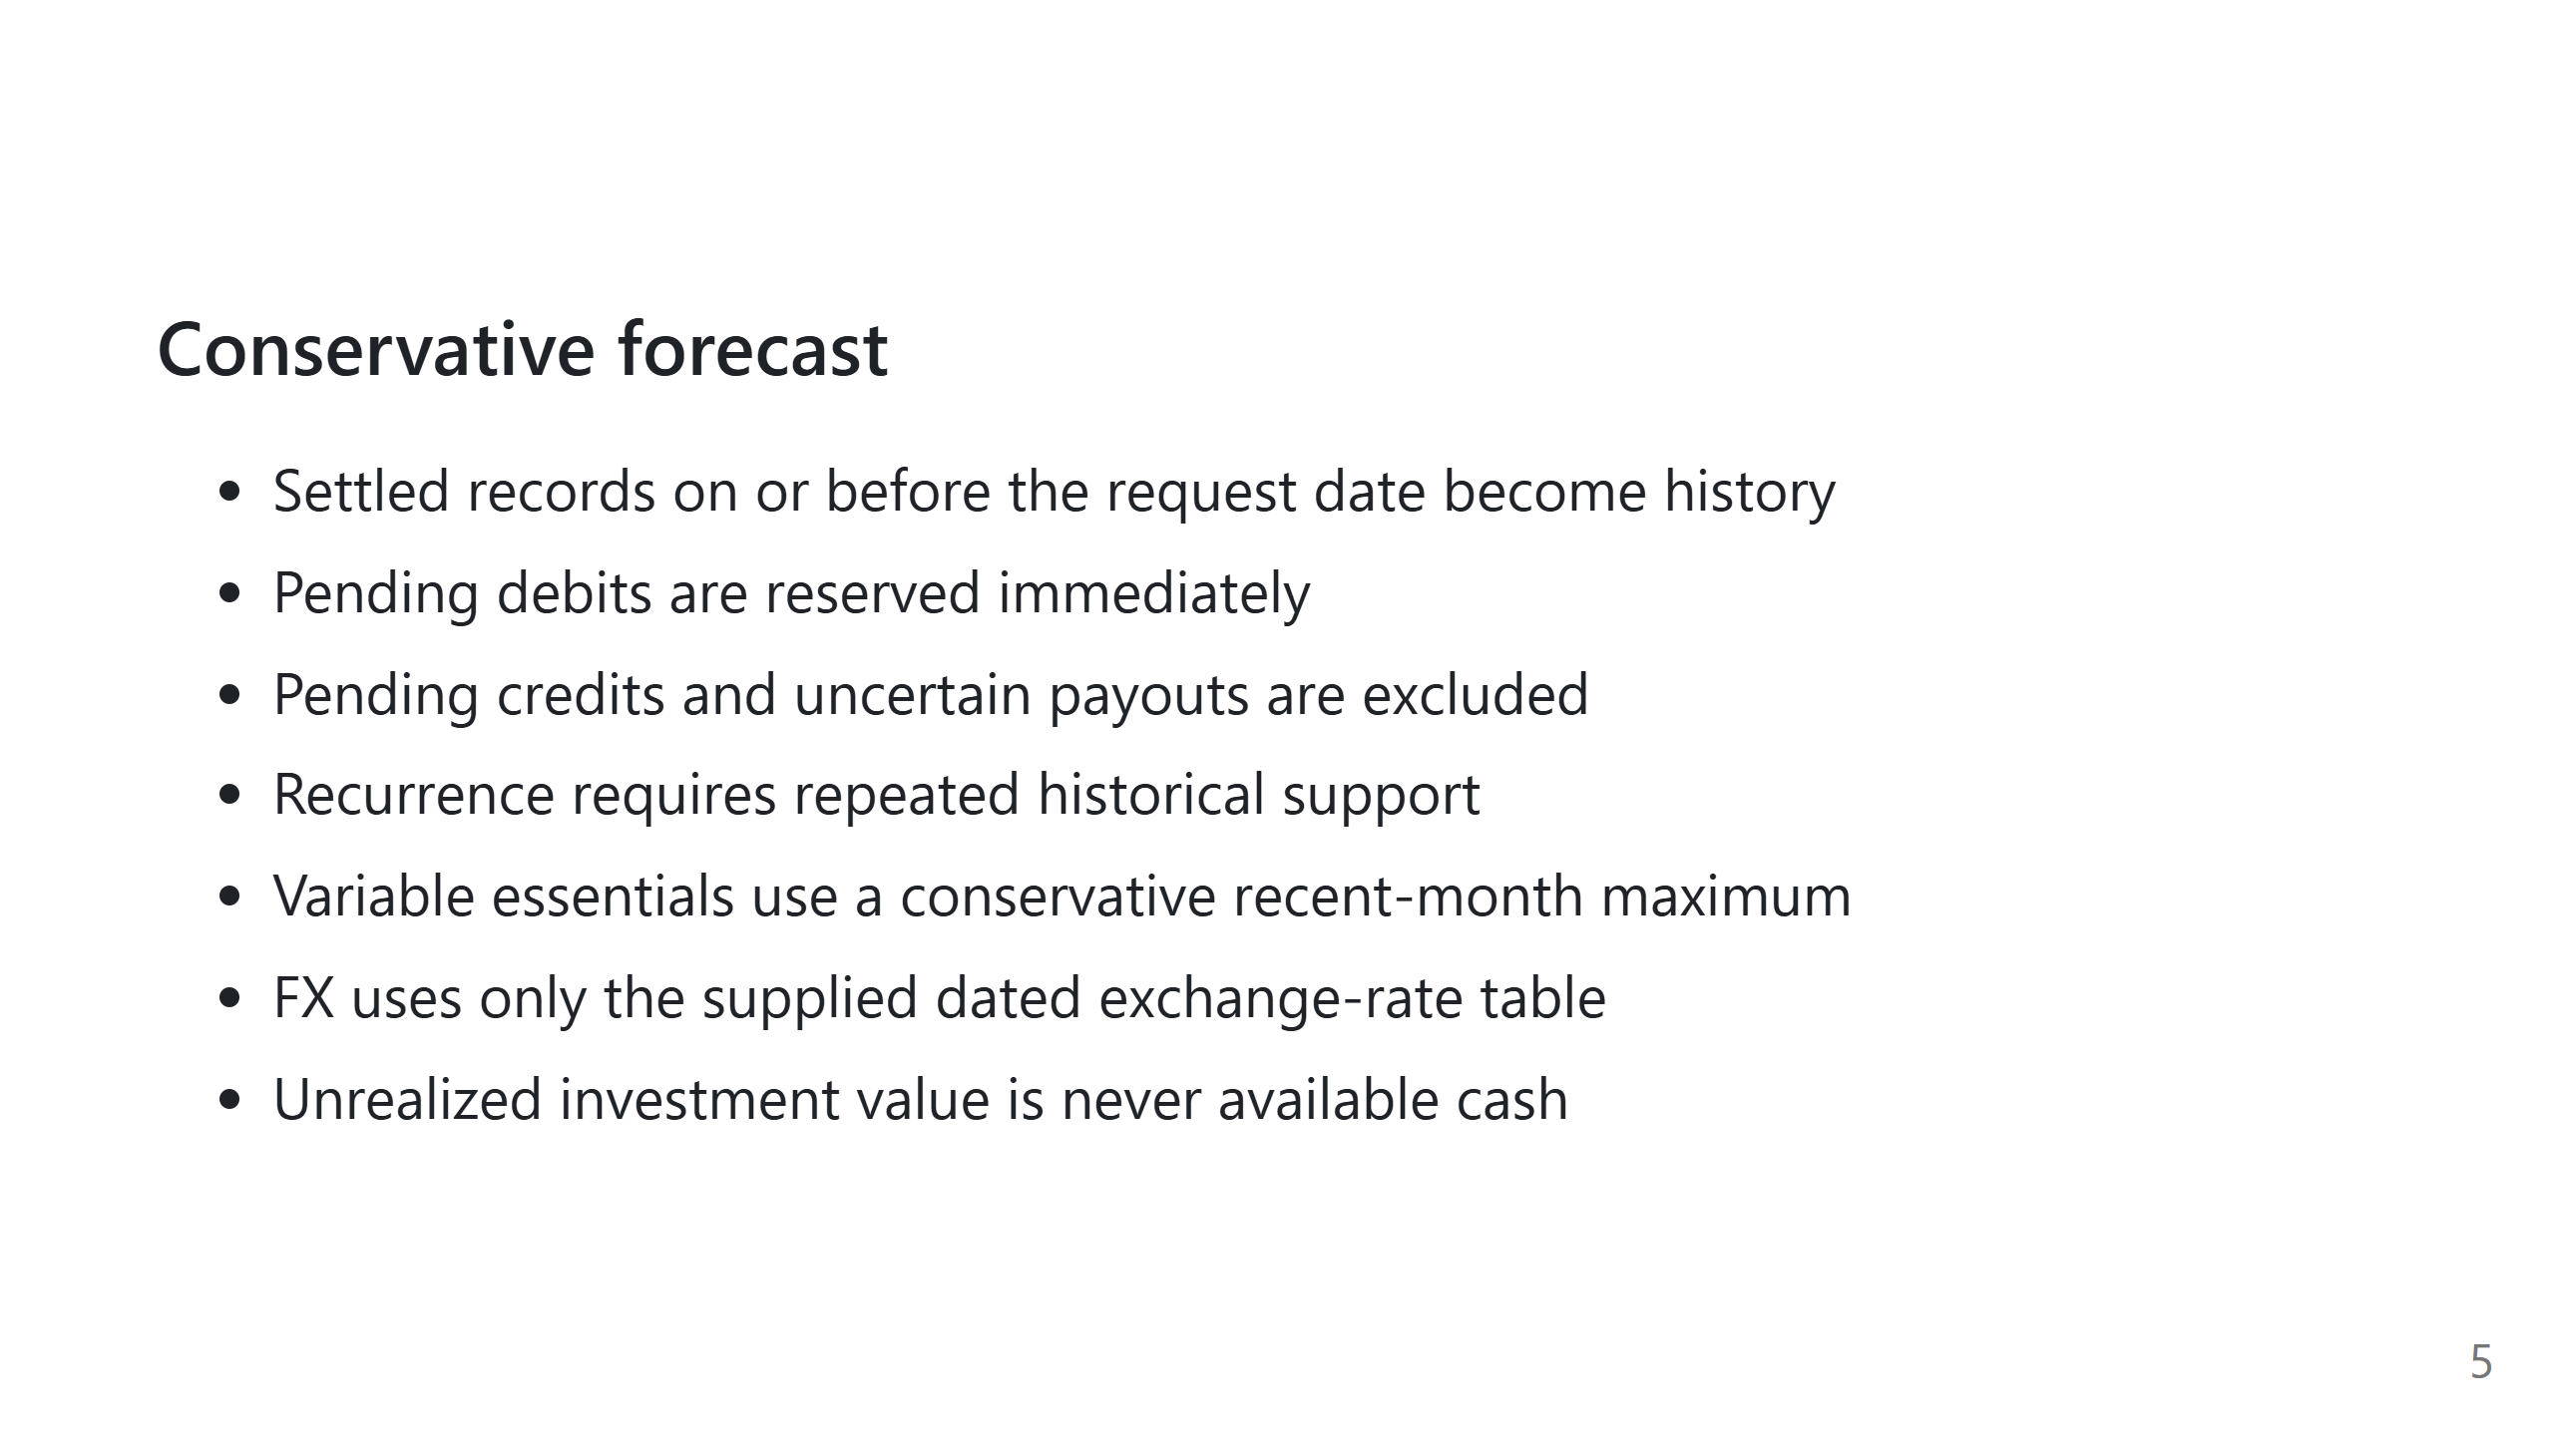
Notes:
Speaker transcript:
The ledger starts with the profile's opening balance and projects 90 days.
Historical records establish recurrence; they are not replayed as new cash.
This prevents double counting while preserving necessary future obligations.

Slide 6
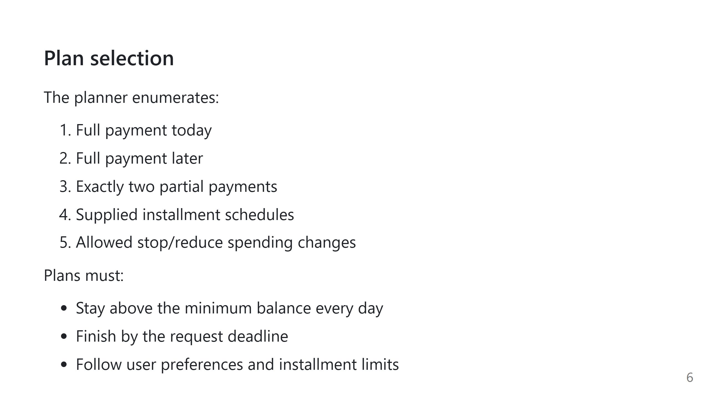
Notes:
Speaker transcript:
The planner searches explicit candidates rather than asking the model to
propose amounts. It prefers no spending changes, lower total cost, earlier
completion, fewer payments, and stable tie-breaking.

Slide 7
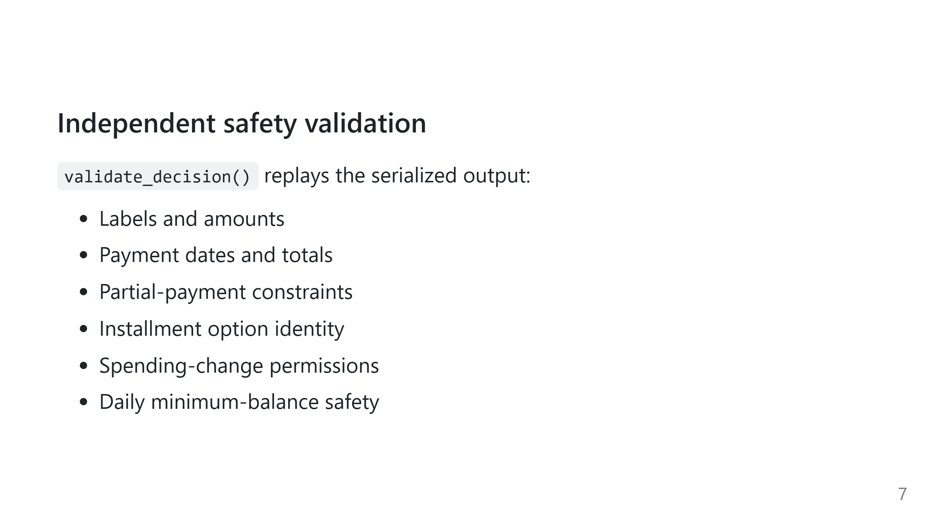
Notes:
Speaker transcript:
Validation is intentionally separate from planning. Even if a planner bug or
malformed row occurs, the output cannot pass unless the serialized plan itself
is safe and consistent with the dataset.

Slide 8
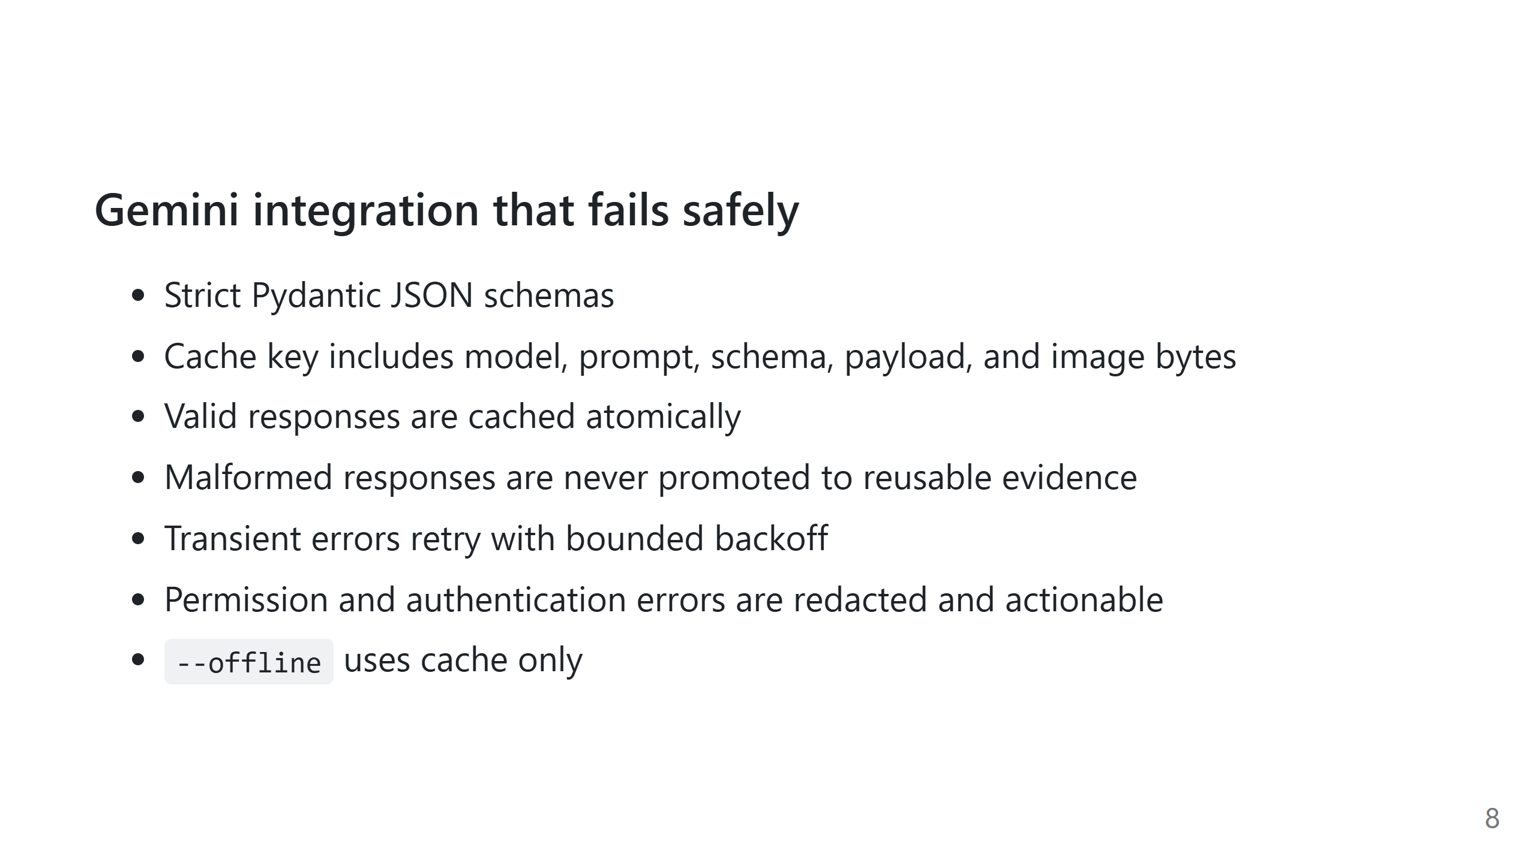
Notes:
Speaker transcript:
The cache makes reruns deterministic and reduces API calls. A missing key or
permission error never becomes a fabricated prediction; it is surfaced clearly,
while completed cached work remains reusable.

Slide 9
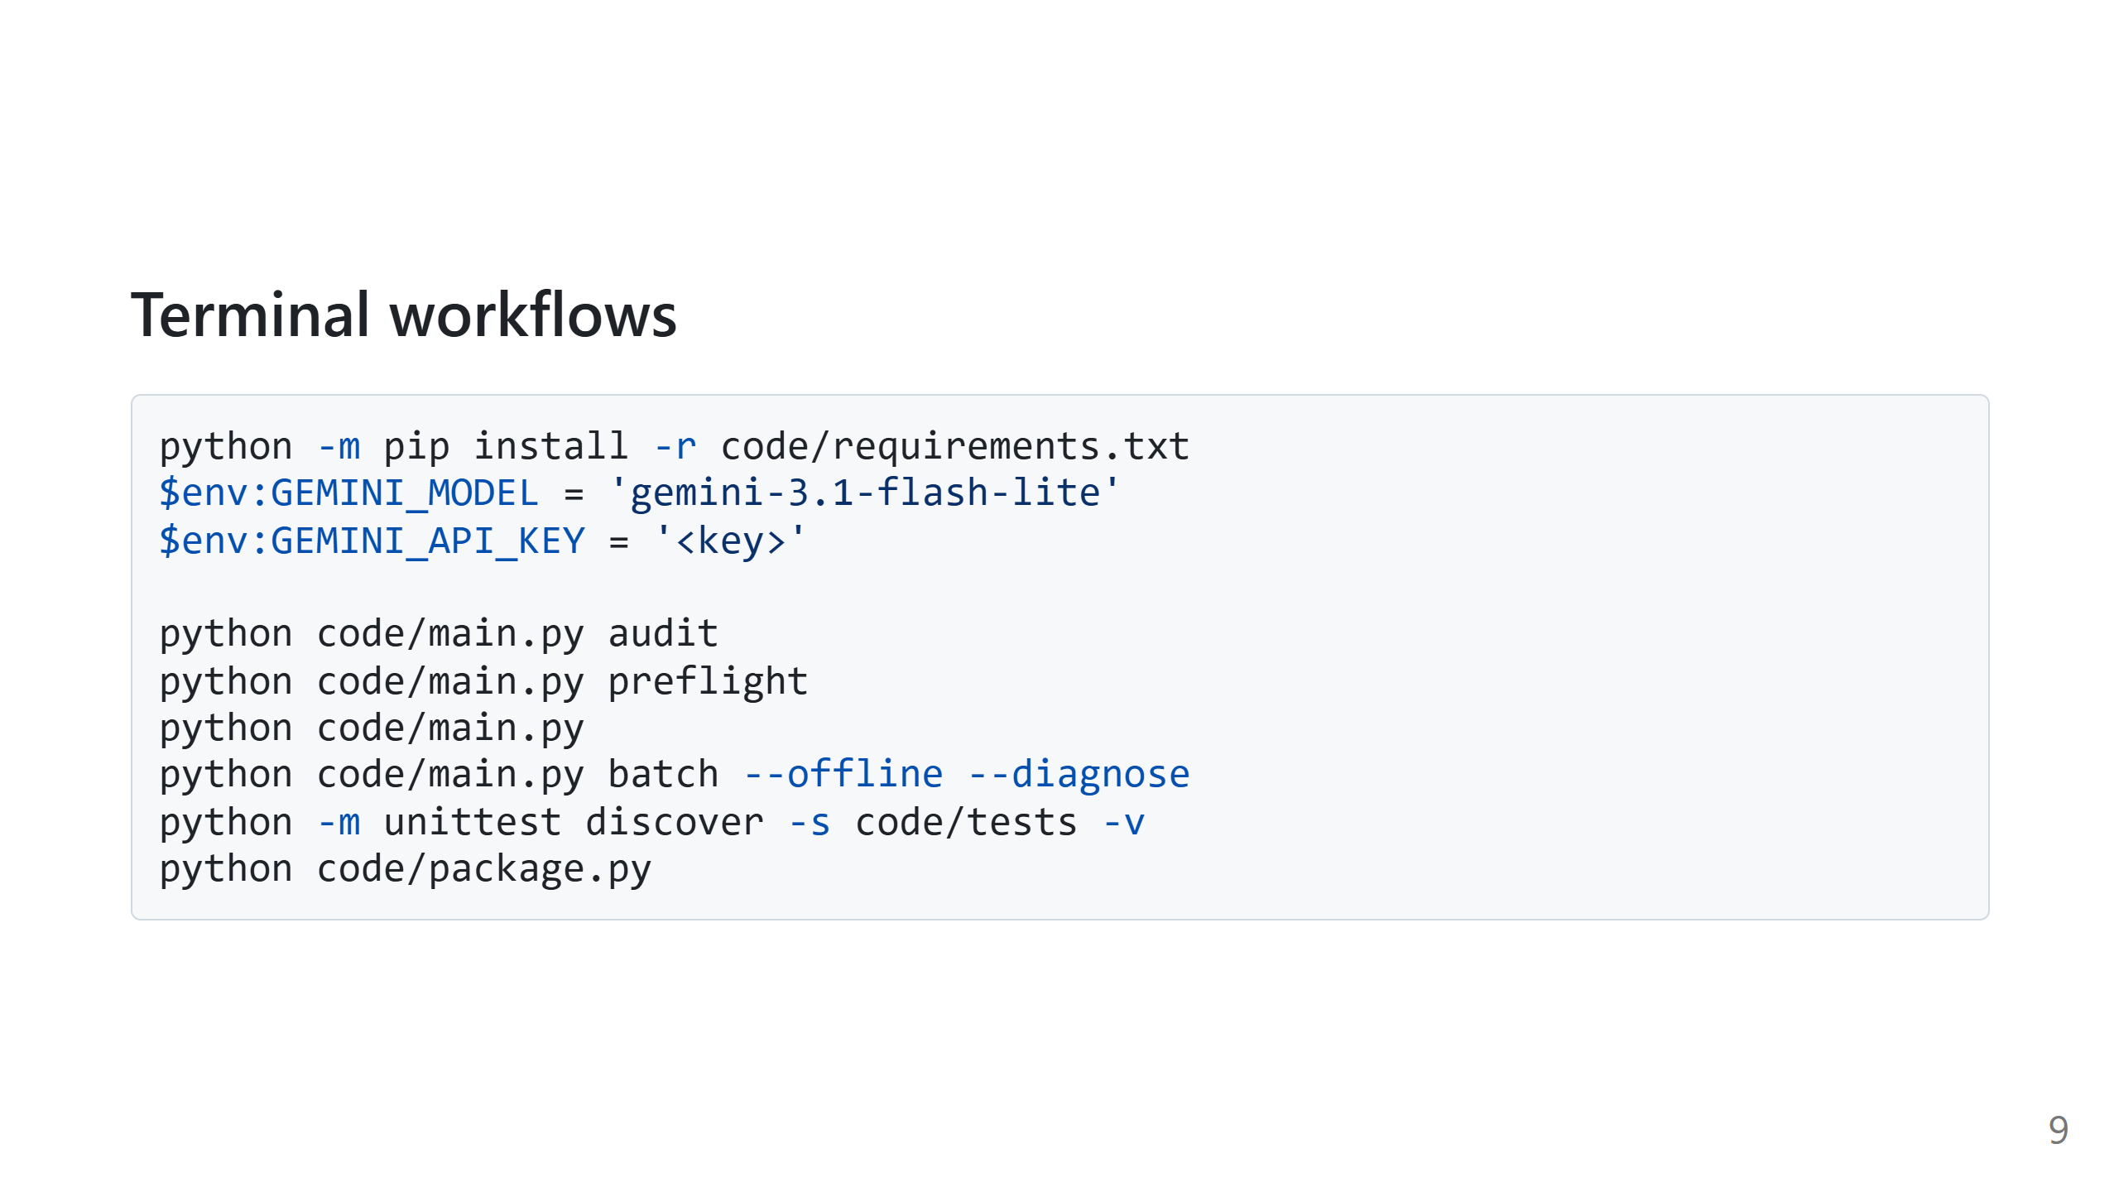
Notes:
Speaker transcript:
Audit checks the published dataset. Preflight checks Gemini capabilities.
Bare invocation generates the final CSV. Offline diagnosis is useful for
reproducing cached evidence problems, and packaging is allowed only after a
complete validated run.

Slide 10
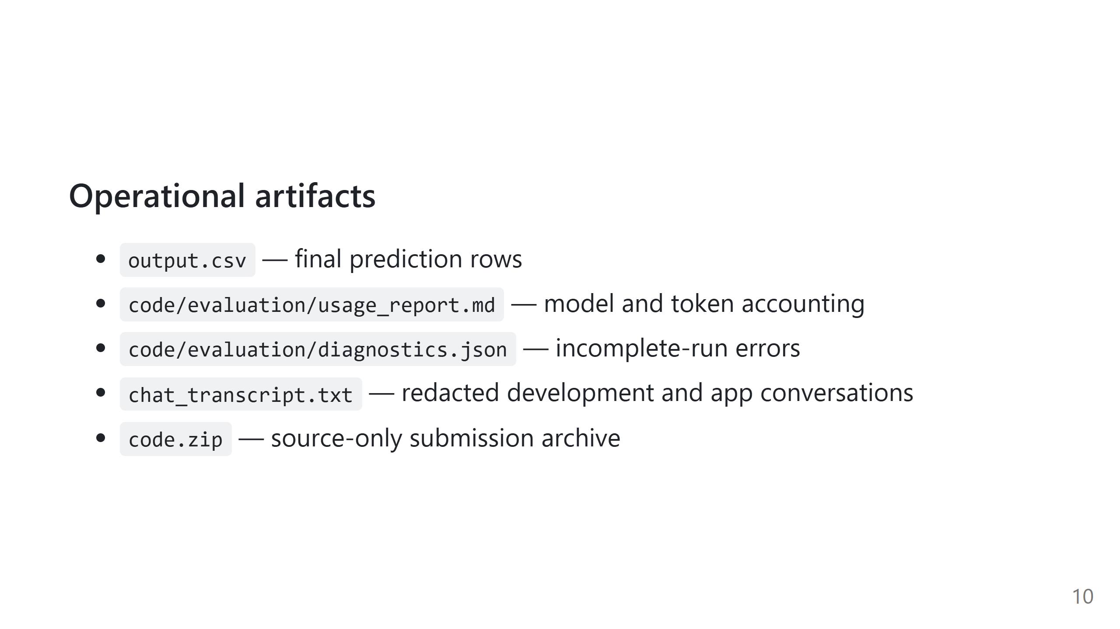
Notes:
Speaker transcript:
These artifacts make the submission auditable. Usage reports distinguish live
calls from cache hits, while transcripts and logs are redacted before export.

Slide 11
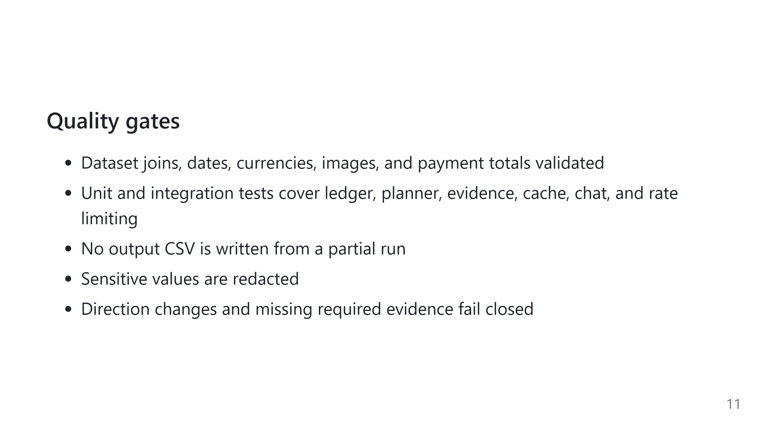
Notes:
Speaker transcript:
The quality strategy combines deterministic financial rules, strict schemas,
independent replay, and regression tests for previously observed evidence
failures. The result is conservative, explainable, and reproducible.

Slide 12

Notes:
Speaker transcript:
Thank you. The central takeaway is simple: use AI to interpret evidence, but
keep affordability mathematics and safety validation deterministic.

