Slide 1

DATA ANALYSIS USING SQL
PRESENTED BY BASU SAXENA

Slide 2
Introduction to the Analysis Introduction: In this analysis, we explore a dataset of titles that includes movies and TV shows. The objective is to extract valuable insights using SQL queries to understand various aspects such as title information, ratings, durations, and trends over time. By leveraging aggregate functions and subqueries, we can gain insights into the dataset that will inform decisions related to content management and audience preferences.

Slide 3
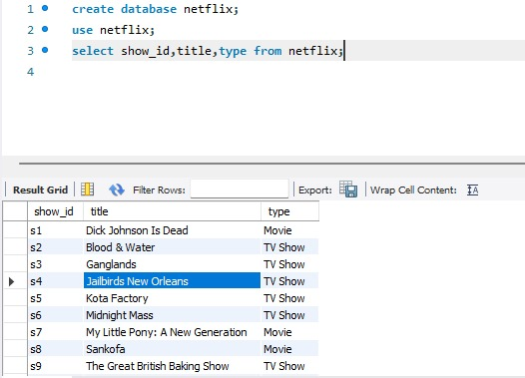
Write a query to list all titles with their show_id, title, and type.
list all titles with their show_id, title, and type.

Slide 4
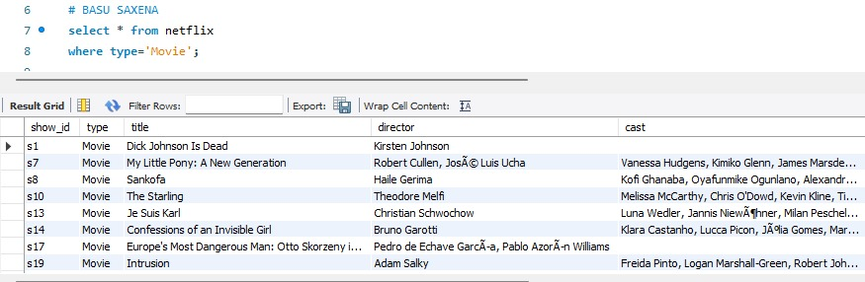
Write a query to display all columns for titles that are Movies.
display all columns for titles that are Movies.

Slide 5
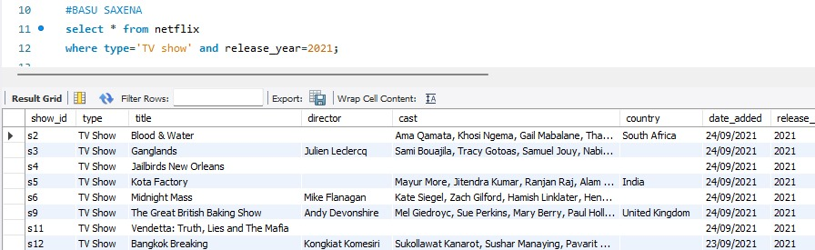
Write a query to list TV shows that were released in the year 2021.
list TV shows that were released in the year 2021.

Slide 6
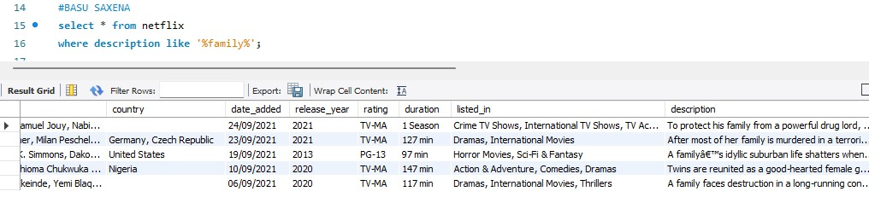
Write a query to find all titles where the description contains the word family.
find all titles where the description contains the word family.

Slide 7
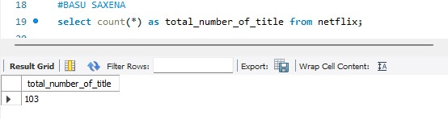
Write a query to count the total number of titles in the dataset.
count the total number of titles in the dataset.

Slide 8
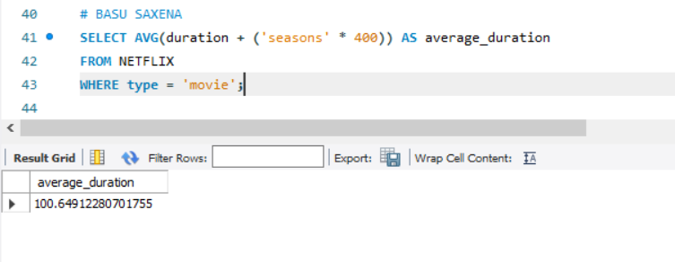
Write a query to find the average duration of all movies (in minutes, wherever the season is mentioned, consider 400 minutes per season).
find the average duration of all movies.

Slide 9
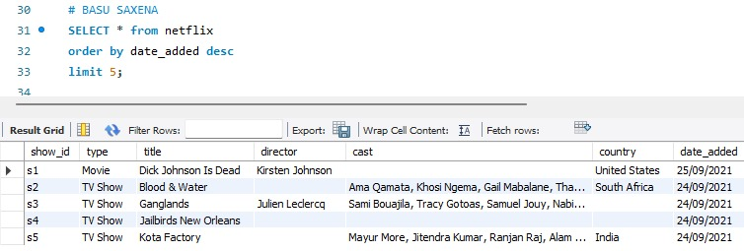
Write a query to list the top 5 latest titles based on the date_added, sorted in descending order.
list the top 5 latest titles based on the date_added, sorted in descending order.

Slide 10
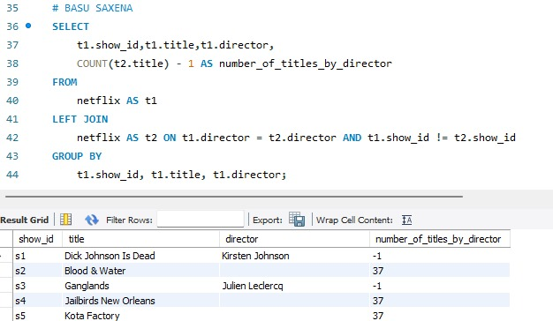
Write a query to list all titles along with the number of other titles by the same director. Include columns for show_id, title, director, and number_of_titles_by_director.
list all titles along with the number of other titles by the same director. Include columns for show_id, title, director, and number_of_titles_by_director.

Slide 11
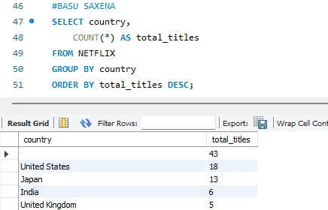
Write a query to find the total number of titles for each country. Display country and the count of titles.
find the total number of titles for each country. Display country and the count of titles.

Slide 12
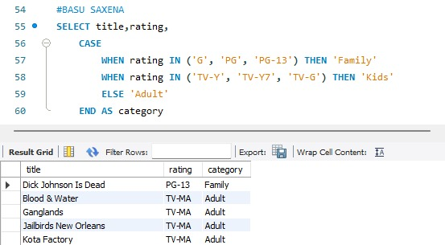
Write a query using a CASE statement to categorize titles into three categories based on their rating: Family for ratings G, PG, PG-13, Kids for TV-Y, TV-Y7, TV-G, and Adult for all other ratings.
categorize titles into three categories based on their rating: Family for ratings G, PG, PG-13, Kids for TV-Y, TV-Y7, TV-G, and Adult for all other ratings.

Slide 13
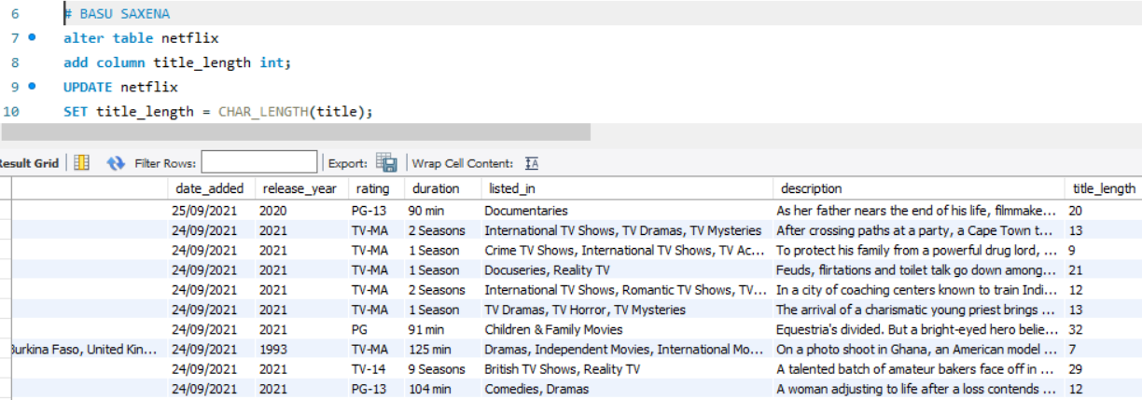
Write a query to add a new column title_length to the titles table that calculates the length of each title.
add a new column title_length to the titles table that calculates the length of each title.

Slide 14
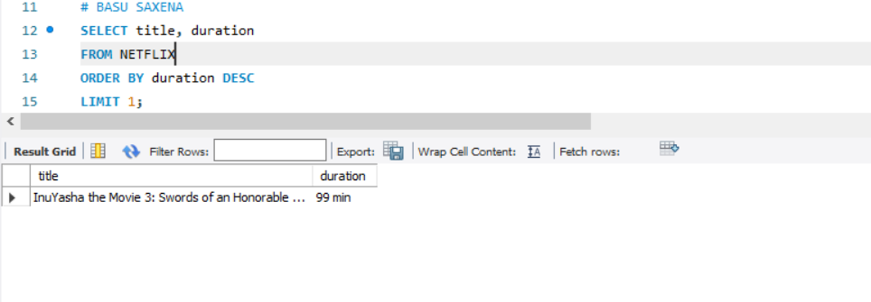
Write a query using an advanced function to find the title with the longest duration in minutes
find the title with the longest duration in minutes

Slide 15
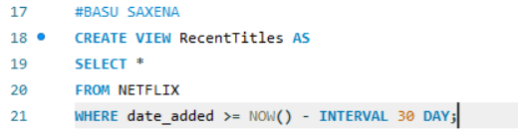
Create a view named RecentTitles that includes titles added in the last 30 day.
view named RecentTitles that includes titles added in the last 30 day.

Slide 16
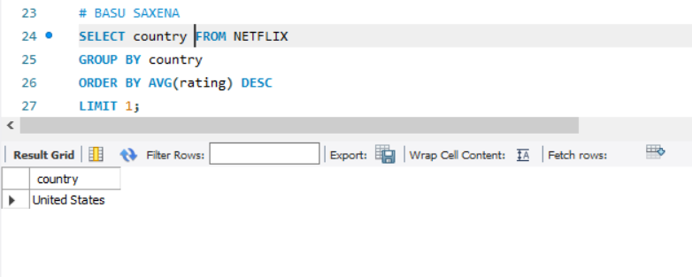
Write a query to find the country with the highest average rating for titles. Use subqueries and aggregate functions to achieve this.
to find the country with the highest average rating for titles.

Slide 17
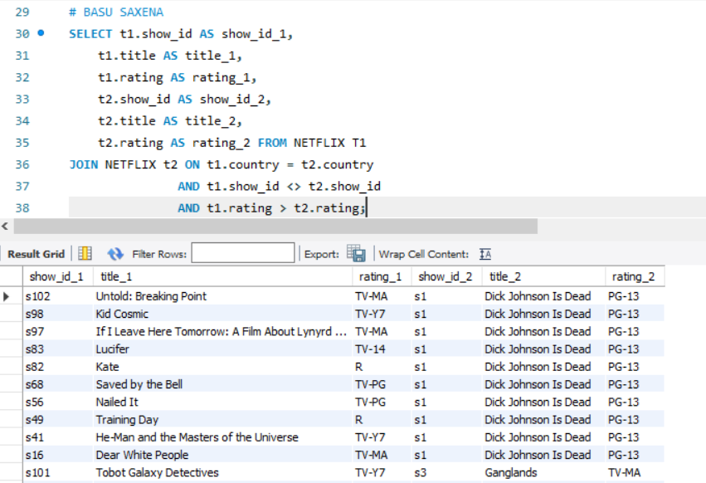
Write a query to find pairs of titles from the same country where one title has a higher rating than the other. Display columns for show_id_1, title_1, rating_1, show_id_2, title_2, and rating_2.
to find pairs of titles from the same country where one title has a higher rating than the other.

Slide 18
Thank you for your attention

