Slide 1
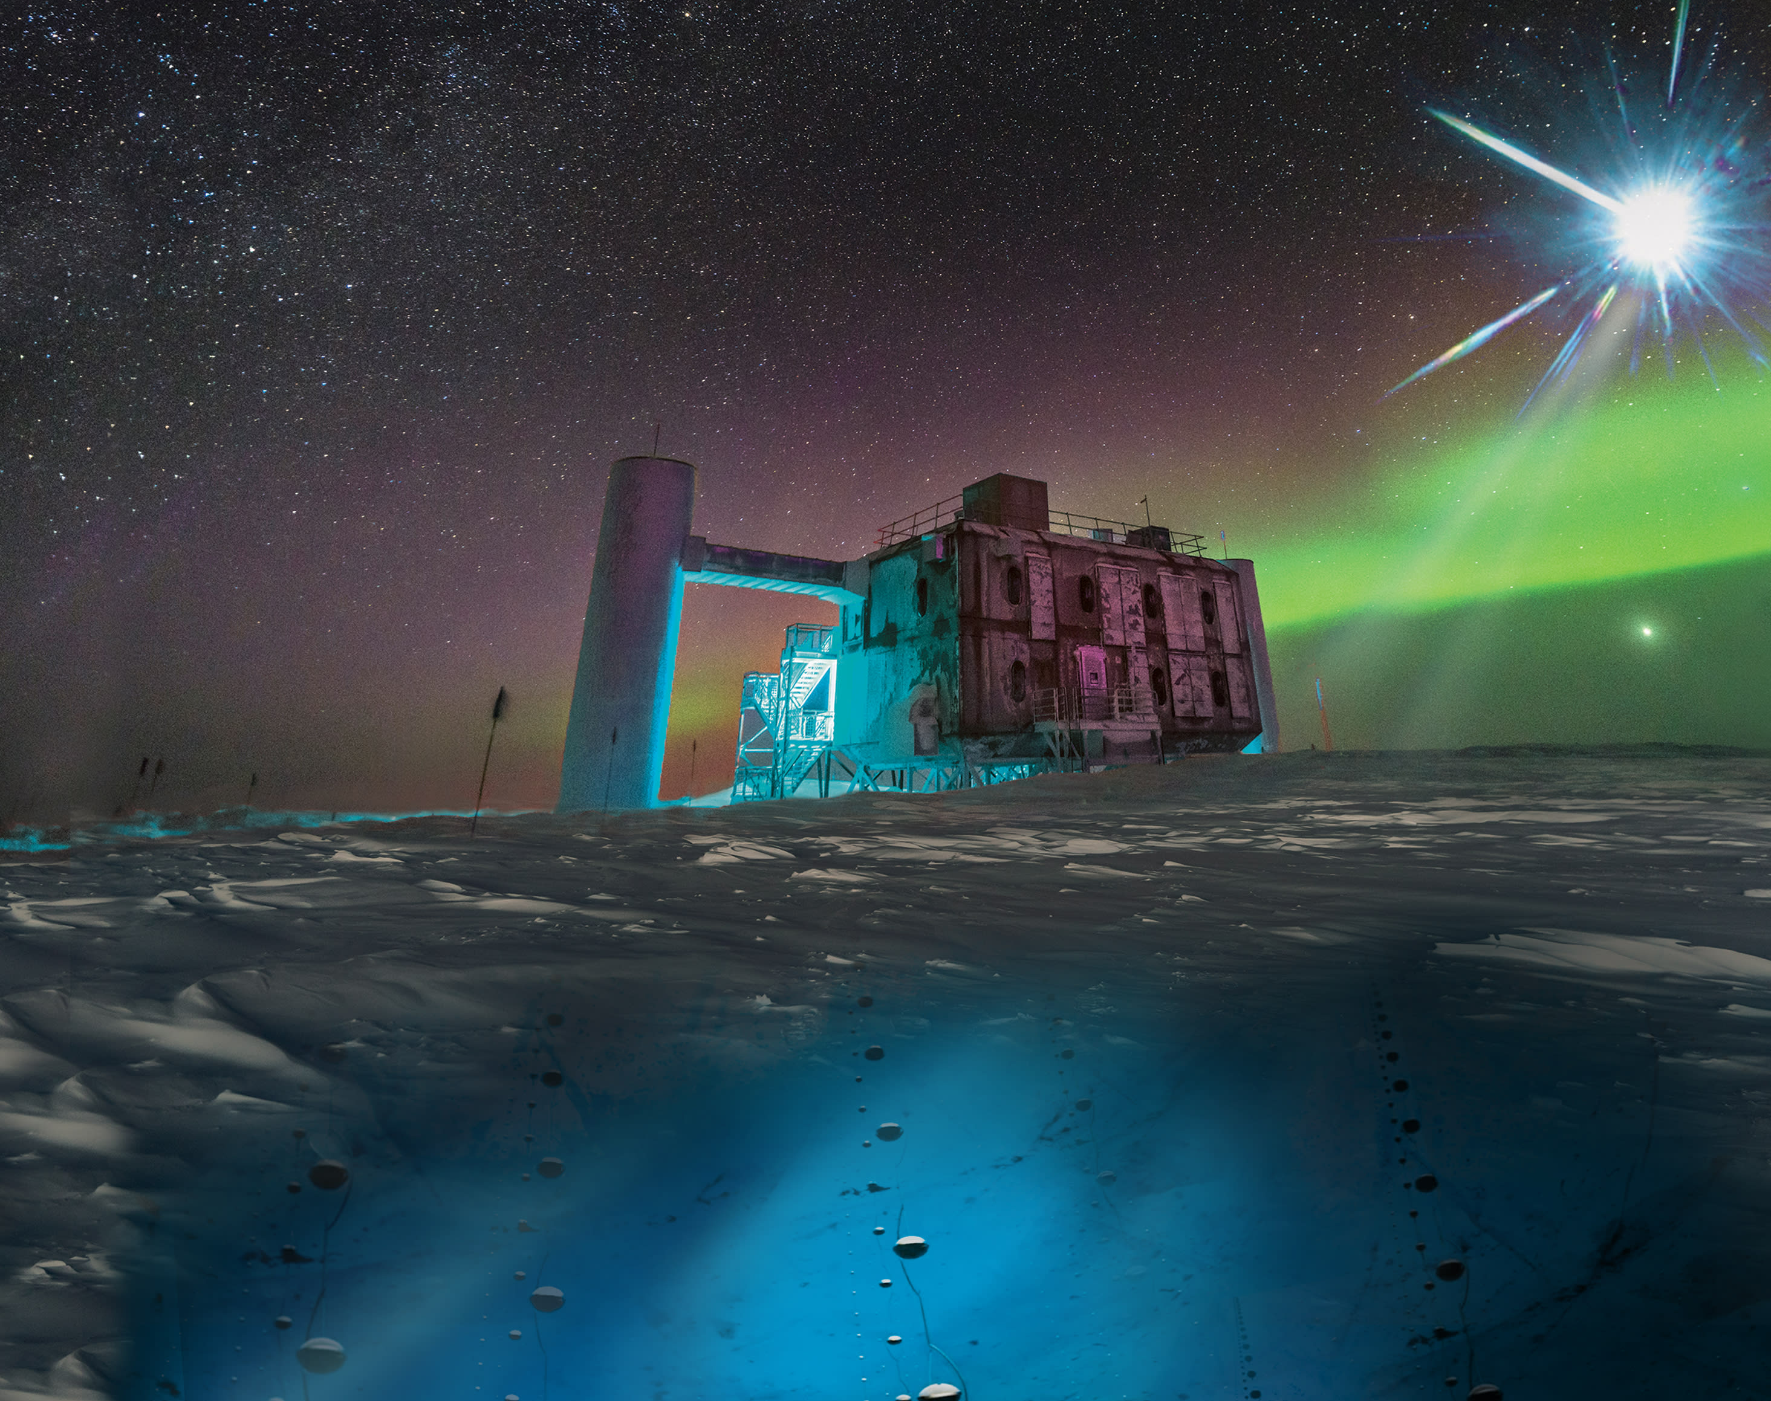
IceCube - Neutrinos in Deep Ice
Group 13
Michael Saxer (saxermi1)
Andrés Mock (mockand1)
Mike Gasser (gassemik)
Fabian Stepinski (stepifab)
Machine Learning Operations
FS 2025

Slide 2
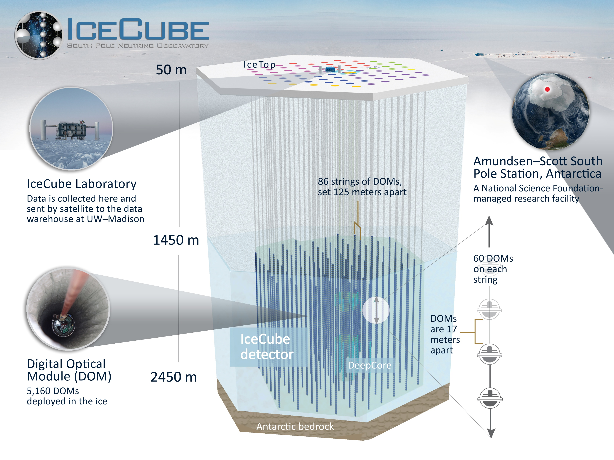
Purpose/Task of the ML System [1/2]
Neutrinos are abundant particles in our universe emitted by violent astrophysical events
Hard to dected since they rarely interact with matter
The IceCube Neutrino Observatory
A detector array spanning a cubic kilometer of Antarctic ice
Detects the directions of neutrino traces using photon detections
Enables determination of the neutrinos' origin, thereby helping locate astrophysical events
Detector Array in the Ice

Slide 3
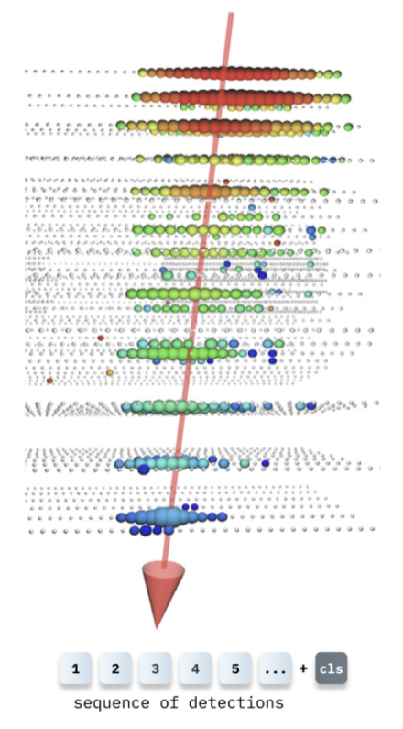
Purpose/Task of the ML System [2/2]
The Kaggle Challenge's 2nd Place Model
Solves a regression task
It takes as input the time-series of DOM (photomultiplier) hits for each event and outputs a 3D unit vector corresponding to the incoming neutrino’s direction
Is already pretrained
Disclaimer: The current model is provisional and may be changed in future stages
3D Unit Vector

Slide 4

Overview of Components/Pipeline/System Setup
Cube 1: Data Emitter
[Laptop/Container 1]
Cube 2: Processing / Model / Monitoring
[Laptop/Container 2]
[Raw IceCube Dataset]
Consumer Container
Pops from Redis
Preprocesses
Calls Model
Sends Heartbeat
Model Server Container
REST API (/predict)
Model Inference
Health Check (/health)
Sends Hearbeat
Emitter Container
Batches and Serialized Events
Pushes to Redis Queue
Send Heartbeat
MLflow Tracker
Inference Logging (Consumer)
Prometheus Container
- Scrapes/Metrics Endpoints on all Containers
Redis Container (Message Broker)
Stored Serialized Event Batches
Grafana Container
Visualizes Heartbeat, Throughput, inference Metrics
Alerts if Heartbeat is missing or high latency

Slide 5
Purpose of the ML Ops Pipeline
Goal: Build pipeline which processes data stream
Simulates the constant data flow
Two containers that communicate with each other
Emitter container (Cube 1) simulates data sensors
Processing module (Cube 2) simulates the remaining steps of the pipeline
Disclaimer: Our aim is NOT to optimize ML performance, but to explore how the IceCube data processing might be structured

Slide 6
List of Tools to be used
Tool | Motivation | Additional Notes
Python | Familiar and flexible language Easy extendable due to the abundance of libraries Selected model is built with PyTorch | We aim to use mostly open-source tools. * potentially subject to change with similar tools
Docker* | Easy to deploy Ensures reproducibility Allows containerization of each component
Redis Community Edition | Easy to use que system Relatively fast deployment
MLflow | Used to log result of model interference
Promotheus | Scrapes metrics (total requests, latency, etc.) from the different containers (including heartbeat) Can define alert rules
Grafana | Dashboard build upon Promotheus Displays metrics
Flask* | Server used to serve the model via REST API

Slide 7
Sources
Title Slide Picture [Slide 1]
IceCube Neutrino Observatory [Slide 2]
Detector Array in the Ice [Slide 2]
Kaggle Challenge
2nd Place Model [Slide 3]
3D Unit Vector [Slide 3]
Ice Pattern [Slide 4]

