Slide 1
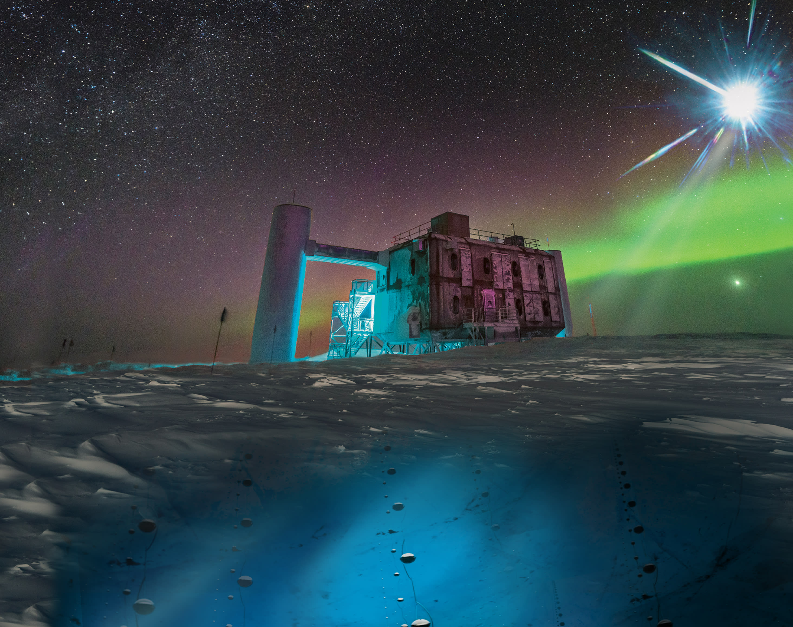
IceCube - Neutrinos in Deep Ice Final Presentation
Group 13
Michael Saxer (saxermi1)
Andrés Mock (mockand1)
Mike Gasser (gassemik)
Fabian Stepinski (stepifab)
Machine Learning Operations
FS 2025

Slide 2
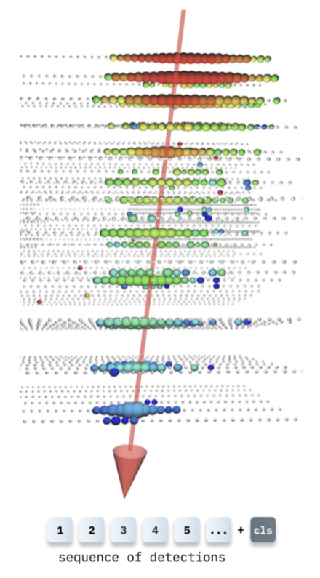
Purpose/Task of the ML System
Neutrinos are abundant particles in our universe emitted by violent astrophysical events
Hard to dected since they rarely interact with matter
The IceCube Neutrino Observatory
A detector array spanning a cubic kilometer of Antarctic ice
Detects the directions of neutrino traces using photon detections (3D Unit Vector)
Enables determination of the neutrinos' origin, thereby helping locate astrophysical events
Disclaimer: Our aim is NOT to optimize ML performance, but to explore how the IceCube data processing might be structured
3D Unit Vector

Slide 3

Overview of Components/Pipeline/System Setup
Data Emitter
Processing / Model / Monitoring
[Raw IceCube Dataset]
Consumer Container
Pops from Redis
Preprocesses
Calls Model
Sends Heartbeat
Model Server Container
REST API (/predict)
Model Inference
Health Check (/health)
Sends Hearbeat
Emitter Container
Batches and Serialized Events
Pushes to Redis Queue
Send Heartbeat
MLflow Tracker
Inference Logging (Consumer)
Prometheus Container
- Scrapes/Metrics Endpoints on all Containers
Redis Container (Message Broker)
Stored Serialized Event Batches
Grafana Container
Visualizes Heartbeat, Throughput, inference Metrics
Alerts if Heartbeat is missing or high latency

Slide 4
Key Features of the MLOps Pipeline [1/2]
Tool | Raison d'être
GiHub Actions | Automatic Checks of Code Quality Automatic requirments.txt check and update Automatic Container Build and upload to GHCR
Docker | Easy to deploy Ensures reproducibility Allows containerization of each component
Redis Community Edition | Easy to use and performant que system Relatively fast deployment
MongoDB | Used to track Events
Promotheus | Scrapes metrics (total requests, latency, etc.) from the different containers (including heartbeat) Can define alert rules
Grafana | Dashboard build upon Promotheus Displays Real Time Metrics
Flask | Server used to serve the model via REST API

Slide 5
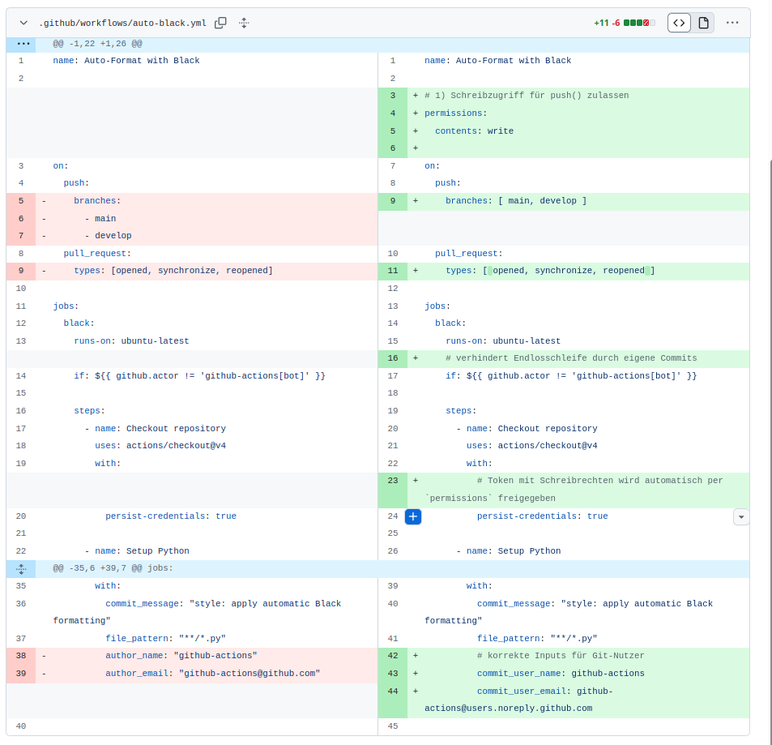
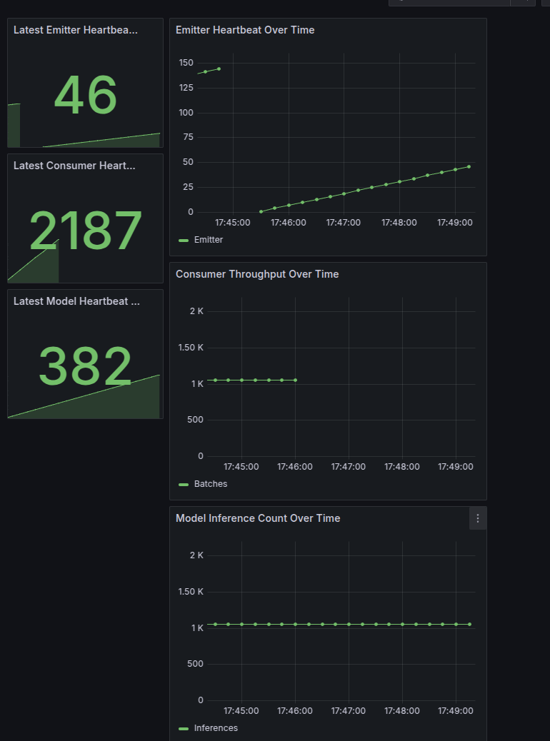
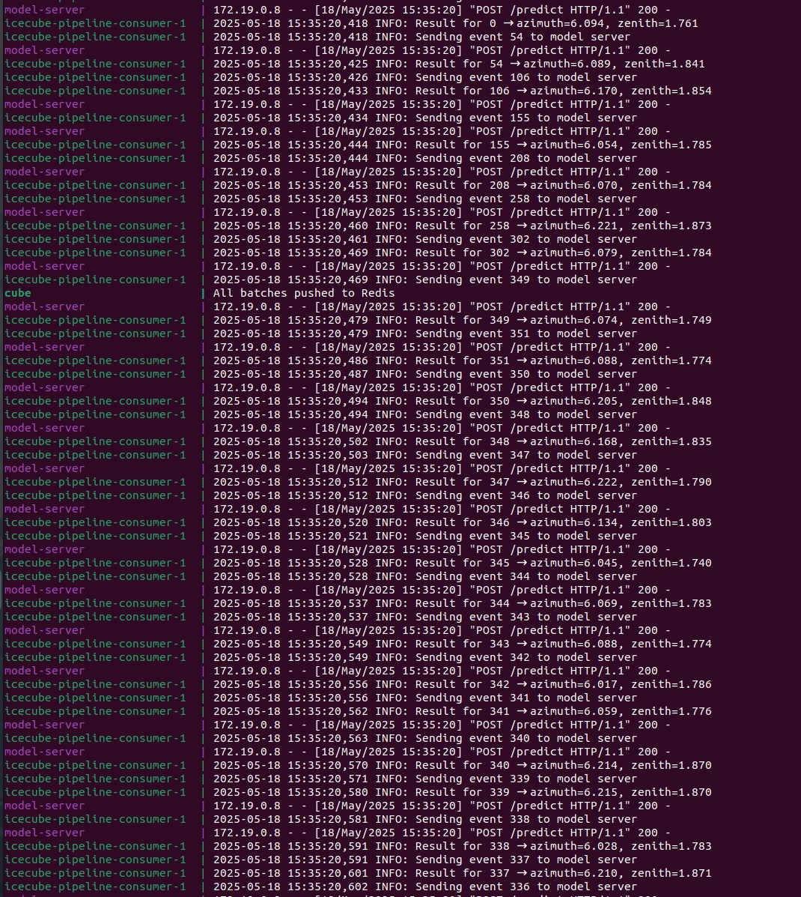
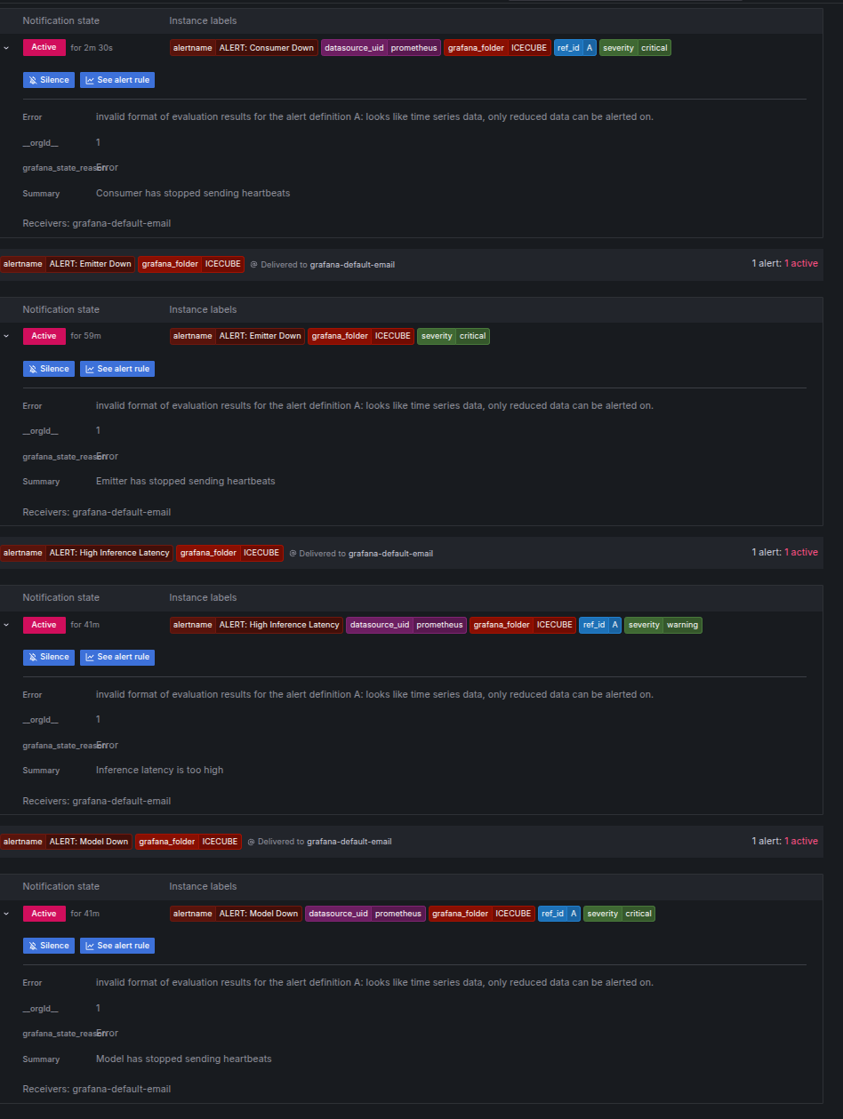
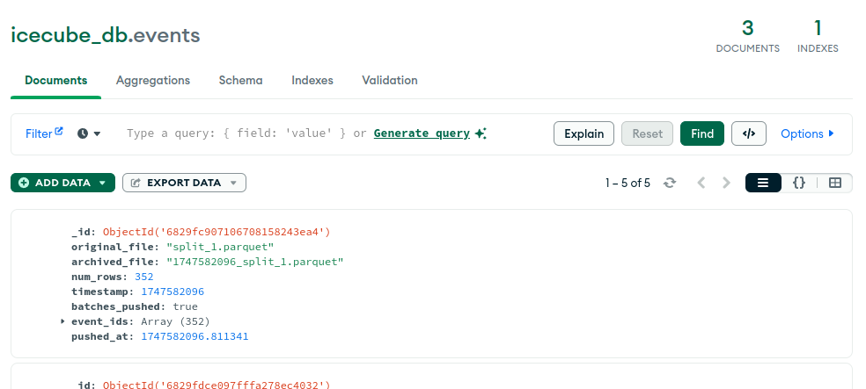
Key Features of the MLOps Pipeline [2/2]
GitHub Actions
Grafana Dashboard with Real Time Insights
«Behind the Scenes» Info Flow
Promotheus (Eg. Automatic Alerts
MongoDB for tracking Evenents

Slide 6
Sources
Title Slide Picture [Slide 1]
3D Unit Vector [Slide 3]
Ice Pattern [Slide 3]

