Slide 1
Frontend
API
HTTP Client
UI
Request Middleware
StreamLit
Request Queue

Slide 2
Embedding Model
Large Language Model
Vocabulary
Prompt
Tokenizer
Agent
Dependency Parsing
Data process

Slide 3
Data
Local Storage
Service Now
Cache
Data Transformer

Slide 4
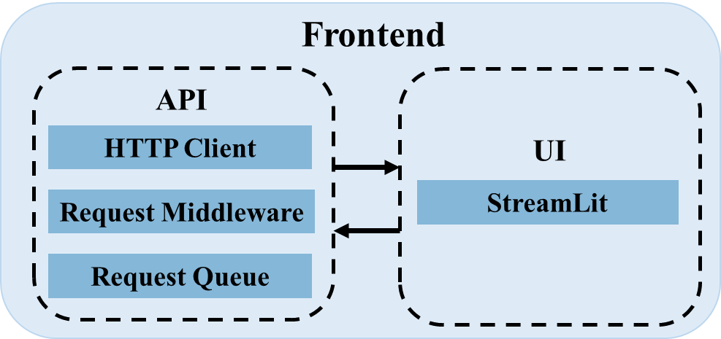
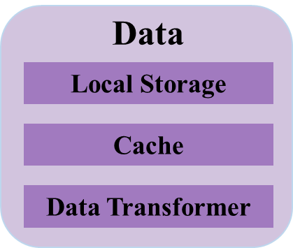
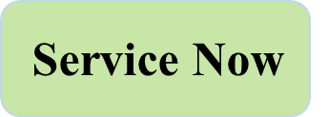
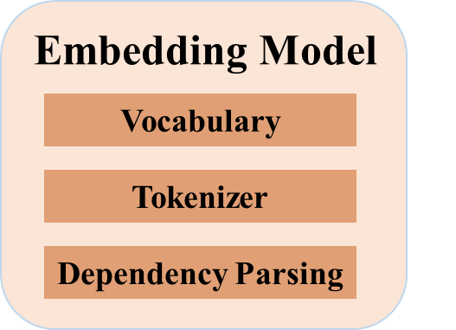
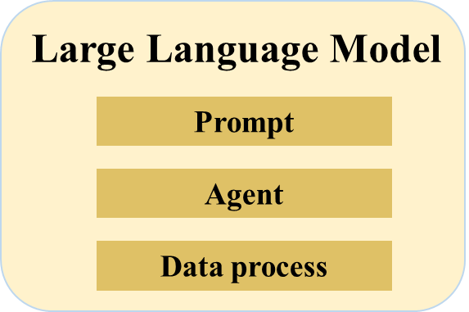
Input
Input
Storage
Input
Storage
Call
Input

Slide 5
