Slide 1
Optimization Methods Lab 10 Session
By Shi Jimao

Slide 2


Task1
The main idea of my algorithm is to use a mate-surrogate model which is mainly based on past empirical probability estimation and evolutionary algorithm.
I define a series mate-surrogate models $H$, and each dimension has a mate-surrogate model $H_{j}$.
Each model maintains two series of probability values $PS_{i,j}$ and $PL_{i,j}$ . The followings are the definition of them.
$PS_{i,j}=P\left(f\left(x_{i,j}^{o}\right)<f(x_{i,j}^{p}) | x_{i,j }^{o}<x_{i,j }^{p}\right)$
$PL_{i,j}=P\left(f\left(x_{i,j}^{o}\right)<f(x_{i,j}^{p}) | x_{i,j }^{o}>x_{i,j }^{p}\right)$

Slide 3
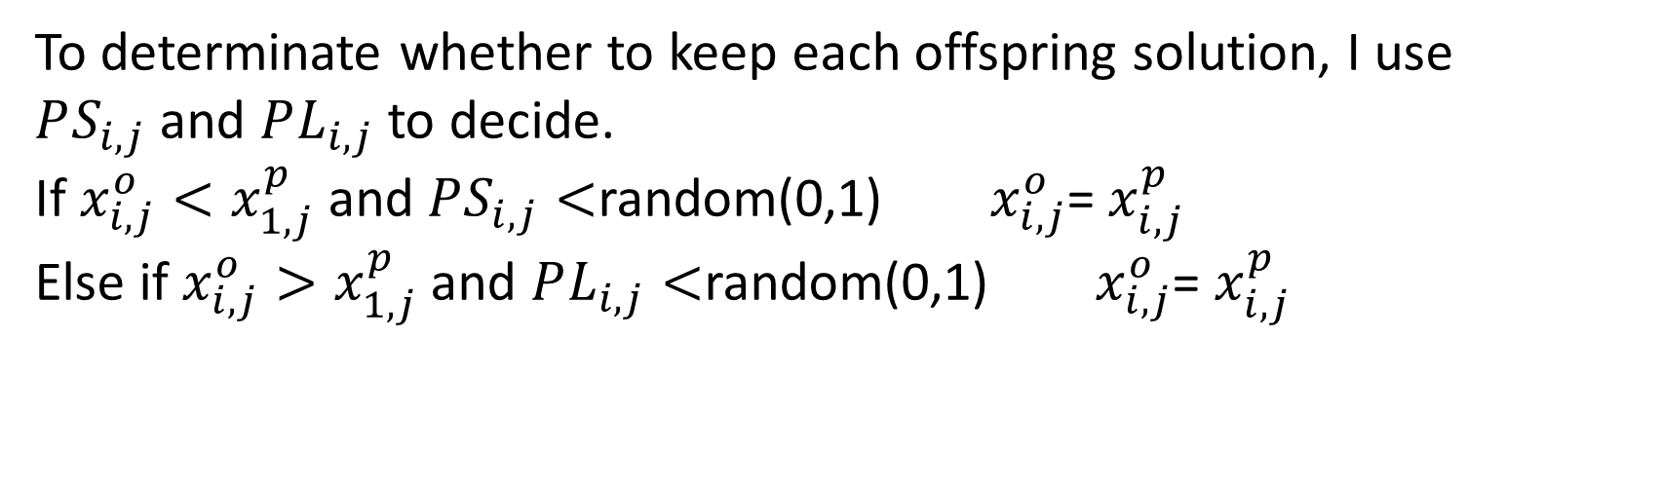

Surrogate process
For generating new solutions, the strategy is in the following:
For i=1 to n
$x_{i,j}^{o}=x_{1,j}^{p}+σ_{i,j}∙Ν(0,1)$
For i=n+1 to λ
$x_{i,j}^{o}=x_{1,j}^{p}+σ_{i,j}∙C(0,1)$
N(0,1) is Gaussian mutation operator
C(0,1) is Cauchy mutation operator
The purpose of combining these two mutation operators is to balance the search efficiency and the effectiveness.
To determinate whether to keep each offspring solution, I use $PS_{i,j}$and $PL_{i,j}$ to decide.
If $x_{i,j}^{o}<x_{1,j}^{p}$ and $PS_{i,j}<$random(0,1) $x_{i,j}^{o}$= $x_{i,j}^{p}$
Else if $x_{i,j}^{o}>x_{1,j}^{p}$ and $PL_{i,j}<$random(0,1) $x_{i,j}^{o}$= $x_{i,j}^{p}$

Slide 4
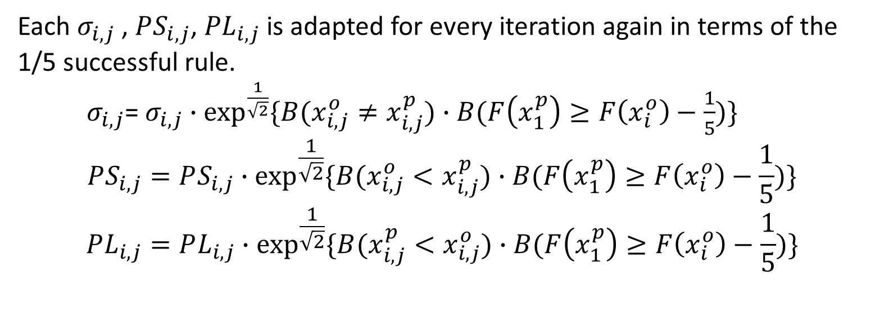
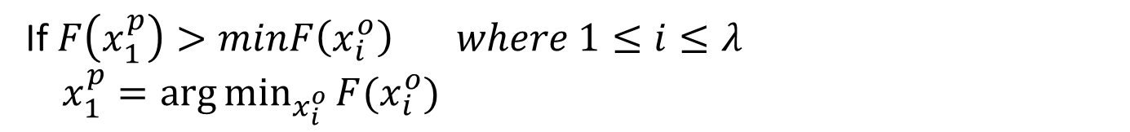
Solution updating
If $F\left(x_{1}^{p}\right)>minF\left(x_{i}^{o}\right) where 1≤i≤λ$
$x_{1}^{p}=\arg{\min_{x_{i}^{o}}{F(x_{i}^{o})}}$
Model and operator updating
B is a boolean function that returns 1 is the statement is true else return 0.
Each $σ_{i,j}$ , $PS_{i,j}$, ${PL}_{i,j}$ is adapted for every iteration again in terms of the 1/5 successful rule.
$σ_{i,j}$= $σ_{i,j}∙\exp^{\frac{1}{\sqrt{2}}}{\{B(x_{i,j}^{o}≠x_{i,j}^{p})∙B(F\left(x_{1}^{p}\right)≥F\left(x_{i}^{o}\right)−\frac{1}{5})\}}$
$$PS_{i,j}=PS_{i,j}∙\exp^{\frac{1}{\sqrt{2}}}{\{B(x_{i,j}^{o}<x_{i,j}^{p})∙B(F\left(x_{1}^{p}\right)≥F\left(x_{i}^{o}\right)−\frac{1}{5})\}}$$
$$PL_{i,j}=PL_{i,j}∙\exp^{\frac{1}{\sqrt{2}}}{\{B(x_{i,j}^{p}<x_{i,j}^{o})∙B(F\left(x_{1}^{p}\right)≥F\left(x_{i}^{o}\right)−\frac{1}{5})\}}$$

Slide 5
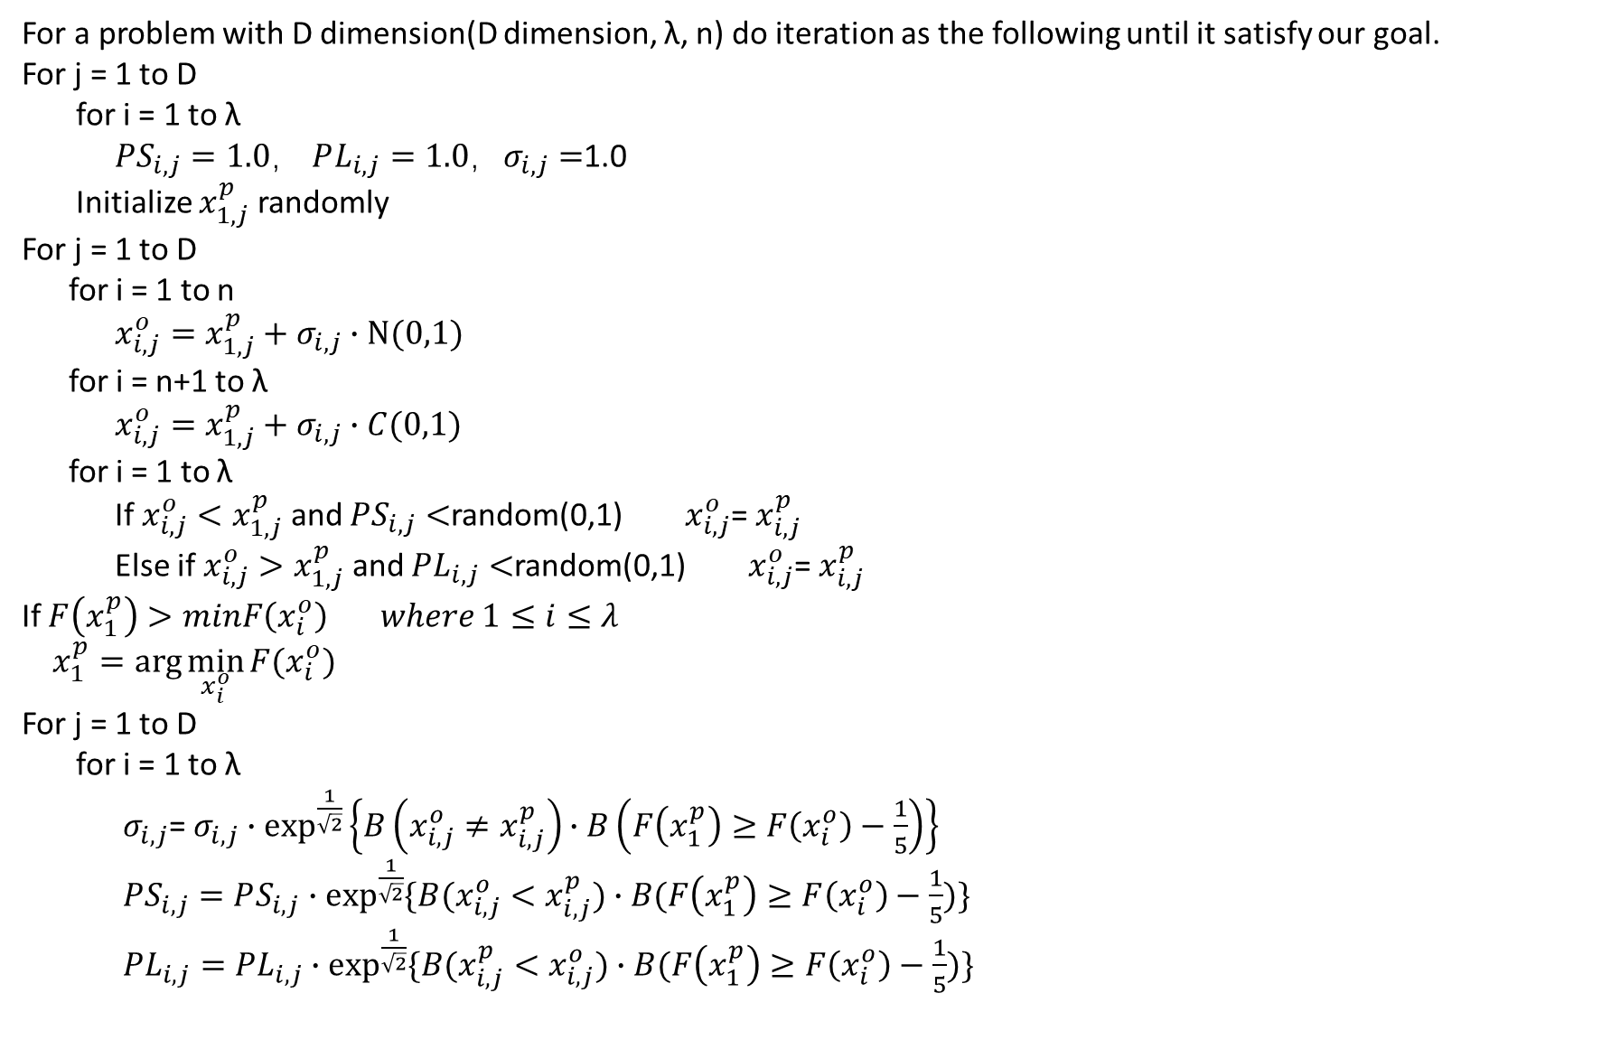
For a problem with D dimension(D dimension, λ, n) do iteration as the following until it satisfy our goal.
For j = 1 to D
for i = 1 to λ
$PS_{i,j}=1.0$， $PL_{i,j}=1.0$，$σ_{i,j}=$1.0
Initialize $x_{1,j}^{p}$ randomly
For j = 1 to D
for i = 1 to n
$x_{i,j}^{o}=x_{1,j}^{p}+σ_{i,j}∙Ν(0,1)$
for i = n+1 to λ
$x_{i,j}^{o}=x_{1,j}^{p}+σ_{i,j}∙C(0,1)$
for i = 1 to λ
If $x_{i,j}^{o}<x_{1,j}^{p}$ and $PS_{i,j}<$random(0,1) $x_{i,j}^{o}$= $x_{i,j}^{p}$
Else if $x_{i,j}^{o}>x_{1,j}^{p}$ and $PL_{i,j}<$random(0,1) $x_{i,j}^{o}$= $x_{i,j}^{p}$
If $F\left(x_{1}^{p}\right)>minF\left(x_{i}^{o}\right) where 1≤i≤λ$
$x_{1}^{p}=\arg{\min_{x_{i}^{o}}{F(x_{i}^{o})}}$
For j = 1 to D
for i = 1 to λ
$σ_{i,j}$= $σ_{i,j}∙\exp^{\frac{1}{\sqrt{2}}}\left\{B\left(x_{i,j}^{o}≠x_{i,j}^{p}\right)∙B\left(F\left(x_{1}^{p}\right)≥F\left(x_{i}^{o}\right)−\frac{1}{5}\right)\right\}$
$PS_{i,j}=PS_{i,j}∙\exp^{\frac{1}{\sqrt{2}}}{\{B(x_{i,j}^{o}<x_{i,j}^{p})∙B(F\left(x_{1}^{p}\right)≥F\left(x_{i}^{o}\right)−\frac{1}{5})\}}$
$PL_{i,j}=PL_{i,j}∙\exp^{\frac{1}{\sqrt{2}}}{\{B(x_{i,j}^{p}<x_{i,j}^{o})∙B(F\left(x_{1}^{p}\right)≥F\left(x_{i}^{o}\right)−\frac{1}{5})\}}$
Complete pseudocode
surrogate model

Slide 6
Analysis
This algorithm is more suitable for high dimension optimization problem.
It can also get a good result of low dimension while it may cause longer time.

