Slide 1
Optimization Methods Lab 12 Session
By Shi Jimao

Slide 2
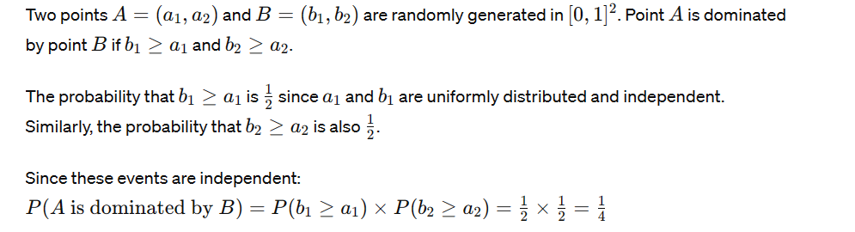
mathematically calculate the solution
numerically estimate the solution
0.248585(1000 times)

Slide 3
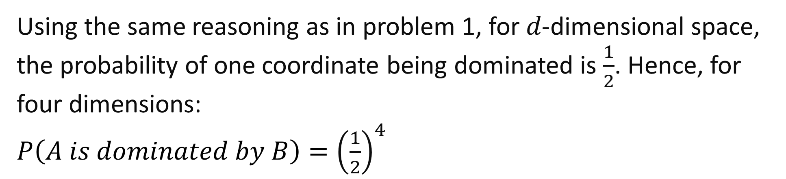
mathematically calculate the solution
Using the same reasoning as in problem 1, for 𝑑-dimensional space, the probability of one coordinate being dominated is $\frac{1}{2}$​. Hence, for four dimensions:
$P\left(A is dominated by B\right)={\left(\frac{1}{2}\right)}^{4}$
numerically estimate the solution
0.062072(1000 times)

Slide 4
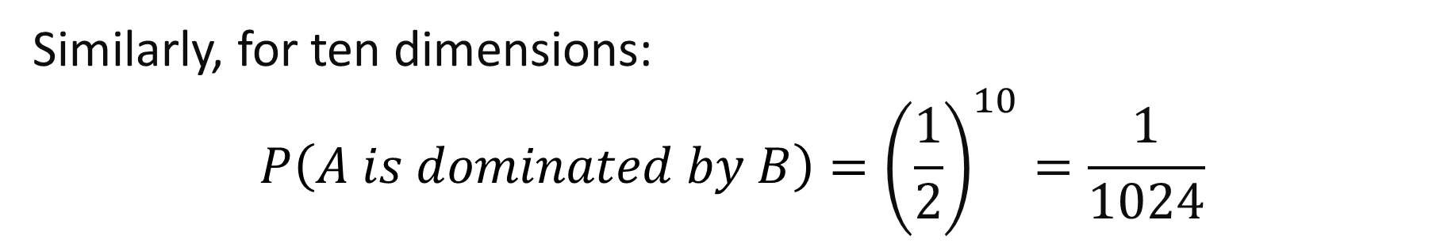
mathematically calculate the solution
Similarly, for ten dimensions:
$$P\left(A is dominated by B\right)={\left(\frac{1}{2}\right)}^{10}=\frac{1}{1024}$$
numerically estimate the solution
0.000967(1000 times)

Slide 5
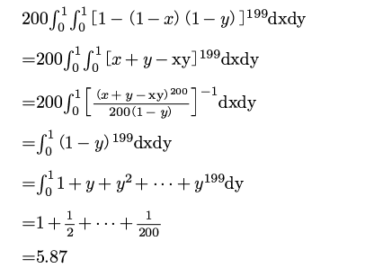
mathematically calculate the solution
numerically estimate the solution
5.74(1000 times)

Slide 6
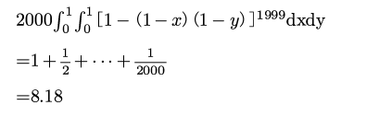
mathematically calculate the solution
Similar with (4), we can get
numerically estimate the solution
8.174(1000 times)

Slide 7

mathematically calculate the solution
numerically estimate the solution
180.315(1000 times)

Slide 8

mathematically calculate the solution
numerically estimate the solution
1381.012(1000 times)

