Slide 1
Optimization Methods Lab 13 Session
By Shi Jimao

Slide 2

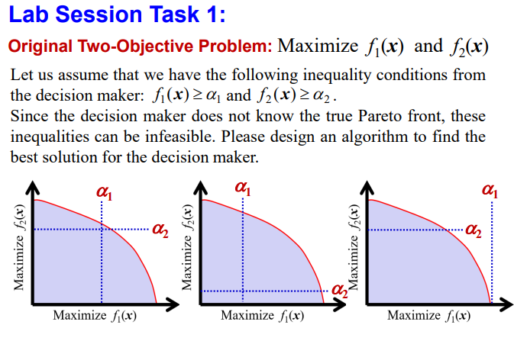
Task1

Slide 3
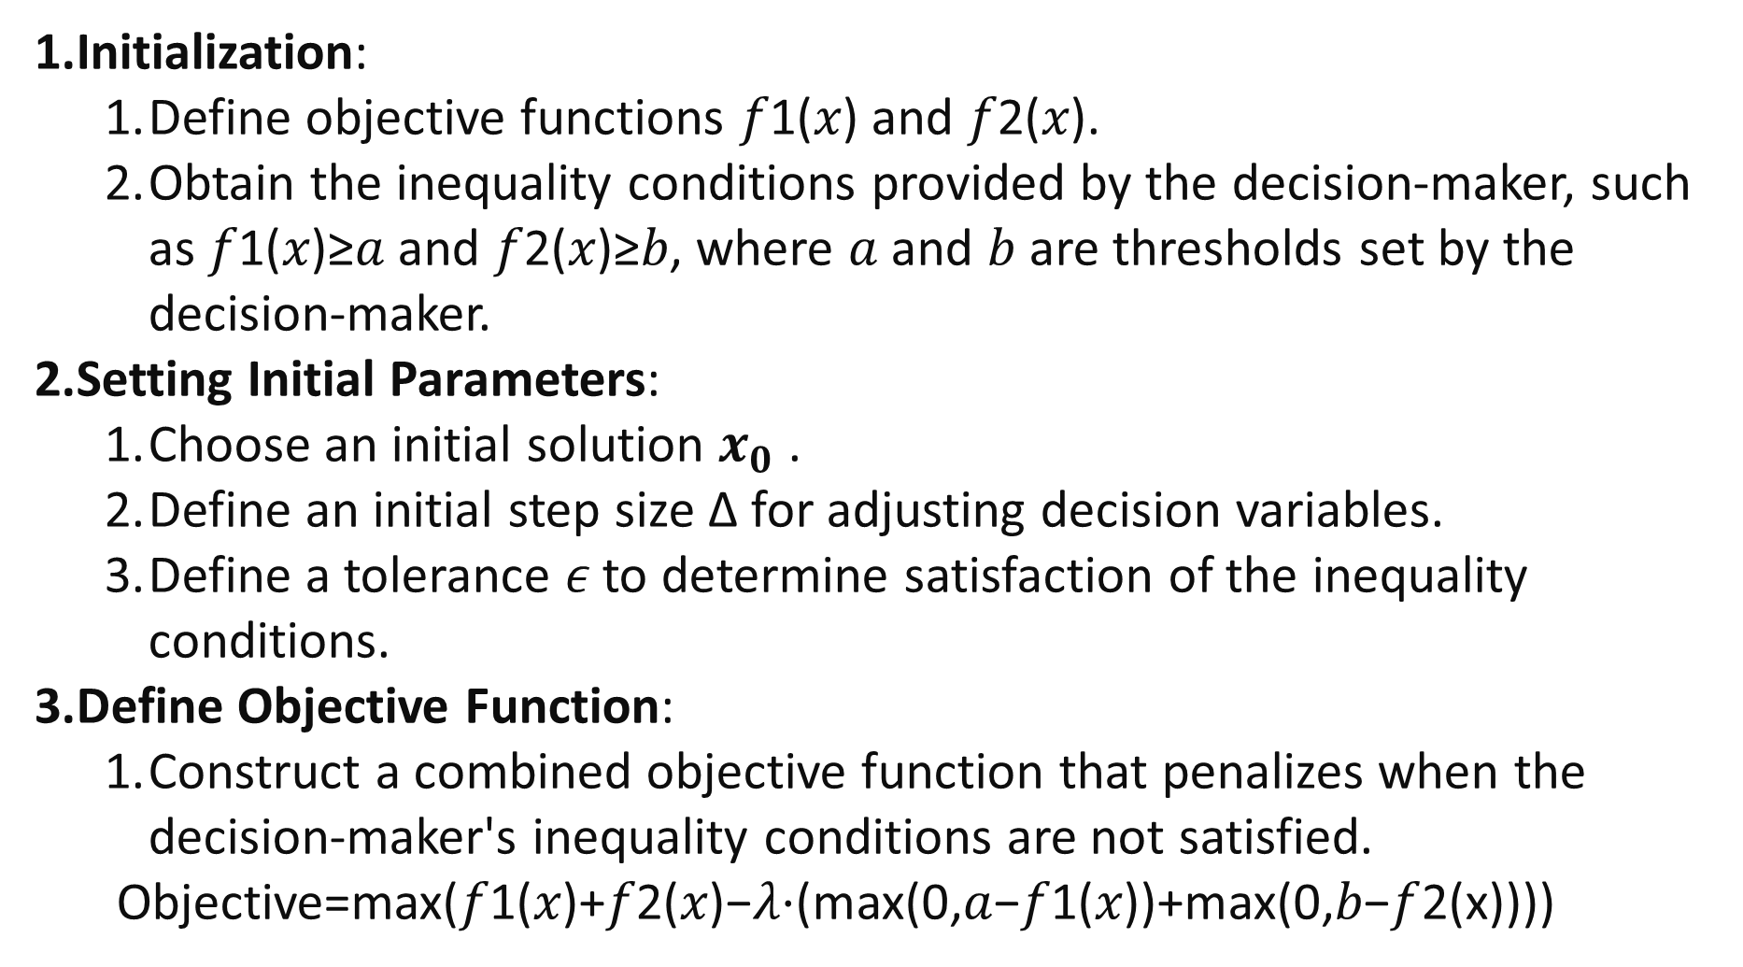
Initialization:
Define objective functions 𝑓1(𝑥) and 𝑓2(𝑥).
Obtain the inequality conditions provided by the decision-maker, such as 𝑓1(𝑥)≥𝑎 and 𝑓2(𝑥)≥𝑏, where 𝑎 and 𝑏 are thresholds set by the decision-maker.
Setting Initial Parameters:
Choose an initial solution $x_{0}$ .
Define an initial step size Δ for adjusting decision variables.
Define a tolerance 𝜖 to determine satisfaction of the inequality conditions.
Define Objective Function:
Construct a combined objective function that penalizes when the decision-maker's inequality conditions are not satisfied.
Objective=max⁡(𝑓1(𝑥)+𝑓2(𝑥)−𝜆⋅(max⁡(0,𝑎−𝑓1(𝑥))+max⁡(0,𝑏−𝑓2(x))))

Slide 4
4.Iterative Search:
Use genetic algorithms to iteratively adjust the solution x to optimize the combined objective function.
In each iteration, check if the current solution satisfies the inequality conditions. If satisfied, record the current solution as a potential optimal solution.
5.Termination Criteria:
Terminate the search when the combined objective function no longer significantly improves or when the maximum number of iterations is reached.
Return the recorded potential optimal solution.

Slide 5
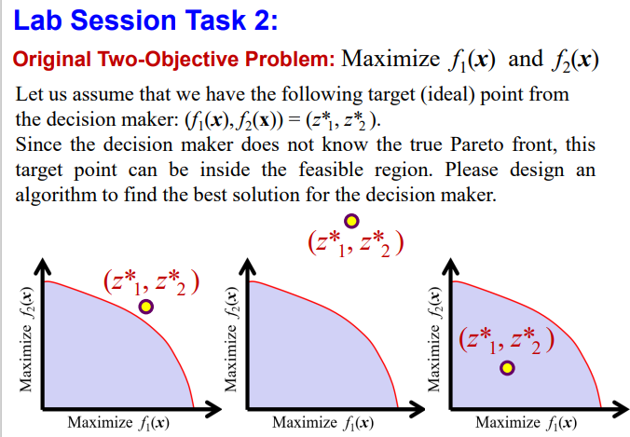
Task2

Slide 6
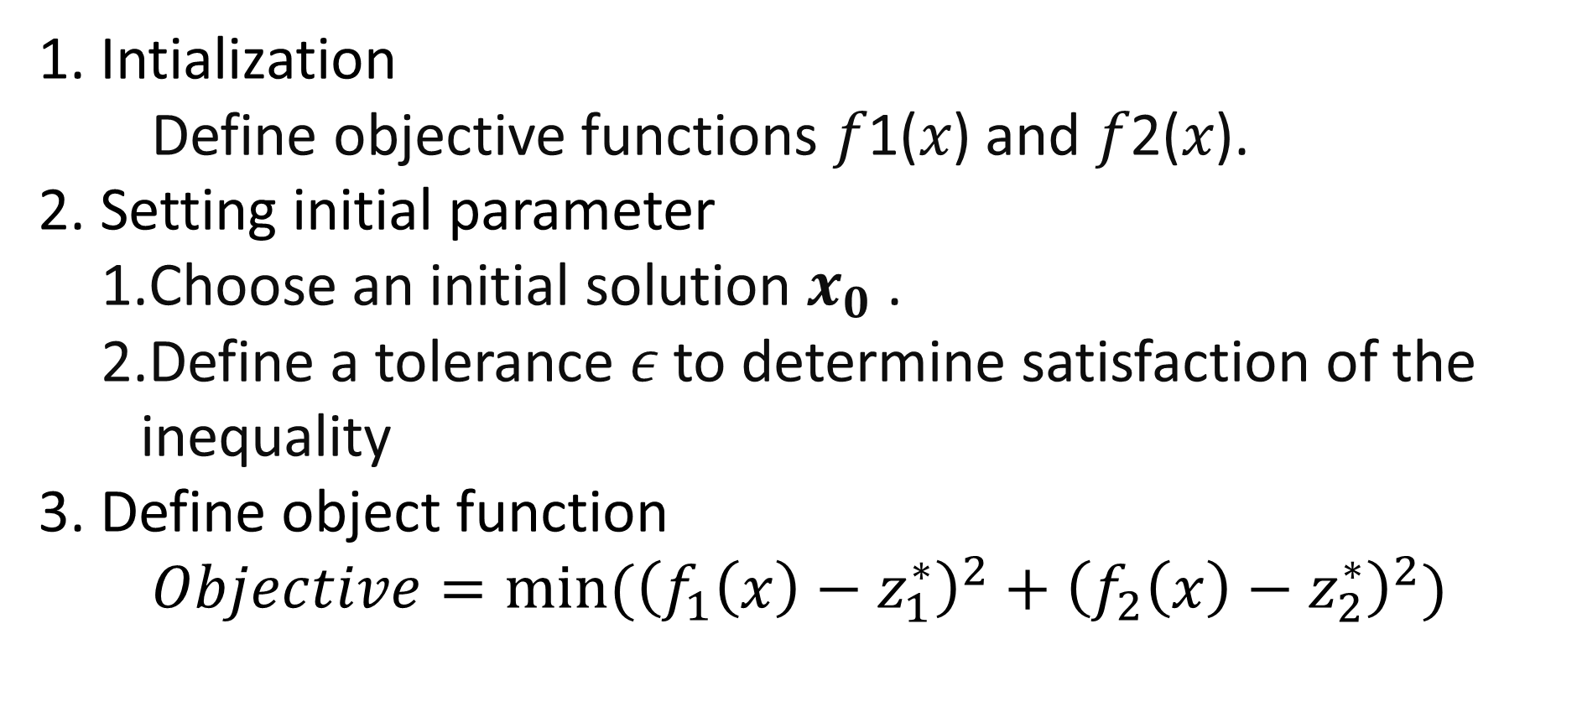
1. Intialization
Define objective functions 𝑓1(𝑥) and 𝑓2(𝑥).
2. Setting initial parameter
Choose an initial solution $x_{0}$ .
Define a tolerance 𝜖 to determine satisfaction of the inequality
3. Define object function
$Objective=min⁡({\left(f_{1}\left(x\right)−z_{1}^{∗}\right)}^{2}+{\left(f_{2}\left(x\right)−z_{2}^{∗}\right)}^{2})$

Slide 7
4.Iterative Search:
Use genetic algorithms to iteratively adjust the solution x to optimize the combined objective function.
In each iteration, check if the current solution satisfies the inequality conditions. If satisfied, record the current solution as a potential optimal solution.
5.Termination Criteria:
Terminate the search when the combined objective function no longer significantly improves or when the maximum number of iterations is reached.
Return the recorded potential optimal solution.

Slide 8
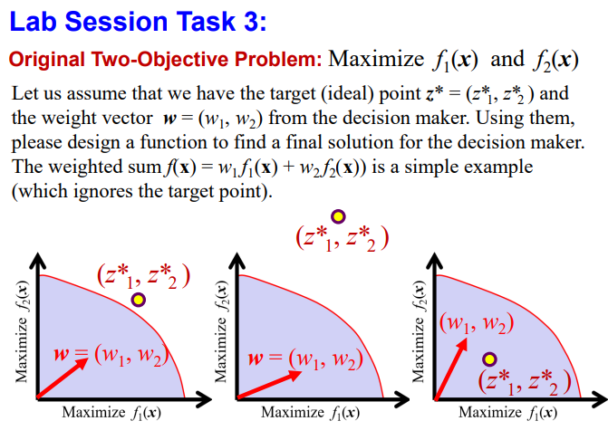
Task3

Slide 9
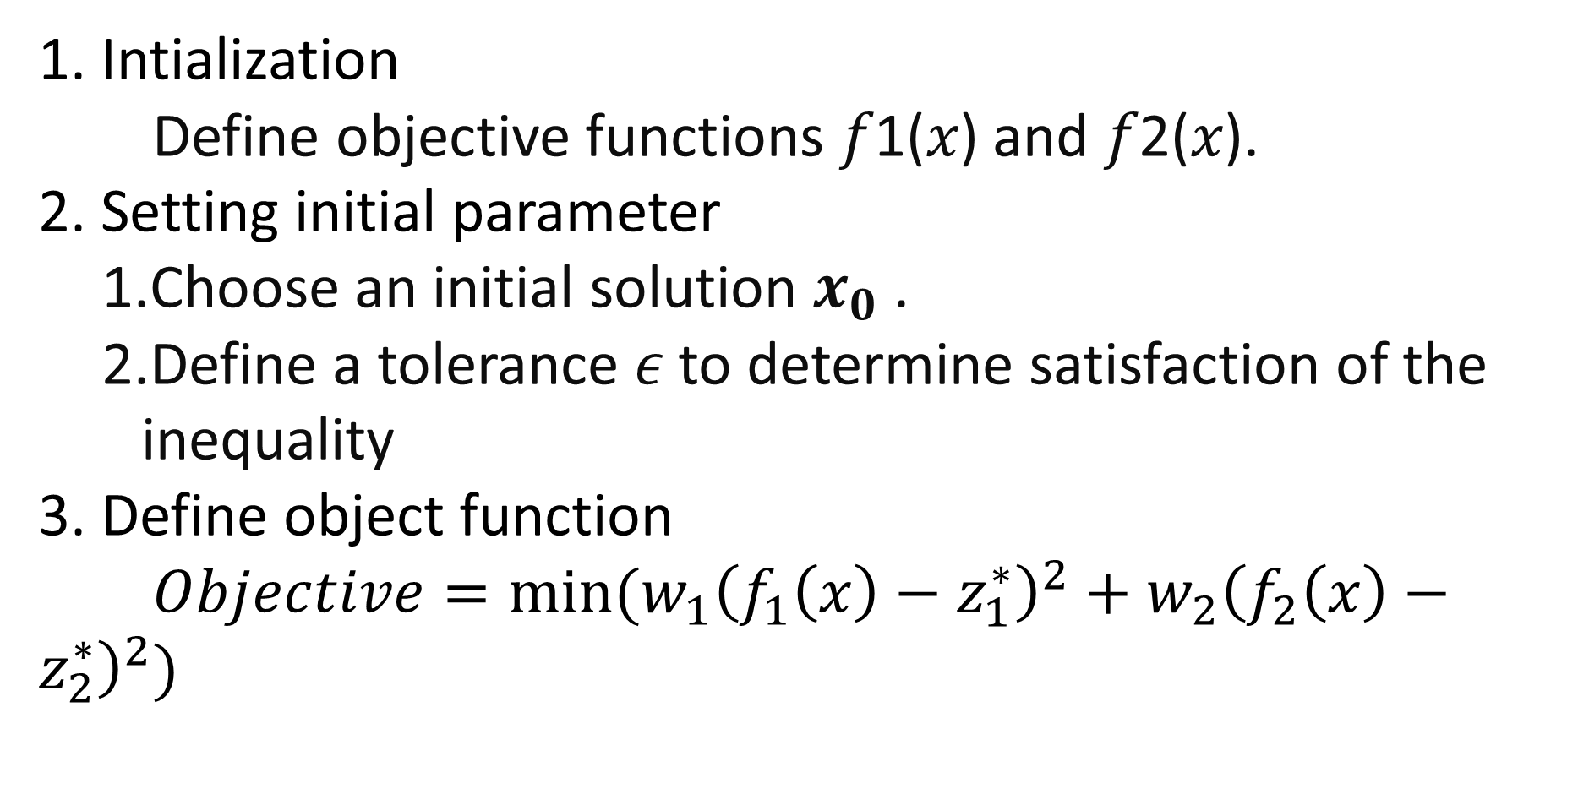
1. Intialization
Define objective functions 𝑓1(𝑥) and 𝑓2(𝑥).
2. Setting initial parameter
Choose an initial solution $x_{0}$ .
Define a tolerance 𝜖 to determine satisfaction of the inequality
3. Define object function
$Objective=min⁡(w_{1}{\left(f_{1}\left(x\right)−z_{1}^{∗}\right)}^{2}+w_{2}{\left(f_{2}\left(x\right)−z_{2}^{∗}\right)}^{2})$

Slide 10
4.Iterative Search:
Use genetic algorithms to iteratively adjust the solution x to optimize the combined objective function.
In each iteration, check if the current solution satisfies the inequality conditions. If satisfied, record the current solution as a potential optimal solution.
5.Termination Criteria:
Terminate the search when the combined objective function no longer significantly improves or when the maximum number of iterations is reached.
Return the recorded potential optimal solution.

