Slide 1
Optimization Methods Lab 14 Session
By Shi Jimao

Slide 2
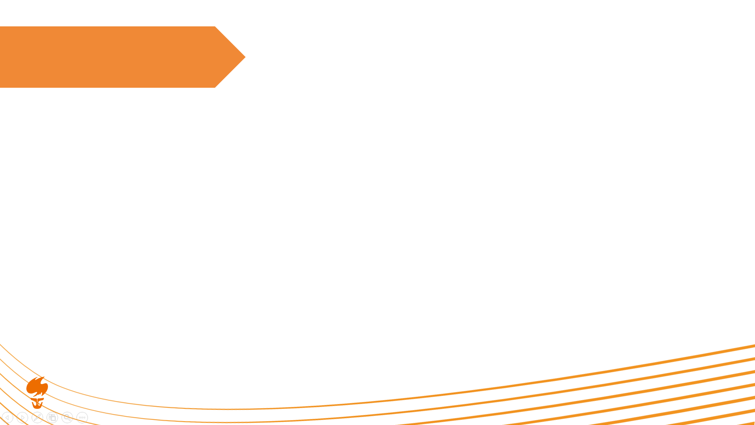
Task1
Since we need the minimum GD value, therefore all points have the same value, which means each point on the line meets requirements.

Slide 3
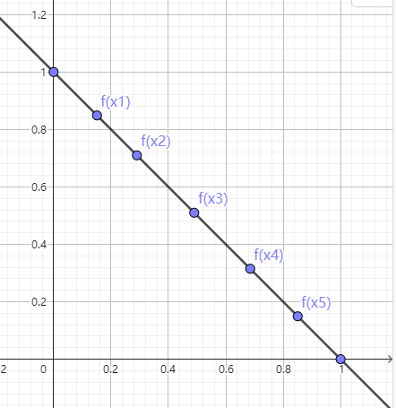

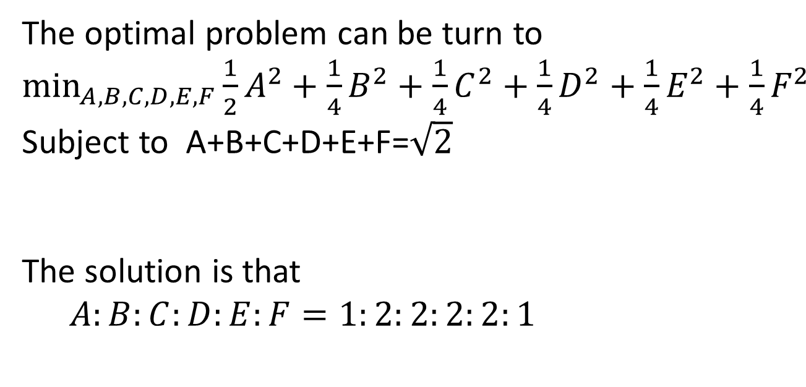
Task2
The optimal problem can be turn to $\min_{A,B,C,D,E,F}{\frac{1}{2}A^{2}+\frac{1}{4}B^{2}+\frac{1}{4}C^{2}+\frac{1}{4}D^{2}+\frac{1}{4}E^{2}+\frac{1}{4}F^{2}}$
Subject to A+B+C+D+E+F=$\sqrt{2}$
The solution is that
$$A:B:C:D:E:F=1:2:2:2:2:1$$

Slide 4
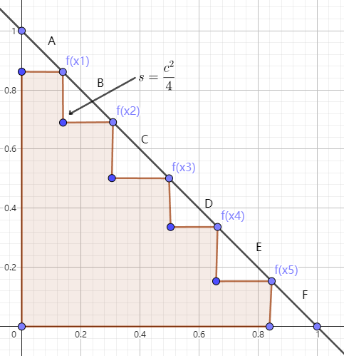

Task3
To maximize the hypervolume is to minimize the total area of the triangles, which is
$$\min_{A,B,C,D,E,F}{\frac{A^{2}+B^{2}+C^{2}+D^{2}+E^{2}+F^{2}}{4}}$$
Subject to A+B+C+D+E+F=$\sqrt{2}$
After that we can get the solution :
$$A:B:C:D:E:F=1:1:1:1:1$$
Which means $A=B=C=D=E=F=\frac{\sqrt{2}}{5}$

Slide 5
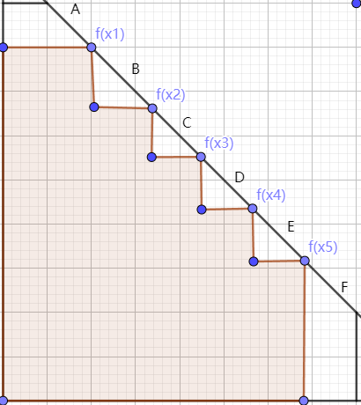

Task4
We need to maximize the origin area, which means to minimize the left area. The optimization problem is to solve:
$$\min_{A,B,C,D,E,F}{\frac{1}{4}A^{2}+\frac{1}{4}B^{2}+\frac{1}{4}C^{2}+\frac{1}{4}D^{2}+\frac{1}{4}E^{2}+\frac{1}{4}F^{2}+\frac{\sqrt{2}}{2}A^{2}+\frac{\sqrt{2}}{4}F^{2}}$$
Subject to A+B+C+D+E+F=$\sqrt{2}$
Let $\overline{A}=A+\sqrt{2}$ and $\overline{F}=F+\sqrt{2}$, then we can simplify the equation into
$$\min_{\overline{A},B,C,D,E,\overline{F}}{{\overline{A}}^{2}+B^{2}+C^{2}+D^{2}+E^{2}+{\overline{F}}^{2}}$$
Subject to $\overline{A}+B+C+D+E+\overline{F}=3\sqrt{2}$ and $\overline{A}≥\sqrt{2}$ and $\overline{F}≥\sqrt{2}$
Apply KKT condition, we have:
$$x−λ−μ_{1}{\left(1,0,0,0,0,0\right)}^{T}−μ_{2}{\left(0,0,0,0,0,1\right)}^{T}=0$$
We can get $x=\left(x_{1},x_{2},x_{3},x_{4},x_{5},x_{6}\right)=\left(\overline{A},B,C,D,E,\overline{F}\right)$
The final solution is $A=F=0$ and $B=C=D=E=\frac{\sqrt{2}}{4}$

Slide 6
Task5
Distribution of Solutions
(i) Solutions well distributed over the entire Pareto front:
This implies that the solutions are spread uniformly across the Pareto front, covering the entire front without any gaps. This distribution ensures that the hypervolume is maximized because it explores all possible combinations of objective values within the defined front.
(ii) Solutions on the boundary of the Pareto front:
Here, most solutions lie on the boundary (extremes) of the Pareto front. This can also maximize the hypervolume because the boundary solutions are typically the most extreme (and hence the furthest away) from the reference point, contributing significantly to the hypervolume measure.

Slide 7
Both distributions can maximize the hypervolume for the following reasons:
Well Distributed Solutions:
When solutions are well distributed, the hypervolume is maximized because every possible combination of f1,f2,f3​ values is considered within the Pareto front constraints. This leads to a comprehensive coverage of the objective space, ensuring that no potential volume is left out. Therefore, each small volume element contributes to the overall hypervolume.
Boundary Solutions:
In contrast, solutions on the boundary, especially at the extreme points, have the advantage of being farthest from the reference point. These extreme points can cover a significant volume individually. When these boundary points are chosen strategically, they can create a large hypervolume by encompassing a substantial part of the objective space. Essentially, the distance of these points from the reference point (1000, 1000, 1000) is maximized, which in turn maximizes the hypervolume.

