Slide 1
Homework2
12112218
Shi Jimao

Slide 2
Question1
For example, the capacity of knapsack is 10,
2 items:
Optimal solution is select B, while greedy algorithm will choose A, because the ratio of A is much bigger than B, while the result is much small than optimal solution.
 | Weight | Value | Ratio
A | 0.00001 | 100 | 10000000
B | 99.9999999999 | 101 | 1.01

Slide 3
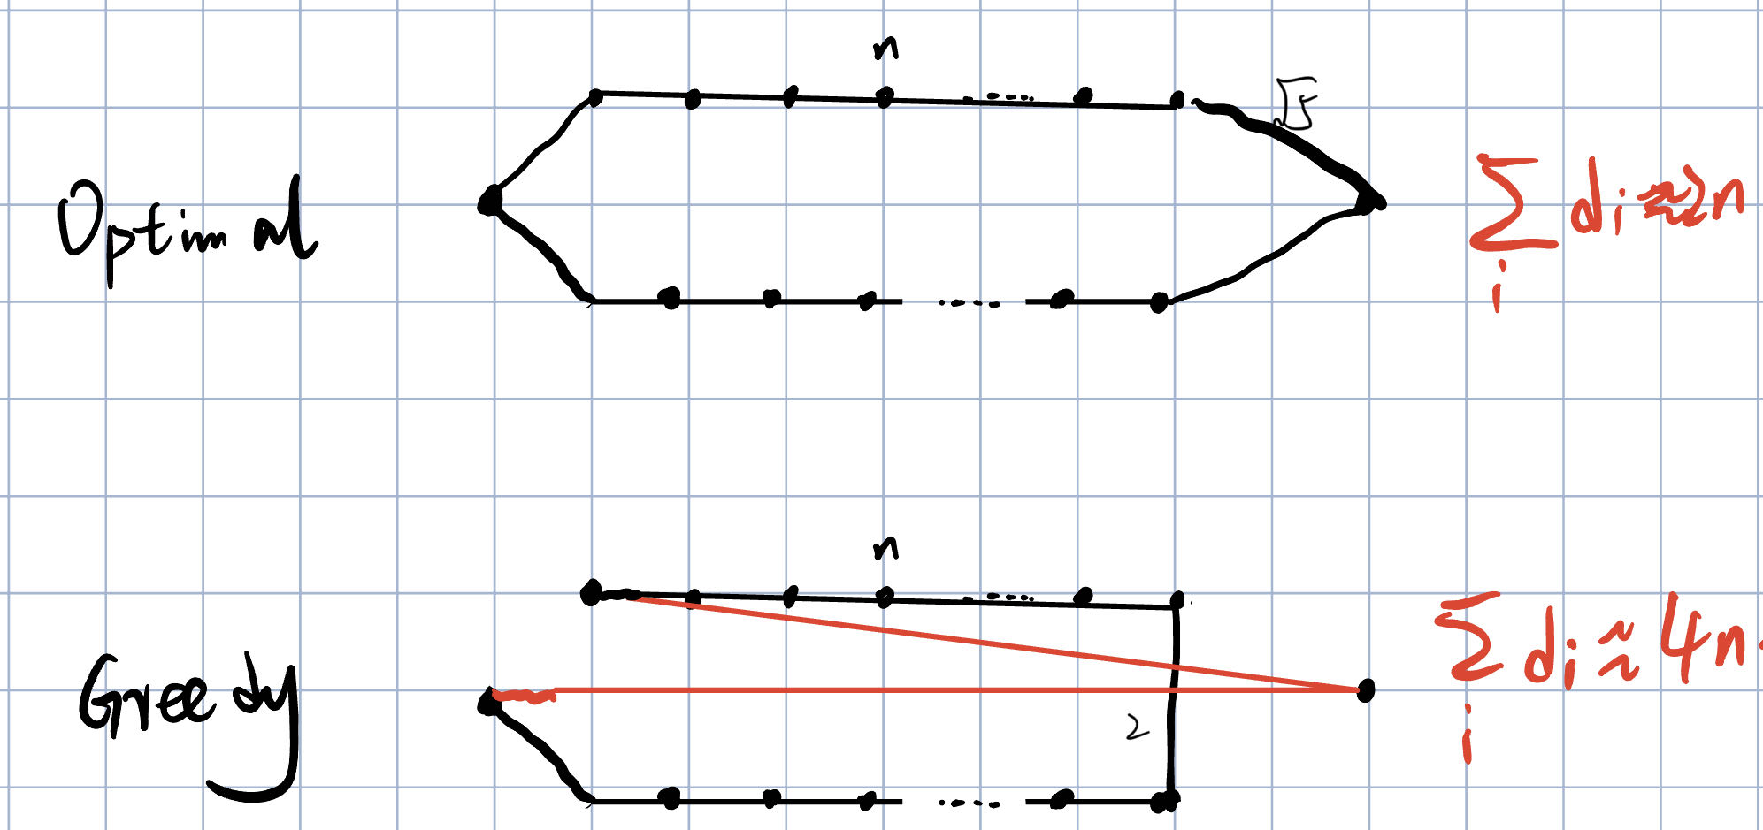
Question2
In such condition, when n is very large, the ratio between optimal solution and greedy algorithm solution is converge to 2

Slide 4
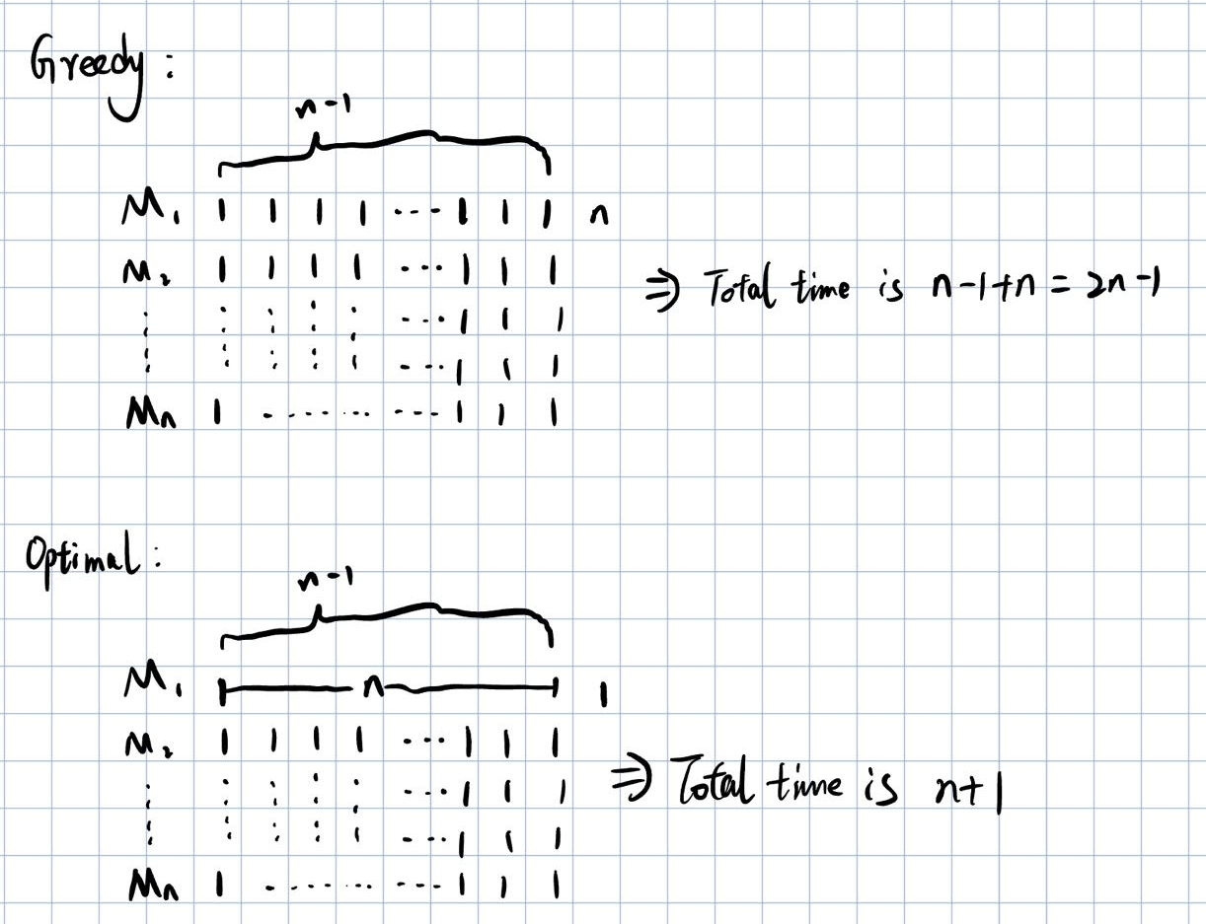
Question3
Suppose n machine n*(n-1) jobs, where the job is one n, and others are all 1.
The ratio between greedy and optimal is (2n-1)/(n+1)
When n is very large, the ratio will converge to 2

