Slide 1
Optimization Methods
Lab 3 Session
12112218 史纪茂

Slide 2
（1）Adjacent Two-City Change
Since we exchange two adjacent points, for n cities, we just consider each point exchange with its left point.
Therefore, the result is n

Slide 3
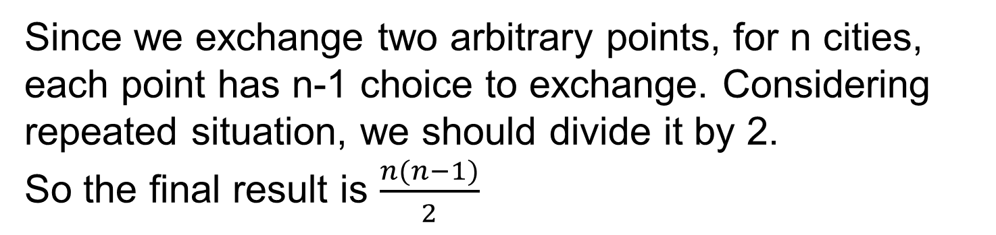
（2）Arbitrary Two-City Change

Slide 4
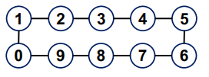

（3）Insertion(Shift)
Since we insert one point from n points, each point has n-2 position to insert.
So the number is n(n-2).
However there exist repeated situation.
For example, situation 1 and 2 are same with different insertion strategy. We can find for each adjacent point has such a situation. For n points, there exist n choice that will lead to repetition.
So we should minus n from n(n-2). Then the final result will be n(n-2)-n=n(n-3)

Slide 5
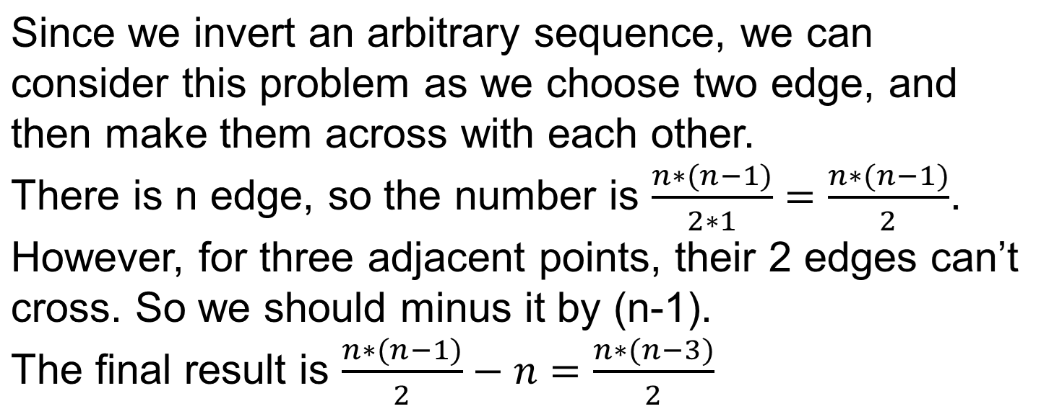
（4）Inversion(Arbitrary Two-Edge Change)

Slide 6
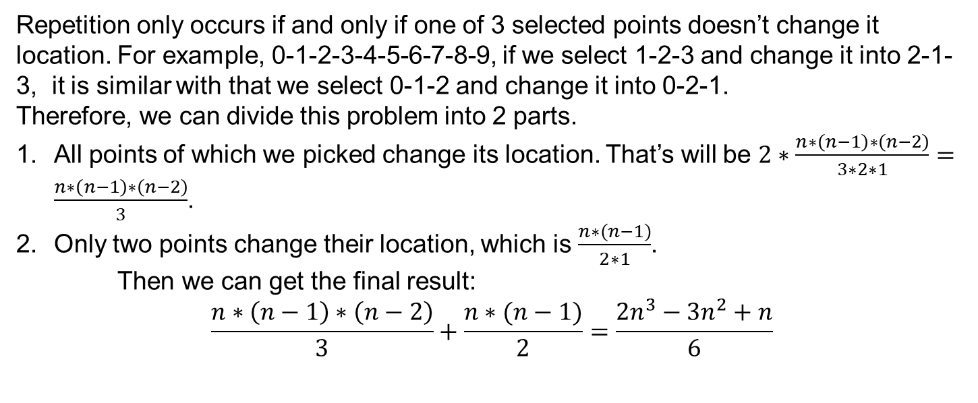
（5）Arbitrary Three-City Change

