Slide 1
Optimization Methods
Lab 4 Session
12112218 史纪茂

Slide 2
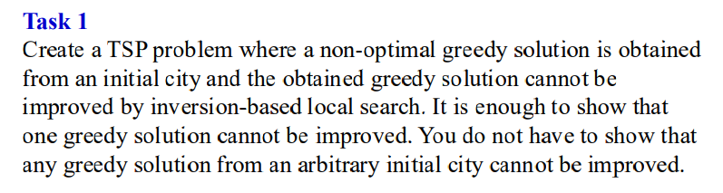
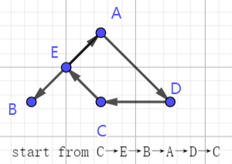
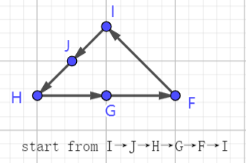
Notify: BE<AE
In left one, we let it should start from E. After using greedy algrithom, we get this solution which can’t be improved by inversion-based local search. At the same time, it is not the optimal solution.
In the right one, it start from I, and then do as the upon graph. And this is the optimal solution.

Slide 3
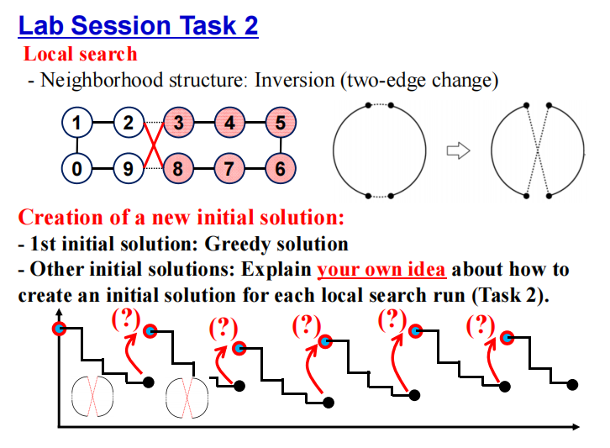
First, we represent the solution of TSP by string. Define the distance between 2 points as the closest length between 2 points.
In the following example, we can find that point 1 and 4 have a path with the length of 2.
1 | 2 | 3 | 4 | 5 | 6
4 | 2 | 3 | 1 | 5 | 6
Therefore, we can create our initial solution by the following instruction.
To create an initial solution for a new local research run, we can exchange the positions of two points which are originally 2 or more apart.

Slide 4
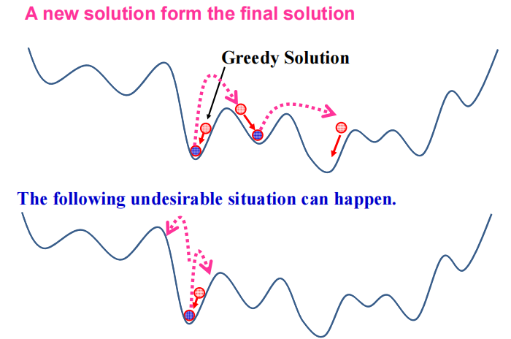
The new initial solution can be far enough away from the last solution, because we exchange 2 edges for 5 times at least to restore the original state. The inversion-based distance between the new initial solution and the last final solution is 5 at least.
Therefore, it is enough for us to jump out of the local optimal trap.

Slide 5
