Slide 1
Optimization Methods Lab 5 Session
By Shi Jimao

Slide 2

Task1
Cooling Schedules:
Constant-high-temperature: 10000.0
Constant-low-temperature: 1.0
Constant-medium-temperature: 100.0
Linear-cooling: decrease linearly with initial value 100.0
Exponential-cooling: decrease exponentially with initial value 100.0

Slide 3
Experiment process
To start with, read all related data from excel files. And we choose the first k items as what the ppt said. We find that k is 38, which means the initial solution contains the first 38 items.
Then start SA process. As for generating new solution in each iteration, we use Hamming distance from 1 to 4 respectively. The result of simulated annealing has randomness, so we conducted 20 parallel averages for a round of experiments as the final result to avoid the influence of randomness on the result.
At last, we draw the result figures and divided them into 4 parts according to their Hamming distance.

Slide 4
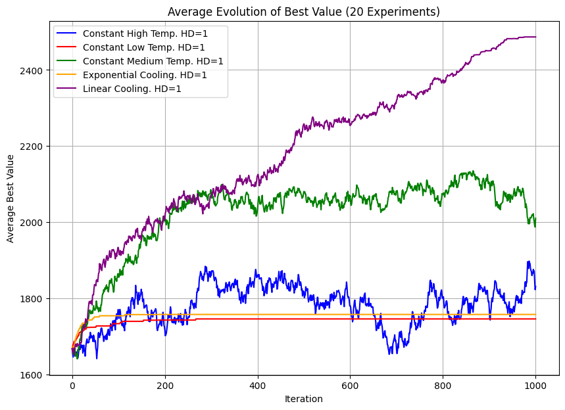
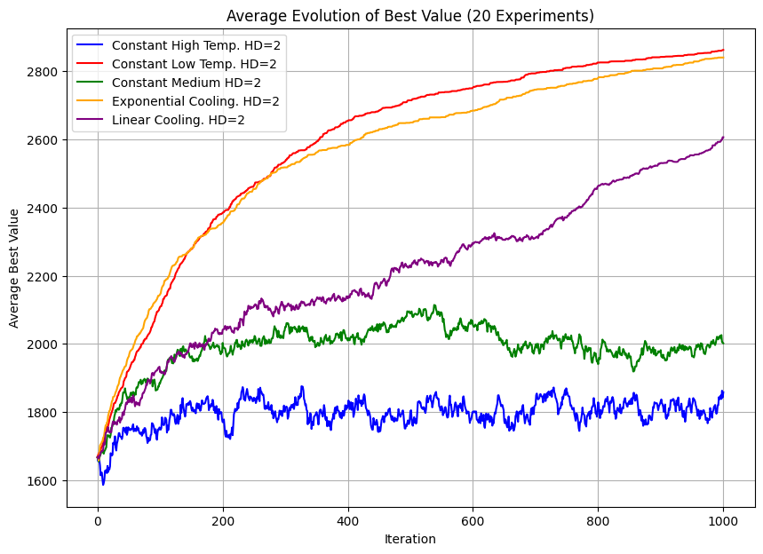
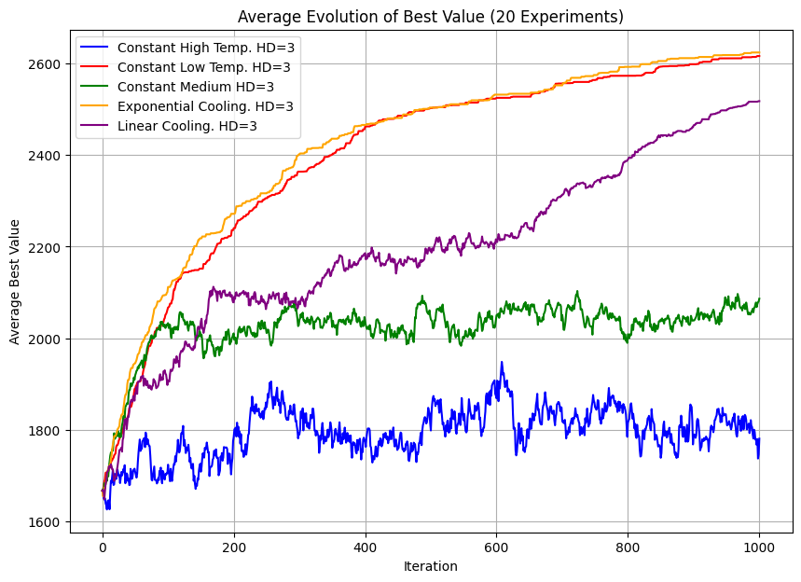
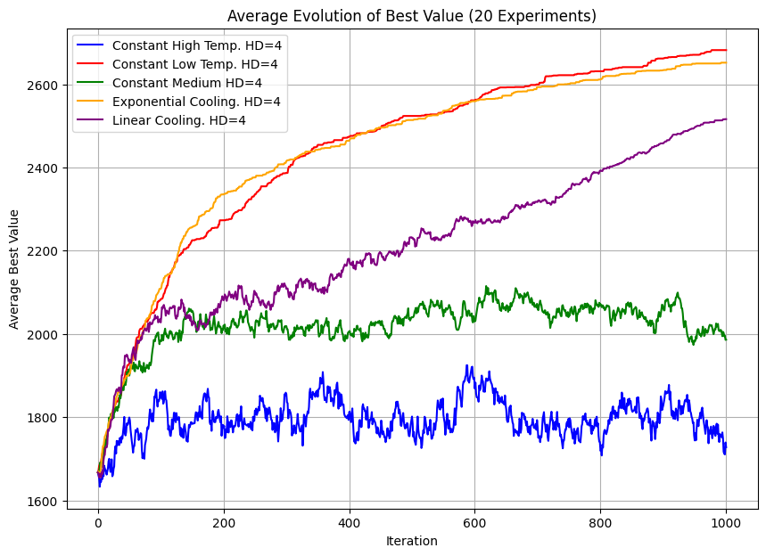

Slide 5
Interpretation of result
When Hamming distance is 1, we can find that constant low temperature and exponential decrease case perform bad. This is because 1 HD for this problem with fixed initial solution always can’t generate a legal and better solution by only change 1 position. While exp-decrease is a little bit better than fixed low temperature, because initial temperature of decrease is higher which can more easily get out of local optimal solution.
At the same time, we can find that the result with constant high temperature is always oscillating since it is similar with random search.
When Hamming distance is larger that 2, we can see that constant low and exponential decrease temperature always lead to good results.

