Slide 1
Optimization Methods Lab 6 Session
By Shi Jimao

Slide 2

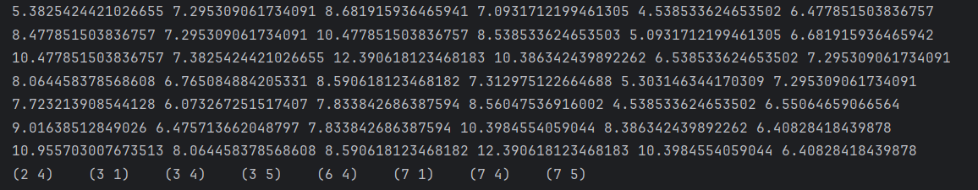
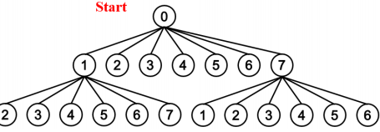
Task1
In depth 2 nodes, 8 nodes will be terminated using the greedy solution of tour length 10.

Slide 3
Task2
I will describe my opinion within an example.
Here are 4 jobs and 4 machines, and I select as the first job. The schedule is shown in followings:
M1
M2
M3
M4

Slide 4
Task2
As for lower bound, I compress the wait time for all tasks except the first for all machines. And then add a period which is the shortest time in the remains jobs of the last machine( ).
Then select the maximum total time from all machines.
M1
M2
M3
M4
Lower bound

Slide 5
Task3
I use a code to estimate the time of m-machine-n-jobs flow task. I set a series of n and record their running time and shown in the following picture.
For n is from 200000 to 400000, it needs about 4s. Therefore, about one hour, it can solve the problem with n = 30000000 within 1 hour.
N | 30 | 300 | 3000 | 30000 | 300000 | 3000000
Running Time/s | 0.02 | 0.077 | 0.435 | 3.809 | 38.829 | 368.907

