Slide 1
Optimization Methods Lab 9 Session
By Shi Jimao

Slide 2

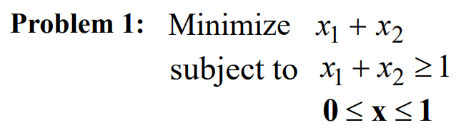
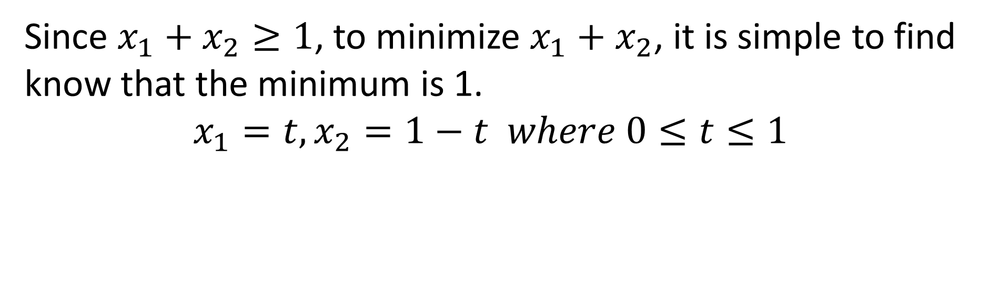
Task1
Since $x_{1}+x_{2}≥1$, to minimize $x_{1}+x_{2}$, it is simple to find know that the minimum is 1.
$$x_{1}=t, x_{2}=1−t where 0≤t≤1$$

Slide 3
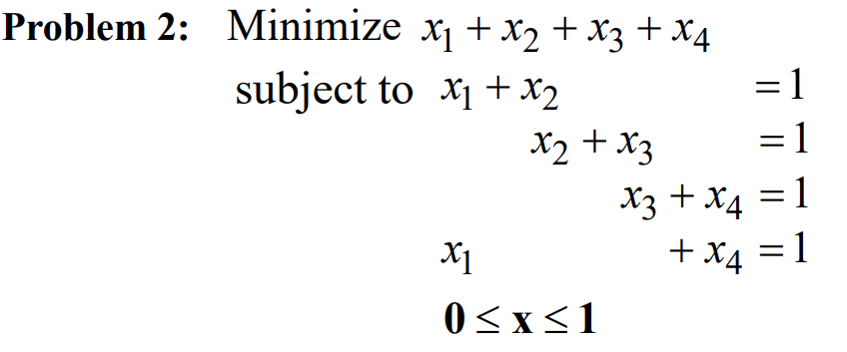

Task1
If we add the first and third constraint, we can directly get that $x_{1}+x_{2}+x_{3}+x_{4}=1$, which means that the minimum value is 1

Slide 4
Task2
In this task , I use these 3 LP solvers: GLPK (GNU Linear Programming Kit), Gurobi, PuLP, and get the result for two problems shown in the following tables.
 | x1 | x2 | Object function
GLPK | 1.0 | 0.0 | 1.0
Gurobi | 1.0 | 0.0 | 1.0
PuLP | 1.0 | 0.0 | 1.0
Problem1
 | x1 | x2 | x3 | x4 | Object function
GLPK | 0.0 | 1.0 | 0.0 | 1.0 | 2.0
Gurobi | 1.0 | 0.0 | 1.0 | 0.0 | 2.0
PuLP | 0.0 | 1.0 | 0.0 | 1.0 | 2.0
Problem2

Slide 5
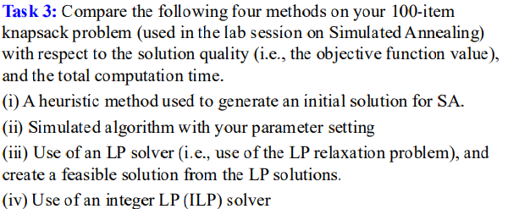
Task3
Approach to change LP to integer problem:
Set boundary = 1;
Set element = (element<boundary)
While constraint is satisfied:
Set element = (element<boundary)
boundary-=0.01
 | (i) | (ii) | (iii) | (iv)
Running time | 0.06ms | 200ms | 1.14ms | 431ms
Object value | 1667 | 2953 | 2987 | 3093

Slide 6
Task4
 | (i) | (ii) | (iii) | (iv)
Running time | 0.43ms | 413ms | 2.14ms | 631ms
Object value | 4190 | 6248 | 6260 | 6341
200-item
 | (i) | (ii) | (iii) | (iv)
Running time | 0.89ms | 723ms | 3.41ms | 90067ms
Object value | 9841 | 12918 | 12929 | 12936
400-item
For using an integer LP (ILP) solver, the running time increase very fast when the scale of the problem grows, while using an LP solver increase nearly linearly.

Slide 7
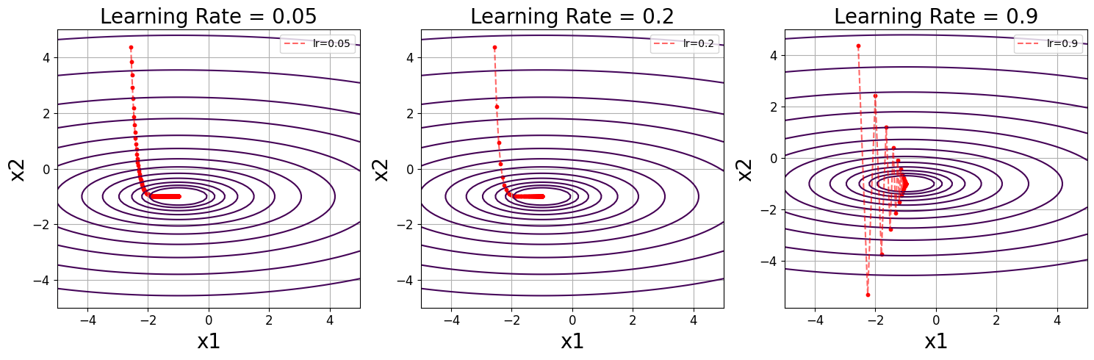
Task5
I set 3 learning rate: 0.05,0.2 and 0.9
When learning rate is too small, it will take a long time to search at beginning. And if learning rate is too large, it will cause shaking. Therefore, select learning rate with a median value like 0.2 is reasonable .

