Slide 1
208dowels
B-MAT-400

Slide 2
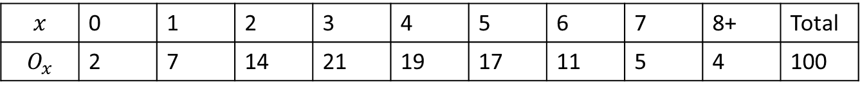
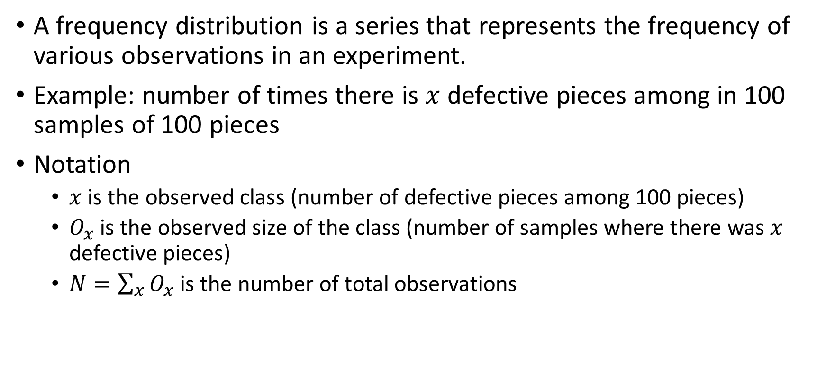
Frequency distribution
A frequency distribution is a series that represents the frequency of various observations in an experiment.
Example: number of times there is $x$ defective pieces among in 100 samples of 100 pieces
Notation
$x$ is the observed class (number of defective pieces among 100 pieces)
$O_{x}$ is the observed size of the class (number of samples where there was $x$ defective pieces)
$N=\sum_{x}{O_{x}}$ is the number of total observations
$$x$$ | 0 | 1 | 2 | 3 | 4 | 5 | 6 | 7 | 8+ | Total
$$O_{x}$$ | 2 | 7 | 14 | 21 | 19 | 17 | 11 | 5 | 4 | 100

Slide 3
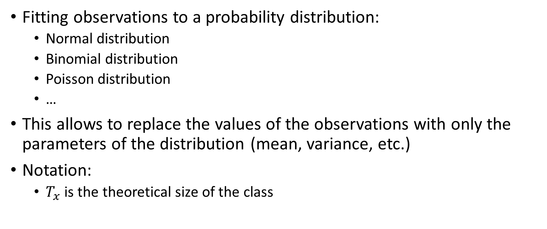
Distribution fitting
Fitting observations to a probability distribution:
Normal distribution
Binomial distribution
Poisson distribution
…
This allows to replace the values of the observations with only the parameters of the distribution (mean, variance, etc.)
Notation:
$T_{x}$ is the theoretical size of the class

Slide 4
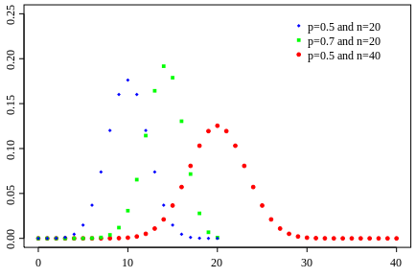
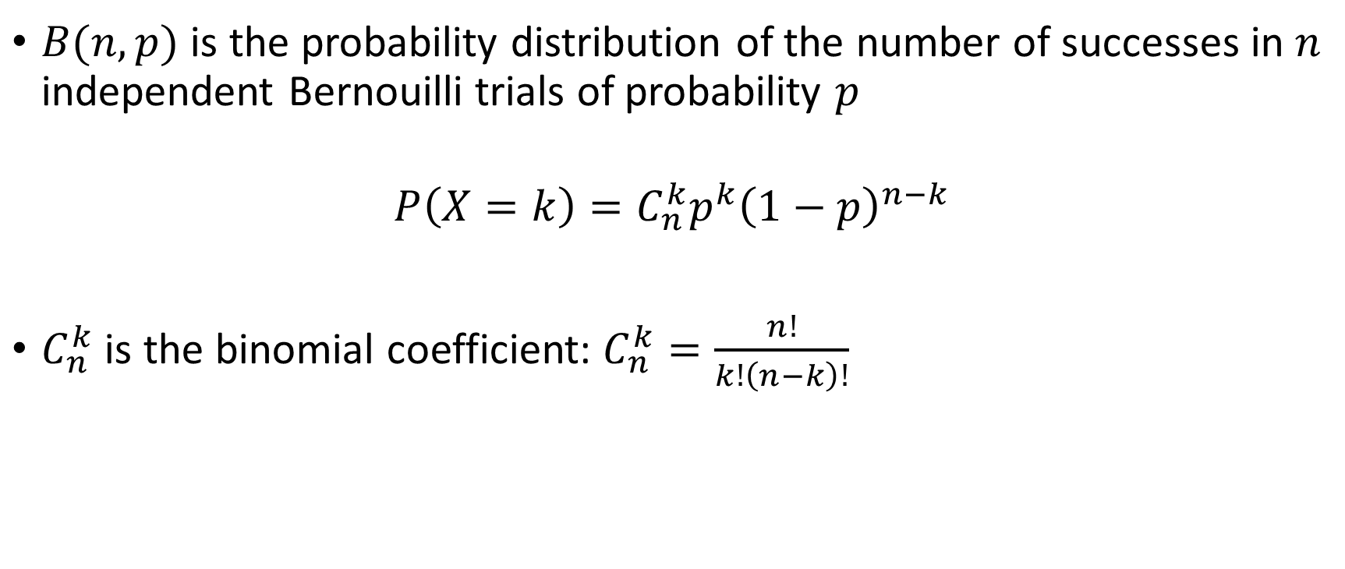
Reminder: Binomial distribution
$B(n,p)$ is the probability distribution of the number of successes in $n$ independent Bernouilli trials of probability $p$
$$P\left(X=k\right)=C_{n}^{k}p^{k}{\left(1−p\right)}^{n−k}$$
$C_{n}^{k}$ is the binomial coefficient: $C_{n}^{k}=\frac{n!}{k!\left(n−k\right)!}$

Slide 5
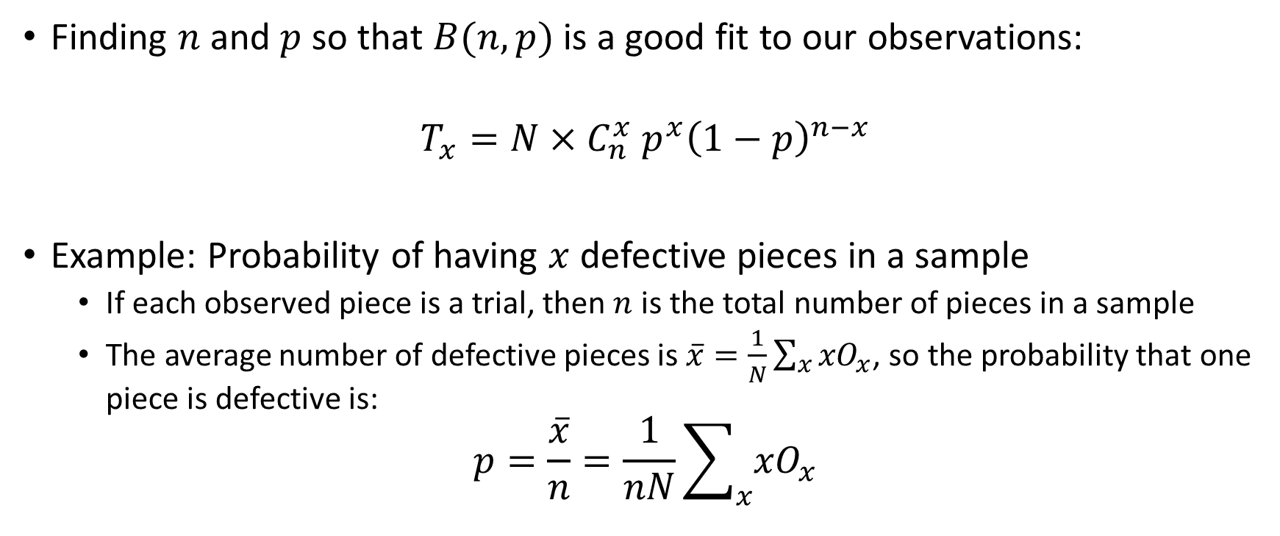
Binomial distribution fitting
Finding $n$ and $p$ so that $B(n,p)$ is a good fit to our observations:
$$T_{x}=N{×C}_{n}^{x}p^{x}{\left(1−p\right)}^{n−x}$$
Example: Probability of having $x$ defective pieces in a sample
If each observed piece is a trial, then $n$ is the total number of pieces in a sample
The average number of defective pieces is $\overline{x}=\frac{1}{N}\sum_{x}{{xO}_{x}}$, so the probability that one piece is defective is:
$$p=\frac{\overline{x}}{n}=\frac{1}{nN}\sum_{x}{{xO}_{x}}$$

Slide 6
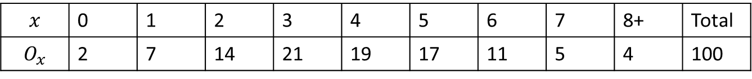
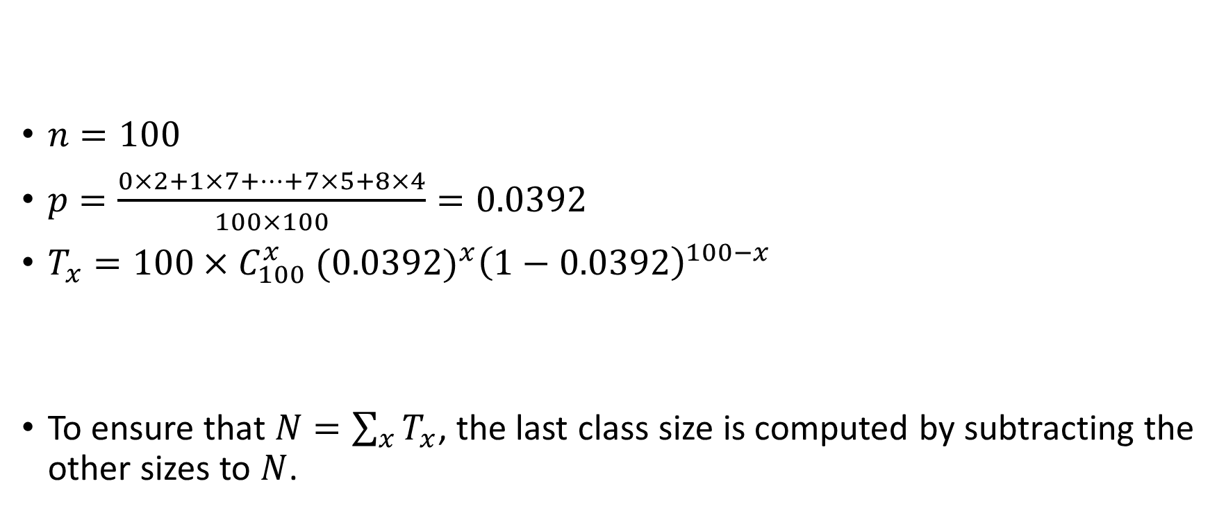
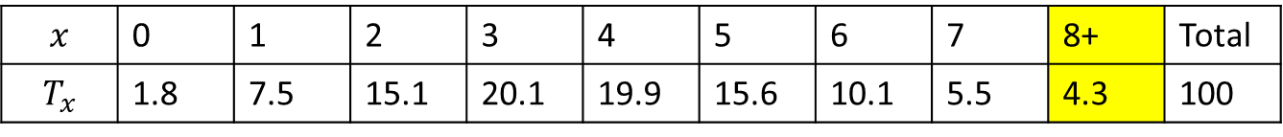
Example
$n=100$
$p=\frac{0×2+1×7+…+7×5+8×4}{100×100}=0.0392$
$T_{x}=100{×C}_{100}^{x}{(0.0392)}^{x}{\left(1−0.0392\right)}^{100−x}$
To ensure that $N=\sum_{x}{T_{x}}$, the last class size is computed by subtracting the other sizes to $N$.
$$x$$ | 0 | 1 | 2 | 3 | 4 | 5 | 6 | 7 | 8+ | Total
$$O_{x}$$ | 2 | 7 | 14 | 21 | 19 | 17 | 11 | 5 | 4 | 100
$$x$$ | 0 | 1 | 2 | 3 | 4 | 5 | 6 | 7 | 8+ | Total
$$T_{x}$$ | 1.8 | 7.5 | 15.1 | 20.1 | 19.9 | 15.6 | 10.1 | 5.5 | 4.3 | 100

Slide 7
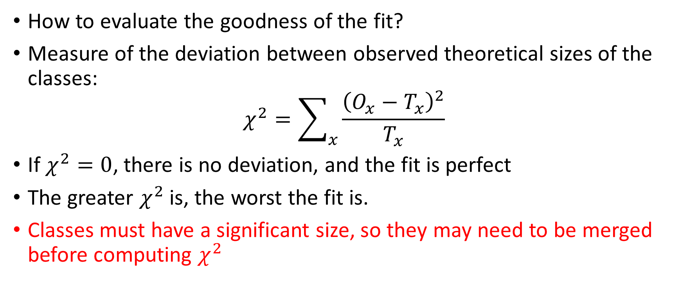
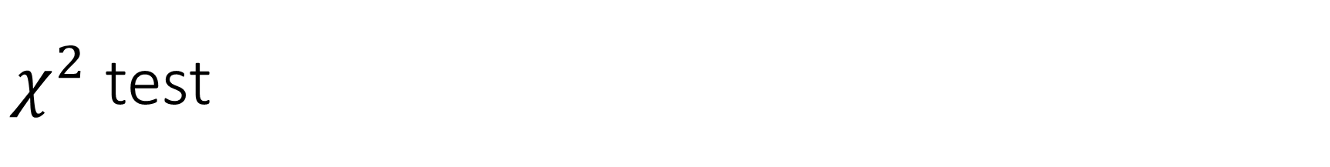
$χ^{2}$ test
How to evaluate the goodness of the fit?
Measure of the deviation between observed theoretical sizes of the classes:
$$χ^{2}=\sum_{x}{\frac{{\left(O_{x}−T_{x}\right)}^{2}}{T_{x}}}$$
If $χ^{2}=0$, there is no deviation, and the fit is perfect
The greater $χ^{2}$ is, the worst the fit is.
Classes must have a significant size, so they may need to be merged before computing $χ^{2}$

Slide 8
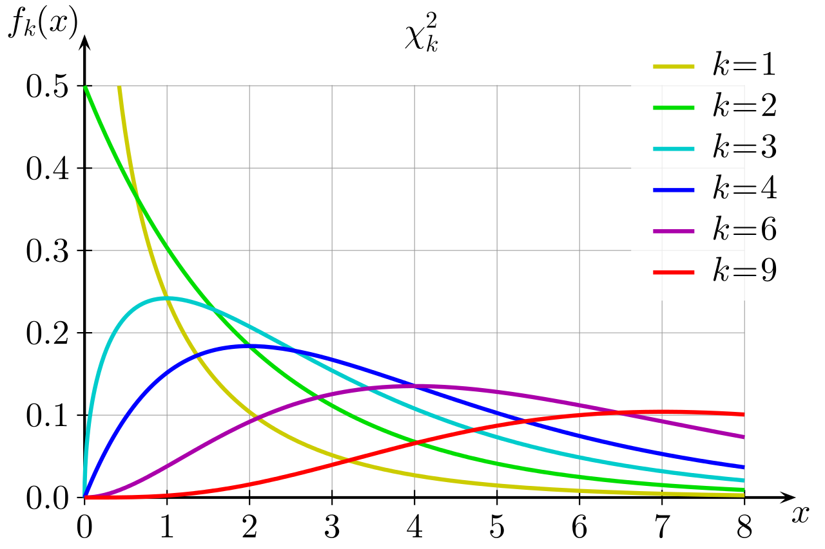
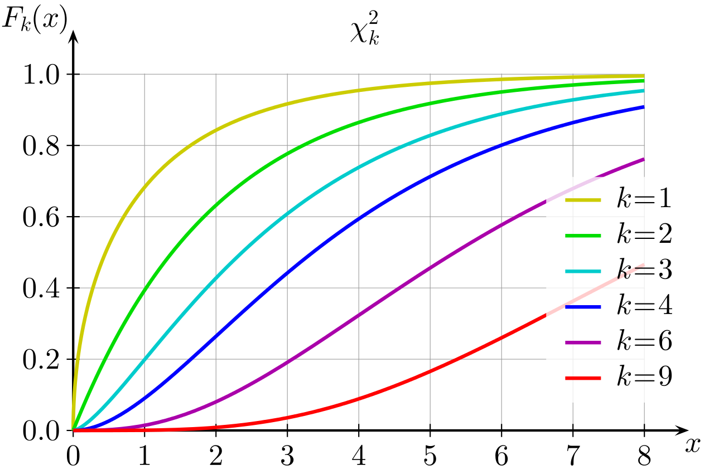
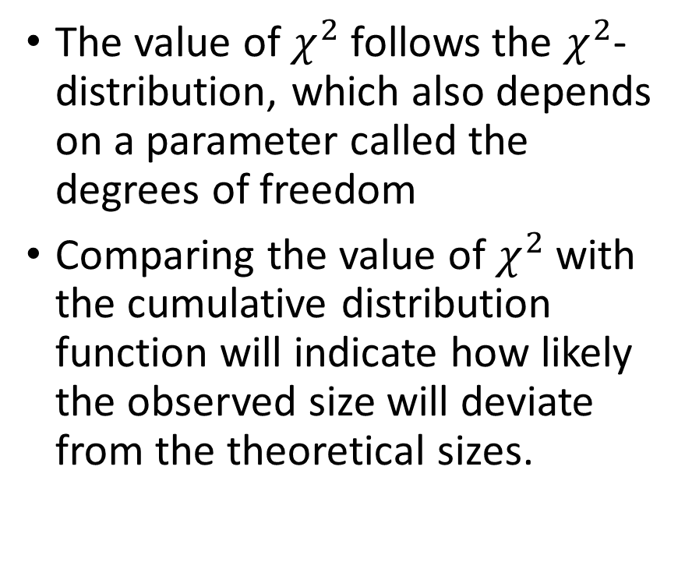
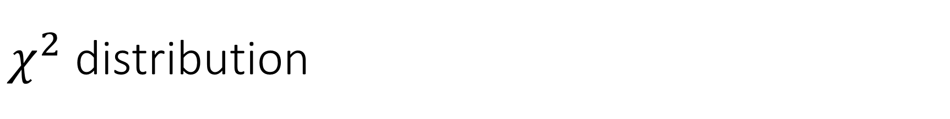
$χ^{2}$ distribution
The value of $χ^{2}$ follows the $χ^{2}$-distribution, which also depends on a parameter called the degrees of freedom
Comparing the value of $χ^{2}$ with the cumulative distribution function will indicate how likely the observed size will deviate from the theoretical sizes.

Slide 9
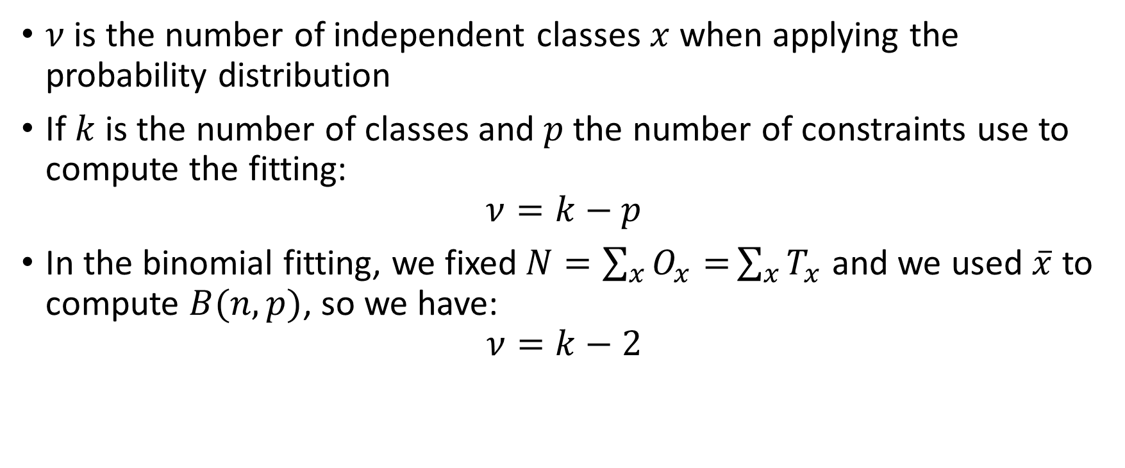
Degrees of freedom
$ν$ is the number of independent classes $x$ when applying the probability distribution
If $k$ is the number of classes and $p$ the number of constraints use to compute the fitting:
$$ν=k−p$$
In the binomial fitting, we fixed$N=\sum_{x}{O_{x}=}\sum_{x}{T_{x}}$ and we used $\overline{x}$ to compute $B(n,p)$, so we have:
$$ν=k−2$$

Slide 10

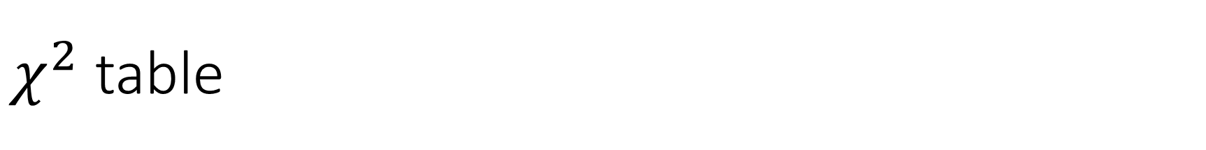
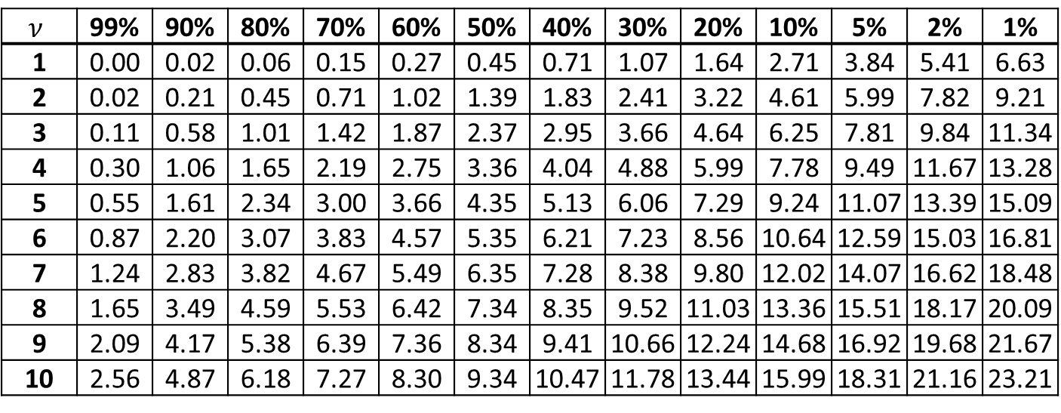
$χ^{2}$ table
Knowing the value of $χ^{2}$ and the degrees of freedom, we can use a $χ^{2}$ table to determine the goodness of the fit
$$ν$$ | 99% | 90% | 80% | 70% | 60% | 50% | 40% | 30% | 20% | 10% | 5% | 2% | 1%
1 | 0.00 | 0.02 | 0.06 | 0.15 | 0.27 | 0.45 | 0.71 | 1.07 | 1.64 | 2.71 | 3.84 | 5.41 | 6.63
2 | 0.02 | 0.21 | 0.45 | 0.71 | 1.02 | 1.39 | 1.83 | 2.41 | 3.22 | 4.61 | 5.99 | 7.82 | 9.21
3 | 0.11 | 0.58 | 1.01 | 1.42 | 1.87 | 2.37 | 2.95 | 3.66 | 4.64 | 6.25 | 7.81 | 9.84 | 11.34
4 | 0.30 | 1.06 | 1.65 | 2.19 | 2.75 | 3.36 | 4.04 | 4.88 | 5.99 | 7.78 | 9.49 | 11.67 | 13.28
5 | 0.55 | 1.61 | 2.34 | 3.00 | 3.66 | 4.35 | 5.13 | 6.06 | 7.29 | 9.24 | 11.07 | 13.39 | 15.09
6 | 0.87 | 2.20 | 3.07 | 3.83 | 4.57 | 5.35 | 6.21 | 7.23 | 8.56 | 10.64 | 12.59 | 15.03 | 16.81
7 | 1.24 | 2.83 | 3.82 | 4.67 | 5.49 | 6.35 | 7.28 | 8.38 | 9.80 | 12.02 | 14.07 | 16.62 | 18.48
8 | 1.65 | 3.49 | 4.59 | 5.53 | 6.42 | 7.34 | 8.35 | 9.52 | 11.03 | 13.36 | 15.51 | 18.17 | 20.09
9 | 2.09 | 4.17 | 5.38 | 6.39 | 7.36 | 8.34 | 9.41 | 10.66 | 12.24 | 14.68 | 16.92 | 19.68 | 21.67
10 | 2.56 | 4.87 | 6.18 | 7.27 | 8.30 | 9.34 | 10.47 | 11.78 | 13.44 | 15.99 | 18.31 | 21.16 | 23.21

Slide 11
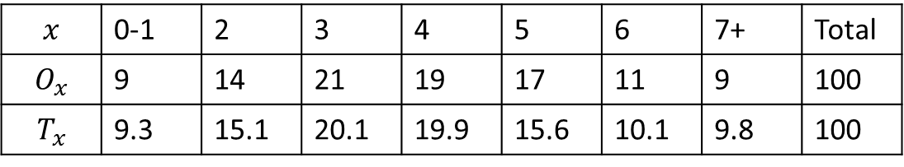
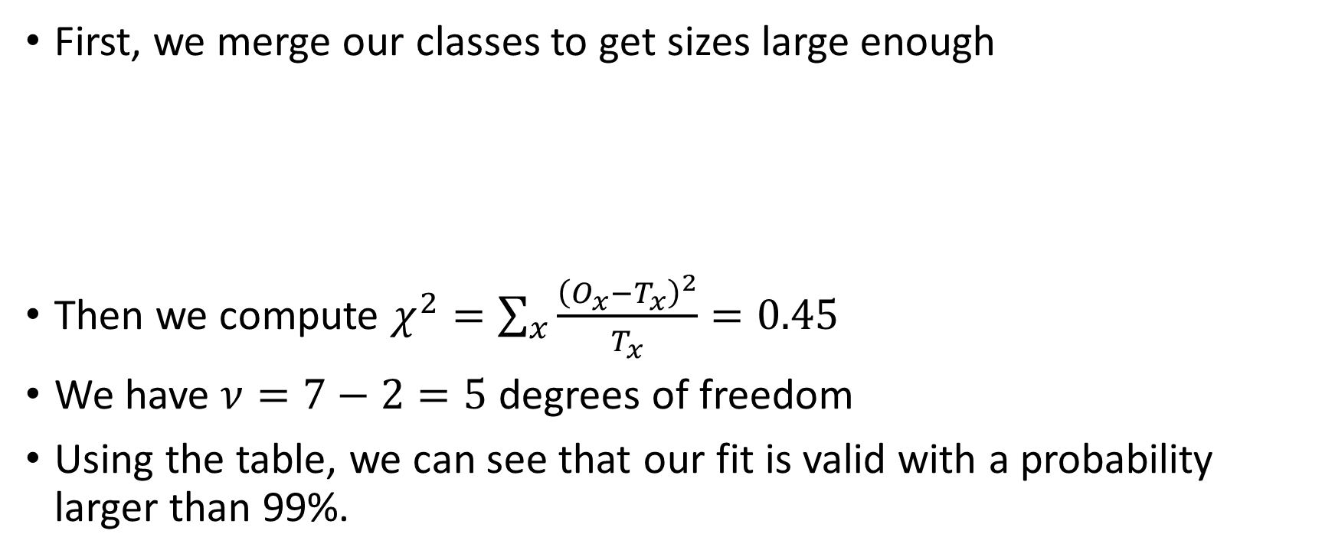
Example
First, we merge our classes to get sizes large enough
Then we compute $χ^{2}=\sum_{x}{\frac{{\left(O_{x}−T_{x}\right)}^{2}}{T_{x}}}=0.45$
We have $ν=7−2=5$ degrees of freedom
Using the table, we can see that our fit is valid with a probability larger than 99%.
$$x$$ | 0-1 | 2 | 3 | 4 | 5 | 6 | 7+ | Total
$$O_{x}$$ | 9 | 14 | 21 | 19 | 17 | 11 | 9 | 100
$$T_{x}$$ | 9.3 | 15.1 | 20.1 | 19.9 | 15.6 | 10.1 | 9.8 | 100

Slide 12
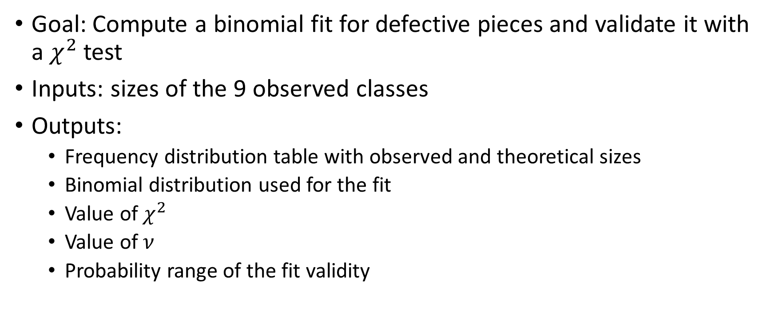
208dowels
Goal: Compute a binomial fit for defective pieces and validate it with a $χ^{2}$ test
Inputs: sizes of the 9 observed classes
Outputs:
Frequency distribution table with observed and theoretical sizes
Binomial distribution used for the fit
Value of $χ^{2}$
Value of $ν$
Probability range of the fit validity

Slide 13
Suggested bonuses
Use other distribution for the fits:
Normal distribution
Poisson distribution
…

