Slide 1
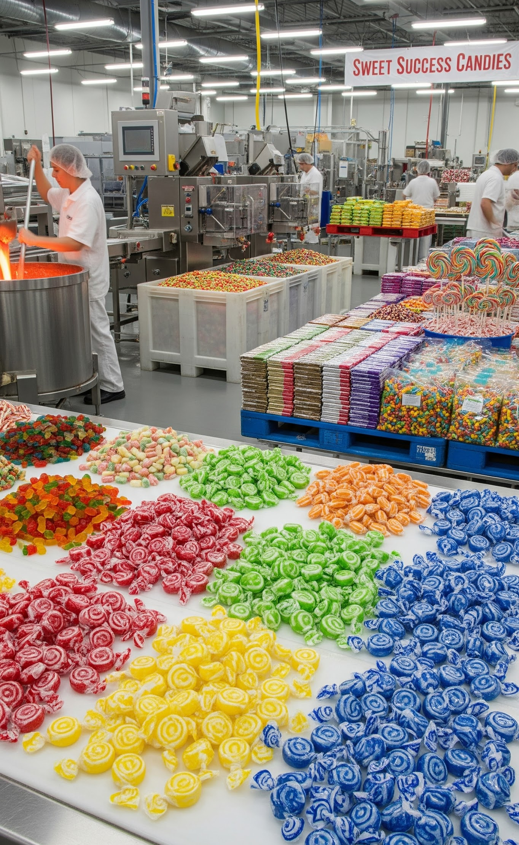

November 30, 2025
Candy Factory
Utilizing Object Oriented Design Principles to Create a Java Application
Contributor
Travis Dagostino
Contributor
Abdulraheem Giwa
Contributor
Kelly Payne

Slide 2
Content
Overview of Project
OOD Patterns Implemented
Functional Responsibilities
Changes/Issues Encountered
Application Demo
01
02
03
04
05
Columbus State University
Object Oriented Development

Slide 3


Project Summary
Project Summary
Our project, Candy Factory, simulates how a candy store manages sales.
The System functionality includes:
A user interface for viewing candy options and performing admin actions
A data storage component for managing products and orders
Back-end logic for updating inventory, processing orders, and sending stock notifications
Candy Factory

Slide 4
Object Oriented Design (OOD) Patterns Implemented
Factory Pattern (Multiple)
Observer Pattern
Singleton Pattern (Multiple)
Used to construct different candy types and packaging variants improving flexibility and reducing duplication
Inventory Subject notifies observers when stock reaches low threshold (Admin UI)
DataSource and UserManage ensure only one instance of database and user state exists
Facade Pattern
Command Pattern
Decorator Pattern
Used for connecting the BE services into the FE user interface
Handles discounts and cart item operations providing extensible pricing logic
Used for candy wrapping and packaging allowing for future enhancements without modifying candy base classes
Candy Factory
OOD Patterns

Slide 5
Functional Components
Travis Dagostino
Admin Dashboard
Inventory Stock Alert
Connect Customer Dashboard
Login / User Management
Maven Scripts
Functionality
Order Management, Inventory Management and Alerts, and User management (Factory)
Connected BE Inventory alerts with the Admin Dashboard (Observer)
Connected Customer Dashboard to login flow
Implemented basic user management/auth through local CSV storage and password hashing (Singleton)
Configured Maven for the project and built the scripts that run different sections of the application - i.e. login flow versus demo flow when testing BE
Candy Factory

Slide 6
Functional Components
Abdulraheem Giwa
Order Management
Low-stock Alerts
Data Persistance
Backend Facade
Compilation Validation
Functionality
Implemented BE logic for order creation, inventory updates, and discount system (Command Pattern)
Implemented low-stock alerts for the BE (Observer Pattern)
Ensure data for orders persisted across sessions through use of CSVs
Provided a backend facade for the front end UI to connect with
Ensure backend compiles and runs under primary Maven script (mvn clean javafx:run -P login-ui)
Candy Factory

Slide 7
Functional Components
Kelly Payne
Customer Dashboard
Candy Catalog
Cart
Checkout
Functionality
Central location for allowing users to place an order - orders are tracked for a given user, and user profile is stored
Available candies, quantities, weight, price, and wrapping/packaging options, loaded from a CSV file
Ability to add items to cart, review items, and cart summary
Implemented order submission and checkout through UI, finalizing the cart and clearing it after the order is placed
Order Management
View past orders, and order details
Candy Factory

Slide 8
Changes/Issues Encountered
Issues
The main issues that came up occurred in regards to coding conflicts and connecting individual contributions to the larger application
Some UI and backend components initially conflicted in Source control, required cleanup and merge resolution
Unifying Backend via a facade with the UI
Primary architecture change was a shift in focus from handling online versus in-person stores to an application for Customers/Admin
Iterative improvements to the application - there’s always more that could be done!
Candy Factory

