Slide 1
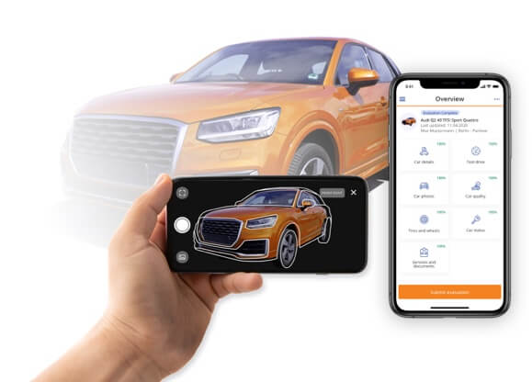
Auto Taxi App
TRAVEL CHEAPER AND SAFER

Slide 2
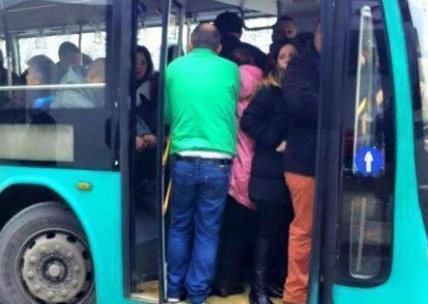
Auto taxi is the application of the future, which will greatly facilitate public transport and will also be a plus for the environment.
As we all know, public transport in Albania is in a scandalous state, and requires a solution as fast and efficiently as possible.

Slide 3

Also fuel prices are unaffordable for most of the population.
Getting a car and going somewhere costs you a lot, as well as public transport is extremely overcrowded and not within the standards.

Slide 4
Therefore, a solution is needed for the citizens and that is what we want to bring.
The auto taxi application that we want to create is perfect for resolving this issue.
As a start this application will work like that:
- For example, if someone has a trip to a city and will go by his car to have a cheaper fee he can place a notice in this application, the notice includes the name, the surname of the citizen, the location where the trip start and the correct time, destination, as well as information about the vehicle such as the license plates, the type of car and the passenger fee.

Slide 5
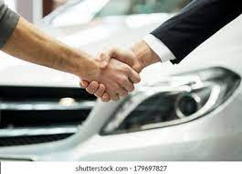
On the other hand, citizens who want to travel somewhere will enter their information, which consists of their name, surname, departure and arrival location and the minimum and maximum fee they can afford.

Slide 6

In terms of revenue gain, the main thing will be advertising and subscriptions.

Slide 7

Creating a team is very necessary.
To achieve the goal, we need a team made up of a graphic designer, a programmer, and a funder .

Slide 8

The plan will be focus on application development by promoting the application on all social networks or on television and offers will also be made to users regarding subscriptions. In conclusion, a great future awaits us.

Slide 9

To finalize, the only need we have, to bring this project to life is a financial investment, because the success of this application is guaranteed.

Slide 10


This project was realized by:
ARDIT RASENI
RINILD COBOJ
KIRDEN ASANBEJLLI
ELDORADO HAXHIAJ
BRIKEN SHEHAJ

