Slide 1
Research Seminar HW2
Seif Yacoub

Slide 2
The Data:
Articles and Research papers about the Russian food.

Slide 3
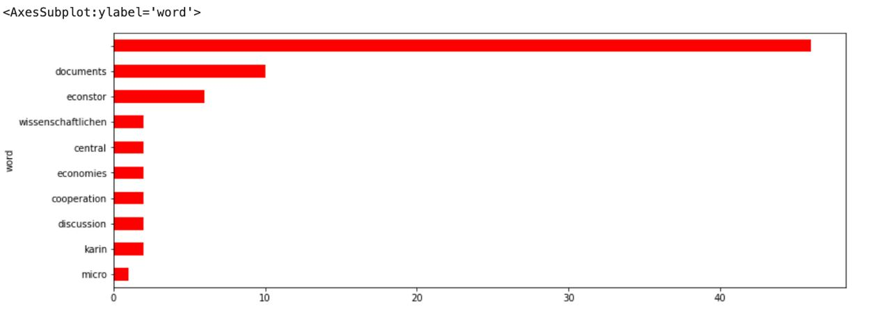
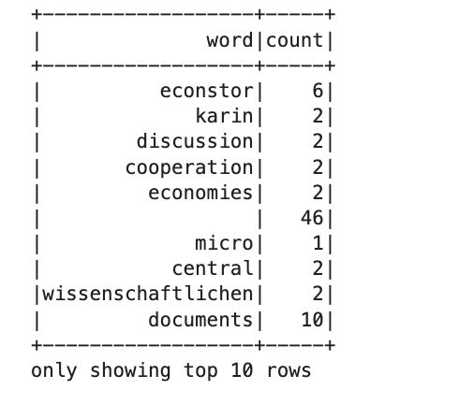
The Results

Slide 4
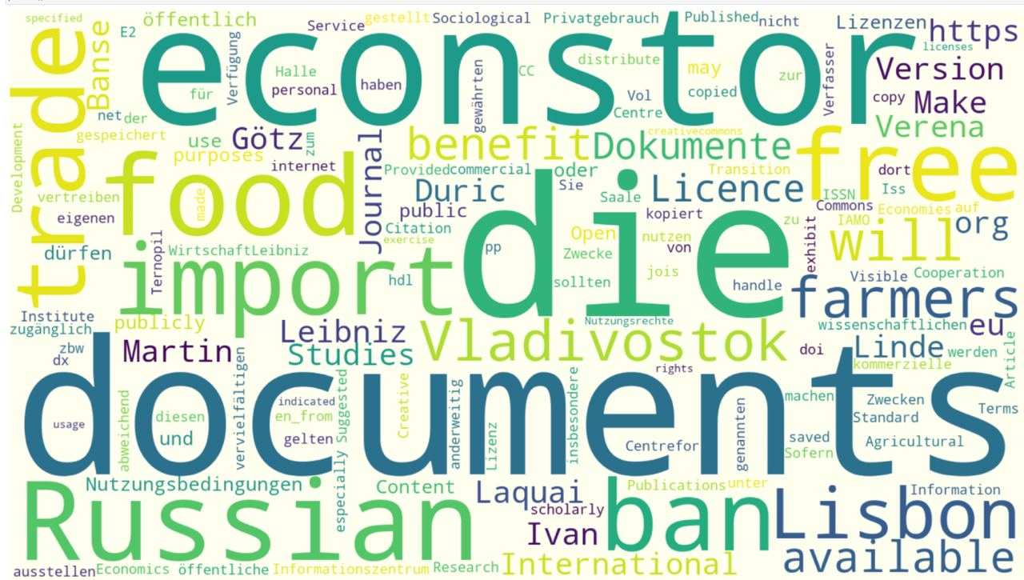
WordCloud

