Slide 1
Time Series Forecasting and Hypothesis Testing on Electricity Demand in United States
Sayak Kumar Dutta
Praxis Tech School
Roll: A23036

Slide 2
Table of contents
01
04
02
05
03
06
Objective
Time Series Forecasting
Hypothesis Testing
ARIMA and SARIMA Test Analysis & Interpretation
Hypothesis Test Analysis & Interpretation
Conclusion

Slide 3
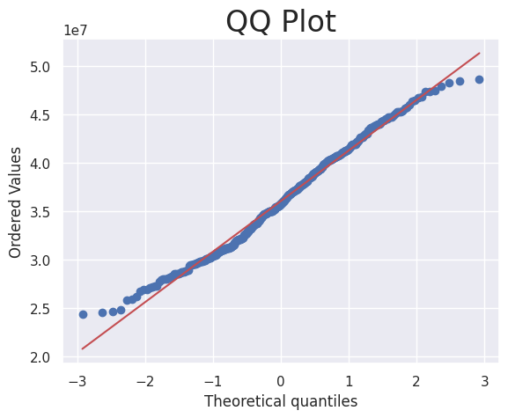
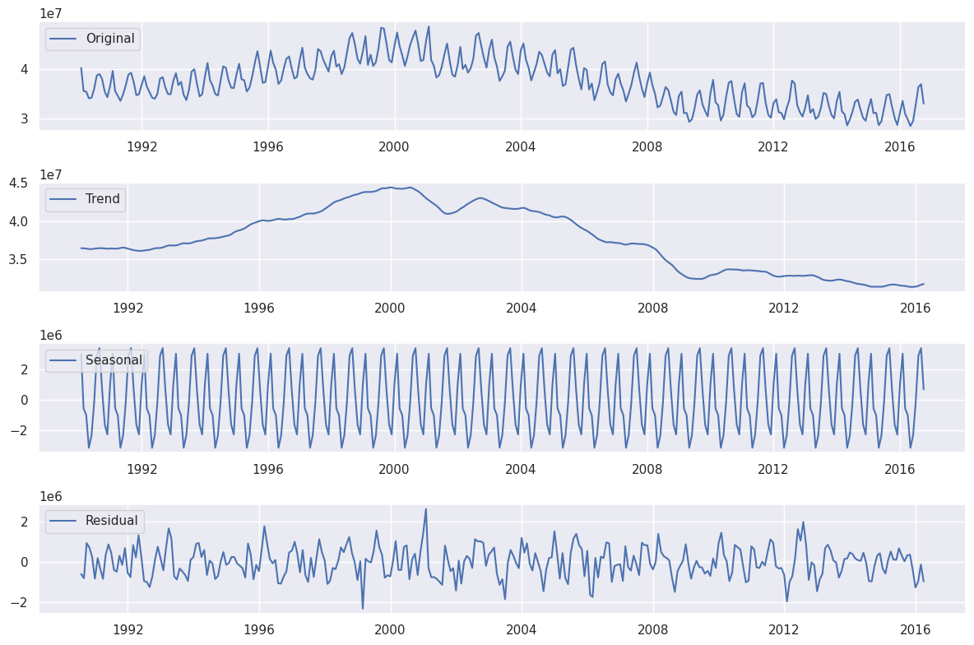
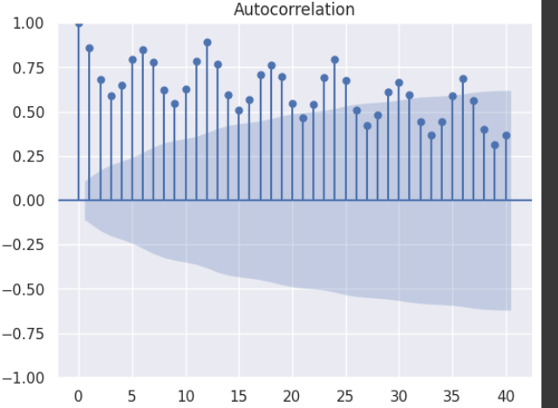
Objective of the Project
Our objective is to examine the data and hypotheses for precise future electricity demand predictions in the USA. Utilizing time series forecasting to optimize power distribution and strategize the implementation of new power sources.
AIM: To explore and predict month-wise electricity demand in the USA.
EDA Insights:
The dataset is normally distributed from QQ plot
The dataset has seasonality
Evidence Validation: ADF Hypothesis Testing & ACF plots validated the results
Data Source:https://www.eia.gov/electricity/data/state/

Slide 4
Hypothesis Testing
T-Test:
Null Hypothesis (H0): There is no significant difference in the mean 'Unit Generated' between two groups
Alternative Hypothesis (H1): There is a significant difference in the mean 'Unit Generated' between the groups.
Identified significant differences in electricity demand levels between two groups Total Power Unit generated in USA (from 1999 to 2009) and (from 2010 to 2020)
Output: T-statistic: 13.211182757799744, p-value: 1.9541992558764684e-29
We reject Null Hypothesis
Identified significant differences in mean electricity demand levels between two groups i.e Total Power Unit generated in USA (from 1999 to 2009) and (from 2010 to 2020) in two states and doing it for all states
Output: All p value <0.05
So, We don’t reject Null Hypothesis

Slide 5
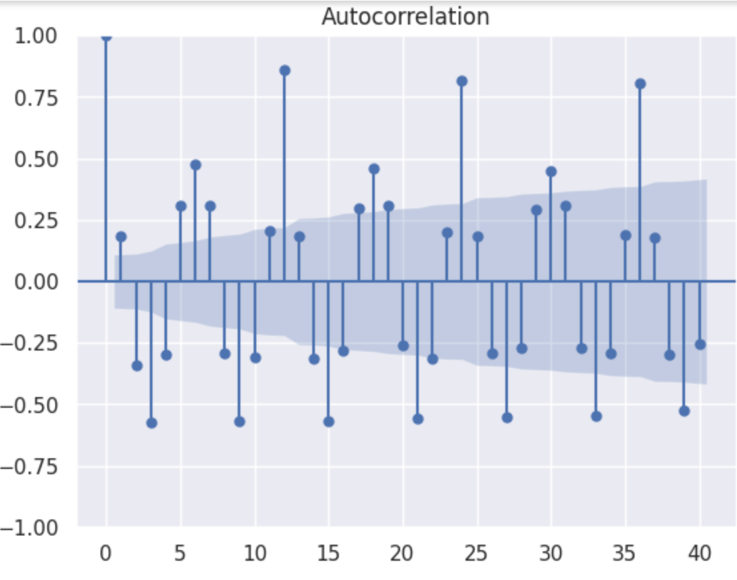
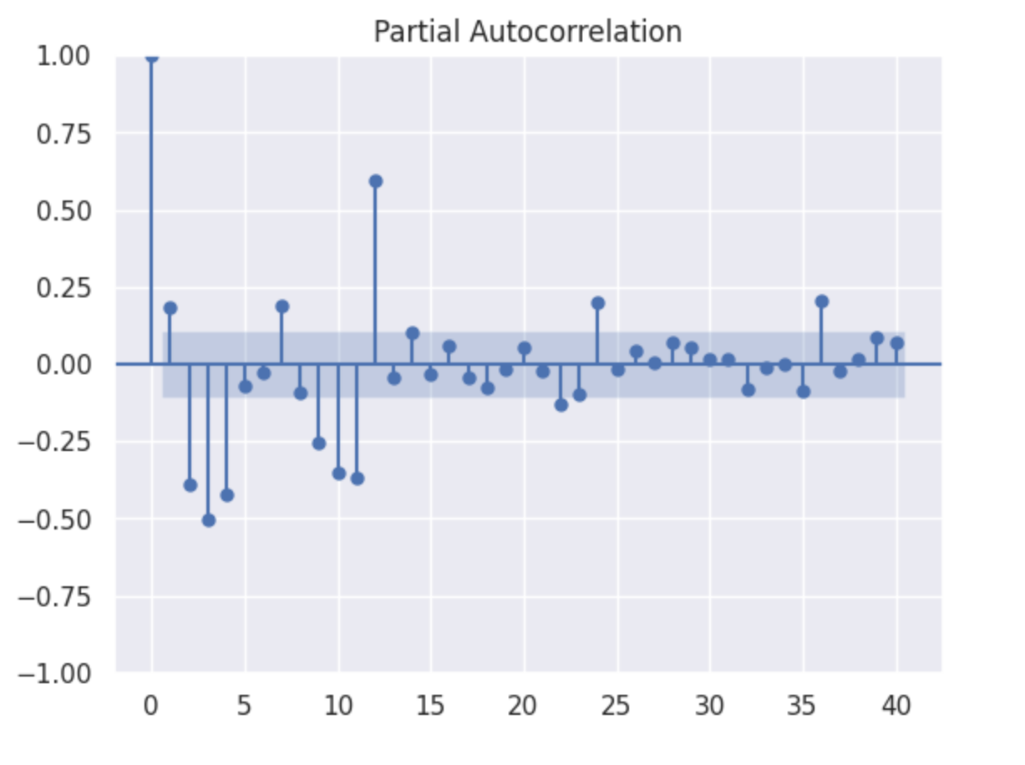
Time Series Forecasting
After Differencing ACF & PACF Plot
ADF TEST
Null Hypothesis (H0): The time series has a unit root, indicating it is non-stationary.
Alternative Hypothesis (H1): The time series does not have a unit root, indicating it is stationary.
Since significant so we do not find evidence of stationarity in dataset. p=0.69

Slide 6
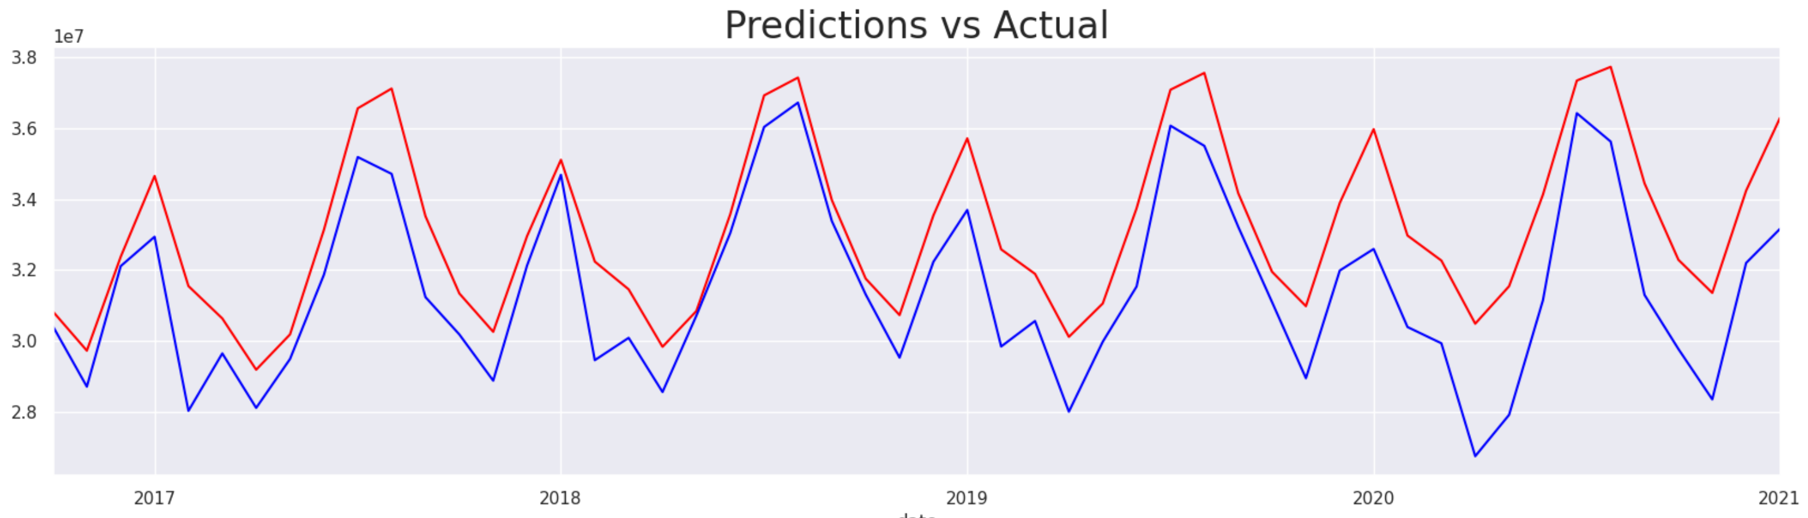
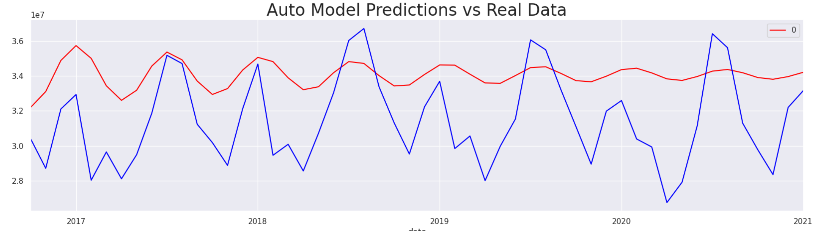
Forecasting Graph

Slide 7
Interpretation
Model Specification:
Model: SARIMAX(3, 1, 3) - This indicates the SARIMA model order. SARIMA(3,1,3) means you have a Seasonal Autoregressive Integrated Moving Average model with order (p=3, d=1, q=3).
Coefficients and Significance:
ar.L1, ar.L2, ar.L3: Autoregressive coefficients at lags 1, 2, and 3. Interpretation depends on context. Here, ar.L1 is positive but not statistically significant, ar.L2 is negative and not significant, and ar.L3 is negative and highly significant.
ma.L1, ma.L2, ma.L3: Moving average coefficients at lags 1, 2, and 3. Negative ma.L1 and ma.L3 are statistically significant.
sigma2: Estimated variance of the residuals. It seems quite large, possibly indicating volatility in the residuals.
Statistical Tests:
Ljung-Box (Q) Statistic: Tests whether there is serial correlation in the residuals. A high p-value (0.74) indicates that there is no significant autocorrelation up to lag 1.
Jarque-Bera (JB) Statistic: Tests whether the residuals are normally distributed. A high p-value (0.60) suggests that the residuals are approximately normally distributed.
Heteroskedasticity (H) Statistic: Tests whether the residuals exhibit changing variance over time. A p-value of 0.78 suggests no evidence of heteroskedasticity.

Slide 8
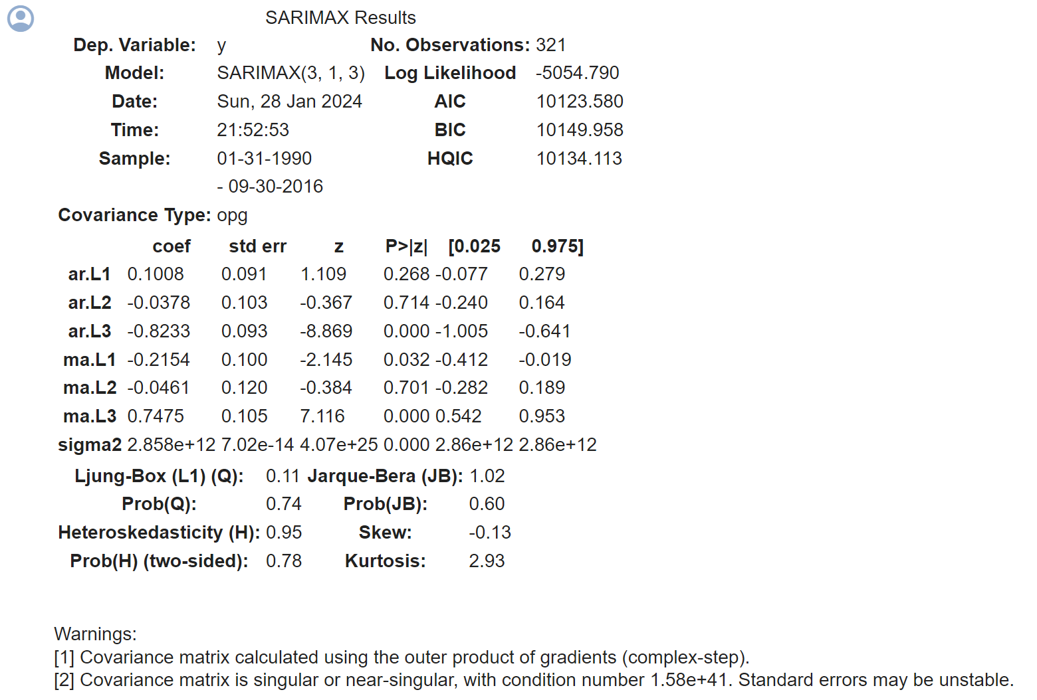
SARIMAX Results

Slide 9
Conclusion
The project's findings offer crucial insights into forecasting the energy demand of USA. We find the data fits the SARIMA model best because of seasonality. With these we can predict future values of energy demand thus optimizing total energy production.

Slide 10


