Slide 1

ĐỀ TÀI 17: BIN PACKING LOWER, UPPER BOUND
TỐI ƯU LẬP KẾ HOẠCH
THÀNH VIÊN:
VŨ DUY ANH – 20172951
VŨ TIẾN MỪNG – 20173261

Slide 2

NỘI DUNG
MÔ TẢ VẤN ĐỀ
4
MÔ HÌNH HÓA BÀI TOÁN
3
2
PHƯƠNG PHÁP GIẢI QUYẾT
1
NHẬN XÉT KẾT QUẢ
Notes:
Notes to presenter:
What steps will you be taking as a result of this learning experience?
Did you learn from any failed experiences? How will you do things differently?
What advice will you give to others so they can learn from your experiences?
How can you share what you learned with a real-world audience?
Some examples of next steps might be:
After delivering my first persuasive presentation, I am thinking about joining the debate team.
After making my first film, I’m considering entering it in our school film festival or local film festival.
After connecting with this career expert, I’d like to do some research on that career field because it sounds interesting to me.
This SmartArt allows you add images and text to help outline your process. If a picture is worth a thousand words, then pictures and words should help you communicate this reflection on learning perfectly! You can always click on Insert>SmartArt to change this graphic or select the graphic and click on the Design contextual menu to change the colors.
Feel free to use more than one slide to share your next steps. It also helps to add some video content to explain your message.

Slide 3
MÔ TẢ VẤN ĐỀ
Có N khách hàng
Mỗi khách hàng i có 1 lượng hàng d(i) trị giá tiền hàng là c(i)
Có K xe chuyển hàng
Mỗi xe k có trọng tải tối thiểu c1(k) và tối đa c2(k)
Yêu cầu:
Mỗi khách chỉ được giao bởi nhiều nhất 1 xe
Tổng lượng hàng trên xe phải nằm trong giới hạn tối thiểu và tối đa của tải trọng xe.
Sắp xếp sao cho tổng số tiền hàng thu được là lớn nhất.
Notes:
Notes to presenter:
What steps will you be taking as a result of this learning experience?
Did you learn from any failed experiences? How will you do things differently?
What advice will you give to others so they can learn from your experiences?
How can you share what you learned with a real-world audience?
Some examples of next steps might be:
After delivering my first persuasive presentation, I am thinking about joining the debate team.
After making my first film, I’m considering entering it in our school film festival or local film festival.
After connecting with this career expert, I’d like to do some research on that career field because it sounds interesting to me.
This SmartArt allows you add images and text to help outline your process. If a picture is worth a thousand words, then pictures and words should help you communicate this reflection on learning perfectly! You can always click on Insert>SmartArt to change this graphic or select the graphic and click on the Design contextual menu to change the colors.
Feel free to use more than one slide to share your next steps. It also helps to add some video content to explain your message.

Slide 4

MÔ HÌNH HÓA
Biến:
X(i,k) = 1: khách hàng i được giao hàng bởi xe k và ngược lại
i = 0,1,…,N-1
k = 0,1,..,K-1
y: số tiền hàng lớn nhất thu được.
Miền giá trị:
D(X(i,k)) = {0,1}
D(y) = {0,1,…, $\sum_{i=0}^{N−1}{c\left(i\right)\}}$
Notes:
Notes to presenter:
What steps will you be taking as a result of this learning experience?
Did you learn from any failed experiences? How will you do things differently?
What advice will you give to others so they can learn from your experiences?
How can you share what you learned with a real-world audience?
Some examples of next steps might be:
After delivering my first persuasive presentation, I am thinking about joining the debate team.
After making my first film, I’m considering entering it in our school film festival or local film festival.
After connecting with this career expert, I’d like to do some research on that career field because it sounds interesting to me.
This SmartArt allows you add images and text to help outline your process. If a picture is worth a thousand words, then pictures and words should help you communicate this reflection on learning perfectly! You can always click on Insert>SmartArt to change this graphic or select the graphic and click on the Design contextual menu to change the colors.
Feel free to use more than one slide to share your next steps. It also helps to add some video content to explain your message.

Slide 5

MÔ HÌNH HÓA
Ràng buộc:
Mỗi khách chỉ được giao bởi nhiều nhất 1 xe:
$\sum_{k=0}^{K−1}{X\left(i,k\right)≤1}∀ i⋹N$.
Mỗi xe k có trọng tải tối thiểu c1(k) và tối đa c2(k):
c1(k) $≤ \sum_{i=0}^{N−1}{X\left(i,k\right).d\left(i\right)≤c2\left(k\right)}$
Hàm mục tiêu:
y = $\sum_{i=0}^{N−1}{\sum_{k=0}^{K−1}{X\left(i,k\right).c\left(i\right)→max }}$
Notes:
Notes to presenter:
What steps will you be taking as a result of this learning experience?
Did you learn from any failed experiences? How will you do things differently?
What advice will you give to others so they can learn from your experiences?
How can you share what you learned with a real-world audience?
Some examples of next steps might be:
After delivering my first persuasive presentation, I am thinking about joining the debate team.
After making my first film, I’m considering entering it in our school film festival or local film festival.
After connecting with this career expert, I’d like to do some research on that career field because it sounds interesting to me.
This SmartArt allows you add images and text to help outline your process. If a picture is worth a thousand words, then pictures and words should help you communicate this reflection on learning perfectly! You can always click on Insert>SmartArt to change this graphic or select the graphic and click on the Design contextual menu to change the colors.
Feel free to use more than one slide to share your next steps. It also helps to add some video content to explain your message.

Slide 6

CÁC HƯỚNG GIẢI QUYẾT
OR-TOOLS
01
02
CHOCO
OPENCBLS
03
Notes:
Notes to presenter:
What did you think at first?
What obstacles did you encounter along the way?
How did you overcome those obstacles?
What images can you add to support your process?
This SmartArt allows you add images and text to help outline your process. If a picture is worth a thousand words, then pictures and words should help you communicate this reflection on learning perfectly! You can always click on Insert>SmartArt to change this graphic or select the graphic and click on the Design contextual menu to change the colors.
Feel free to use more than one slide to reflect upon your process. It also helps to add some video of your process.

Slide 7

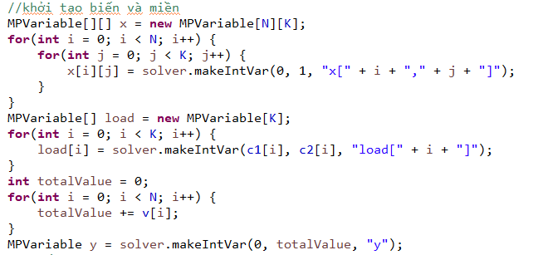
OR-TOOLS
Khởi tạo biến và miền
Notes:
Notes to presenter:
Description of what you learned in your own words on one side.
Include information about the topic
Details about the topic will also be helpful here.
Tell the story of your learning experience. Just like a story there should always be a beginning, middle and an end.
On the other side, you can add a graphic that provides evidence of what you learned.
Feel free to use more than one slide to reflect upon your process. It also helps to add some video of your process.

Slide 8
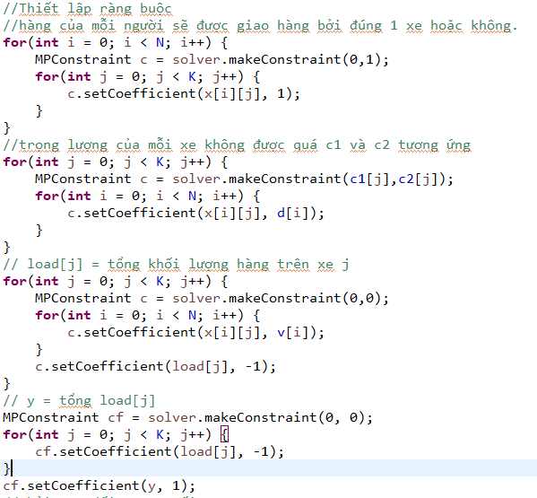
OR-TOOLS
Thiết lập các ràng buộc
Notes:
Notes to presenter:
Description of what you learned in your own words on one side.
Include information about the topic
Details about the topic will also be helpful here.
Tell the story of your learning experience. Just like a story there should always be a beginning, middle and an end.
On the other side, you can add a graphic that provides evidence of what you learned.
Feel free to use more than one slide to reflect upon your process. It also helps to add some video of your process.

Slide 9
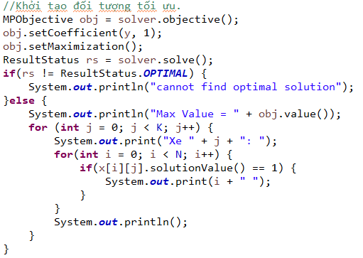
OR-TOOLS
Khởi tạo đối tượng tối ưu
Notes:
Notes to presenter:
Description of what you learned in your own words on one side.
Include information about the topic
Details about the topic will also be helpful here.
Tell the story of your learning experience. Just like a story there should always be a beginning, middle and an end.
On the other side, you can add a graphic that provides evidence of what you learned.
Feel free to use more than one slide to reflect upon your process. It also helps to add some video of your process.

Slide 10
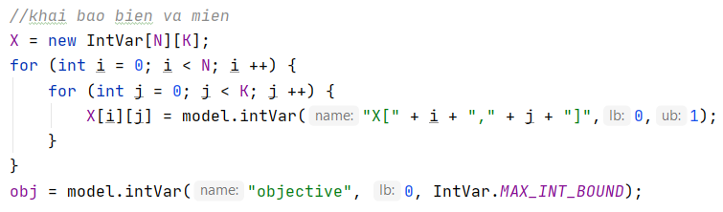
Choco-solver
Khai báo biến và miền
Notes:
Notes to presenter:
Description of what you learned in your own words on one side.
Include information about the topic
Details about the topic will also be helpful here.
Tell the story of your learning experience. Just like a story there should always be a beginning, middle and an end.
On the other side, you can add a graphic that provides evidence of what you learned.
Feel free to use more than one slide to reflect upon your process. It also helps to add some video of your process.

Slide 11
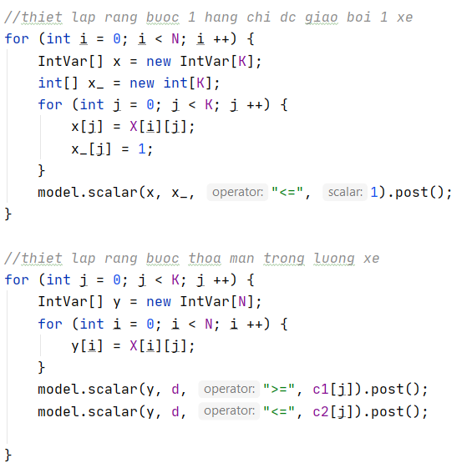
Choco-solver
Thiết lập các rằng buộc
Notes:
Notes to presenter:
Description of what you learned in your own words on one side.
Include information about the topic
Details about the topic will also be helpful here.
Tell the story of your learning experience. Just like a story there should always be a beginning, middle and an end.
On the other side, you can add a graphic that provides evidence of what you learned.
Feel free to use more than one slide to reflect upon your process. It also helps to add some video of your process.

Slide 12
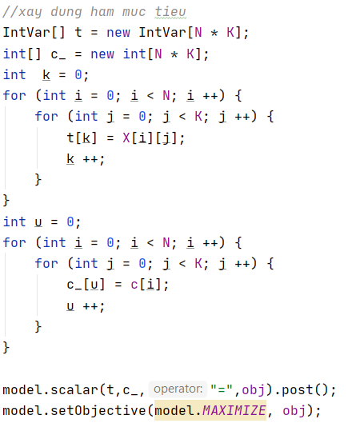
Choco-solver
Xây dựng hàm mục tiêu
Notes:
Notes to presenter:
Description of what you learned in your own words on one side.
Include information about the topic
Details about the topic will also be helpful here.
Tell the story of your learning experience. Just like a story there should always be a beginning, middle and an end.
On the other side, you can add a graphic that provides evidence of what you learned.
Feel free to use more than one slide to reflect upon your process. It also helps to add some video of your process.

Slide 13
Localsearch
Việc khởi tạo biến và các rằng buộc cũng tương tự như Choco
Chiến lược tìm kiếm: Kết hợp đồng thời các rằng buộc và mục tiêu thành một hàm duy nhất điều khiển tìm kiếm
Notes:
Notes to presenter:
Description of what you learned in your own words on one side.
Include information about the topic
Details about the topic will also be helpful here.
Tell the story of your learning experience. Just like a story there should always be a beginning, middle and an end.
On the other side, you can add a graphic that provides evidence of what you learned.
Feel free to use more than one slide to reflect upon your process. It also helps to add some video of your process.

Slide 14
Kết quả và nhận xét
Template Editing Instructions and Feedback
N - K | Or-tool Obj – time | Choco-solver Obj - time | Localsearch Obj - time
10 – 5 | 797 – 0.03s | 738 – 0.3s | 797 – 0.03s
50 – 5 | 1179 – 23s | 1907 – 0.06s | 1031 – 0.05s
30 – 10 | 2216 – 200s | 2071 – 0.06s | 1636 – 0.08s
100 – 70 | 10151 – 0.8s | 9293 – 4.8s | 10151 – 1.5s
200 - 100 | 19152 – 60s | 15944 – 68s | 19152 – 9s

Slide 15
Kết quả và nhận xét
O
Nhận xét:
Về kết quả tối ưu:
- Or-tools và LocalSearch cho kết quả tương đương nhau và tối ưu hơn so vơi Choco.
- Kết quả của LocalSearch là thay đổi trong khoảng gần đúng.
Về thời gian chạy:
- Thời gian chạy trung bình của Or-toos là 72s, Choco là 14s, LocalSearch 3s.
- Ta thấy thời gian chạy của LocalSearch là nhanh hơn hẳn so với phần còn lại.

Slide 16
Kết quả và nhận xét
O
Kết luận:
Nếu cần một thuật toán cho kết quả gần tối ưu thì nên dung LocalSearch vì có thời gian tính nhanh.
Nếu cần một thuật toán cho kết quả tối ưu chính xác thì nên dùng Or-Tools.

Slide 17


