Slide 1


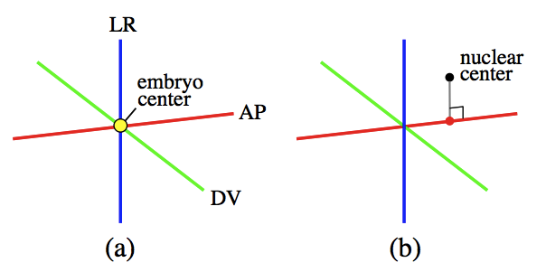
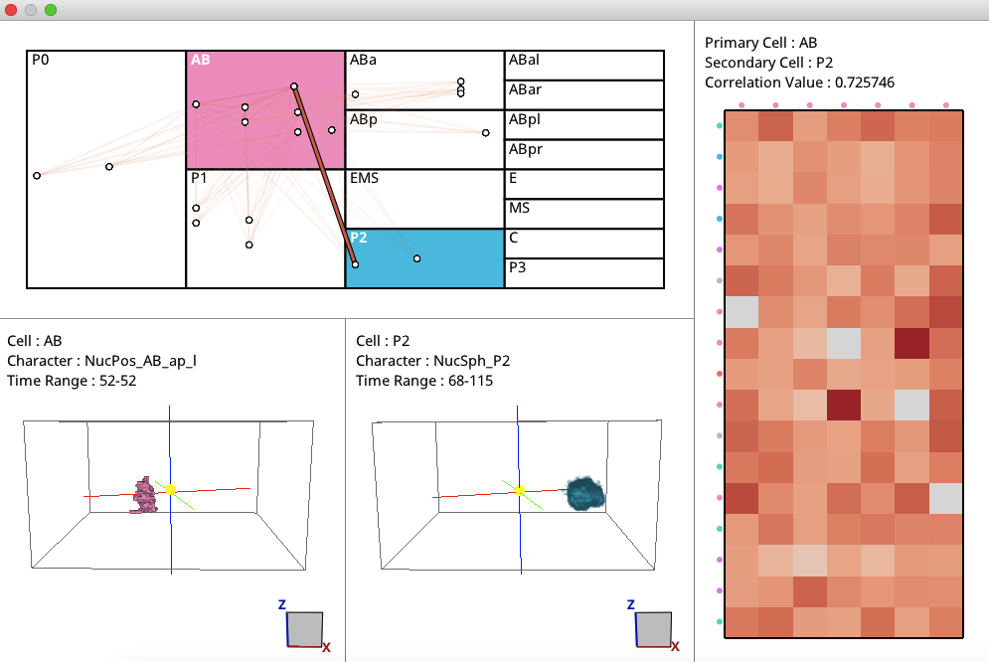
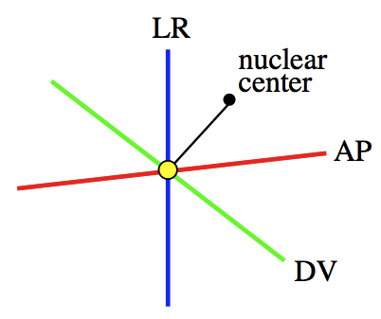
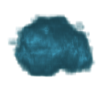
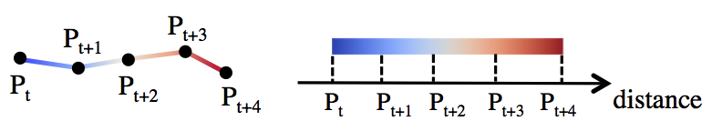
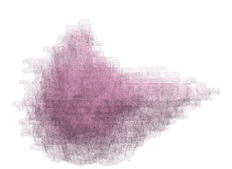
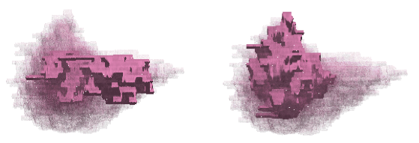

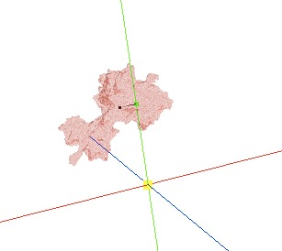
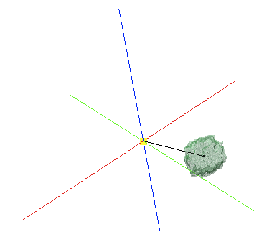
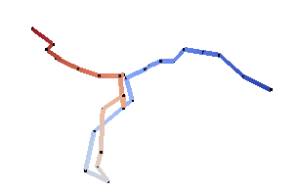

Cell nucleus visualization
with phenotypic characteristics
Sayaka Nagai, Naohisa Sakamoto（Kobe University）
Koji Kyoda, Shuichi Onami（Laboratory for Developmental Dynamics, RIKEN Quantitative Biology Center）
Introduction
Represetation of phenotypic characteristics
Nuclear position
Draw AP, DV and LR axes.
Plot an embryo and
a nuclear center.
Draw the foot of the
perpendicular.
Elucidation of biological mechanism of C.elegans.
Phenotypic characteristic
ー Spatiotemporal features
of a cell.
(ex. Cell nuclear position,
movement distance)
Distance between a nuclear center and an emryo center
Draw AP, DV and LR axes.
Connect a nuclear center and an embryo center.
Cell nucleus
visualization
Time range:68-115
→ cell nucleus shapes are overlapped.
S.Nagai, N.Sakamoto, Development of a visual analytics system for cell division dynamics in early C.elegans embryos,
SIGGRAPH ASIA Symposium on Visualization (SA17), 2017
Movement distance of a cell nucleus
Problem
We cannot observe an individual shape.
It is necessary to observe a time change of cell nucleus shapes.
It is difficult to compare phenotypic characteristics (ex. position and distance) only from cell nucleus shapes.
Connect cell nuclear centers.
(P_{t} is the position of a cell nucleus at the time step t.)
→A cell nucleus moves from blue to red.
Objective
Result
Animation of cell nucleus shapes over several time steps.
Improving representation of phenotypic characteristics
(position and distance).
Animation of cel nucleus shapes
"Movement distance of AB nucleus” (27 time steps)
Method
overlapped
t=3
t=23
Animation of cel nucleus shapes
Represetation of phenotypic characteristics
A cell nucleus shape with
a phenotypic chatacteristic
changes over time.
"DV position of
ABp nucleus"
"Distance between
nuclear center and
EMS embryo center"
"Movement distance
of AB nucleus"
|
t
An overlapped shape
All the cell nuclei are overlapped
with a constant opacity .
Select time step t
Conclusion
Opacity animation of
cell nucleus shapes
A cell nucleus at t th step → Opaque
Other ones → lower opacity
Detailed cell nucleus shape changes could be observed by the interactive opacity animation.
Representations of cell nuclear position and distance are helpful for comparison of two phenotypic characteristics.
IEEE Pacific Visualization Symposium (PacificVis 2018) Kobe, Japan April 10 to 13, 2018

