Slide 1
Time Series Analysis
Bhubaneswar Temperature Forecast
Submitted By
Sayak Hatui 2105236
Anulipi Jana 21051974
Anurupa Saha 21051975
Adarsh Mishra 21053250
Submitted To
Dr. Soumya Ranjan Mishra

Slide 2
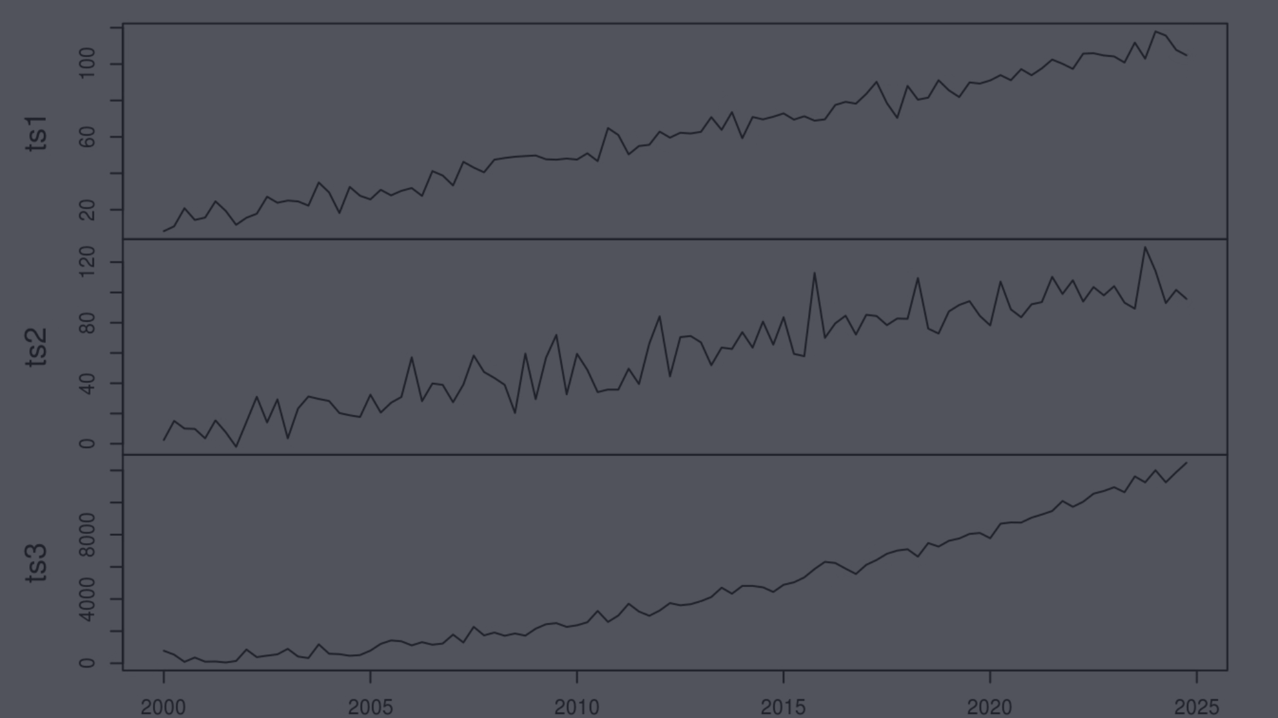
OUTLINE
1
Introduction
5
Stationarity Check
5.1
Augmented Dickey-Fuller (ADF) Test
2
Dataset
5.2
KPSS (Kwiatkowski-Phillips-Schmidt-Shin) Test
3
Data Cleaning
6
Time Series Modeling
3.1
Null Value Check and Drop.
6.1
SARIMAX
3.2
Set Outliers
6.2
LSTD
7
Result & Analysis
3.3
Handle missing values.
4
8
Challenges & Consideration
Data Visualization
9
Reference

Slide 3
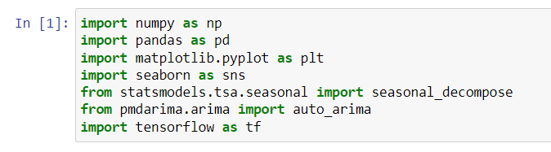
INTRODUCTION
1.1
Goal
The primary objective of this project is to leverage time series analysis techniques to forecast temperature trends in a city
1.2
Definition
Time series analysis comprises methods for analyzing time series data in order to extract meaningful statistics and other characteristics
of the data to create a model to predict future values based on previously observed values
1.3
Importance Of Temperature Forecasting
Temperature forecasting plays a critical role in numerous sectors, including agriculture, energy management, and urban planning.
1.4
Real-World Applications
Used for non-stationary data, like economic, weather, stock price, and retail sales in this post.
1.5
Imported Libraries
1.6
Using Models
SARIMA , LSTM

Slide 4
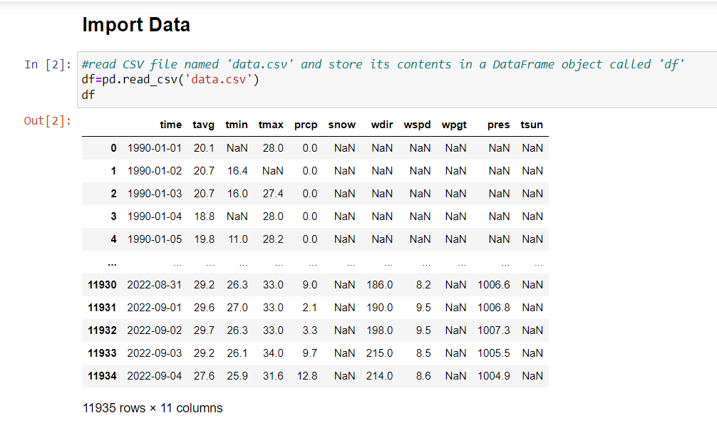
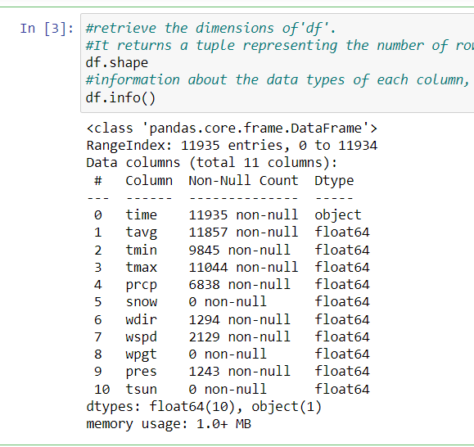
DATASET
The dataset used in this project contains historical surface temperature data for Bhubaneswar from the year 1990 upto 2022. It includes monthly average temperature readings over a certain period.
This data was taken from Berkeley Earth Data page: https://github.com/AdArSh-1101/Temperature_Forecasting/blob/main/data.csv
Number of row and column : 11935 X 11

Slide 5
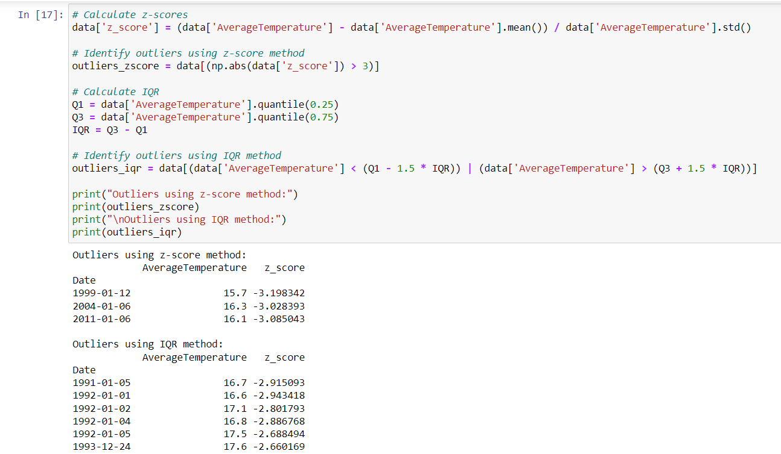
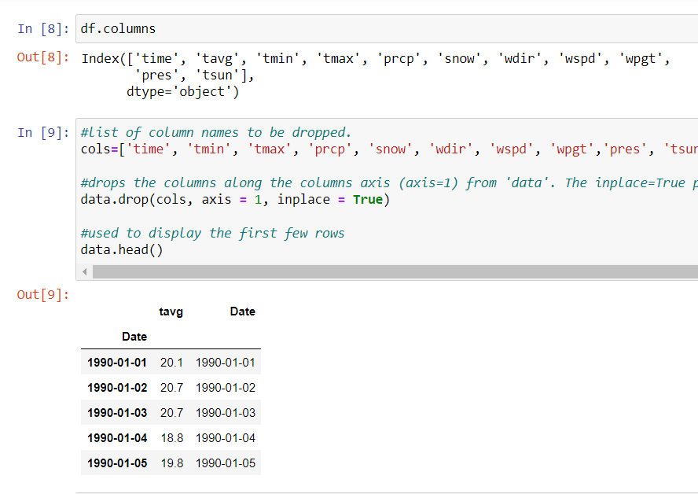
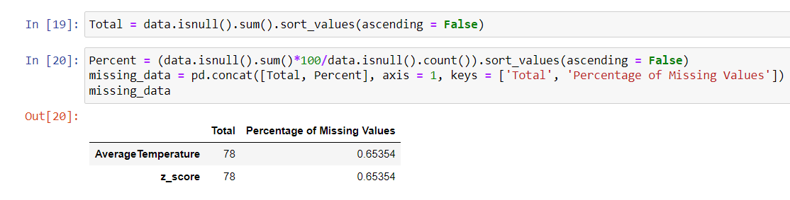
DATA PRE-PROCESSING
3.1
Null Values Check & Drop
3.3
Handle Missing Values
In data set there are 11 column , but all column are not necessary . So, drop those columns for better performance in further steps.
It’s crucial to identify and address missing entries in your surface temperature data before proceeding with model building
3.2
Set Outliers
Outliers are data points that deviate significantly from the overall pattern of the data.
For detection use Z-Score , IQR technique .
Shows dates with temperatures corresponding to z-scores below a certain threshold (-3), indicating potential outliers on the colder side.
The table highlights several dates with temperatures falling outside the IQR range, suggesting possible outliers.

Slide 6
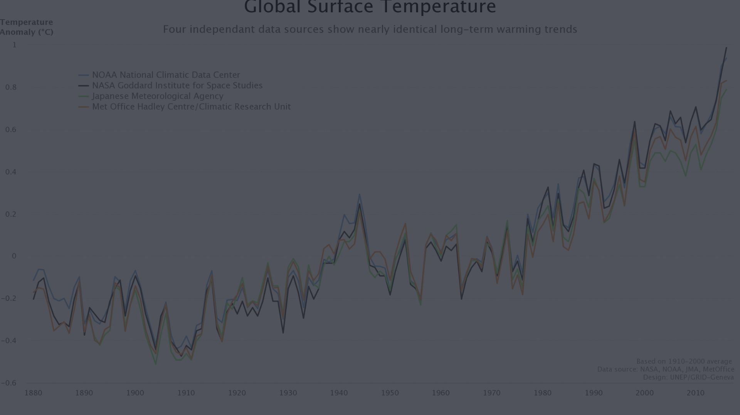
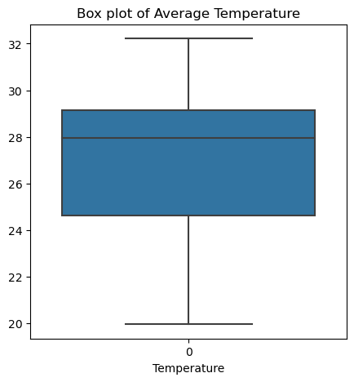
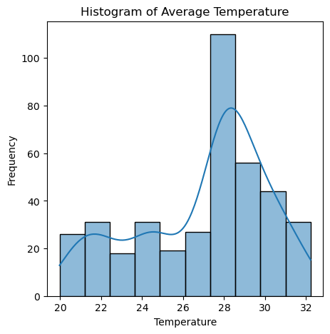
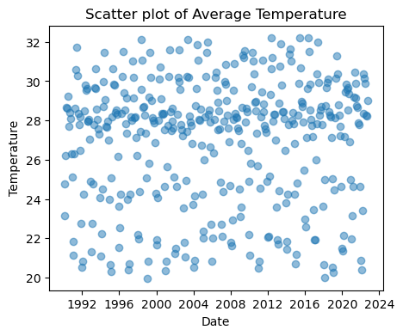
DATA VISUALIZATION
To conduct Exploratory Data Analysis (EDA) on temperature data, we can use various visualization techniques such as line plots, histograms, and box plots to understand the distribution, patterns, anomalies, trends, and seasonality in the data.
Box plots can provide insights into the central tendency and variability of temperature data and help detect outliers
Histograms can show us the distribution of temperature values and help identify any outliers or unusual patterns.
It displays individual data points as dots on a two-dimensional plane. Scatter plots are useful for identifying patterns, trends, correlations, and outliers in the data.

Slide 7
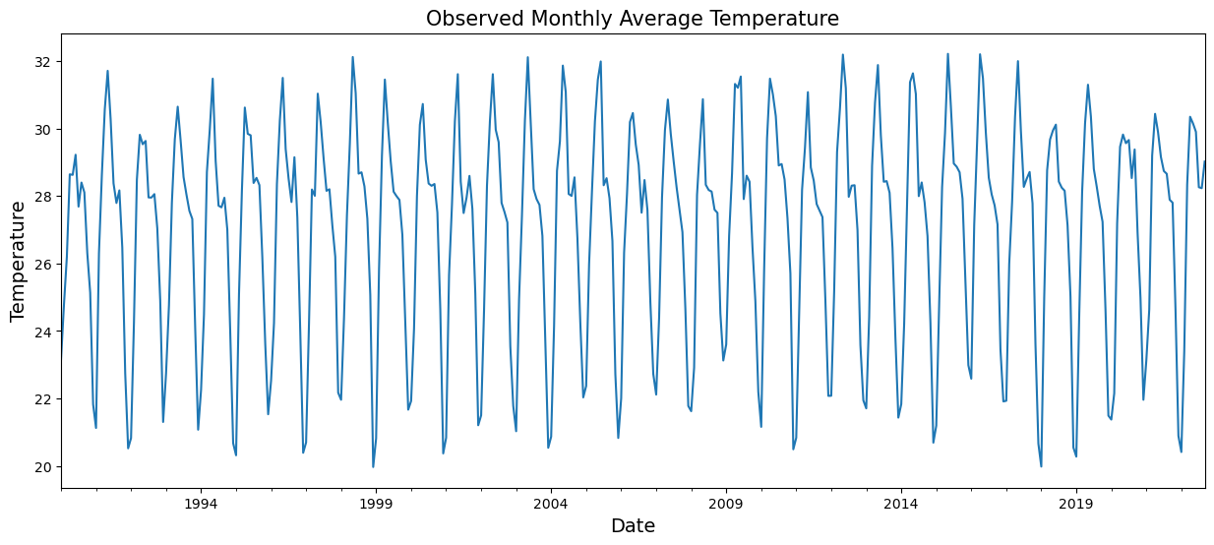
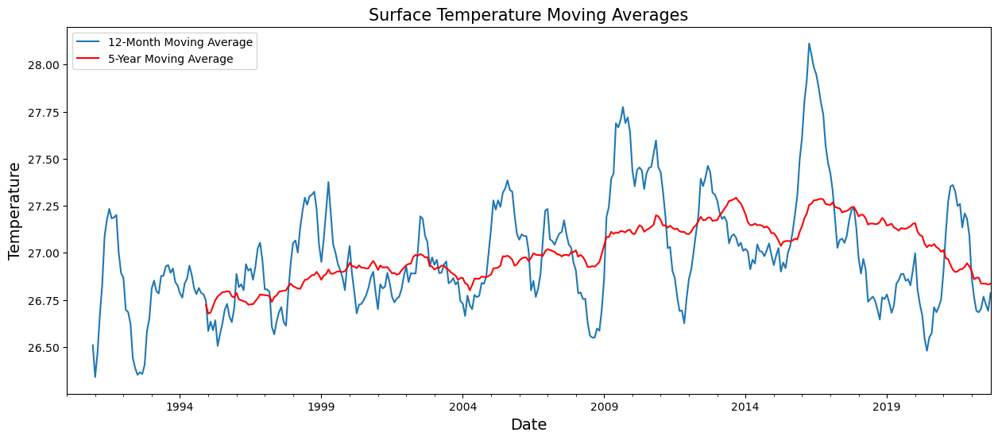
DATA VISUALIZATION
Monthly Average Temperature
From this graph, we can infer that the temperature ranges between 20°C and 32°C.
Surface Temperature Moving Average
We can observe a significant increase in temperature between the years 2014 and 2019 in this graph.

Slide 8
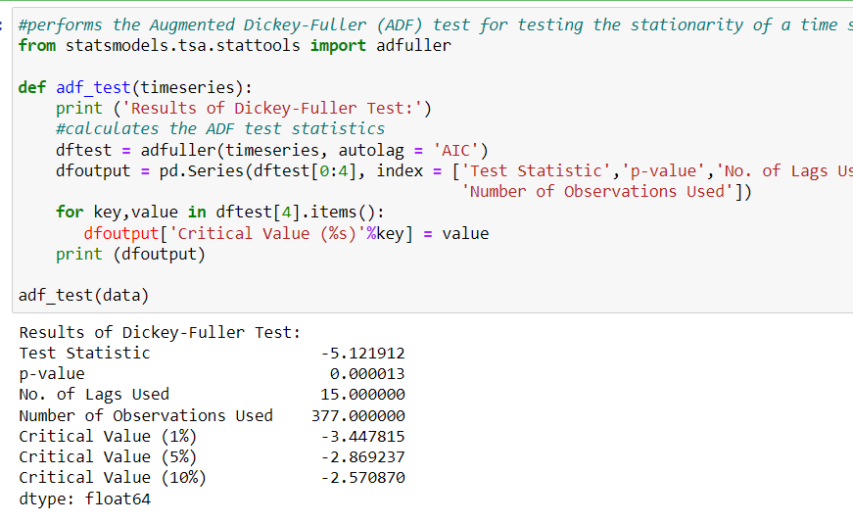
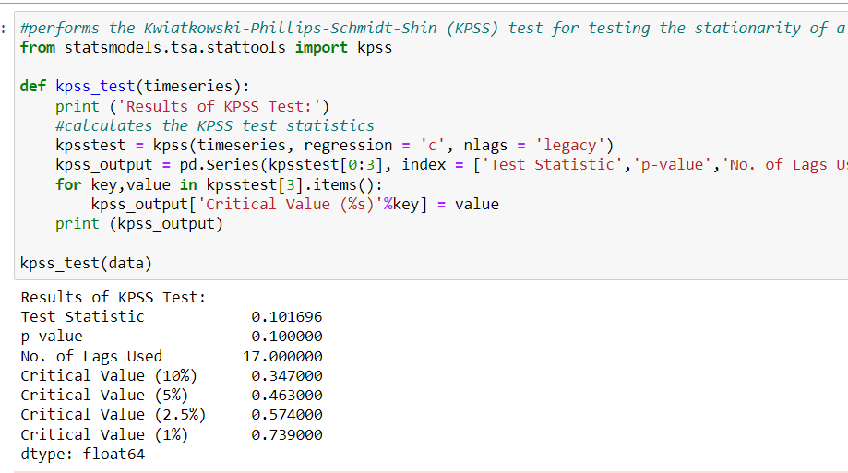
STATIONARITY CHECK
Stationarity in data refers to a property where the statistical properties of a time series dataset, such as mean, variance, and autocorrelation, remain constant over time.
If the data is non-stationary, it may need to be transformed to achieve stationarity before applying certain models
To check whether the time series is stationary or non-stationary we use
Augmented Dickey-Fuller (ADF) Test
Kwiatkowski-Phillips-Schmidt-Shin (KPSS) Test
The presence of a unit root in a time series indicates non-stationarity.
If the p-value is less than a chosen significance level (e.g., 0.05), the null hypothesis of a unit root is rejected, suggesting stationarity.
Accepting the alternative hypothesis of stationarity enables the use of modeling techniques like ARIMA for further analysis.
The KPSS test complements the ADF test by assessing if a time series is trend-stationary or difference-stationary.
It helps distinguish between stationary data around a deterministic trend (null hypothesis) and non-stationary data with a unit root (alternative hypothesis), aiding in accurate time series modeling and forecasting.

Slide 9

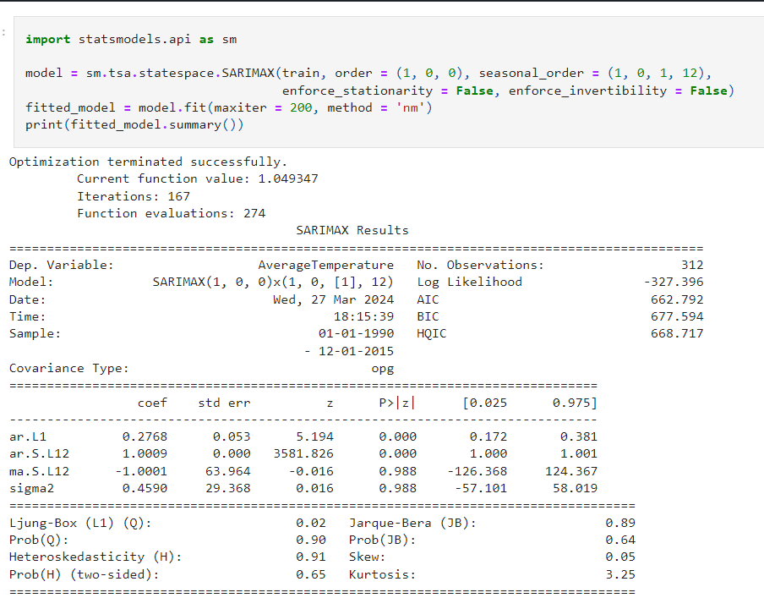
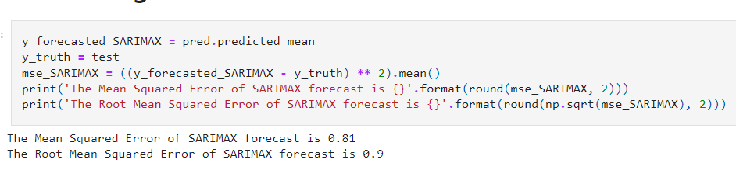
TIME SERIES MODELING
6.1
SARIMAX
S : Seasonal component that captures seasonal patterns in the data.
AR : AutoRegressive terms represent the dependence of the current observation on previous observations.
I : Integrated term denotes differencing to make the time series stationary.
MA : Moving Average terms account for the dependency between an observation and a residual error from a moving average model.
X : Exogenous variables that are external factors influencing the time series.
Training SARIMAX Model
Evaluating SARIMAX Model
The RMSE tells us that the SARIMAX model was able to forecast the monthly average temperature within 0.9°C of the true temperature.

Slide 10
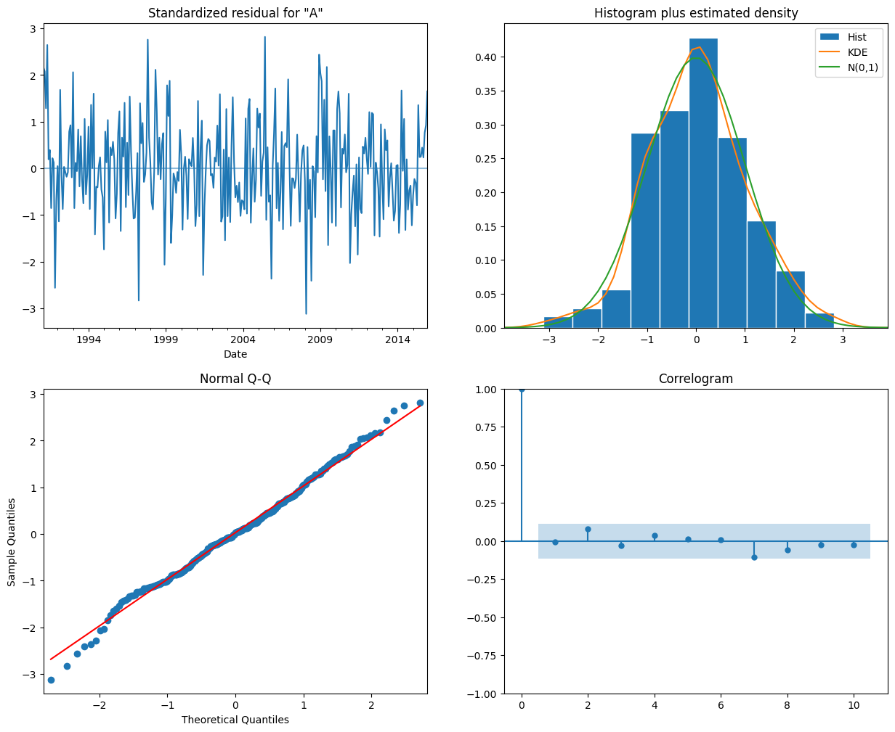
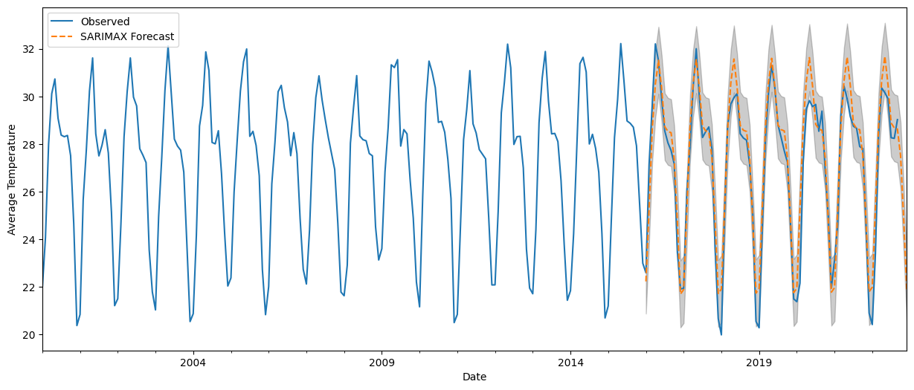
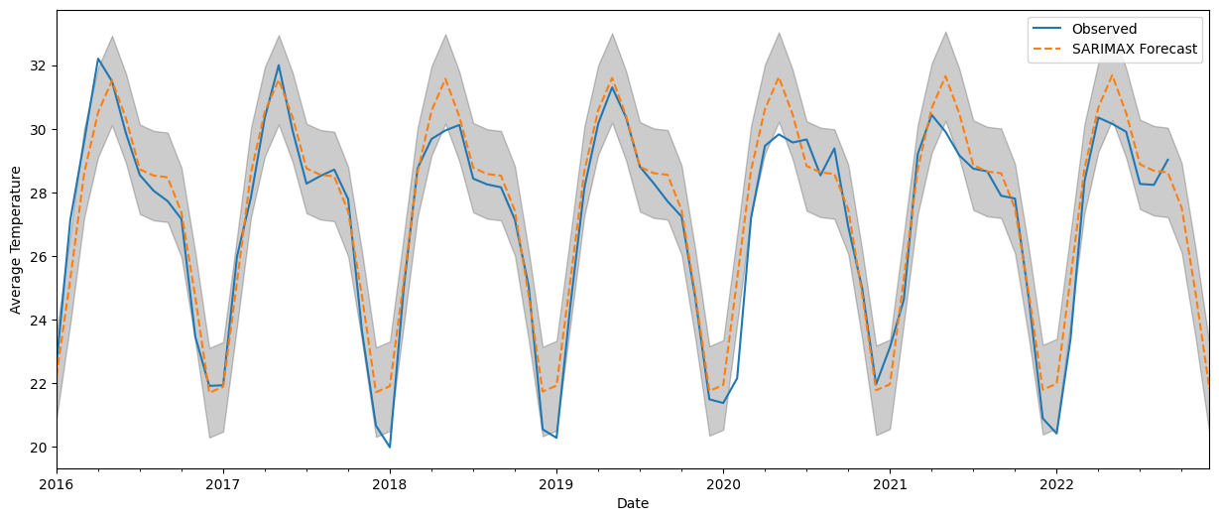
TIME SERIES MODELING
Plotting Diagnosis
Model Forecasting
Zoom Forecasting
As seen through the histogram and the Normal Q-Q, the residuals are normally distributed and the correlogram confirms that there's insignificant autocorrelation present in the residuals.

Slide 11
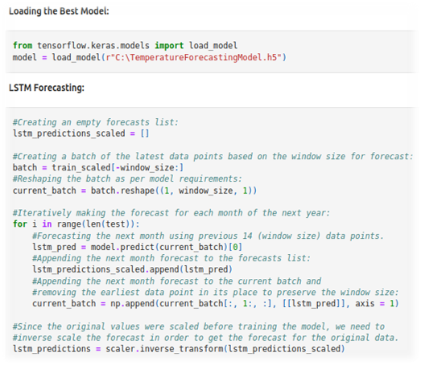
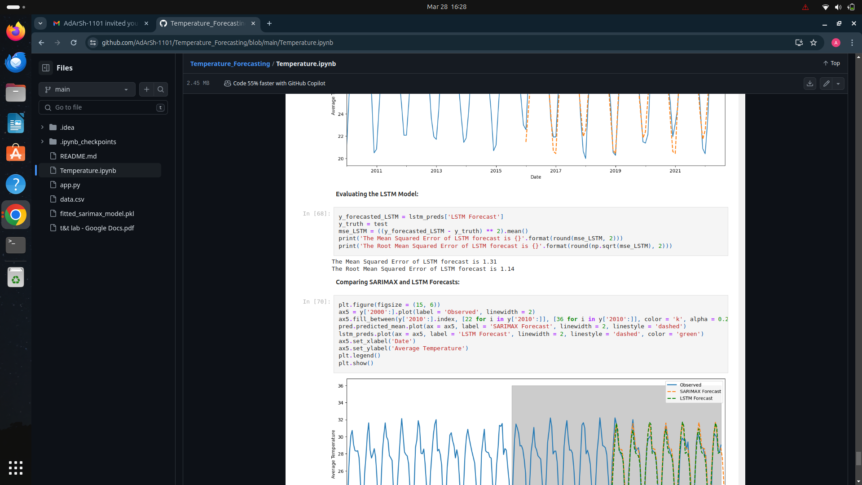
TIME SERIES MODELING
6.2
LSTM
L : Long
ST: Short-term
M: Memory
Training LSTM Model
Evaluating LSTM Model
The RMSE tells us that the LSTM model was able to forecast the monthly average temperature within 1.14°C of the true temperature.

Slide 12
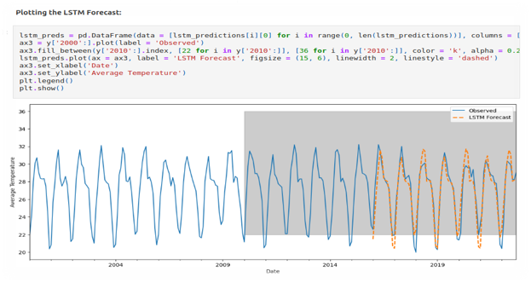
TIME SERIES MODELING
Plotting LSTM Forecasting

Slide 13
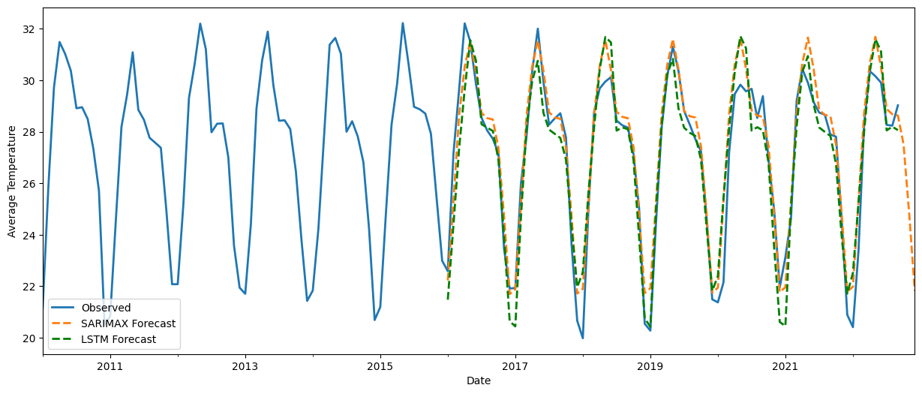
RESULT & ANALYSIS
The accuracy of both the SARIMAX and LSTM models was evaluated using Mean Squared Error (MSE) and Root Mean Squared Error (RMSE).
The SARIMAX Model had an RMSE value of 0.9 whereas the LSTM model had an RMSE value of 1.14.
The SARIMAX model outperforms the LSTM model in predicting monthly average surface temperatures in Bhubaneswar, India, showing lower RMSE, tighter confidence intervals, and improved alignment with observed trends.

Slide 14
CHALLENGES
Missing Data
Non-stationarity
Outliers
External Factors
Temperature data can have gaps due to instrument malfunctions or extreme weather events.
These missing values can introduce errors in model fitting and forecasting.
Temperatures can exhibit trends (warming/cooling) and seasonal variations.
Models struggle with data that isn't statistically constant over time.
Extreme weather events can create outliers in the data, which can skew the model and lead to inaccurate forecasts.
Factors like urban heat islands or changes in land cover can influence local temperatures and need to be accounted for in the model.

Slide 15



Considerations for Effective Modeling
Data Preprocessing
Address missing data using techniques like interpolation or imputation.
Stationarity Transformation
Detrending (removing long-term trends) or differencing (focusing on changes between data points) can make the data more
stationary for modeling.
Outlier Detection and Handling
Identify and potentially remove outliers with minimal impact on the overall data or use robust statistical methods less sensitive to outliers.

Slide 16

REFERENCE
https://github.com/miladbehrooz/Timeseries_Analysis_Temperature
https://github.com/imkhoa99/Time-Series-Analysis-and-Weather-Forecast-
https://www.kaggle.com/code/ameykamble/time-series-analysis-using-temperature-data

Slide 17

THANK YOU

