Slide 1
Project Title: ATM Surface Simulation
Group Members
Sr.No | Name | Roll No
1 | Varada Vitthal Pawar | 27
2 | Sayali Tatyaso Dabade | 33
3 | Virendra Vilas Katale | 41
4 | Prajval Madhukar Bhatale | 42

Slide 2
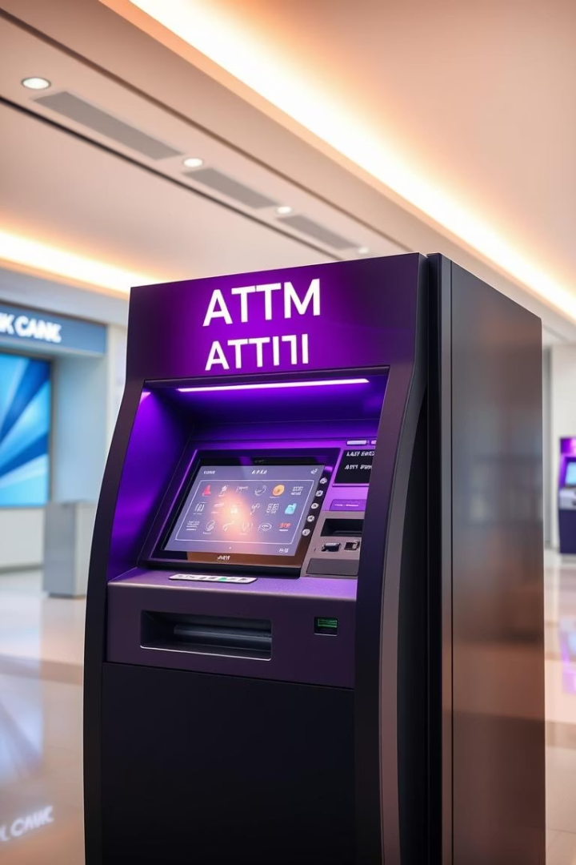
ATM Surface Simulation
This presentation explores the simulation of an ATM surface, designed to replicate the core functionalities of a real Automated Teller Machine in a virtual environment. The primary objective is to create a user-friendly interface that enables users to perform basic banking operations such as PIN authentication, balance inquiry, cash withdrawal, and mini-statement generation without physical interaction. This simulation serves educational, training, and prototyping purposes, offering a safe and efficient way to understand ATM operations.

Slide 3
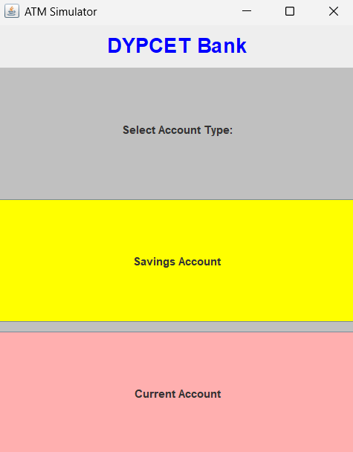
Project Objectives
User Interaction
Simulate realistic ATM screen interactions and inputs.
Security Features
Implement secure transactions and user authentication mechanisms.
System Accuracy
Ensure realistic cash handling and balance updates.
User Experience
Create an intuitive and responsive ATM interface.

Slide 4
System Architecture
Frontend
Backend
Database
Graphical user interface simulating ATM screens and input devices.
Processes transactions, validates input, and controls cash dispensing logic.
Stores user data, account balances, and transaction history securely.

Slide 5
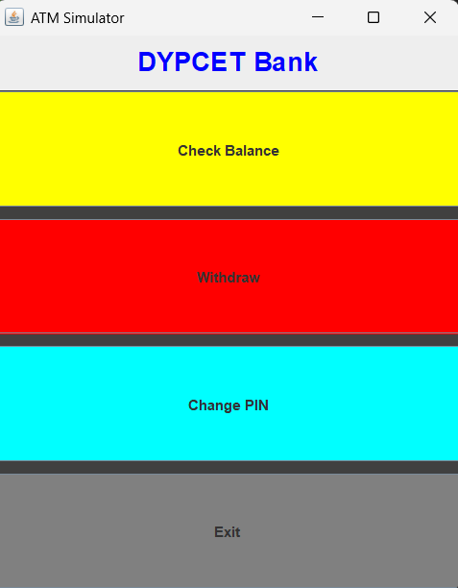




Working of the System
Start
User inserts card or selects account option on screen.
Authentication
System requests PIN entry and verifies identity securely.
Transaction
User chooses transaction type; system processes request instantly.
Completion
System dispenses cash and prints receipt, then logs out user.

Slide 6

Java Concepts Used
Object-Oriented Programming
Use of classes and objects to model ATM components and behavior.
Exception Handling
Robust error detection and user-friendly error messages.
Threading
Managing concurrent user sessions securely and efficiently.
GUI Libraries
Java Swing/AWT for creating interactive ATM interface elements.

