Slide 1
Profit:Month
File created on: 7/12/19 6:38:54 PM EDT

Slide 2


Slide 3


Slide 4
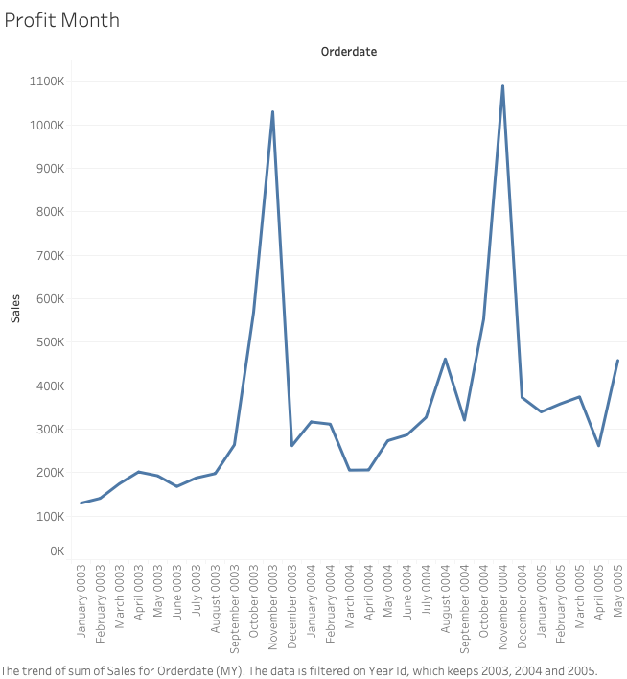

Slide 5
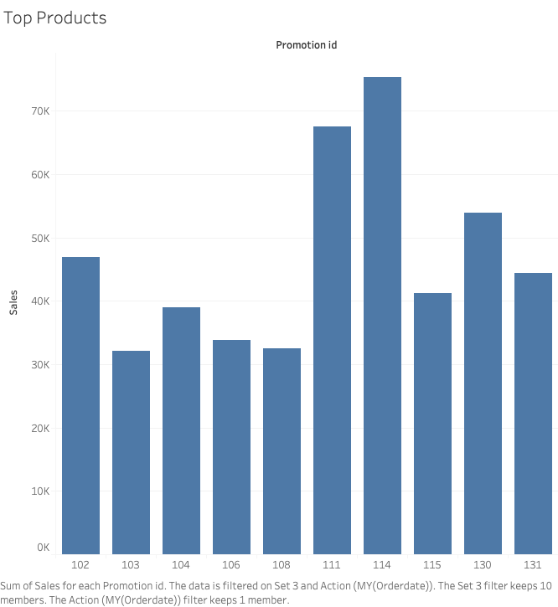

Slide 6
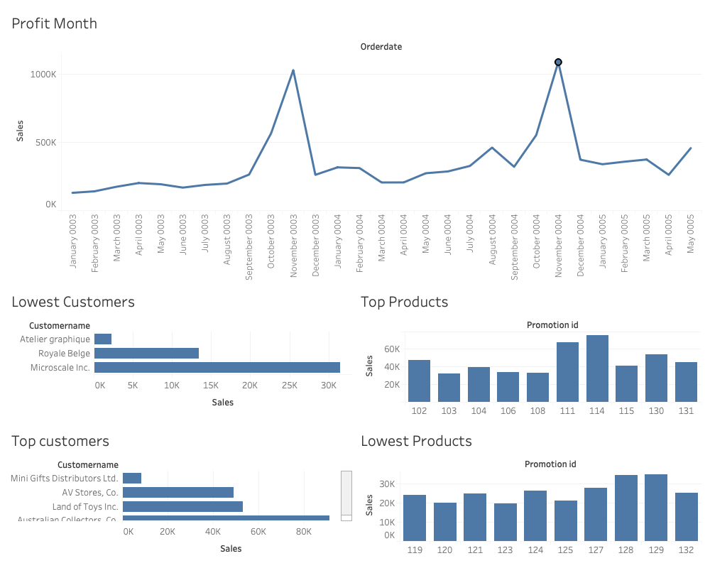

Slide 7
