Slide 1
Vehicle Insurance Fraud Detection
- Sayali Chabhare

Slide 2
Problem Statement :-
The goal of this project is to build a model that can detect vehicle insurance fraud. The challenge is that frauds are less common as compared to legit insurance claims. It consists of 15,420 records of which only 6% (923 records) are fraudulent.

Slide 3
Flow Diagram :
Model
Data Frame
1
Data
Collection
Data
Preprocessing
EDA
Class Imbalance treatment
Model
Data Frame
3
Model
Data Frame
2
Outlier Treatment /Skewness
Model
Validation
Feature
Engineering

Slide 4
Data And Cleaning :
Data contains 15420 observations and 33 attributes.
Target Attribute :
- Fraud Found :
Missing value Treatment
- No missing value
Drop Column’s which are non relevant.
Data Type Conversion using Label Encoder.
Duplicates :
- No duplicates found in records .

Slide 5
Basic Data Table:
Model Name | Accuracy | Precision | Recall | F1 Score
Logistic Regression | 93.450065 | 0.000000 | 0.000000 | 0.000000
Decision Tree | 89.332036 | 0.277228 | 0.234310 | 0.253968
Random Forest | 93.612192 | 0.024752 | 1.000000 | 0.048309
K – Nearest Neighbors | 93.450065 | 0.004950 | 0.500000 | 0.009804
Support Vector Machine | 93.450065 | 0.000000 | 0.000000 | 0.000000
Naïve Bayes | 92.833982 | 0.079208 | 0.313725 | 0.126482
Conclusion: From above table Random Forest is best fitted model from other models.

Slide 6
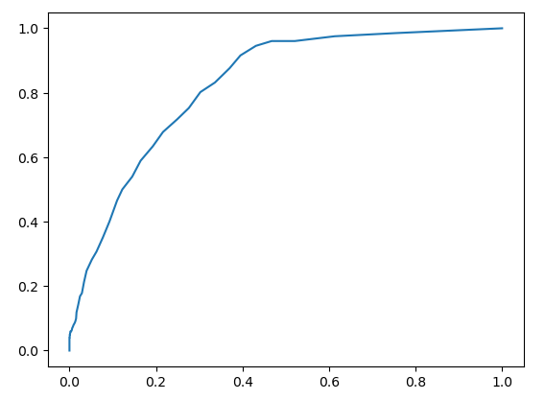
Graph of best flitted model :
AUC & ROC

Slide 7
EDA :
Visualization
Class Imbalance Treatment
- Smote
Outlier Treatment
Skewness
- No skewness

Slide 8
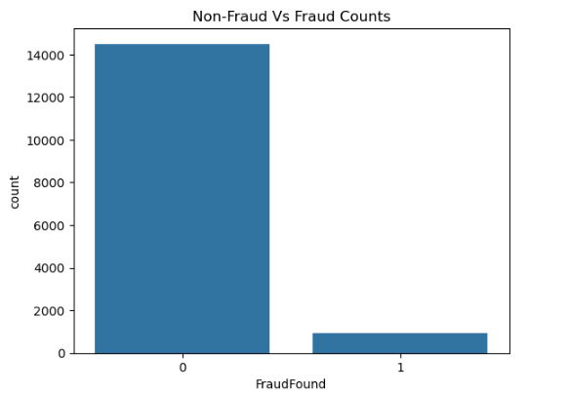
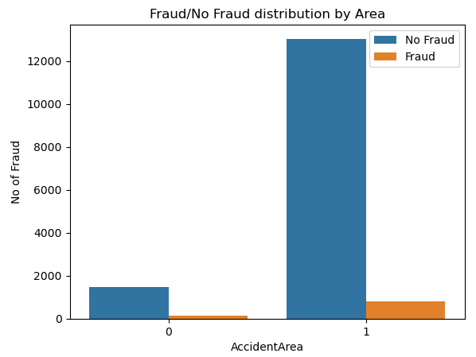
Visualization:
from above graph we can observed count of frauds
we can observe that Urban area experiences more frauds

Slide 9
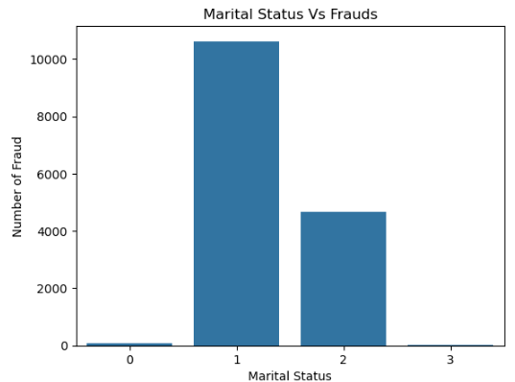
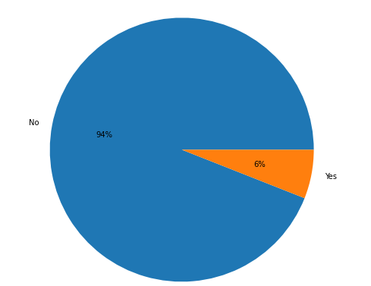
from above graph we can see married are involved in more frauds.
From above graph we can observed that there are 6% fraudulent

Slide 10
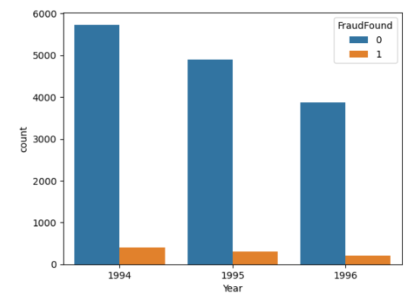
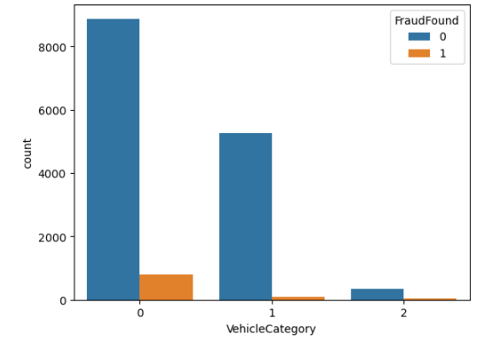
we can observe in year 1994 and 1995 there is more fraud as compared to 1996
from above observation we can see that sedan have most frauds

Slide 11
Class Imbalance Treatment :
The dataset has class imbalanced issue in Fraud Found (Target Column):
- No :14497
- Yes : 923
Using Smote to treat the class imbalance isuue:
- No : 14497
- Yes : 14497

Slide 12
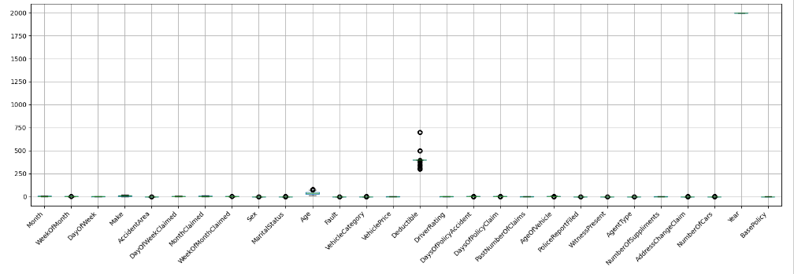
Data Boxplot :

Slide 13
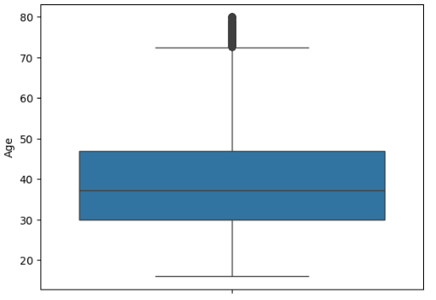
Outlier Graph:

Slide 14
Model Data Frame:
Model name | Accuracy | Precision | Recall | F1 Score
Logistic Regression | 75.099155 | 0.772914 | 0.743421 | 0.757881
Decision Tree | 91.308846 | 0.943228 | 0.890827 | 0.916279
Random Forest | 95.206070 | 0.968878 | 0.938079 | 0.953230
K-Nearest Neighbors | 78.444559 | 0.982900 | 0.705449 | 0.821378
Support Vector Machine | 49.732713 | 0.021546 | 0.538462 | 0.041434
Naïve Bayes | 79.530954 | 0.818741 | 0.784661 | 0.801339
Conclusion: From above table we have 6 models out of which random forest are best fitted model.

Slide 15
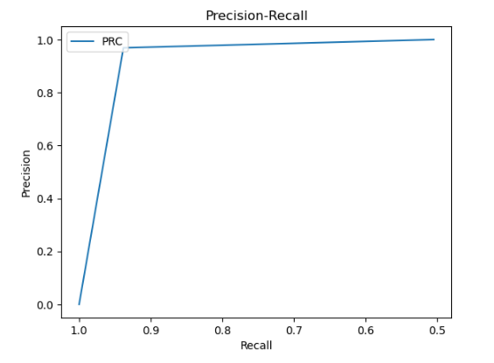
Graph of best flitted model :
:

Slide 16
Feature selection :
For feature selection using RFE(Recursive feature elimination).
Then applied XgBoost on model.
Model name | Accuracy | Precision | Recall | F1 Score
Random Forest | 95.206070 | 0.968878 | 0.938079 | 0.953230
Random Forest (RFE) | 93.981409 | 0.966826 | 0.921447 | 0.94359
XgBoost | 94.395585 | 0.955882 | 0.934470 | 0.945055
Conclusion: From above table Xgboost is performing good.

Slide 17
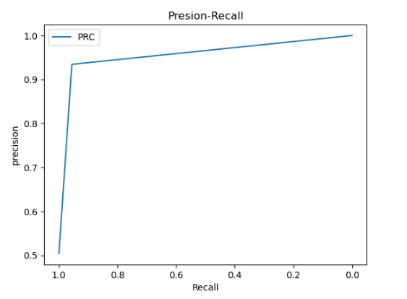
Graph of best flitted model :

Slide 18
Cross Validation :
For Model validation using StratifiedKFold cross validation.
The StratifiedKFold method shows a mean accuracy of 0.92 indicating strong predictive performance across different data split.
It minimizing the risk of overfitting.

Slide 19
Draw Backs :
The dataset is highly imbalanced, with only 6% of the records being fraudulent. This can cause the model to focus more on the majority class (non-fraudulent claims), leading to poor performance in detecting the minority class (fraud).
Standard metrics like accuracy can be misleading in imbalanced datasets. High accuracy can be achieved by predicting mostly non-fraudulent claims, masking the model's inability to detect fraud.
The small number of fraudulent records (only 923) may limit the model's ability to learn diverse patterns of fraudulent behavior, leading to poor generalization to unseen fraud cases.

Slide 20
Thank You

