Slide 1

Deogiri Institute of engineering and management studies ,Aurangabad.
Presentation on
Program to Implement NFA with epsilon move to DFA Conversion
Presentation by
Sayali Sapkal (36151)
Kajari Daulatabadkar(36152)

Slide 2
Non-Deterministic Finite Automaton (NDFA)
Non-deterministic Finite Automata (NFA) : NFA is a finite automaton where for some cases when a single input is given to a single state, the machine goes to more than 1 states, i.e. some of the moves cannot be uniquely determined by the present state and the present input symbol.
An NFA can be represented as M = { Q, ∑, ∂, q0, F}
Q → Finite non-empty set of states. ∑ → Finite non-empty set of input symbols. ∂ → Transitional Function. q0 → Beginning state. F → Final State
NFA with (null) or ∈ move : If any finite automata contains ε (null) move or transaction, then that finite automata is called NFA with ∈ moves.

Slide 3
Graphical Representation of a NDFA
A NDFA is represented by digraphs called state diagram. The vertices represent the states. The arcs labelled with an input alphabet show the transitions. The initial state is denoted by an empty single incoming arc. The final state is indicated by double circles.

Slide 4
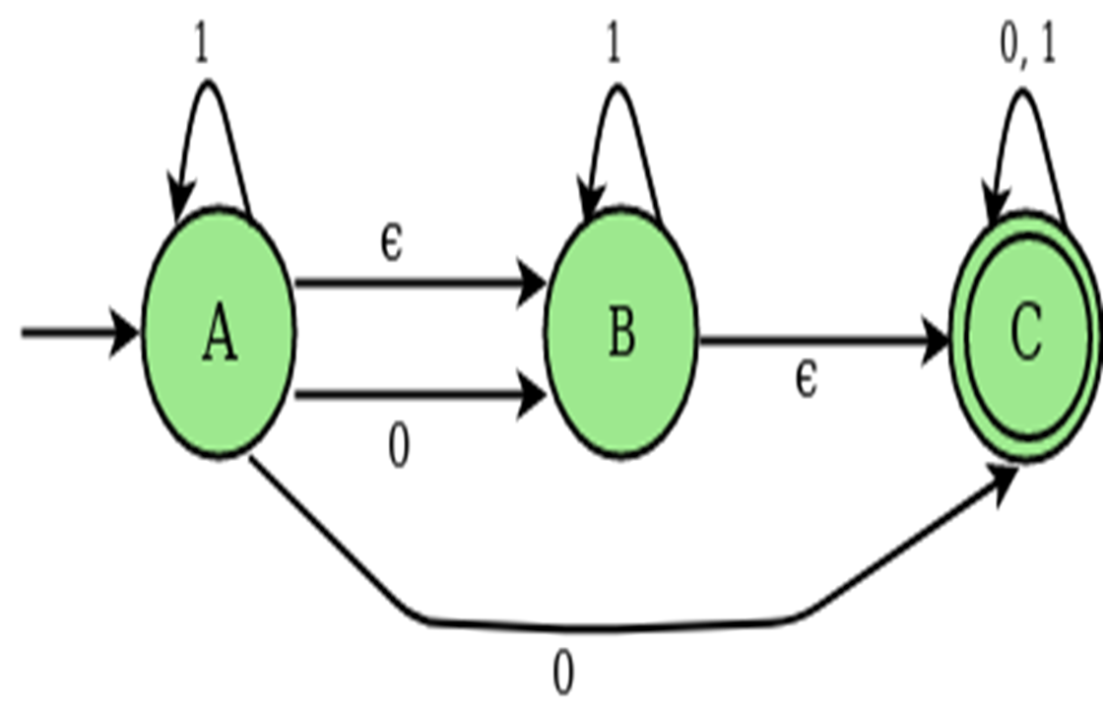
NDFA Diagram With Epsilon Move

Slide 5
Steps to Convert NFA with ε-move to DFA
Step 1 : Take ∈ closure for the beginning state of NFA as beginning state of DFA. Step 2 : Find the states that can be traversed from the present for each input symbol(union of transition value and their closures for each states of NFA present in current state of DFA).
Step 3 : If any new state is found take it as current state and repeat step 2. Step 4 : Do repeat Step 2 and Step 3 until no new state present in DFA transition table. Step 5 : Mark the states of DFA which contains final state of NFA as final states of DFA.

Slide 6
Applications
Vending Machines
Traffic Lights
Video Games
Text Parsing
Compiler Designing
Mathematical Model
Finite State Machines
Mathematical Analysis
Computing In Mathematices

Slide 7
CONCLUSION
If we want to construct an FA which accepts a language, sometimes it becomes very difficult or seems to be impossible to construct a direct NFA or DFA. But if NFA with ∈ moves is used, then the transitional diagram can be constructed and described easily.

Slide 8
THANK YOU !!

