Slide 1
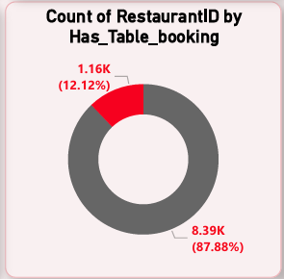
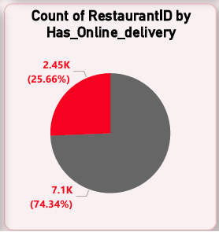
Percentage of Restaurants based on “Has Table booking” & “ Has Online delivery”
Key Insights:
Has Table Booking:
Total % Restaurants has No Table Booking: 87.88 %
Total % Restaurants has Table Booking: 12.12 %
Has Online Delivery:
Total % Restaurants has No Online Delivery: 74.34 %
Total % Restaurants has Online Delivery: 25.66 %

Slide 2
