Slide 1
Exploring Life Expectancy: Global Health Dynamics
By:
SAYALI DESHMUKH

Slide 2
Introduction and Dataset Overview
Introduction:
Delving into a dataset encompassing health-related indicators across countries and years.
Highlighting potential goals: Health Analysis, Identifying Patterns, Comparative Studies, Policy Evaluation, and Research.
Data Overview:
Comprehensive breakdown of numerical and categorical data.
Examples of numerical data: Life Expectancy, Adult Mortality, Alcohol Consumption, etc.
Examples of categorical data: Country, Year, Status.
Dataset Details:
Size: 2938 rows and 22 fields.

Slide 3
Unveiling Insights: Objectives and Analytical Focus
Objectives:
Unraveling the complex interplay of health variables, patterns, and disparities globally.
Focusing on the dichotomy between developed and developing countries.
Analytical Focus:
Addressing Critical Questions:
Exploration of life expectancy differences between developed and developing nations.
Understanding the relationship between alcohol consumption and BMI and its public health implications.
Analyzing variations in adult mortality rates across different countries.
Temporal analysis of the evolution of alcohol consumption over the years.
Conclusion:
Emphasizing that the analysis goes beyond descriptive statistics to inform public health strategies.
Highlighting the significance of understanding global health dynamics in our interconnected world.

Slide 4
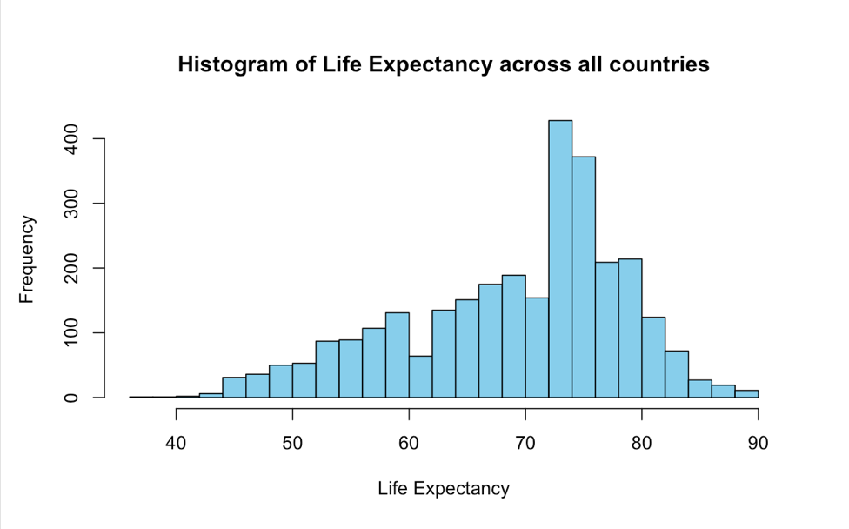
Visualizations - Life Expectancy Histogram
Distribution of Life Expectancy Across Countries
A histogram visually represents the distribution of life expectancy
The peak in the 70-80 range indicates high life expectancy across all countries

Slide 5
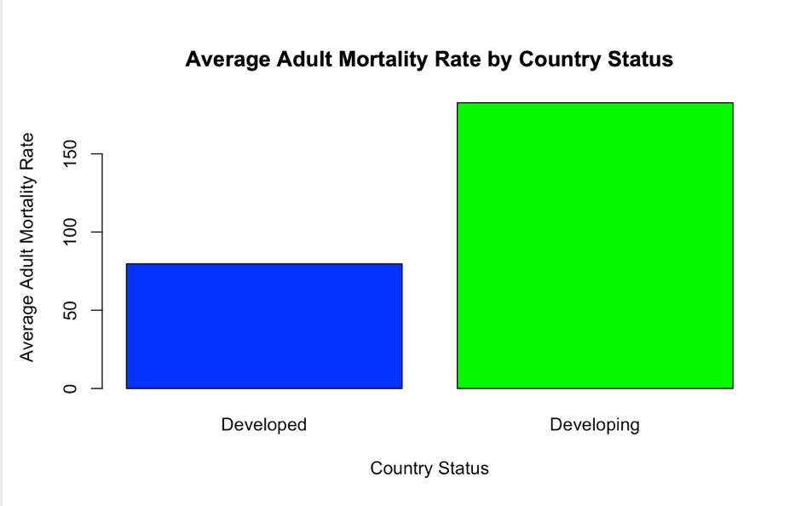
Visualizations - Bar Chart
Average Adult Mortality Rates by Country Status
A bar chart compares average adult mortality rates for "Developed" and "Developing" countries.
Developed countries show lower average adult mortality rates.

Slide 6
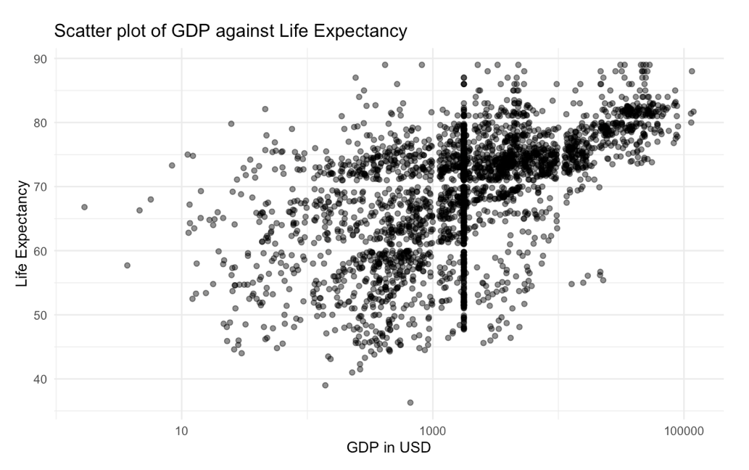
Visualizations - Scatter Plot
GDP vs. Life Expectancy
A scatter plot suggests a positive correlation between GDP and life expectancy.
Higher GDP per capita may be associated with longer life expectancy.

Slide 7
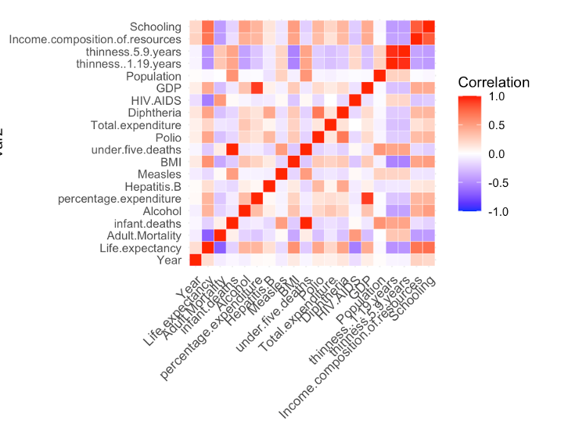
Correlation Heatmap
Correlation Between Health Indicators
A heatmap visually represents the correlation matrix, indicating strength and direction of relationships.
Helps identify patterns and relationships within the dataset.

Slide 8
Descriptive Statistics - Table 1. Descriptive Statistics of Key Health Indicators
Variable | N | Mean | SD | Min | Median | Max | Rang | Skew | Kurtosis | SE | Trimmed
Adult Mortality | 2938 | 164.7 | 124.0 | 1 | 144 | 723 | 722 | 1.17 | 1.75 | 2.28 | 150.4
Alcohol | 2938 | 4.546 | 3.921 | 0.01 | 3.7 | 17.8 | 17.8 | 0.072 | 0.175 | 2.17 | 36.67
Life Expectancy | 2938 | 69.22 | 9.52 | 36.3 | 63.1 | Not Provided | Not Provided | Not Provided | Not Provided | Not Provided | Not Provided
Percentage Expenditure | 2938 | 738.25 | 1987.91 | 0 | 4.6 | Not Provided | Not Provided | Not Provided | Not Provided | Not Provided | Not Provided
Summary Statistics of Key Health Indicators
These statistics offer a snapshot of key health indicators, aiding in understanding the health and socio-economic conditions of the countries in the dataset.

Slide 9
Life Expectancy by Country
These statistics illuminate life expectancy variations, facilitating comparisons between nations and highlighting disparities in health outcomes.
Descriptive Statistics - Table 2. Life Expectancy by Country
Country | Mean | SD | Min | Median | Max
Afghanistan | 58.19 | 2.38 | 54.8 | 57.8 | 65
Albania | 75.16 | 1.84 | 72.6 | 75.6 | 77.8
Algeria | 73.62 | 1.55 | 71.3 | 73.95 | 75.6
Yemen | 63.86 | 1.81 | 61.1 | 63.95 | 68
Zambia | 53.91 | 6.67 | 43.8 | 56.55 | 63
Zimbabwe | 50.49 | 6.83 | 44.3 | 47.4 | 67

Slide 10
Hypothesis Testing Question 1: Is there a significant difference in alcohol consumption between the years 2000 and 2015 in developing countries?
Null Hypothesis (H0): There is no significant difference in alcohol consumption between the years 2000 and 2015 in developing countries.
Alternative Hypothesis (H1): There is a significant difference in alcohol consumption between the years 2000 and 2015 in developing countries.
Output: Paired t-test
data: data_2000 and data_2015
t = -1, df = 1, p-value = 0.5
alternative hypothesis: true mean difference is not equal to 0
95 percent confidence interval: -6.441916 5.501916
sample estimates: mean difference -0.47
With a p-value of 0.5, surpassing the common significance level of 0.05, we do not reject the null hypothesis. This implies no significant difference in alcohol consumption between 2000 and 2015 in developing countries. The confidence interval, containing zero, reinforces this, indicating a lack of significant mean difference. Despite a slight decrease in alcohol consumption (-0.47), it is statistically insignificant. In conclusion, the analysis doesn't provide compelling evidence for a noteworthy change in alcohol consumption between the two years in developing countries, suggesting observed differences could be due to random variability.

Slide 11
Is there a significant difference in life expectancy between developing and developed countries in the year 2015?
Null Hypothesis (H0): There is no difference in life expectancy between developing and developed countries in 2015.
Alternative Hypothesis (H1): There is a significant difference in life expectancy between developing and developed countries in 2015.
Output: Welch Two Sample t-test
data: developing_life_expectancy and developed_life_expectancy
t = -12.753, df = 102.42, p-value < 2.2e-16
alternative hypothesis: true difference in means is not equal to 0
95 percent confidence interval:-12.733045 -9.305573
sample estimates: mean of x mean of y
69.69007 80.70937
The small p-value provides strong evidence to reject the null hypothesis, indicating a significant difference in life expectancy between developing and developed countries in 2015. The negative t-value and confidence interval point to a lower average life expectancy in developing countries compared to developed ones. In summary, the statistical analysis supports the conclusion that, on average, developed countries had a significantly higher life expectancy than developing countries in 2015.

Slide 12
Is there a significant difference in under-five mortality rates between the years 2010 and 2015 in all countries?
Null Hypothesis (H0): There is no significant difference in under-five mortality rates between the years 2010 and 2015 in all countries.
Alternative Hypothesis (H1): There is a significant difference in under-five mortality rates between the years 2010 and 2015 in all countries.
Output:
Paired t-test
data: data_2010 and data_2015
t = 2.4536, df = 182, p-value = 0.01508
alternative hypothesis: true mean difference is not equal to 0
95 percent confidence interval: 1.358047 12.510805
sample estimates: mean difference 6.934426
The p-value of 0.01508, below the 0.05 significance level, supports rejecting the null hypothesis. This suggests a significant increase in under-five mortality rates between 2010 and 2015 across all countries. The positive mean difference of 6.93 and the 95% confidence interval (1.36 to 12.51) provide insights into the magnitude of this change, indicating the average rise and the likely range for the true mean difference.

Slide 13
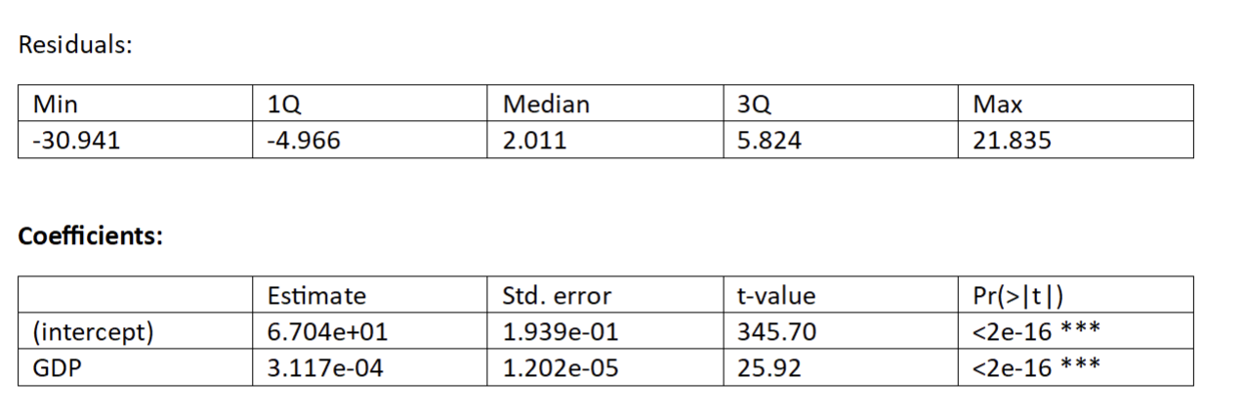
Regression and Interpretation
If there is any significant relationship between GDP and life expectancy?
Dependent Variable: Life Expectancy
Independent Variable: GDP
Null Hypothesis (H0): There is no significant linear relationship between GDP and Life Expectancy.( the coefficient of GDP in the regression model being equal to zero.)
Alternative Hypothesis (H1): There is a significant linear relationship between GDP and Life Expectancy.
Call:lm(formula = Life.expectancy ~ GDP, data = health_data
Signif. codes: 0 ‘***’ 0.001 ‘**’ 0.01 ‘*’ 0.05 ‘.’ 0.1 ‘ ’ 1
Residual standard error: 8.584 on 2936 degrees of freedom
Multiple R-squared: 0.1853, Adjusted R-squared: 0.185
F-statistic: 667.8 on 1 and 2936 DF, p-value: < 0.00000000000000022
Conclusion:The analysis suggests a statistically significant relationship between GDP and Life Expectancy.

Slide 14
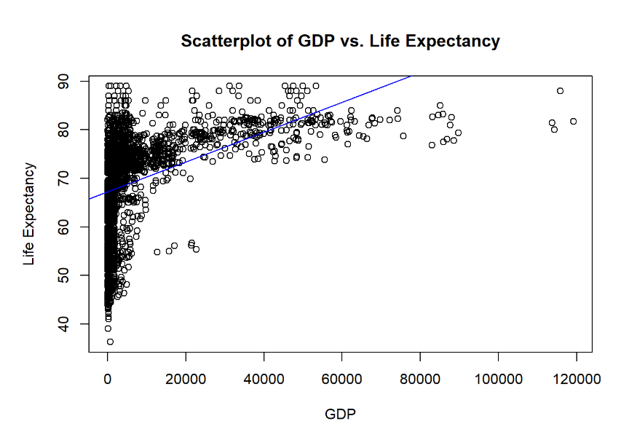

Slide 15
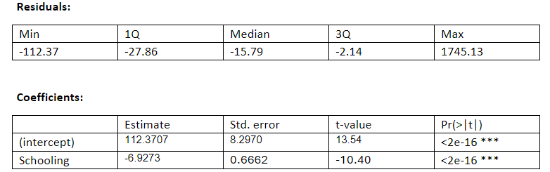
Does Schooling have a significant impact on Infant Mortality?
Dependent Variable: Infant Mortality
Independent Variable: Schooling
Null Hypothesis (H0): Schooling does not significantly impact Infant Mortality.
Alternative Hypothesis (H1): Schooling has a significant impact on Infant Mortality.
Call: lm(formula = infant.deaths ~ Schooling, data = health_data)
Signif. codes: 0 ‘***’ 0.001 ‘**’ 0.01 ‘*’ 0.05 ‘.’ 0.1 ‘ ’ 1
Residual standard error: 117.9 on 2773 degrees of freedom
Multiple R-squared: 0.03753, Adjusted R-squared: 0.03718
F-statistic: 108.1 on 1 and 2773 DF, p-value: < 2.2e-16
Conclusion:
The analysis provides compelling evidence to reject the null hypothesis, indicating that Schooling has a significant impact on Infant Mortality

Slide 16
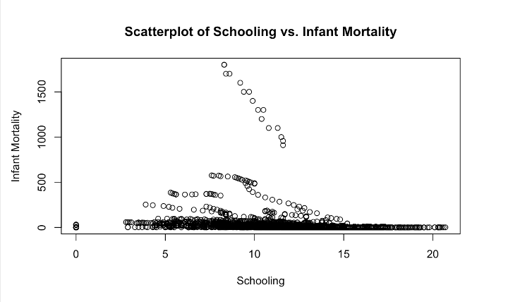

Slide 17
Correlation Analysis
Pearson correlation test between Schooling and BMI
Output Pearson's product-moment correlation:
Null Hypothesis : the true correlation between Schooling and BMI is equal to 0.
Alternate Hypothesis : the true correlation between Schooling and BMI is not equal to 0.
data: health_data$Schooling and health_data$BMI
t = 31.267,
df = 2936,
p-value < 0.00000000000000022
alternative hypothesis: true correlation is not equal to 0
confidence interval: 95%
Sample Correlation (cor): 0.5
Conclusion: The analysis provides strong evidence that Schooling and BMI are correlated, with a moderate positive correlation.

Slide 18
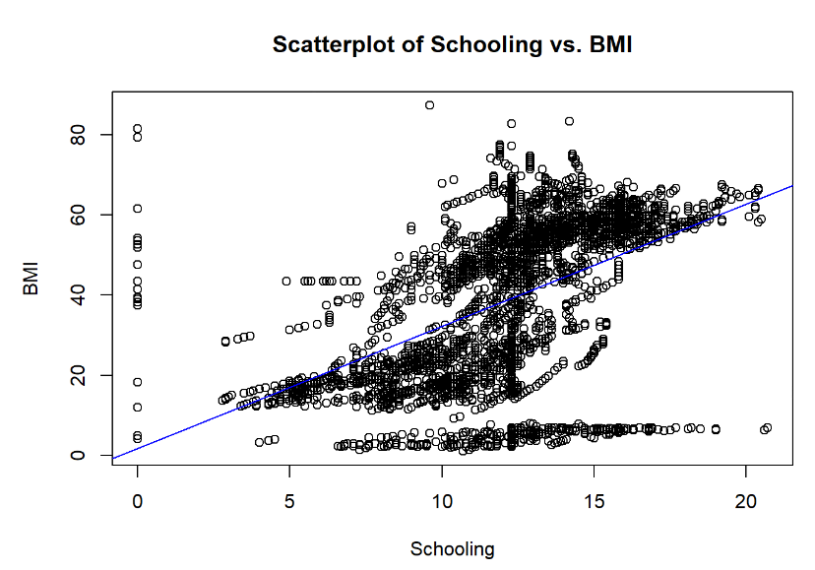

Slide 19
Key Implications
Tailored Interventions:
Findings highlight the need for tailored interventions based on specific challenges faced by each country.
One-size-fits-all approaches are less effective; context-specific healthcare strategies are essential.
Holistic Health Strategies:
Health outcomes are influenced by various factors, necessitating holistic strategies.
Interconnected elements, from lifestyle to socio-economic conditions, must be considered for overall well-being.
Proactive Public Health Measures:
Understanding temporal trends enables proactive public health measures.
Anticipating changes in health indicators before widespread issues arise significantly impacts community health.
Equity in Healthcare:
Disparities in life expectancies and adult mortality rates underscore the importance of addressing equity in healthcare.
Policies should ensure universal access to quality healthcare services and resources.

Slide 20
Key Insights and Recommendations
Overview of Global Health Indicators
Economic Impact on Health
Snapshot of Health Conditions
Specific Analyses Insights
Alcohol Consumption (2000-2015): No significant change in developing countries.
Developed vs. Developing Countries (2015): Significant life expectancy disparities.
Under-Five Mortality (2010-2015): Significant global increase, requiring targeted interventions.
Key Findings and Conclusions
GDP and Life Expectancy: Statistically significant relationship.
Impact of Schooling on Infant Mortality: Significantly influential.
Overall Conclusion
Global health trends underscore interconnectedness of socio-economic factors and health outcomes.
Call to action: Targeted interventions needed to address disparities and improve global health.

Slide 21
Thank You
Thank you for your attention! Feel free to reach out for further inquiries.

