Slide 1
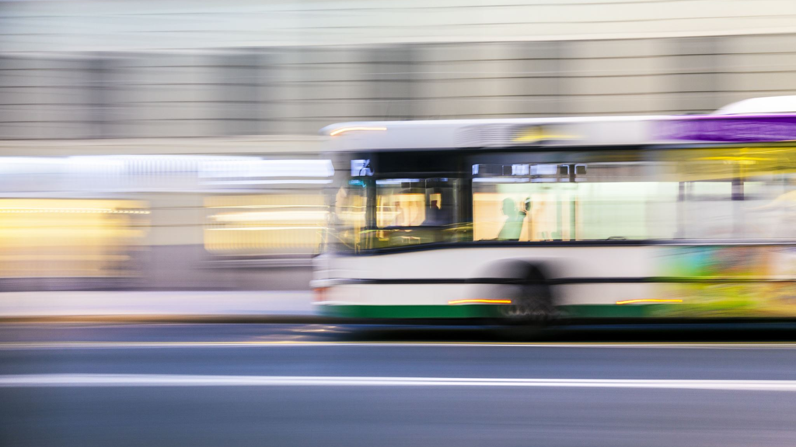
Uber and Lyft Rideshare Dataset Boston
SAYALI DESHMUKH

Slide 2

Project Overview
Objective: Develop a system using historical ride data for optimized transportation services.
Dataset & Interest:
Detailed ride info (timestamp, location, weather).
Aims to enhance services, reduce costs, and boost customer satisfaction.
Key Services:
Real-time ride demand prediction.
Route optimization for reduced travel time.
Dynamic pricing based on demand and weather.
Weather-aware service recommendations.
Questions to Address:
Accurate prediction of future ride demand?
Impact of weather on demand and pricing?
Route optimization strategies?
Pricing tactics for peak and off-peak hours?
Using data to enhance rider and driver experiences

Slide 3

Entities & Attributes:
Entities: Rides, Cab, Weather, Apparent Weather, Payment.
Attributes: Timestamp, Source/Destination, Ride details, Weather, cab type.
User Types:
Riders, Drivers, Service Providers, Data Analysts.
Primary Use Cases & Personas:
Demand Prediction:
Persona: Data Analyst
Route Optimization:
Persona: Drivers, Service Providers
Dynamic Pricing:
Persona: Service Providers
Service Recommendations:
Persona: Riders

Slide 4
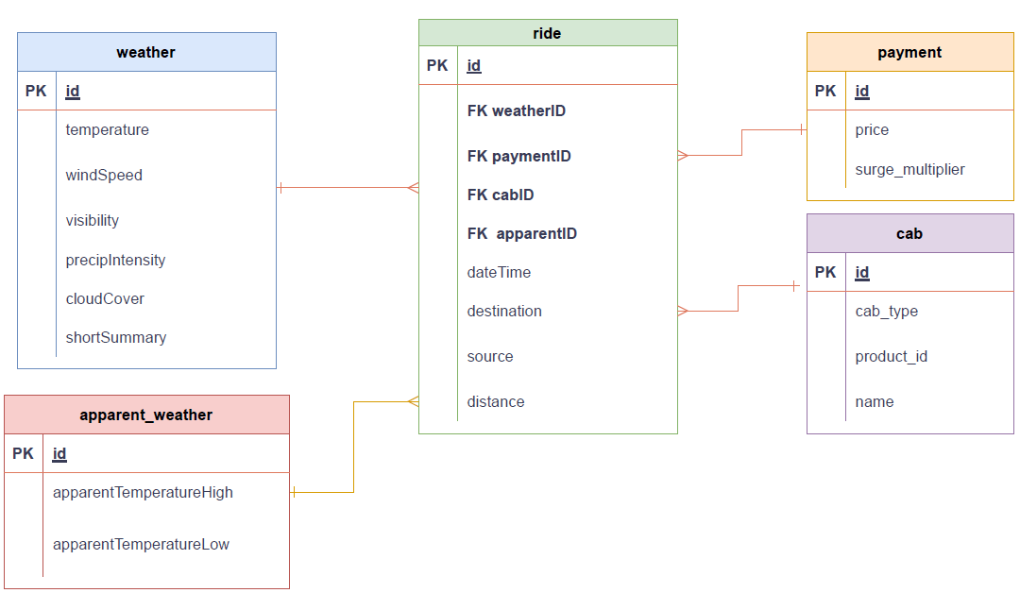
ER Diagram

Slide 5

Other Business Rules & Facts
Hour, Day, Month: Time-Based Analytics
Analyze busiest hours of the day, track monthly trends, and identify patterns based on the day of the week.
Latitude, Longitude: Location History
Create a historical log of ride origins and destinations.
Analyze popular routes, optimize driver distribution, and understand geographical patterns.
Wind Gust, Wind Gust Time: Wind Gust Information
Provide details on wind gusts during rides.
Enhance safety with weather-related notifications for users and drivers.
UV Index, UV Index Time: UV Index Notifications
Send notifications for high UV index, advising precautions like sunscreen application.
Prioritize user and driver safety based on weather conditions.
Moon Phase: Moon Phase Information
Add a unique touch to user experience by displaying current moon phase during rides.
Enhance app interface aesthetics and engagement.
Ozone: Air Quality Tracking
Utilize ozone attribute for real-time air quality tracking.
Implement features promoting eco-friendly transportation options for environmentally conscious users.

Slide 6
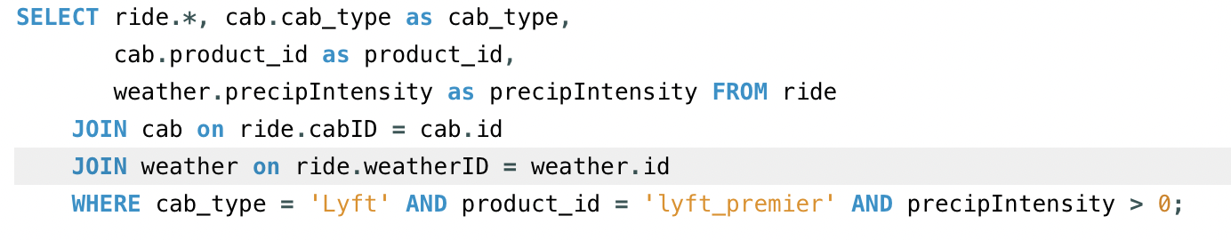
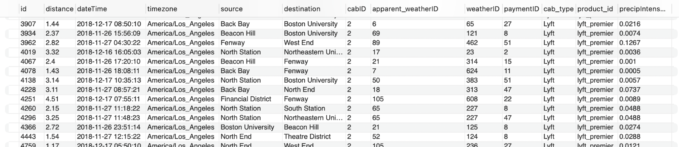
Retrieve Lyft Premier Rides with Rainy Weather
This SQL query retrieves details about Lyft Premier rides during rainy weather.
It selects information from the ride table, including associated cab and weather details, focusing on Lyft Premier rides (cab_type = 'Lyft' AND product_id = 'lyft_premier') where the precipitation intensity is greater than 0.
Combine data from the ride, cab, and weather tables using JOIN operations based on matching IDs.

Slide 7
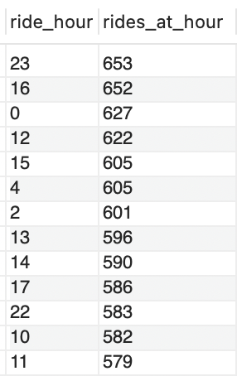
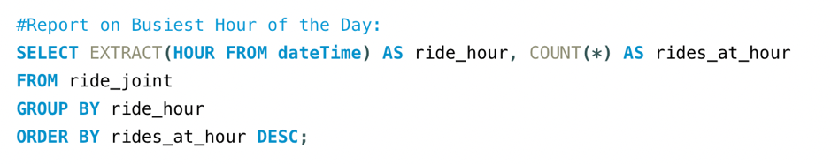
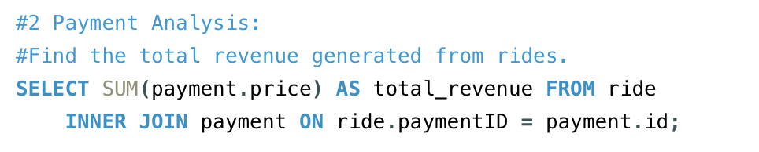

Report on Busiest hour of the day and find the total revenue generated from rides
The query provides a count of rides for each hour of the day, identifying the busiest hour by sorting the results in descending order.
This query retrieves the combine revenue of both lyft and uber

Slide 8
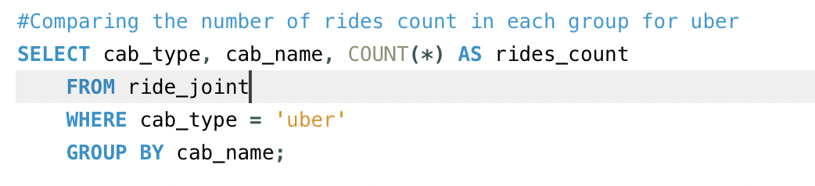
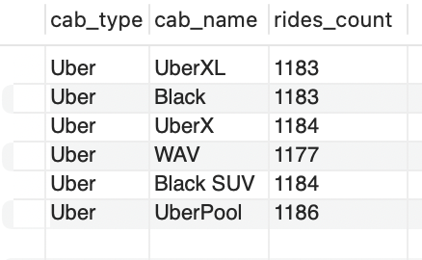
Retrieves the rides count in each ride type for Uber
This query retrieves the rides count in each ride type for uber. This helps us to understand the popularity among ride types

Slide 9
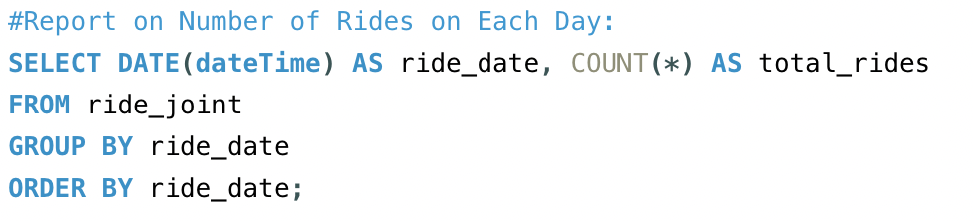
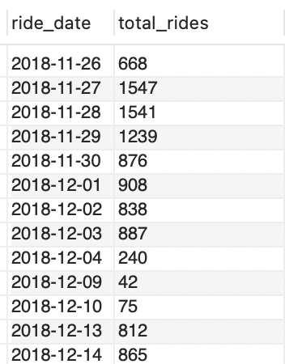
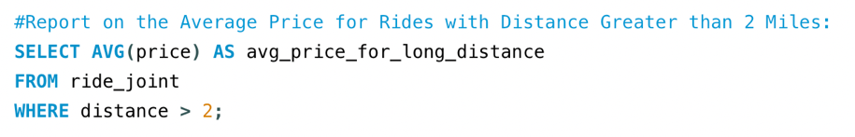

Report on Number of Rides on Each Day and the average price of rides with distance greater than 2 miles
The query provides a count of rides for each day, grouping the results by date and presenting them in chronological order.
The query calculates the average price for rides with a distance more than 2 miles, providing a metric for longer-distance rides.

Slide 10
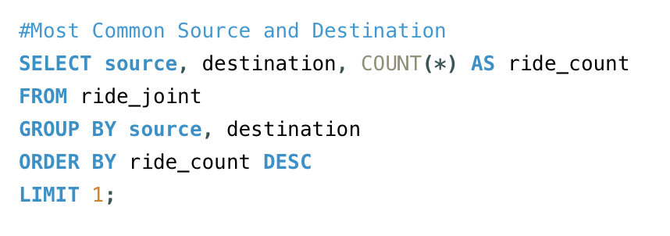

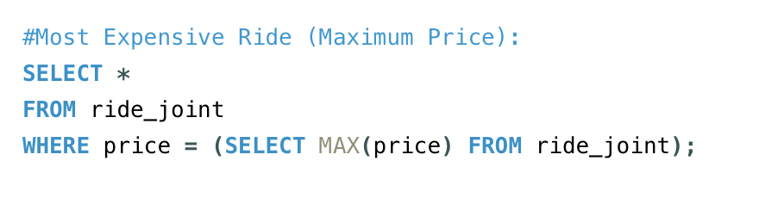
Metrics And Analytics
The query identifies and returns the most common source and destination pair based on the highest count of rides between them
This SQL query retrieves information about the most expensive ride by selecting all columns from the ride_joint table where the price matches the maximum price in the entire dataset.

Slide 11
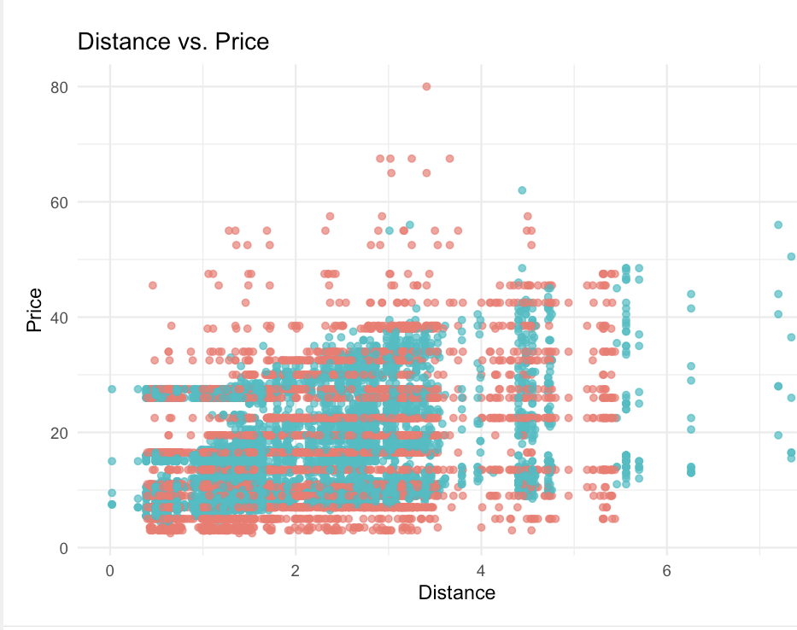
The scatter plot depicts the correlation between ride distance and price and transparency for visualizing overlaps in the rideshare dataset.

Slide 12
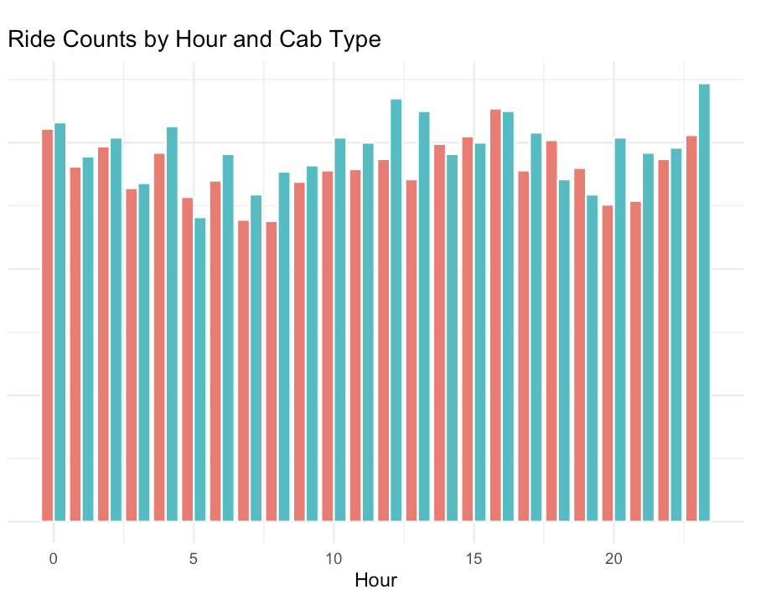
The plot showcases no. of rides vs hour with distinct colors for Lyft and Uber cab type, this shows grouped bars by hour for comparison of ride counts across different hours and cab types.

Slide 13
Security And Privacy
Security Considerations in Ride-Sharing Dataset
1. Location Data
2. Timestamps
3. Ride Details
4. Weather Conditions
5. Surge Multiplier
6. Data Retention
7. Data Access Controls
8. Data Anonymization
9. Security of Storage and Transmission

Slide 14
Take Away : Key Finding
Informed Decision-Making
Structured Database
Seamless Data Insertion
Dynamic Querying
Joint Operations for Integration
Robust Analysis and Metrics
Security Measures
Scalable Cloud-Based Architecture
User-Centric Approach
Continuous Improvement

Slide 15
What would I do differently next time?
Granular Surge Pricing Patterns
User-Specific Ride Preferences
Localized Service Optimization
Behavioral Timestamp Patterns
Route Efficiency Metrics
Temporal Trends in Ride Demand
Predictive Modeling Insights
Economic Disparities in Ride Usage
Long-Term User Behavior Analysis
Weather-Driven User Mobility Patterns

Slide 16
Thank You
Thank you for your attention! Feel free to reach out for further inquiries.

