Slide 1

Consumer Behavior with Credit Cards
By – Sayali Deshmukh

Slide 2

Introduction
This dataset consists of 10,000 customers mentioning their Age, Salary, Attrition Flag, credit card limit, credit card category, etc. There are nearly 18 features.
Here we are conducting visual analysis of the distribution and relationships of key variables in the credit card dataset.
We got insights into customer behavior and demographic characteristics, such as age, gender, education level, etc.
We are identifying significant correlations between financial indicators, such as credit limits and transaction counts.
We performed statistical analysis to validate assumptions, identify trends, and draw meaningful conclusions from the dataset.

Slide 3

Objective
Identify Churn Factors: Uncover why customers leave
Informed Decisions: Use data to reduce attrition
Enhance Retention: Keep more satisfied customers
Data-Backed Insights: Make targeted improvements
Competitive Edge: Adapt services for success
Methodology
Started by reading a dataset named "BankChurners.csv," which likely contains information about bank customers.
Removed any rows with missing information (NA values) from the dataset to make it cleaner and more usable
Transformed two columns, "Education_Level" and "Marital_Status," into categorical factors, which helps with analysis.
Finally, we saved the cleaned dataset as "bank_data.csv" for further analysis or sharing.
We visualized all the plots with the help of ggplot and few different library packages

Slide 4
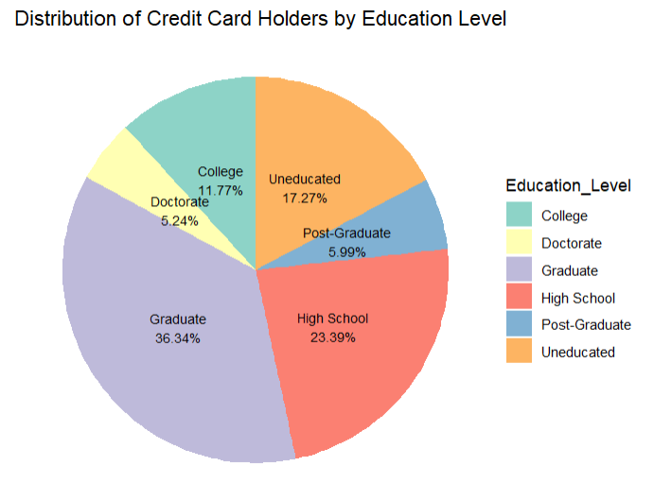
The largest segment belongs to those with a Graduate level of education, constituting 36.34% of all cardholders.
Doctorate holders are the smallest group with 5.24%. It’s interesting to note the significant drop from the Graduate to Post-Graduate and Doctorate levels.
This may indicate that those with higher educational qualifications beyond a graduate degree may not see the need for credit cards or prefer other means of financial management.
These insights could be valuable for credit card companies to strategize their marketing efforts based on education levels.

Slide 5
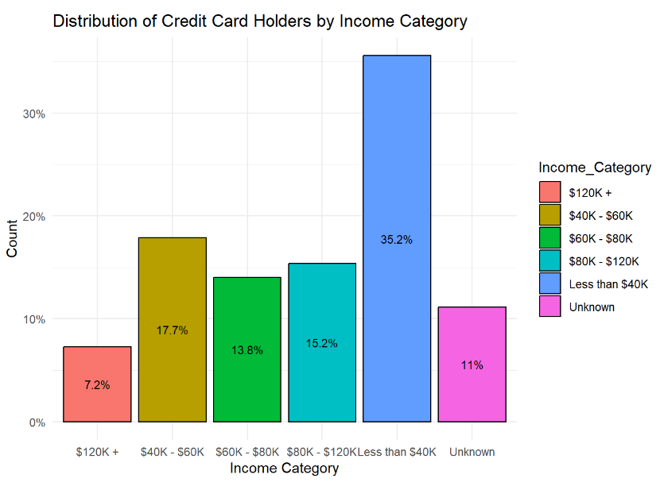
Less than $40K,” indicates that a substantial proportion of credit card holders have lower incomes.
The highest income category of “$120K+” accounts for 7.18% of credit card holders, indicating a smaller proportion of individuals with higher incomes.
Studying this graph helps banks customize their services and credit limits to match the financial situations and requirements of different income groups.

Slide 6
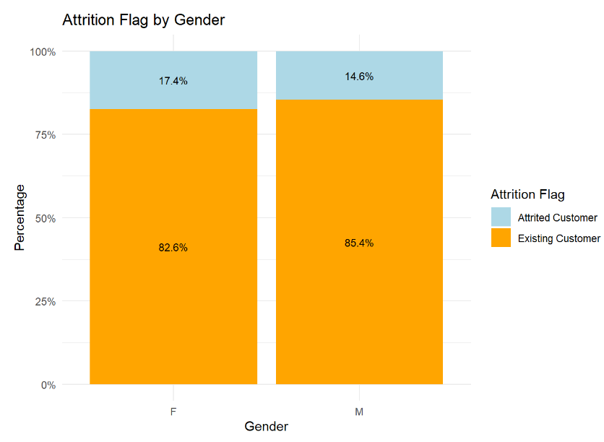
Among female customers, 82% are existing customers, 17.4% of female customers have attrited, representing those who have closed their accounts
Among male customers, 85.4% are existing customers. 14.6% of them have closed their accounts
The results show that both men and women tend to keep their accounts, but more women are leaving compared to men, although the difference is not very big
Understanding the attrition patterns by gender can help in the areas of improvement in customer retention strategies and implement targeted measures to reduce attrition rates and enhance customer loyalty

Slide 7
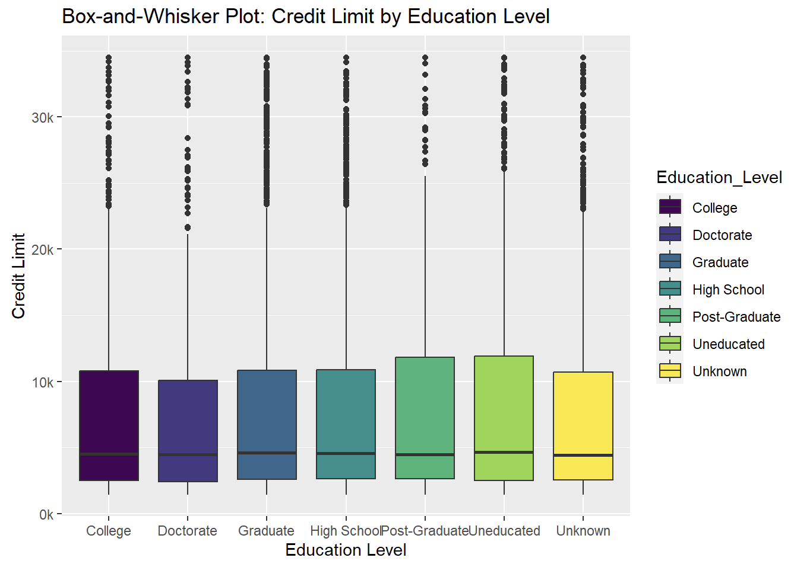
Credit Limit vs. Education
Lower education correlates with wider credit limit ranges
Post-graduates surprisingly have slightly lower credit limits
College graduates and high school graduates often share similar credit limits
Diverse Factors at Play:
Beyond education, factors like income and credit history influence credit limits
Data analysts should consider a holistic approach for more informed credit decisions in the industry

Slide 8
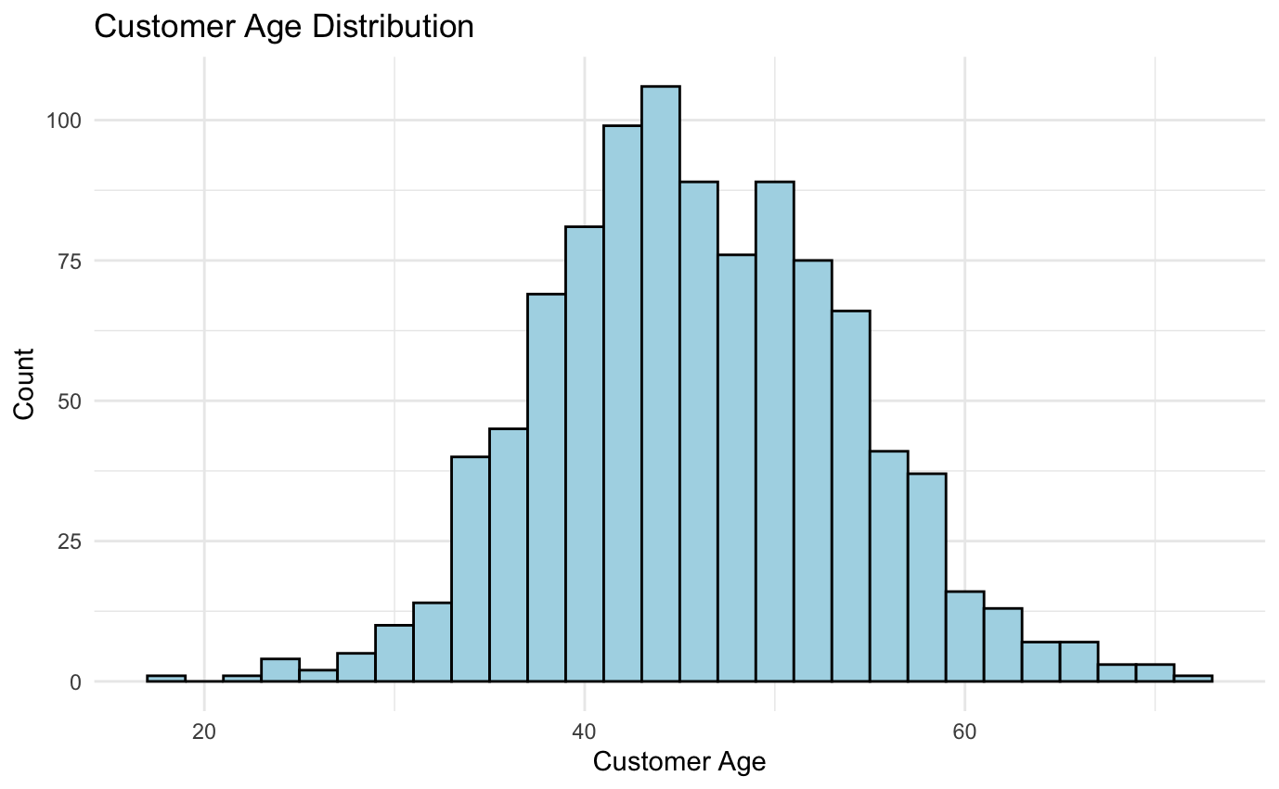
Customer Data Statistics
M
Customer Age
Distribution: Approximately normal
Mean: 46.33 years
Median: 46 years
Standard Deviation: 8.02
Range: 26 to 73 years

Slide 9
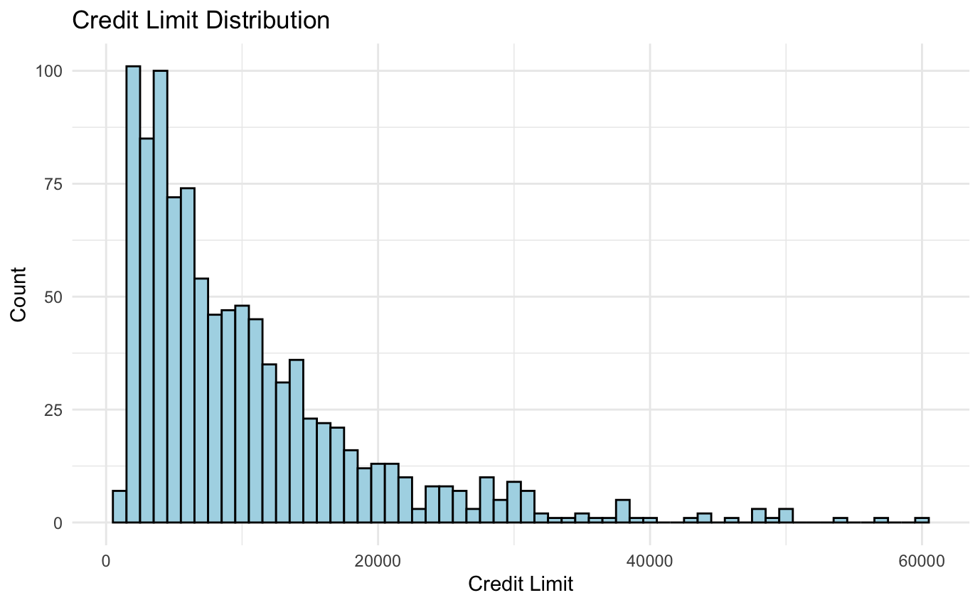
Credit Limit
Distribution: Positively skewed
Mean: $8,631.95
Median: $4,549
Standard Deviation: $9,088.78
Range: $1,438.3 to $34,516
M

Slide 10
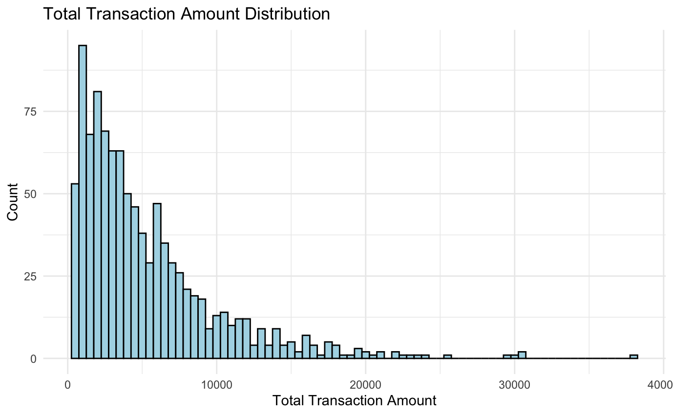
M
Total Transaction Amount
Distribution: Positively skewed
Mean: $4,404.09
Median: $3,899
Standard Deviation: $3,397.13
Range: $510 to $18,484

Slide 11
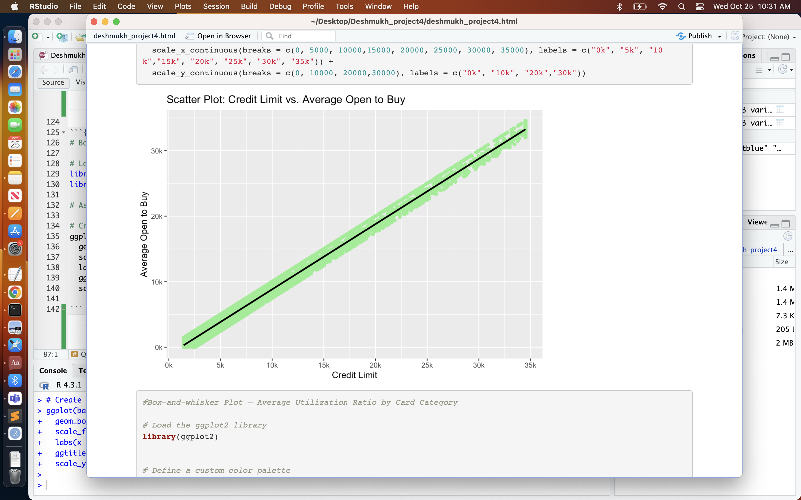
Individual data points are represented by light green markers, and the black trendline illustrates the overall data trend.​
The strong positive correlation suggests that higher credit limits are associated with a significant increase in customers spending power before reaching their credit limits.
The relationship is so strong that we can represent it with a linear regression model. It's denoted as 'Avg Open To Buy = 0.99619 * Credit Limit - 1129.92.

Slide 12
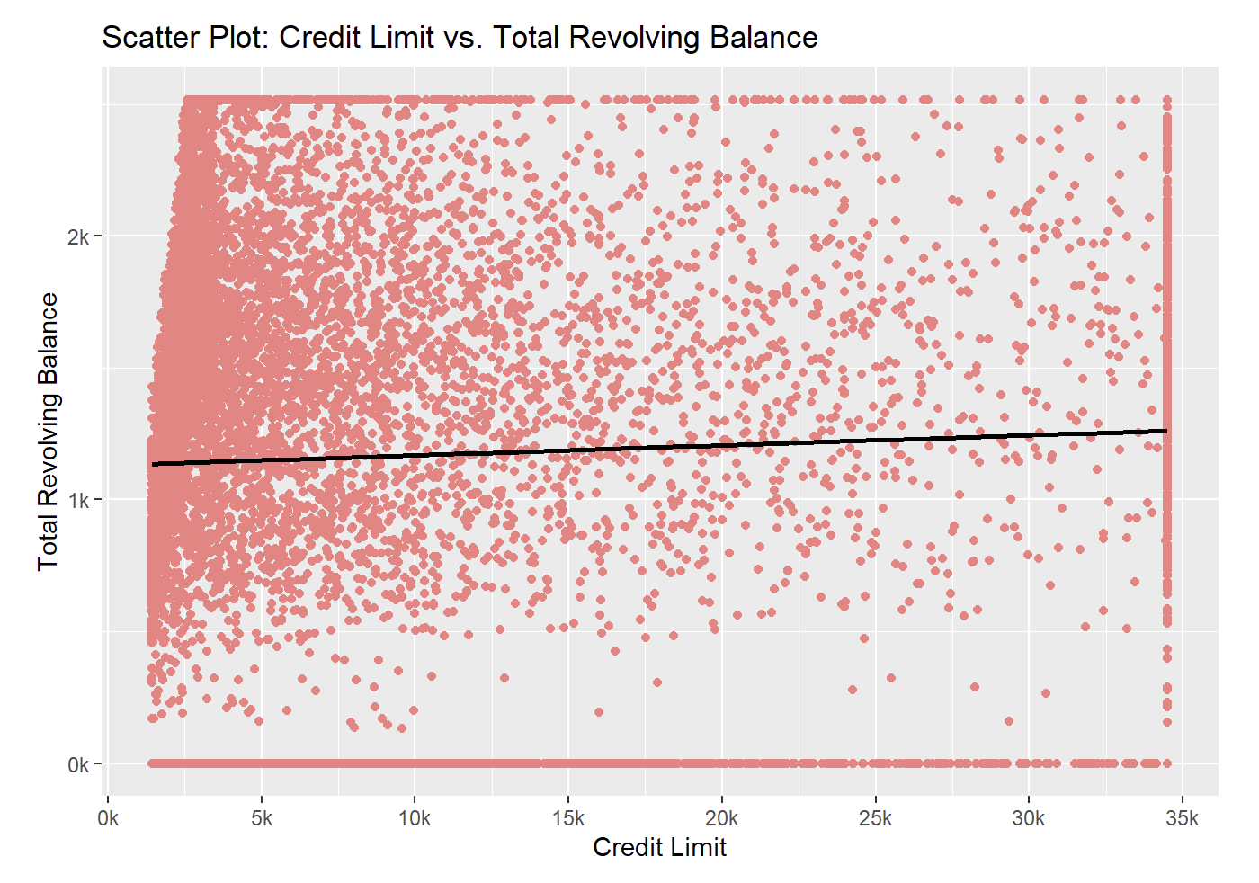
Weak positive correlation between a customer’s credit limit and their total revolving balance
This could suggest that while customers with higher credit limits tend to have slightly higher revolving balances, other factors not included in this analysis likely play a more substantial role in determining a customer’s revolving balance.
These factors could include customer income level, spending habits, and their propensity to carry a balance from month to month.

Slide 13
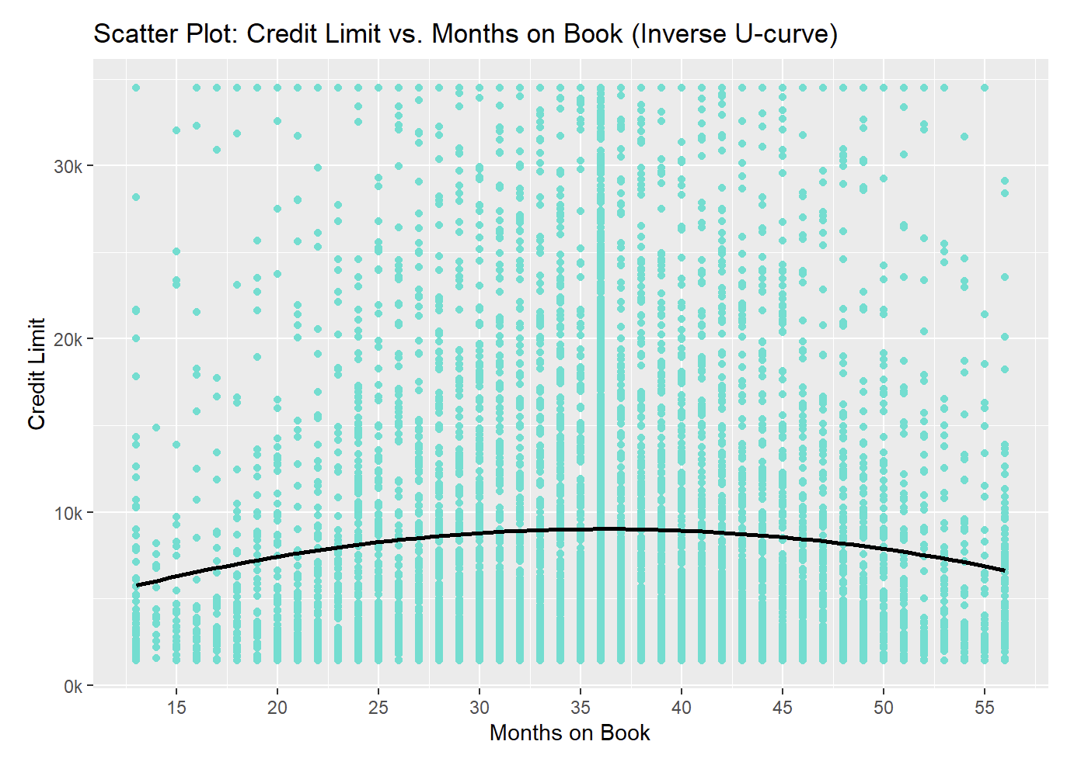
Illustrate an inverse U-curve relationship between the duration the Months on Book and their Credit Limit.
Initially, it appears that as the length of the relationship increases, so does the credit limit.
However, after reaching a certain point, further increases in the length of the relationship are associated with decreases in the credit limit.
This might be explained by various factors such as changes in a customer’s financial situation, reduced spending, or other factors that have led the bank to lower the credit limit.

Slide 14
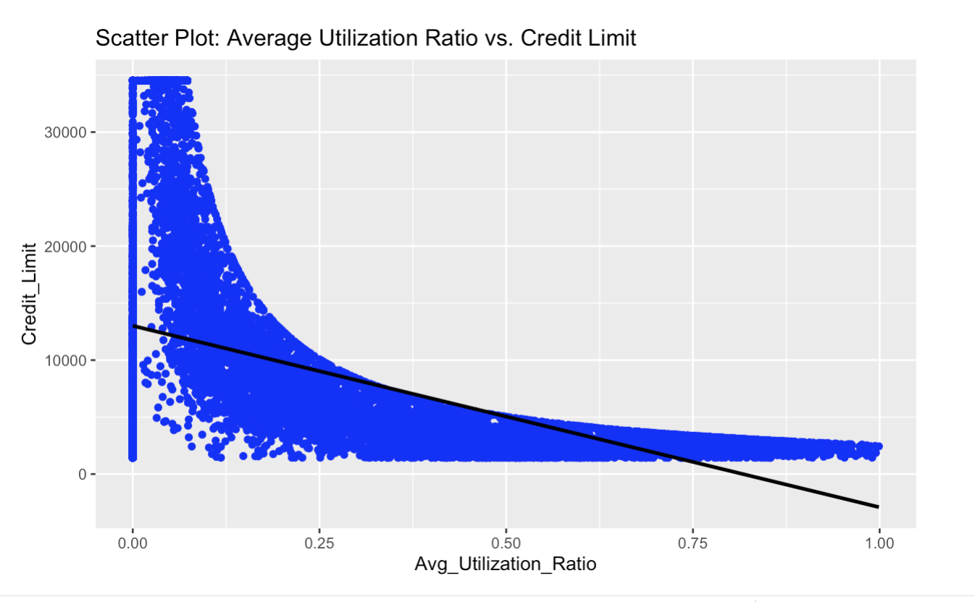
This indicates that as the average utilization ratio decreases, the credit limit tends to increase
Indicator of good financial management, where maintaining a low utilization ratio leads to increased credit trustworthiness.
Implement a rewards program for responsible credit card usage, offering credit limit increases, cashback rewards, and lower interest rates to encourage cardholders to maintain low utilization ratios.

Slide 15
Recommendation​
Identify the Inflection Point: Conduct a detailed analysis to pinpoint the exact stage in the customer's relationship at which credit limits start to decrease. This will help in understanding when and why this trend begins and can inform your strategy.
This could reflect a cautious approach by the bank towards very long-term customers who might be seen as more likely to accumulate debt.
Data-Driven Credit Limit Adjustments: The idea here is to look at how the customers been using card in the past. If they been using it responsibly and not spending too much compared to limit, that's a good sign give customer more spending room. They'll increase custom er credit limit.
Customer Segmentation: Segment customers based on their credit limits and spending behavior. Tailor marketing and communication strategies to address the unique needs of each segment. For example, offer increased limits to high-spending and responsible customers.
Holistic Credit Assessment: Implement a more comprehensive credit assessment approach that takes into account multiple factors, including income, credit history, and spending patterns, in addition to education level. This will result in a fairer and more accurate determination of credit limits.
Income-Based Rewards: Bank should offer special rewards and benefits that are appealing to customers. For example, they can offer cashback on luxury items or exclusive access to premium products or services. This means Sales and Marketing team should concentrate more on promoting these special benefits to people with higher incomes because they are less likely to use credit cards. By doing this, you can encourage more high-income customers to choose your credit card for their needs.

Slide 16
Conclusion
Diversity in Customer Profiles: The data showcases a diverse customer base with varying income levels, education backgrounds, and credit behaviors. Understanding and accommodating this diversity is crucial for financial institutions.
Income Not Sole Determinant: While income is a significant factor in credit limit decisions, the relationship between income and credit limits is not always straightforward. Higher income does not always correlate directly with higher credit limits, as seen in the 'Post-Graduate' category.
Spending Behavior Complexity: Utilization ratios across different card categories highlight the complexity of spending behavior. Customers often associated with lower incomes, exhibit a broader range of utilization ratios, suggesting a mix of responsible and potentially risky spending.
Account retention: Findings indicate that both male and female customers have similar levels of account retention, but the attrition rate is slightly higher among female customers.
Customer-Centric Approach: A customer-centric approach is essential. Providing financial education, transparent communication, and customized solutions helps build trust and fosters responsible credit card usage.
Continuous Adaptation: The financial landscape and customer behavior are dynamic. Financial institutions must continuously adapt their strategies, regularly assess customer profiles, and stay agile in addressing changing needs.

Slide 17
Citation
Credit Card customers Goyal https://www.kaggle.com/datasets/sakshigoyal7/credit-card-customers
How to Use geom_smooth in R Ebner & Newbie https://www.sharpsightlabs.com/blog/geom_smooth/
ggplot2 box plot : Quick start guide - R software and data visualization http://www.sthda.com/english/wiki/ggplot2-box-plot-quick-start-guide-r-software-and-data-visualization
Bar plot in ggplot2 with geom_bar and geom_col https://r-charts.com/ranking/bar-plot-ggplot2/

Slide 18
Thankyou!!

