Slide 1
NumPy
Atul Kahate

Slide 2
What is NumPy?
Numerical Python (NumPy) is an open source Python library
Used as the basis for Pandas, SciPy, Matplotlib etc
Contains single/multidimensional arrays and matrices
Python list versus NumPy array
A single list can contain different data types, but all the elements in a NumPy array must be of the same data type
Reason: To ensure that the mathematical operations on the elements are efficient
NumPy Arrays are faster and more compact (use less memory) than Python lists

Slide 3
NumPy Array Code Example
C:\code\Data Analytics\implementation\numpy\1-array.py and 1-array-properties.py
Now try a two-dimensional NumPy array: 2-array-2d.py
How to interpret axes? See next slide

Slide 4
Creating a NumPy Array – 6 Methods
Conversion from other Python structures (i.e. lists and tuples)
Intrinsic NumPy array creation functions (e.g. arange, ones, zeros, etc.)
Replicating, joining, or mutating existing arrays
Reading arrays from disk, either from standard or custom formats
Creating arrays from raw bytes through the use of strings or buffers
Use of special library functions (e.g. random)

Slide 5
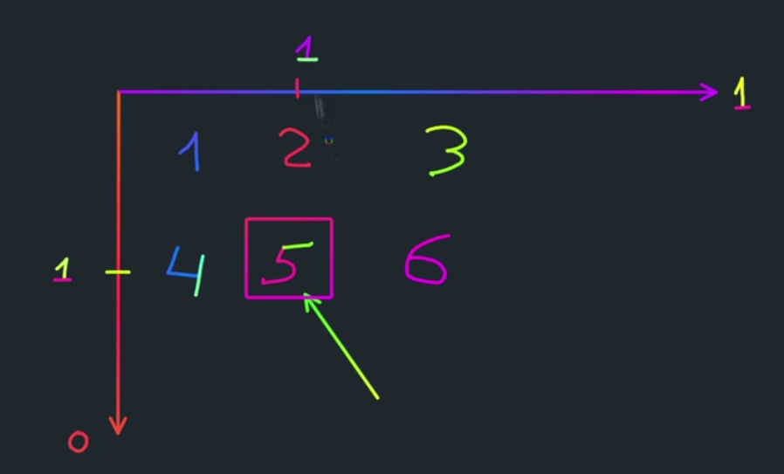
Interpreting Array Axes
Interpreting rows and columns
Value at row 0, column 0 = 1 … row 0, column 1 = 2 … row 1, column 0 = 4
Value at row 1, column 0 = 4 … row 1, column 1 = 5 etc

Slide 6
NumPy Arrays: Practical Usage
Using NumPy arrays for data analysis: 2.1-NumPy-Analysis

Slide 7
Python Lists versus NumPy Arrays
Python Lists
a = [1, 2, 3]
print [q*2 for q in a]
Output: 2, 4, 6
a = [1, 2, 3]
b = [4, 5, 6]
print [q+r for q, r in zip(a, b)]
Output: [5, 7, 9]
NumPy Arrays – Much simpler!
a = np.array([1, 2, 3])
print [a * 2]
Output: array([2, 4, 6])
a = np.array([1, 2, 3])
b = np.array([4, 5, 6])
print (a + b)
Output: array([5, 7, 9])

Slide 8
Creating Vectors (1D Arrays)
We can convert a Python list into a NumPy array
The type will be automatically determined from the list element types
Example: a = np.array([1., 2., 3.])
What if the list was not homogeneous? We will have dtype=‘object’, and the speed advantages of NumPy disappear
a
a = np.array([1., 2., 3.])
.dtype == np.float64
.shape == (3, )
1.
2.
3.

Slide 9
Growing NumPy Arrays
NumPy arrays cannot grow the way a Python list does: No space is reserved at the end of the array to facilitate quick appends
Solutions:
Grow a Python list and convert it to a NumPy array when it is ready or
Preallocate the necessary space with np.zeros or np.empty:
b
b = np.zeroes(3, int)
0
0
0
.dtype == np.int32

Slide 10
Creating an Array Like an Existing Array
We can create a new array that matches the shape and element types of an existing array:
We can also create a new array filled with constants – See next slide
c
c = np.zeroes_like(a)
.dtype == np.float64
.shape == (3, )
0.
0.
0.

Slide 11
Creating Filled Arrays Like an Existing Array
a
a = np.array([1, 2, 3])
1
2
3
b
b
b = np.zeros (3)
0.
0.
0.
b = np.zeros_like (a)
0
0
0
b = np.ones (3)
1.
1.
1.
b = np.ones_like (a)
1
1
1
b = np.empty (3)
<>
<>
<>
b = np.empty_like (a)
1
0
8
b = np.full (3, 7.)
7.
7.
7.
b = np.full_like (a, 7)
7
7
7
All functions that create an array filled with constants have a _like counterpart
The empty() function fills values with random values

Slide 12
Creating an Array using the arange() Function
Returns evenly spaced values within a given interval
np.arange(0,10)
This will create an array of 10 elements with values 0 to 9
Other examples in C:\code\Data Analytics\implementation\numpy
stop
np.arange(6)
0
1
2
3
4
5
start, stop
np.arange(start, stop, step)
np.arange(2, 6)
2
3
4
5
np.arange(1, 6, 2)
1
3
5
start, stop, step

Slide 13
Not So Good with Float Values!
start, stop, step
np.arange(0.4, 0.8, 0.1)
0.4
0.5
0.6
0.7
Ok
np.arange(0.5, 0.8, 0.1)
0.5
0.6
0.7
0.8
Not ok
np.arange(0.5, 0.75, 0.1)
0.5
0.6
0.7
Solution
np.linespace(0.5, 0.7, 3)
0.5
0.6
0.7
Another solution
start, stop, num

Slide 14
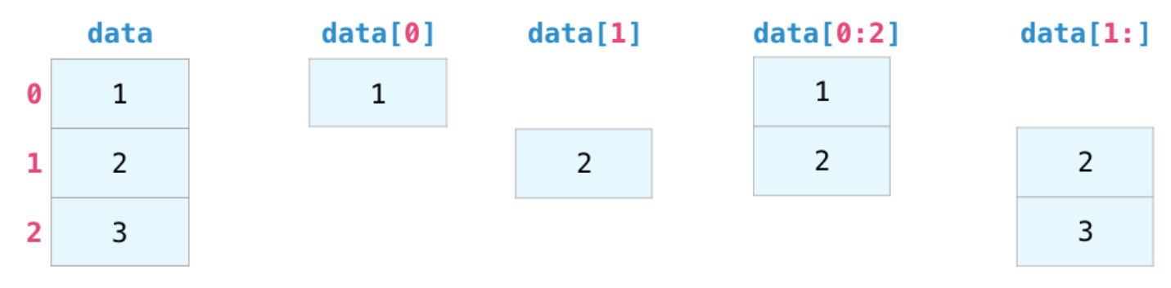
Indexing and Slicing

Slide 15
Vector Indexing
a = np.arange(1, 6)
1
2
3
4
5
0
1
2
3
4
a[1]
a[2:4]
a[-2:]
a[::2]
a[[1, 3, 4]]
a[2:4] = 0
2
3
4
4
5
1
3
5
2
4
5
1
2
0
0
5
Slice from the second-last element till the end
:: means slice, and 2 means every second element; so this means take every second element
Non-standard syntax, tries to get the 1st, 3rd, and 4th elements

Slide 16
Boolean Indexing: Logical Operations
a
1
2
3
4
5
6
7
6
5
4
3
2
1
a > 5
F
F
F
F
F
T
T
T
F
F
F
F
F
np.any(a > 5)
a[a > 5]
np.all(a > 5)
True
6
7
6
False
a[a > 5] = 0
a
1
2
3
4
5
0
0
0
5
4
3
2
1
Considering the original array a
a[(a >= 3) & (a <= 5)] = 0
a
1
2
0
0
0
6
7
6
0
0
0
2
1

Slide 17
Code for the Earlier Slide
import numpy as np;
a = np.array([1, 2, 3, 4, 5, 6, 7, 6, 5, 4, 3, 2, 1])
print (a)
print(np.any(a > 5))
print(a[a > 5])
print(np.all(a > 5))
a[a > 5] = 0
print (a)
a = np.array([1, 2, 3, 4, 5, 6, 7, 6, 5, 4, 3, 2, 1])
a[(a >= 3) & (a <= 5)] = 0
print(a)

Slide 18
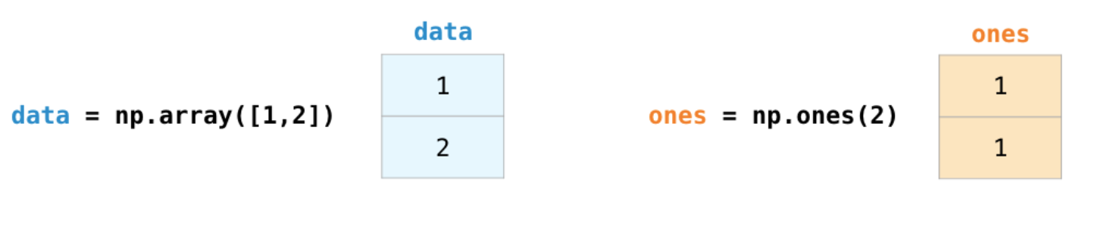
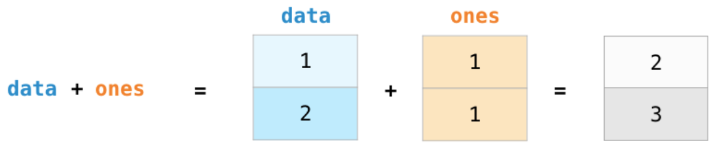
Array Arithmetic
import numpy as np;
data = np.array([1,2])
ones = np.ones(2)
print(data + ones)

Slide 19
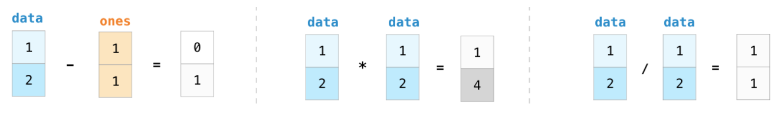
Other Arithmetic Operations

Slide 20
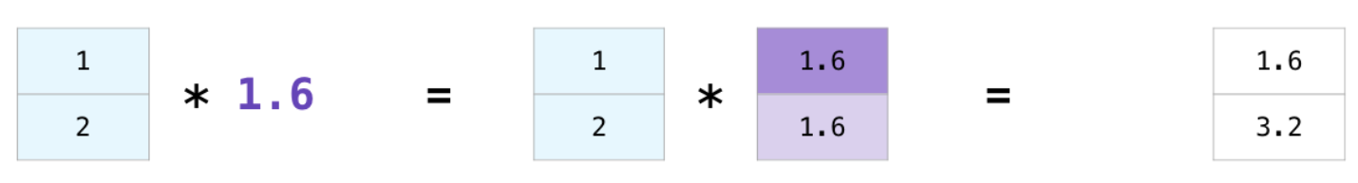
Array and a Scalar

Slide 21
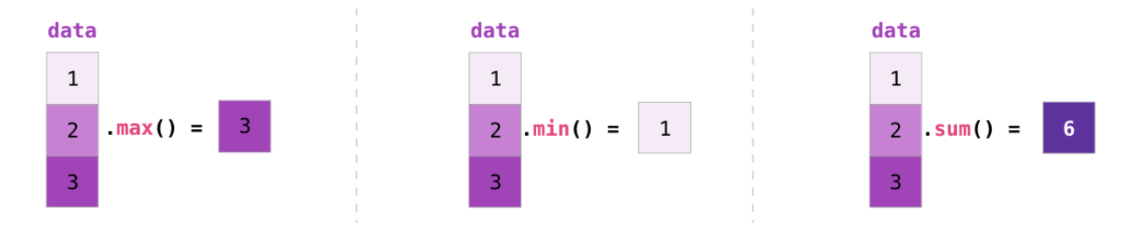
Aggregation

Slide 22
Random Number Generation
Examples
print(np.random.rand(2))
print(np.random.rand(5,5))

