Slide 1
Welcome to EC Lab

Slide 2
Gray Code
In a Gray code only one bit changes between each pair of successive code words.
Gray Code also called as Cyclic Code.
Gray code also called as reflected Binary code.

Slide 3
3 Bit Gray Code as RBC
0000
00011110
000001011010110111101100
2-bit Gray code
00011110
1111
10110100

Slide 4
Applications of Gray code
1.K-Maps(one bit change)
2.To Prevent Spurious output from
Electromechanical Switches
3.Error Correction Codes

Slide 5
Binary To Gray Code
B3 | B2 | B1 | B0 | G3 | G2 | G1 | G0
0 | 0 | 0 | 0 | 0 | 0 | 0 | 0
0 | 0 | 0 | 1 | 0 | 0 | 0 | 1
0 | 0 | 1 | 0 | 0 | 0 | 1 | 1
0 | 0 | 1 | 1 | 0 | 0 | 1 | 0
0 | 1 | 0 | 0 | 0 | 1 | 1 | 0
0 | 1 | 0 | 1 | 0 | 1 | 1 | 1
0 | 1 | 1 | 0 | 0 | 1 | 0 | 1
0 | 1 | 1 | 1 | 0 | 1 | 0 | 0
1 | 0 | 0 | 0 | 1 | 1 | 0 | 0
1 | 0 | 0 | 1 | 1 | 1 | 0 | 1
1 | 0 | 1 | 0 | 1 | 1 | 1 | 1
1 | 0 | 1 | 1 | 1 | 1 | 1 | 0
1 | 1 | 0 | 0 | 1 | 0 | 1 | 0
1 | 1 | 0 | 1 | 1 | 0 | 1 | 1
1 | 1 | 1 | 0 | 1 | 0 | 0 | 1
1 | 1 | 1 | 1 | 1 | 0 | 0 | 0
16 bit refection
8 bit refection
4 bit refection
2 bit refection

Slide 6



K-Map
B1, B0
B1, B0
B3, B2 00
B3, B2
00 01 11 10
01 11 10
00
00
1 1 1 1 |  |  |  | G2= 01 11 | 1 | 1 1 1
1 | 1 | 1 | 1 | 10 | 1 | 1 | 1 | 1
G3 =
01
11
10
B3 = G3
G2= B3 B2 + B3 B2
B1, B0
B1, B0
=B3 + B2
B3, B2 0 |  |  |  |  | B3, B2
G1= | 00 |  |  |  |  | 00
 | 01 |  |  |  | G0= | 01
 | 11 |  |  |  |  | 11
 | 10 |  |  |  |  | 10
0 01 11 | 10 1 1
1 1
1 1
 | 1 1
00 01 11 10 | 1 |  | 1
 | 1 |  | 1
 | 1 |  | 1
 | 1 |  | 1
G0 = B1 B0 + B1 B0
G1= B2 B1 + B2 B1
= B2 + B1
= B1 + B0

Slide 7
B3
G3
B2
G2
B1
G1
B0
G0

Slide 8
Gray To Binary CC
G3 | G2 | G1 | G0 | B3 | B2 | B1 | B0
0 | 0 | 0 | 0 | 0 | 0 | 0 | 0
0 | 0 | 0 | 1 | 0 | 0 | 0 | 1
0 | 0 | 1 | 0 | 0 | 0 | 1 | 1
0 | 0 | 1 | 1 | 0 | 0 | 1 | 0
0 | 1 | 0 | 0 | 0 | 1 | 1 | 1
0 | 1 | 0 | 1 | 0 | 1 | 1 | 0
0 | 1 | 1 | 0 | 0 | 1 | 0 | 0
0 | 1 | 1 | 1 | 0 | 1 | 0 | 1
1 | 0 | 0 | 0 | 1 | 1 | 1 | 1
1 | 0 | 0 | 1 | 1 | 1 | 1 | 0
1 | 0 | 1 | 0 | 1 | 1 | 0 | 0
1 | 0 | 1 | 1 | 1 | 1 | 0 | 1
1 | 1 | 0 | 0 | 1 | 0 | 0 | 0
1 | 1 | 0 | 1 | 1 | 0 | 0 | 1
1 | 1 | 1 | 0 | 1 | 0 | 1 | 1
1 | 1 | 1 | 1 | 1 | 0 | 1 | 0

Slide 9






K-Map
G1, G0
G1, G0
G3, G2
00 01 11 10
G3, G2
00 01 11 10
00
01
11
10
00
01
1 1 1 1
B3=
B3=G3
B2=
1
1
1
1
1
1
1
1
11
10
1 1 1 1
G1, G0
B2= G3 G2 + G3 G2
G3, G2
00 01 | 1₁1 10₁
1 1
 |  | 1 1
1 1
= G3 + G2
00
B1= G3 G2 G1 + G3 G2 G1 + G3 G2 G1 + G3 G2 G1
B1=
01
11
10
= (G3 G2 + G3 G2) G1 + (G3 G2 + G3 G2) G1
= (G3 + G2) G1 + (G3 + G2) G1
= (G3 + G2) (G1 + G1)
= G3 + G2 + G1

Slide 10
G3
B3
G2
B2
G1
B1
G0
B0

Slide 11
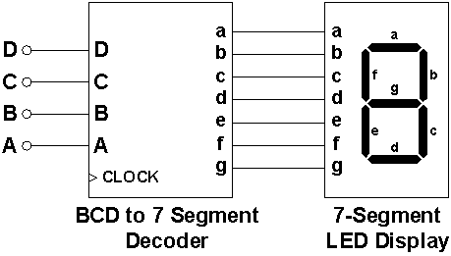
BCD to Seven Segment Display

Slide 12
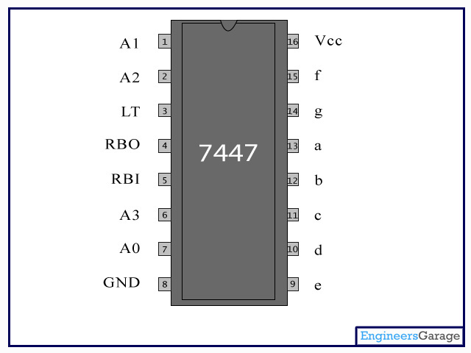
IC 7447 (BCD to 7 Segment Decoder)

Slide 13
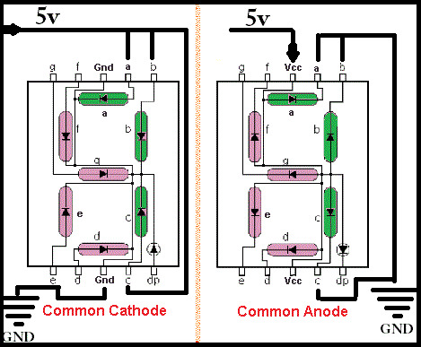
7 Segment Display

Slide 14
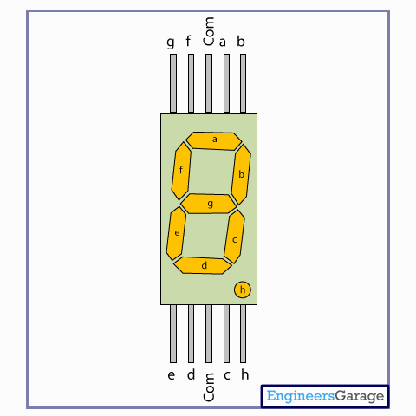
Common Anode Display

Slide 15
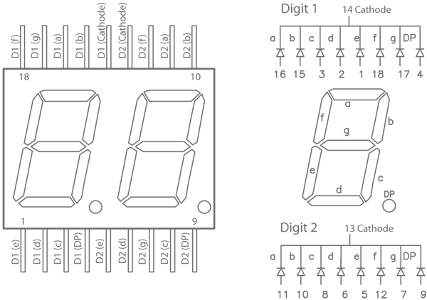
Dual Digit 7 Segment Display

Slide 16
