Slide 1
SDA Assignment 1 Report
Submitted By
Sayam Kumar S20180010158
Hrishabh Pandey S20180010064
Ram Nad S20180010145
Raahul Singh S20180010141

Slide 2
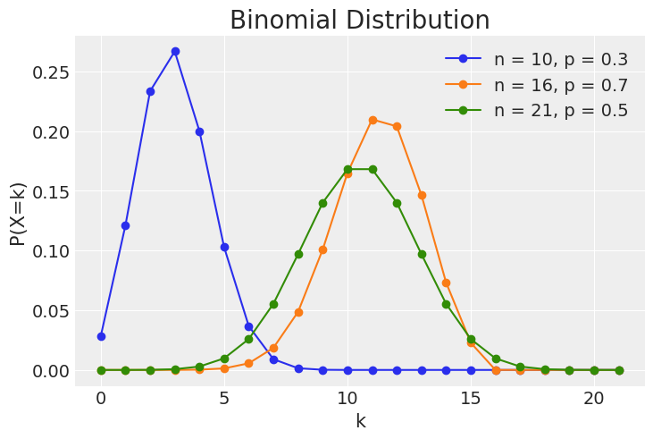

Binomial Distribution

Slide 3
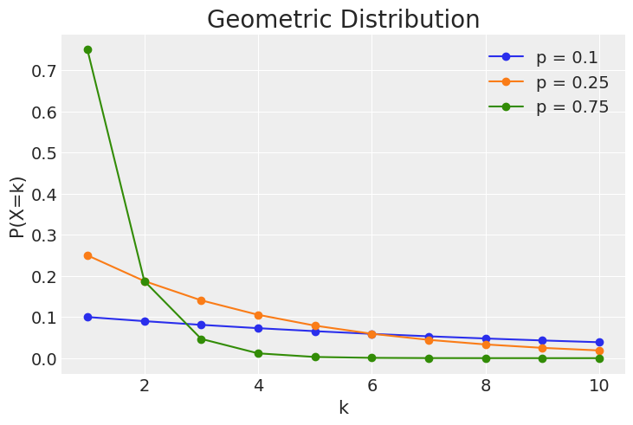

Geometric Distribution

Slide 4
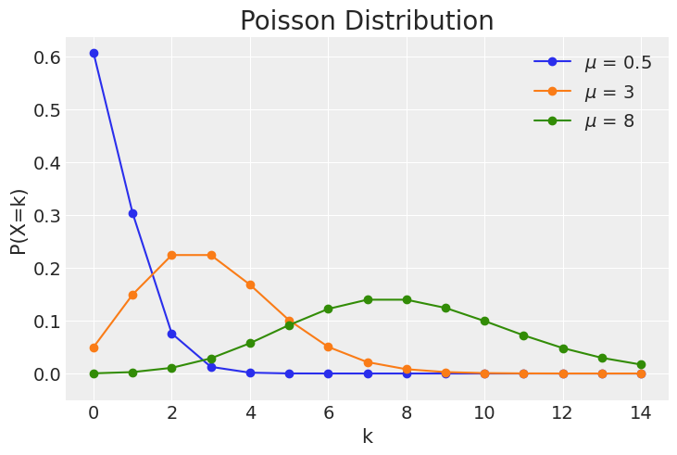

Poisson Distribution

Slide 5
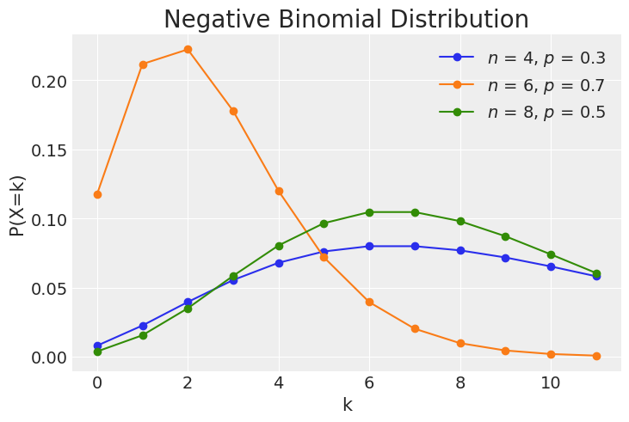

Negative Binomial Distribution

Slide 6
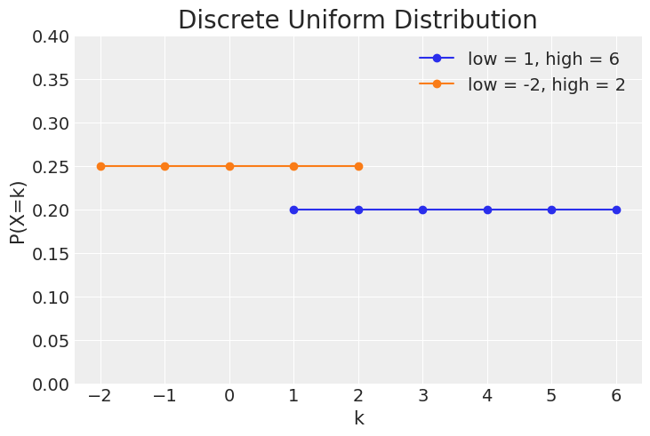
Discrete Uniform Distribution

Slide 7
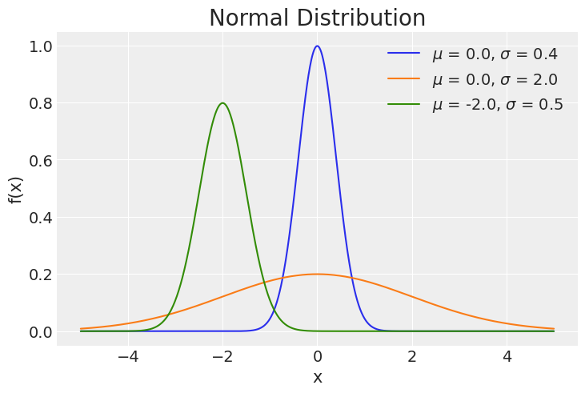

Normal Distribution

Slide 8
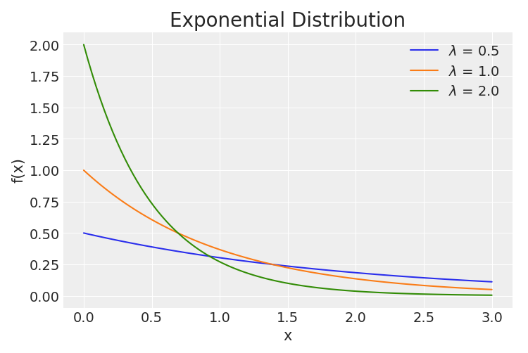

Exponential Distribution

Slide 9
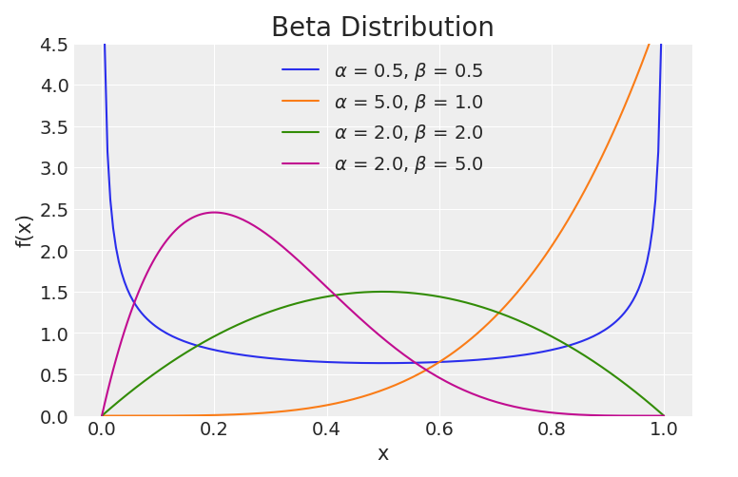
Beta Distribution

Slide 10

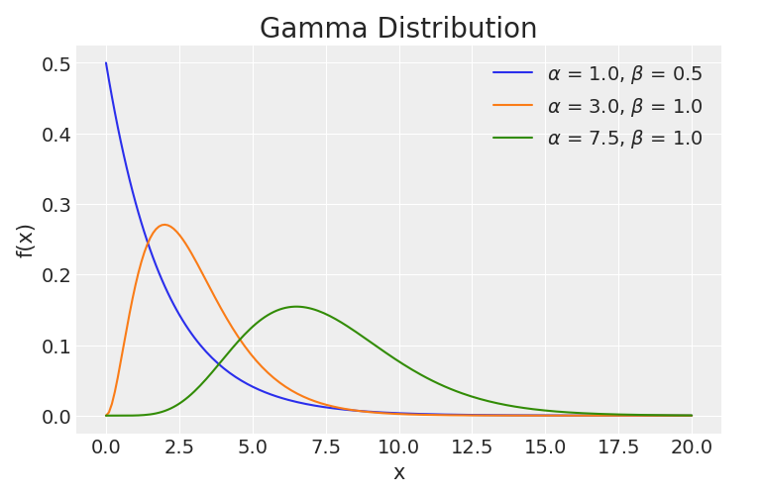
Gamma Distribution

Slide 11
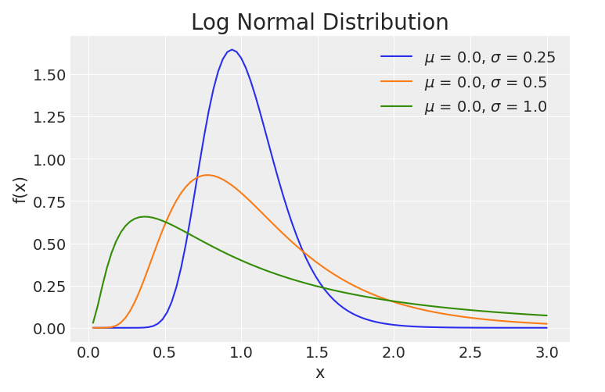
Log Normal Distribution

Slide 12
Part 2: Running 1000 Simulations Central Limit Theorem
We draw 40 samples for a distribution 1000 times and we take the mean for each of the 1000 samples and thus we have plotted the histogram for each distribution w.r.t the frequency of sample size.

Slide 13
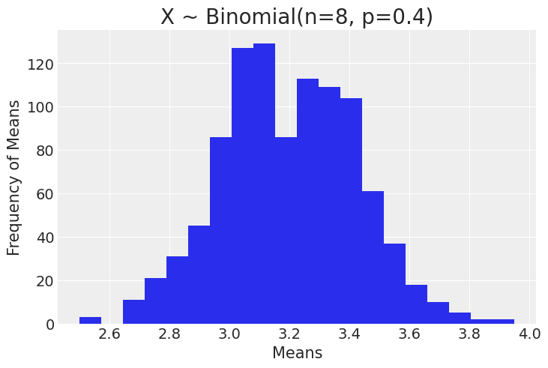

Binomial Distribution

Slide 14

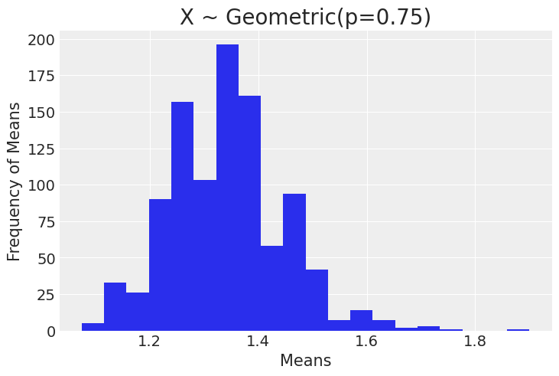
Geometric Distribution

Slide 15

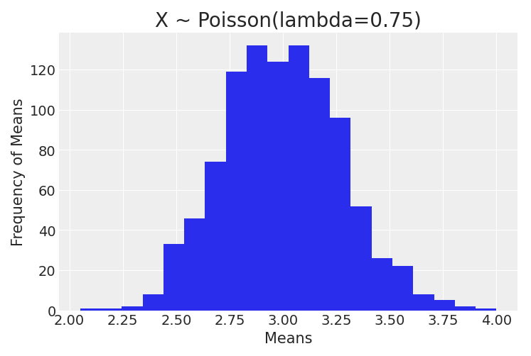
Poisson Distribution

Slide 16
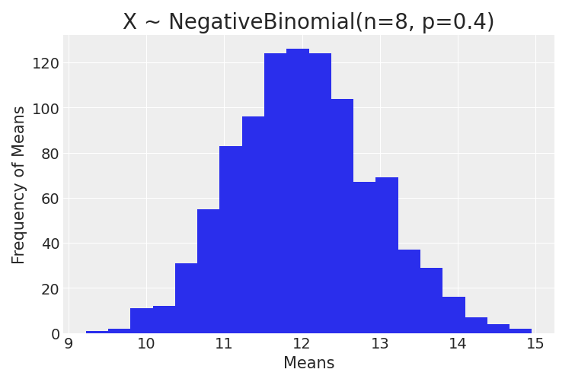

Negative Binomial Distribution

Slide 17
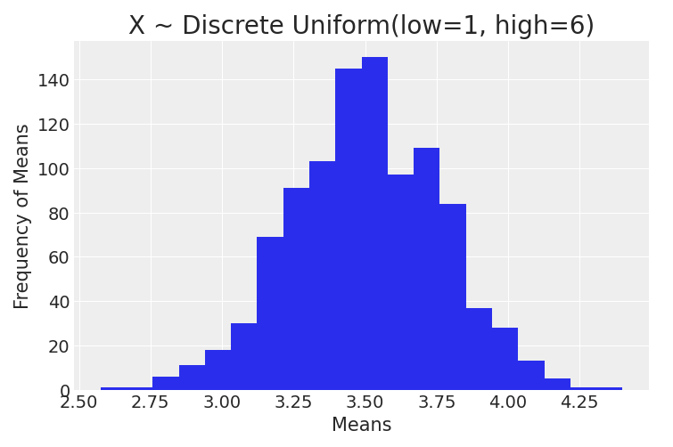

Discrete Uniform Distribution

Slide 18
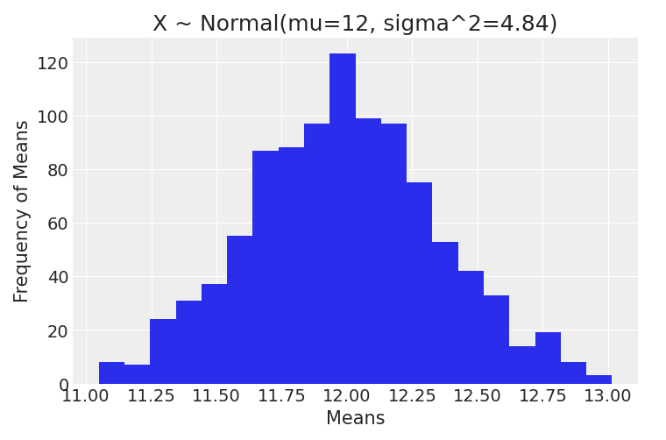

Normal Distribution

Slide 19
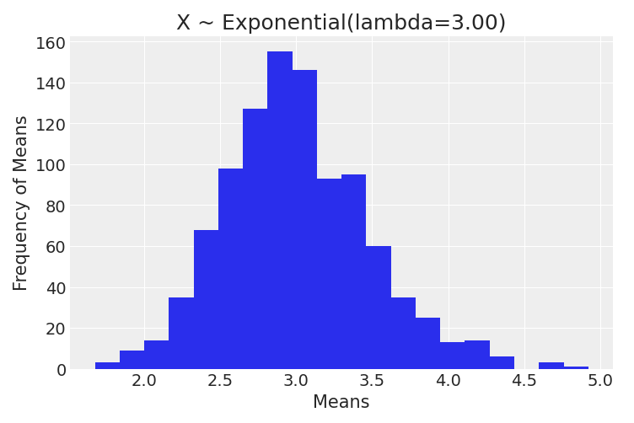

Exponential Distribution

Slide 20
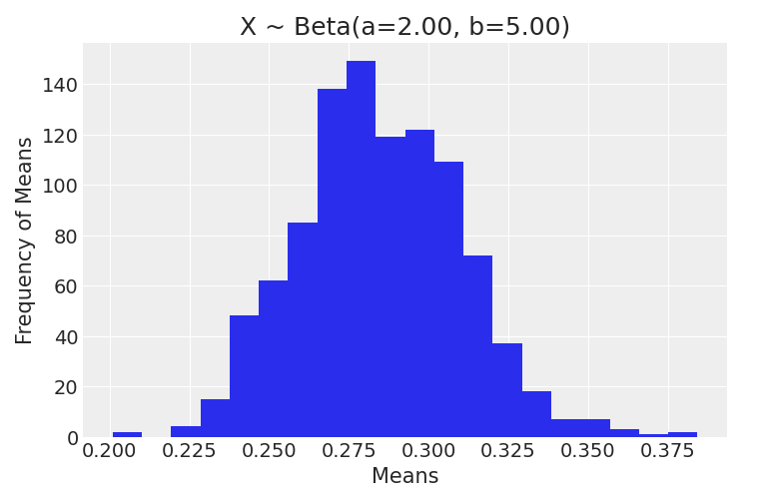

Beta Distribution

Slide 21
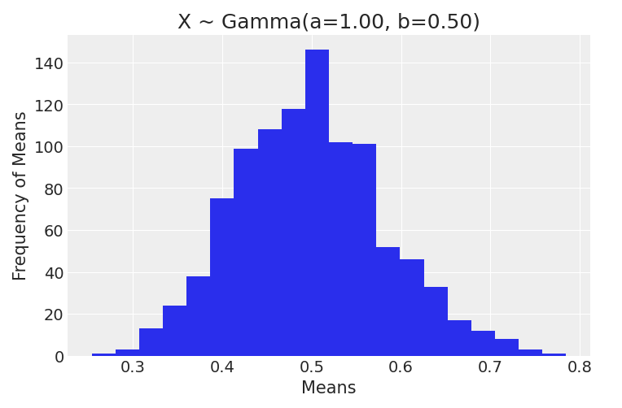

Gamma Distribution

Slide 22
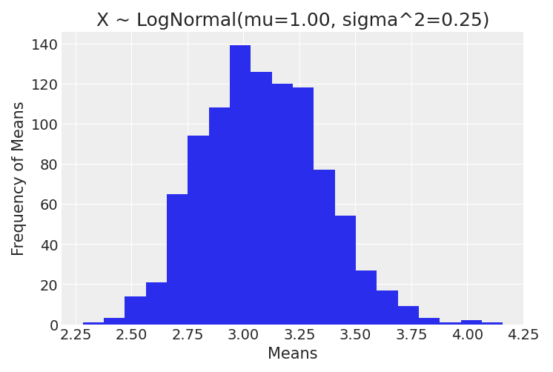

Log Normal Distribution

Slide 23
DONE
After running 1000 simulations for each distribution we have found that the distribution of sample mean approached the normal distribution as the sample size increases and variance of mean tends to 0. This observation applies for all distribution.

