Slide 1
BTP Project
AR / VR based Furniture Marketplace
By - B21SK01
Sayam Kumar - S20180010158
Nitin Kumar Chauhan - S20180010119
Dasari Jayasree - S20180010047

Slide 2
Outline
Objective
Progress
Live Demo
Model details
Mobile App details
Major challenges we faced
Results and Conclusion

Slide 3
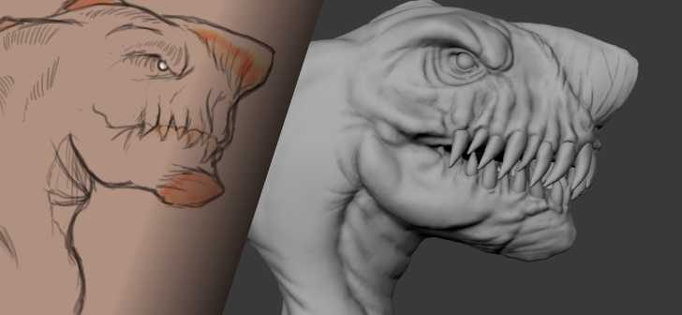
Objective
Use Augmented Reality / Virtual Reality to simplify the work of furniture showrooms and Interior designers.
Scan furniture and store them in central place.
Improve customer engagements by allowing them project furniture in rooms.

Slide 4
Progress
First Evaluation
Learnt the basics of 2D-3D modelling. Literature Review.
Second Evaluation
Model creation phase
Created a novel end-to-end pipeline from 2D image to 3D model shape. Represented the generated 3D model in virtual space.
Third Evaluation
Mobile App creation phase
Created an end-to-end mobile app joining the outcomes of second evaluation. An image is taken from mobile and a 3D model is rendered in virtual space after being generated from server.

Slide 5
Progress
Fourth Evaluation
Fine tuning phase
Trained the network on cabinets and sofa models. Analysis of generative power of the network QR code retrieval of models Improved Mobile App to be fully optimized

Slide 6
Live Demo

Slide 7
Model Related Work

Slide 8
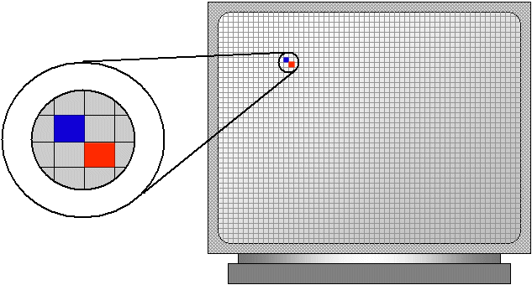
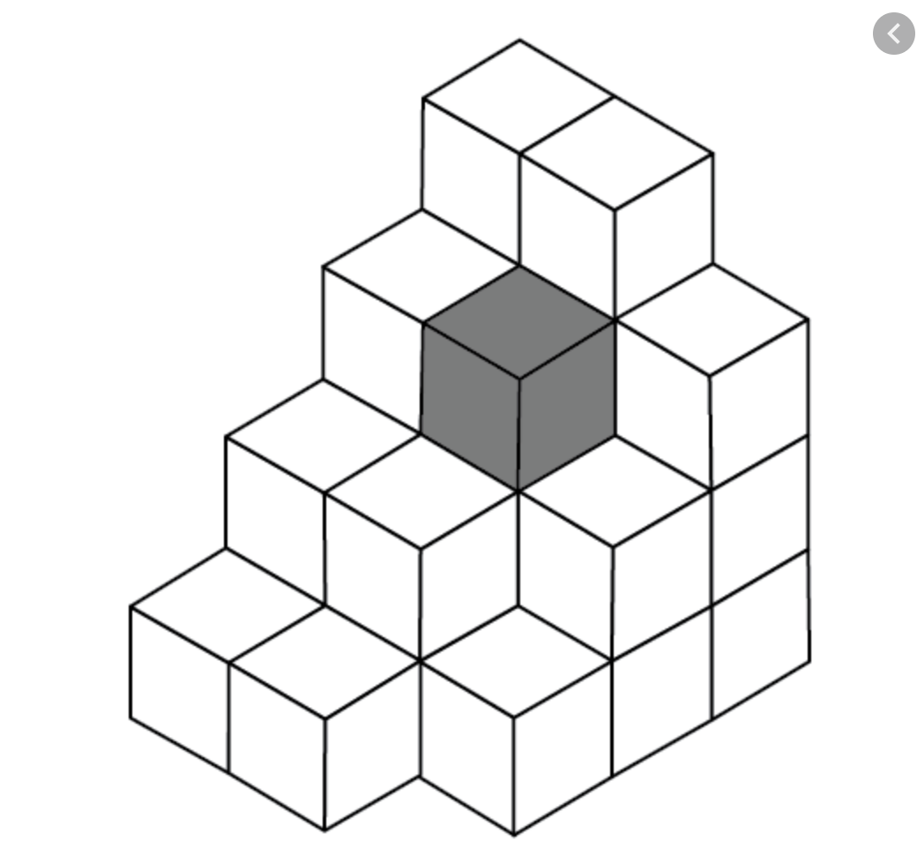
Terminology
Pixel - Smallest unit for a 2D image. All images are formed by stacking and arranging pixels.
Voxel - Smallest cubical unit for a 3d structure.

Slide 9
Problem Definition
Given an input Image (I), generate a 3D model (M) for it.
This can be seen as a Supervised Learning problem. Let’s say, we make use of hypothesis function (h).
M = h(I)
Further breaking it down,
We have ground truth Image I and it's true model M from the dataset.
Our network learns a transition from pixel representation of 2D image to voxel representation of 3D model.
We compare the generated 3D model with true 3D model and use sparse loss functions to train for visually appealing results.

Slide 10
Related Works
Geometry-based Reconstruction - Make 3D objects from 2D images by satisfying geometry constraints and adding prior knowledge. Eg - If I am modelling sphere, I make sure the 3D model has equal radius from center to surface (Moll et al, 2015).
Learning-based Reconstruction - These methods use data driven approaches for 2D-3D mapping. Initial works are described in 3D Recurrent Neural Network (3D-R2N2) (Choy et al, 2016) paper which uses multiple views of images and Long Short Term Memory (LSTM).
Our method uses data driven approaches with Encoder-Decoder networks as hypothesis function.

Slide 11
Dataset
Used Shapenet dataset. Original shapenet:
Is built by generating 3D models using Computer Aided Design (CAD)
270 categories of objects
51k unique 3D models
Our data pipeline -
4 categories - chair, table, cabinet and sofa
Till 2nd eval - 2.2k chair models, 2.5k table models
Now - Added 1.4k cabinets, 2k sofa models
12 2D views for the 3D model as images captured by 30º rotation around vertical axis.
Images in png format and 3D model in obj format.
Background from the images is removed, if any.

Slide 12
Learning Representation
We need to learn two things from an image - 3D model shape and 3D model texture.
Joint Learning
Learn both tasks simultaneously
Each occupied voxel is learnt by 0 or 1. 0 means unoccupied voxel and 1 means occupied voxel.
For color, the network learns three numbers for RGB for occupied voxels and a vector [-1, -1, -1] for unoccupied voxels.
Learn 4 numbers in total.
A bad approach - For sparse models (like chair) and imbalanced voxels, the network pushes more towards learning unoccupied voxels better.

Slide 13
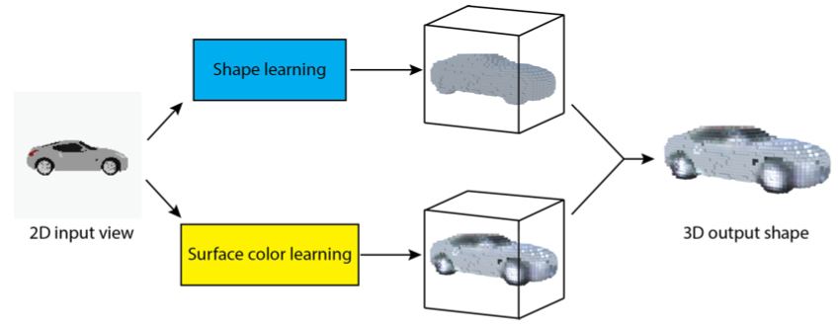
Learning Representation
Our Approach
Learn both tasks separately.
This avoided the training difficulty due to shape color imbalance

Slide 14
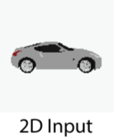
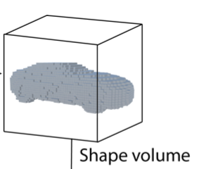
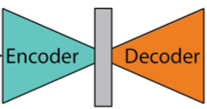
Shape Network
Given an input image (I), the encoder network (e) first learns the latent representation and then is fed into a decoder network (d).
The decoder generates a 1 channel shape volume V’ = d(e(I))

Slide 15
Shape Network
Encoder - 6 2D convolution layers (conv layers for weight sharing and focussing on local relations)
(128, 128, 3)
(64, 64, 64)
(32, 32, 64)
(16, 16, 128)
(8, 8, 128)
(4, 4, 256)
(1, 1, 512)
(7, 7) kernel
64 filters
2 stride
(5, 5) kernel
64 filters
2 stride
(5, 5) kernel
128 filters
2 stride
(3, 3) kernel
128 filters
2 stride
(3, 3) kernel
256 filters
2 stride
(4, 4) kernel
512 filters
2 stride
Decoder - 5 3D convolution layers
(4*4*4*128)
FC Layer
(4, 4, 4, 128)
(8, 8, 8, 128)
(16, 16, 16, 32)
(32, 32, 32, 32)
(64, 64, 64, 16)
(64, 64, 64, 1)
(3, 3, 3) kernel
64 filters
2 stride
(3, 3, 3) kernel
32 filters
2 stride
(3, 3, 3) kernel
32 filters
2 stride
(3, 3, 3) kernel
24 filters
2 stride
(3, 3, 1) kernel
1 filters
2 stride

Slide 16

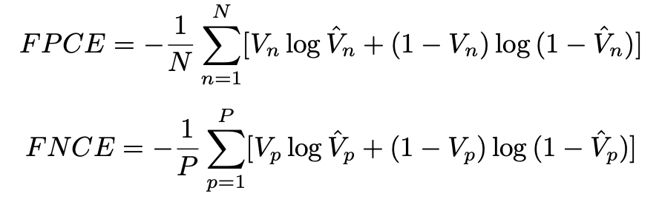
Shape Network Loss Functions
L2 loss =
where i is voxel index and V_{i} is state of voxel occupancy {0, 1}
Moved to Cross Entropy loss
Loss =
To handle sparse relations better, we modified it to use two combined losses -
False Positive Cross entropy on unoccupied voxels
False Negative Cross entropy on occupied voxels

Slide 17


Training
Tech Stack
Train / Test Split = 0.9 / 0.1
Adam learning optimizer
Learning rate = 0.0003
Batch size = 60
Training Epochs = 500
Tensorflow
cv2
Scipy
Python
SSH keys protection

Slide 18
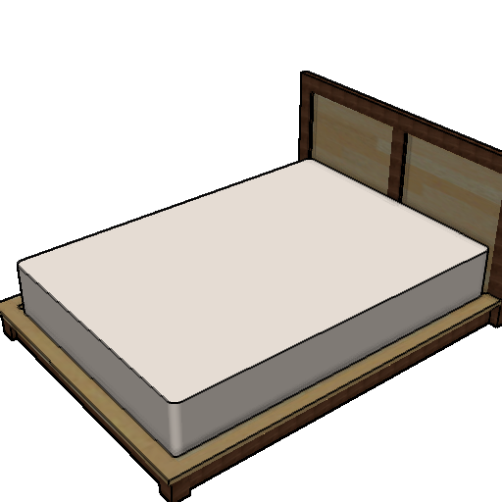
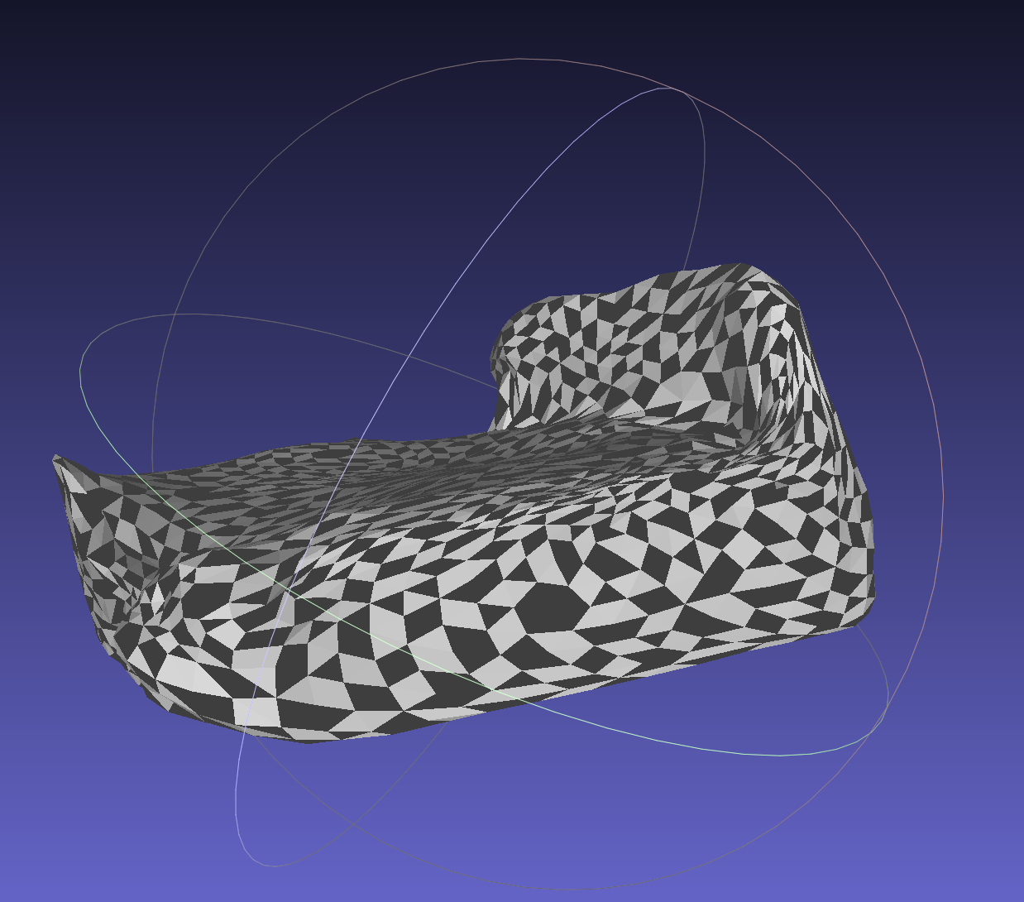
Performance Check on Out-of-Distribution Data
The model is trained on 4 furniture categories i.e. chair, table, cabinet and sofa.
We got visually appealing results for categories outside the 4 mentioned above.
Examples shown in live demo and one more here: Checking model of bed

Slide 19
Mobile App Related Work

Slide 20



Mobile App Interactions
Image Bucket
Requests for Upload URL (PreSigned)
Backend Server

Slide 21
Gets URL using aws SDK
Image Bucket
Requests for Upload URL (PreSigned)
Backend Server

Slide 22
Uploading Image to aws S3
Gets URL using aws SDK
Image Bucket
Requests for Upload URL (PreSigned)
Sends back the URL
Backend Server

Slide 23
Uploading Image to aws S3
Requests for Model Creation (with Image URL)
Backend Server

Slide 24

Uploading Image to aws S3
Saves the Pending Model in DB
DB
Requests for Model Creation (with Image URL)
Backend Server

Slide 25
Uploading Image to aws S3
Saves the Pending Model in DB
Sends Pending model to App
DB
Requests for Model Creation (with Image URL)
Backend Server

Slide 26

Model upload URL (PreSigned)
Image Bucket
Backend Server
Model Creation Server

Slide 27
Model upload URL (PreSigned)
Image Bucket
Requests for Model Creation (with Image URL & Model URL)
Backend Server
Model Creation Server

Slide 28
Gets the image from s3
Model upload URL (PreSigned)
Image Bucket
Requests for Model Creation (with Image URL & Model URL)
Backend Server
Model Creation Server

Slide 29
Gets the image from s3
Model upload URL (PreSigned)
Image Bucket
Requests for Model Creation (with Image URL & Model URL)
Sends the response back
Backend Server
Model Creation Server

Slide 30
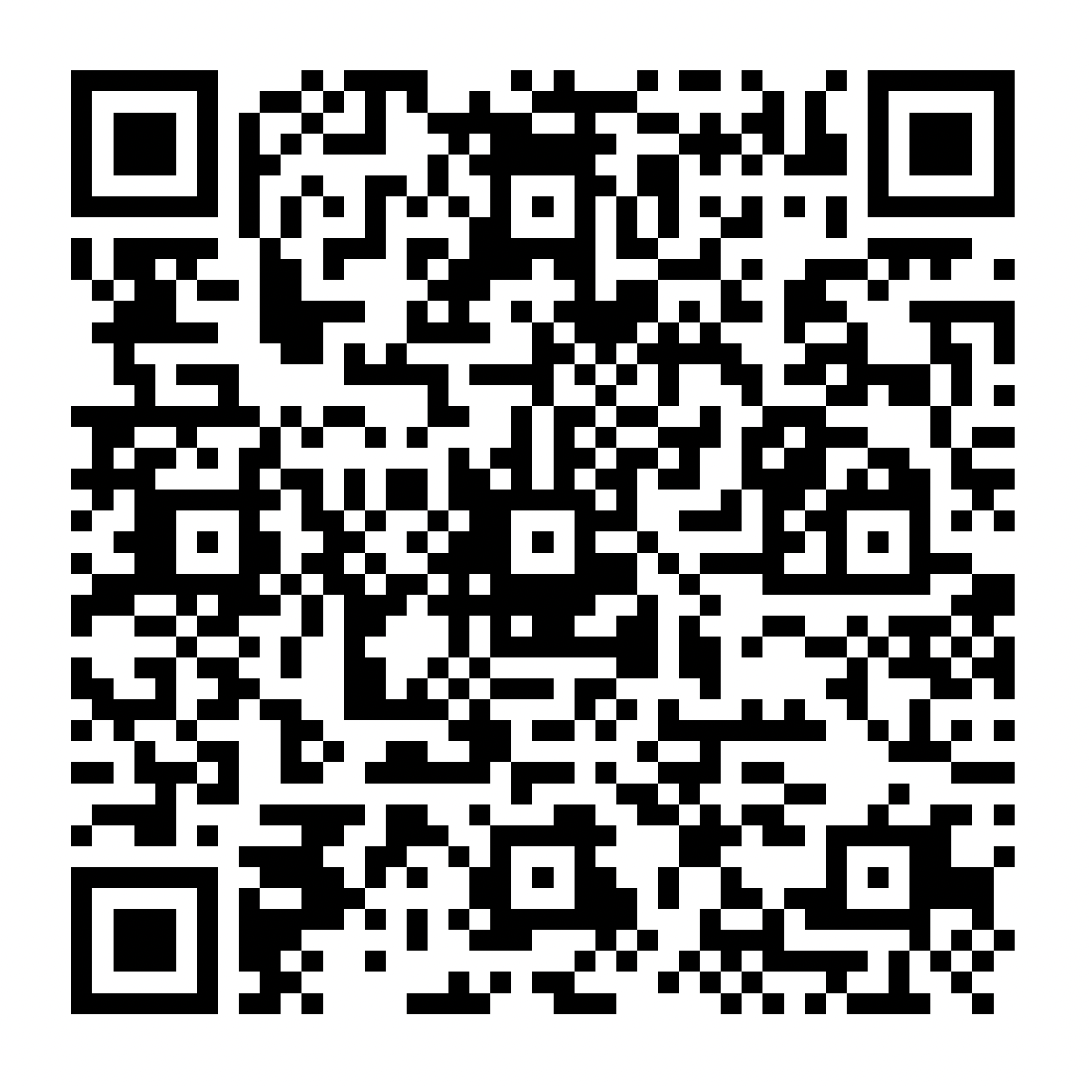
Model Retrieval using QR code
Every Processed 3D model in our Database has a QR code associated with it, which contains information such as model name and the url to download the model.
{
"model_url":"https://btp-model.s3.ap-south-1.amazonaws.com/b74681da17f97068c83346dbf17b0902",
"title":"Table"
}

Slide 31
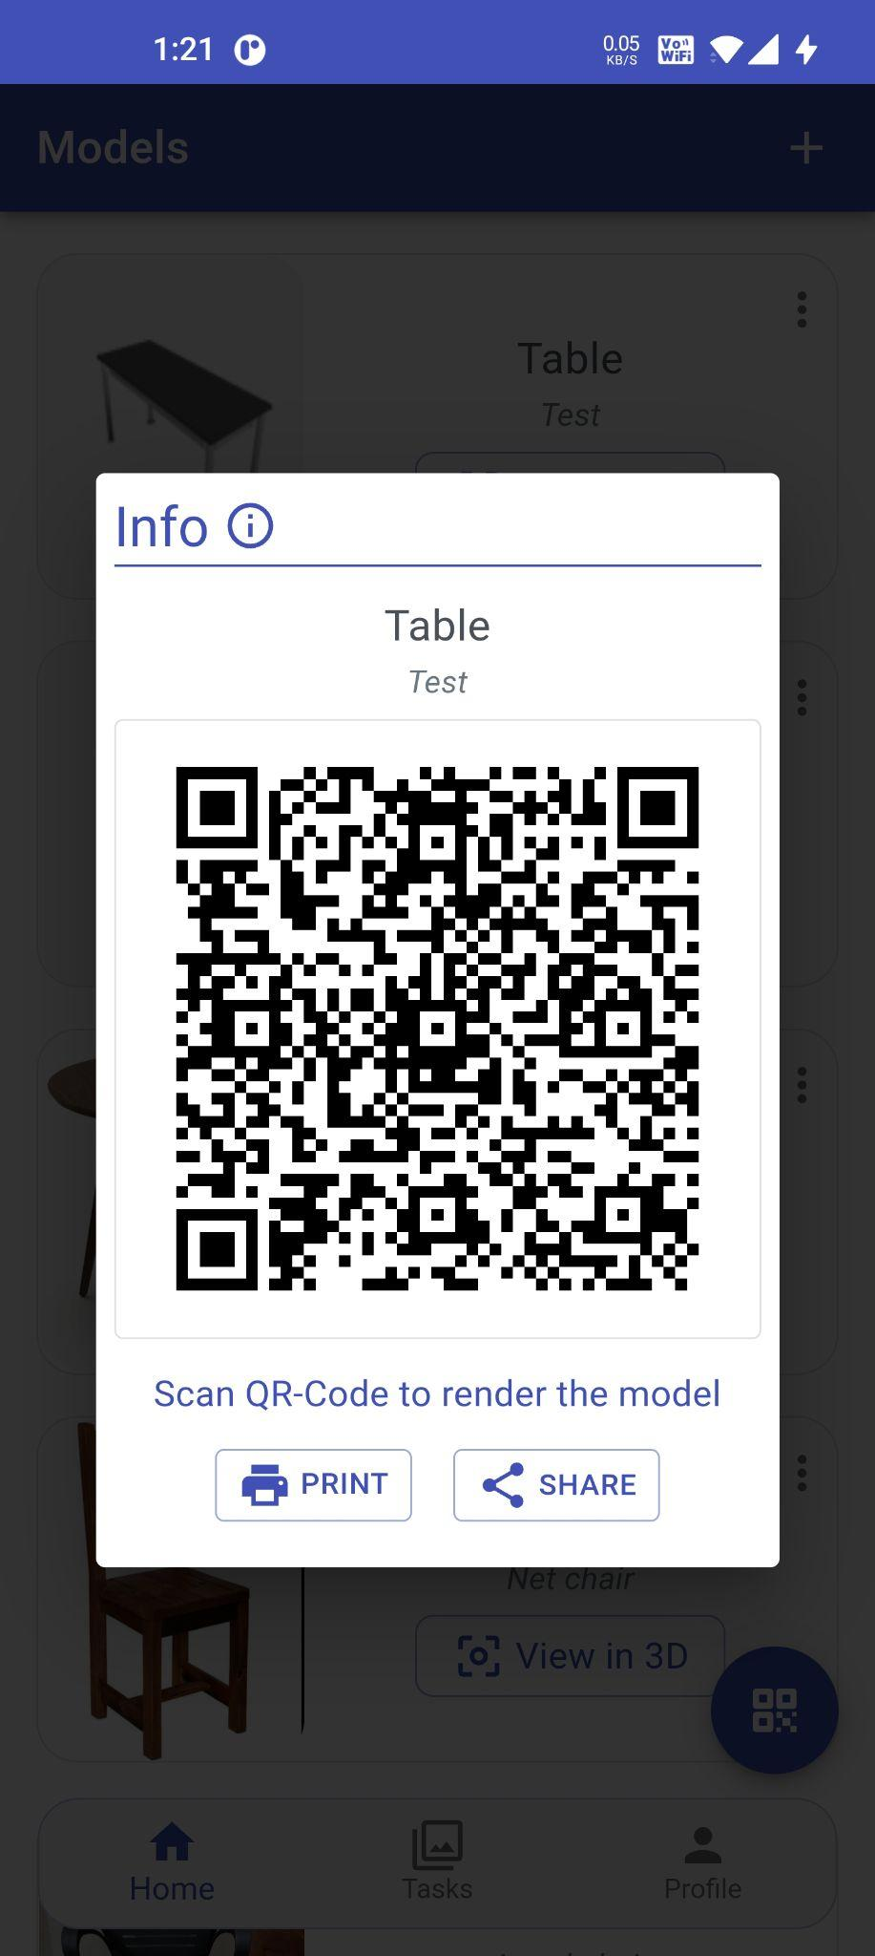
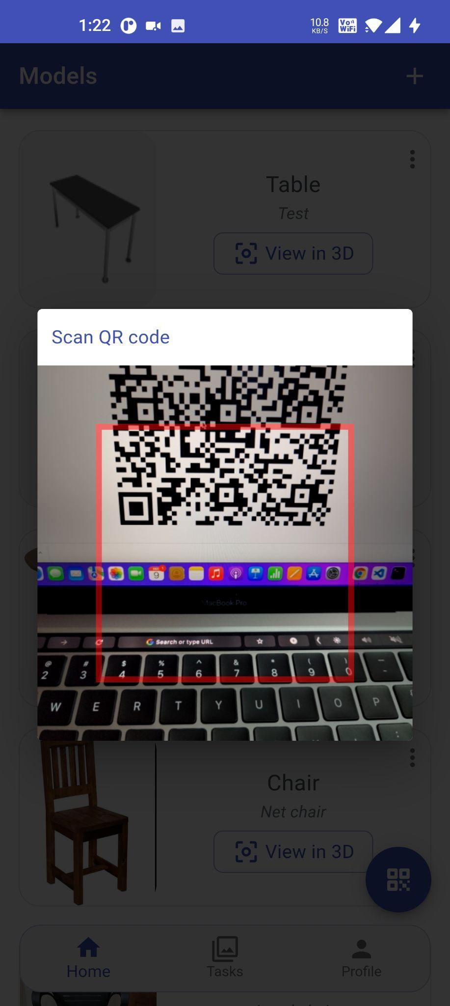
Model Retrieval using QR code
The QR code can be viewed in App which can be printed, saved as pdf or can be shared via email, drive, whatsapp etc.
The app has a QR scanner which scans the generated QR and renders the models in real time.

Slide 32
Mobile App Tech Stack
ARCore
Android
NodeJS
React
AWS S3 bucket

Slide 33
Major Challenges We Faced

Slide 34
High Computation resources required for Color Learning

Slide 35
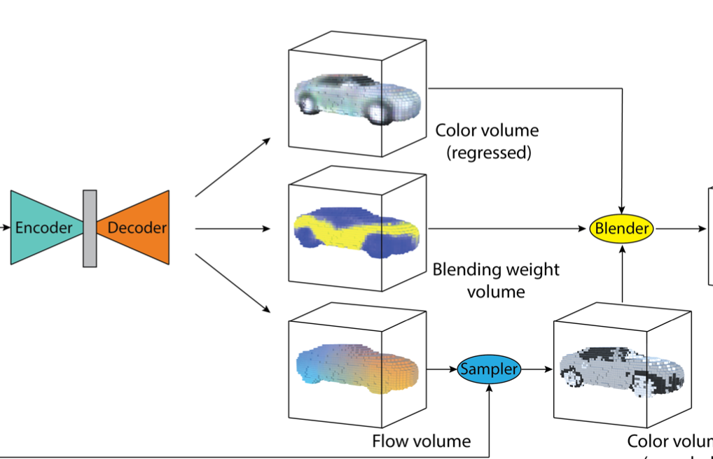
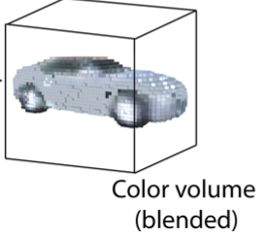
What is Color Learning
For getting the colors, the idea is to build the same 3d structure. Each 3D voxel gets its shape from corresponding voxel index.
Two combined strategies - sample color from 2d image and other regress colors directly.

Slide 36
Color Network
Same Encoder - 6 2D convolution layers
(128, 128, 3)
(64, 64, 64)
(32, 32, 64)
(16, 16, 128)
(8, 8, 128)
(4, 4, 256)
(1, 1, 512)
(7, 7) kernel
64 filters
2 stride
(5, 5) kernel
64 filters
2 stride
(5, 5) kernel
128 filters
2 stride
(3, 3) kernel
128 filters
2 stride
(3, 3) kernel
256 filters
2 stride
(4, 4) kernel
512 filters
2 stride
Decoder - 5 3D convolution layers
(4*4*4*128)
FC Layer
(8, 8, 8, 64)
(16, 16, 16, 32)
(32, 32, 32, 32)
(64, 64, 64, 16)
(64, 64, 64, 3)
Regression output
(3, 3, 3) kernel
64 filters
2 stride
(3, 3, 3) kernel
32 filters
2 stride
(3, 3, 3) kernel
32 filters
2 stride
(3, 3, 3) kernel
16 filters
2 stride
(3, 3, 3) kernel
3 filters
2 stride

Slide 37
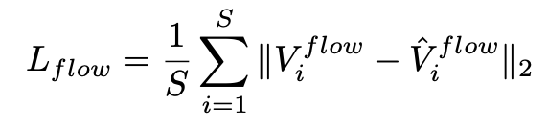
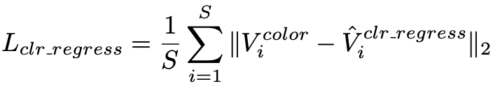

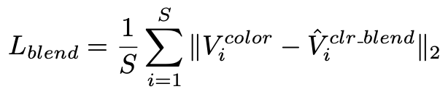

Regression and blending
Loss functions
We use another strategy of Regression to infer 3D surface colors. This will give better results for high rough regions.
We only use Target flow during training.
Target flow loss
Regression loss
Weighted loss
Blend loss
FInal loss
We only train for colored voxels.

Slide 38
Complexity Explosion for color learning
Number of images = 8.1k * 13 = 105k files
Only 10% extraction of files possible in drive in 13 hours
Network * 4
Model + First batch of data did not fit in google colab RAM.
Training will dramatically slow down.
We have the color learning architecture built up. We have documented the way to train the color learning if the interested person has enough compute resources to do so.

Slide 39
2. Finding unbiased metric to check model performance

Slide 40
Find a good metric
We need a metric to decide whether the model’s performance is good or not on a furniture category.
Looking at Mean Squared Loss is not a good choice, because for complex images even with higher loss, the resulting 3D structure can be visually appealing.
If humans sit in the process of labelling good/bad outputs from the model, it adds that person’s bias in the validation process.
Finding a good unbiased metric for our use case, is an open ended research question. If time permitted, we wanted to go back to literature search and tackled this problem.
This problem arise at the time of we collecting different distribution statistics of furniture category and checking the model performance on them.

Slide 41
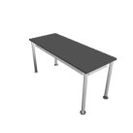
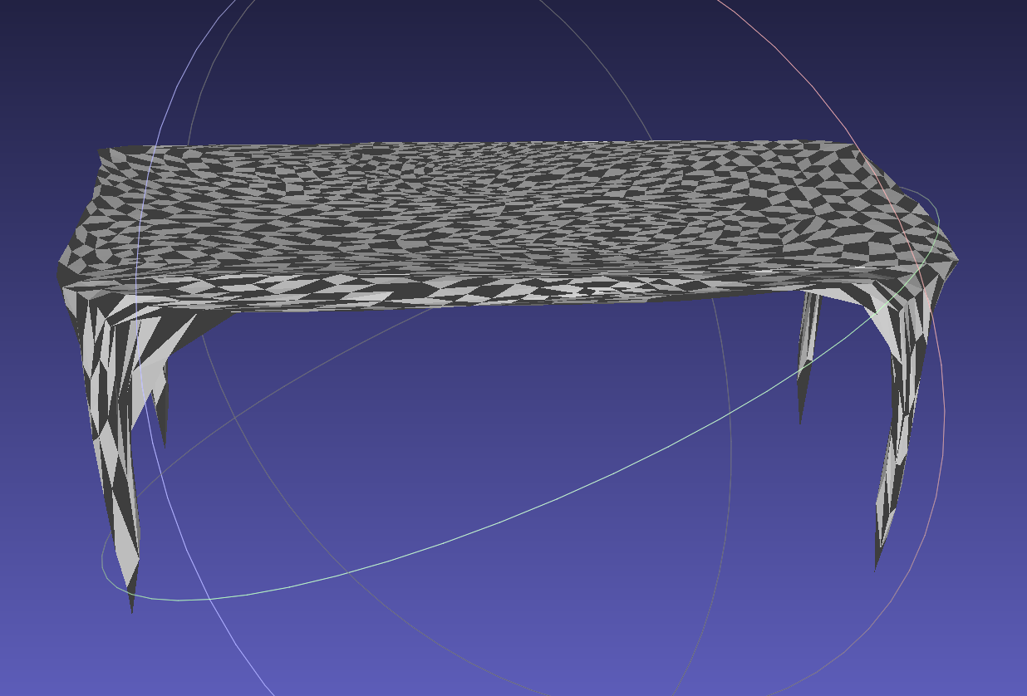
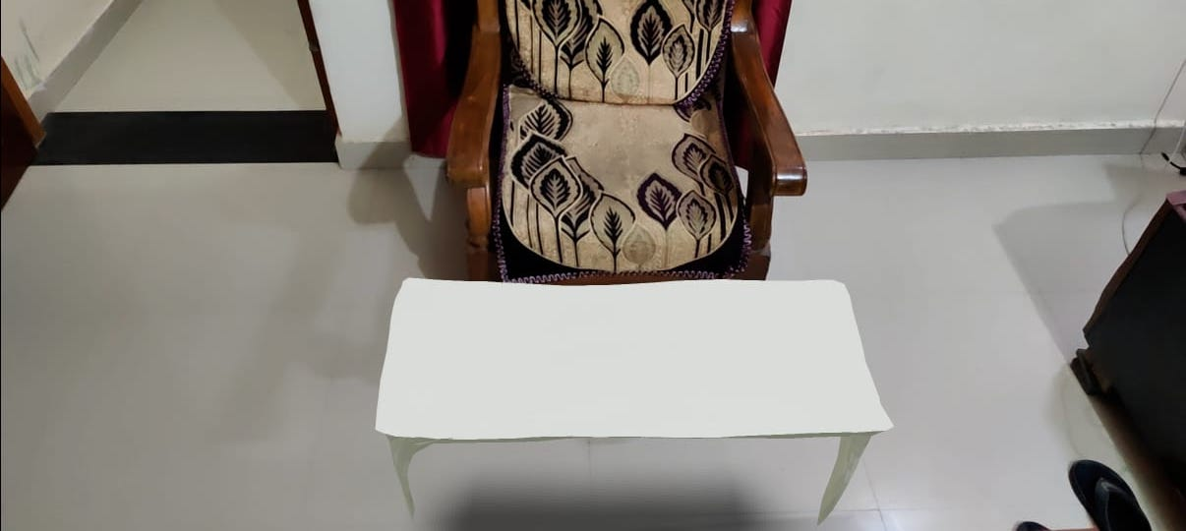
An Example Demo Output of the App
Table
Generated by CVN
In real world
Mobile App
Server
Mobile App

Slide 42
Results and Conclusion
We proposed a data driven solution for our use case.
We got visually appealing results for the furniture categories the model is trained on.
We built a mobile app that integrates end-to-end from Users to Servers and then back to Users.
Whatever challenges we faced, we have extensively documented them.
The work done here can be further carried by solving the challenges.
Finally, we want to thank our BTP advisor, Dr. Subu Kandaswamy for his guidance throughout BTP.

Slide 43
Contributions
Sayam Kumar - S20180010158
Model building related tasks
Preparation of Data Pipelines
Implementation of Model Architecture
Model Training and Model Deployment
Nitin Kumar Chauhan - S20180010119
Mobile App related tasks
Model Rendering using ARCore
Database and Cloud storage management
Dasari Jayasree - S20180010047
Literature Review

Slide 44
References
Tensorflow docs https://www.tensorflow.org/api_docs
AR Core docs https://developers.google.com/ar/reference
Numpy docs https://numpy.org/doc/
Scipy docs https://www.scipy.org/docs.html
Im2Avatar paper https://arxiv.org/pdf/1804.06375.pdf
Wikipedia https://en.wikipedia.org/wiki/Main_Page

