Slide 1

Project Based Learning Presentation –May-2025 Project-Id: P35 Project Title: ( P35-University Time Table Management System)
by
Student Name: Sayam Bahuguna
Section-E2 , Roll No. 45, University Roll No.2418927
Under the mentorship of
Ms.Priyanshi Aggarwal
Graphic Era Hill University, Dehradun

Slide 2
University Time Table Management System
Problem Statement; Design a project in C that will automate timetable creation, ensuring optimal allocation of classrooms, faculty, and resources, while providing access to students and staff for easy viewing and modification.

Slide 3
ABOUT THE PROJECT
● The University Timetable Management System is developed to automate and
optimize the scheduling of classes, faculty, and classrooms across departments.
Traditionally, timetable creation is handled manually, which is time-consuming and
prone to conflicts such as overlapping classes, unavailable faculty, or overbooked
classrooms. This project aims to address these issues by providing a structured,
modular software solution that enhances accuracy, saves time, and simplifies
management.
● To ensure a clean and maintainable design, the system is divided into independent
functional modules, each responsible for a specific task. The Input Module collects
academic data like course names, faculty information, and room details. The
Validation Module ensures correctness and prevents clashes. The Scheduling
Module assigns time slots based on availability and conflict-free rules. The File
Handling Module maintains data persistence, allowing users to save and retrieve
schedules. Additional modules such as View, Update, and Report Generation make
the system user-friendly and flexible.
● By separating responsibilities into self-contained modules, the system becomes easy
to update, test, and scale without affecting other components. This modular approach
not only improves the system's clarity and reusability but also aligns with good
software development practices. The end goal is to provide students, faculty, and
administrators with a reliable tool to view, modify, and manage academic timetables
efficiently.

Slide 4
LIST OF MODULES USED:-
Modules of the Timetable Management System
1. Input Module
Collects input for faculty, classrooms, courses, and time slots from the user.
2. Validation Module
Ensures that input data is valid (e.g., no duplicate time slots, correct IDs).
3. Scheduling Module
Assigns courses to rooms and faculty without conflicts based on availability.
4. View Module
Displays the timetable in a readable format for students and staff.
5. Update Module
Allows modifications to existing entries without affecting other data.
6. File Handling Module
Manages saving and loading data to/from a file for persistence.
7. Report Generation Module
Prepares reports such as daily schedules or faculty-wise timetables.
8. Main Control Module
_Manages menu navigation and connects all other modules without direct
interference.

Slide 5
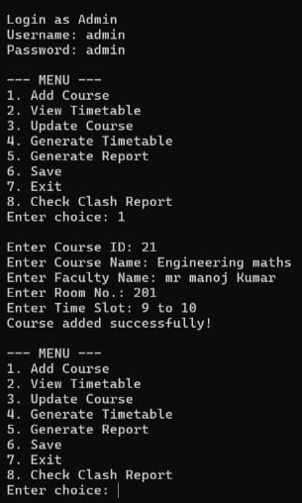
Input Module
Collects input for faculty, classrooms, courses, and time slots from the user.

Slide 6
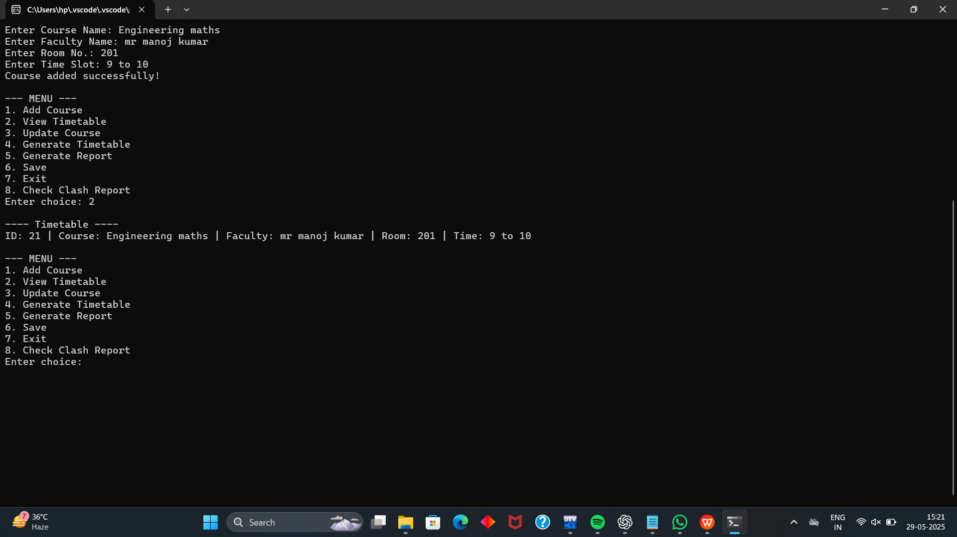
View module
Displays the timetable in a readable format for students and staff.

Slide 7
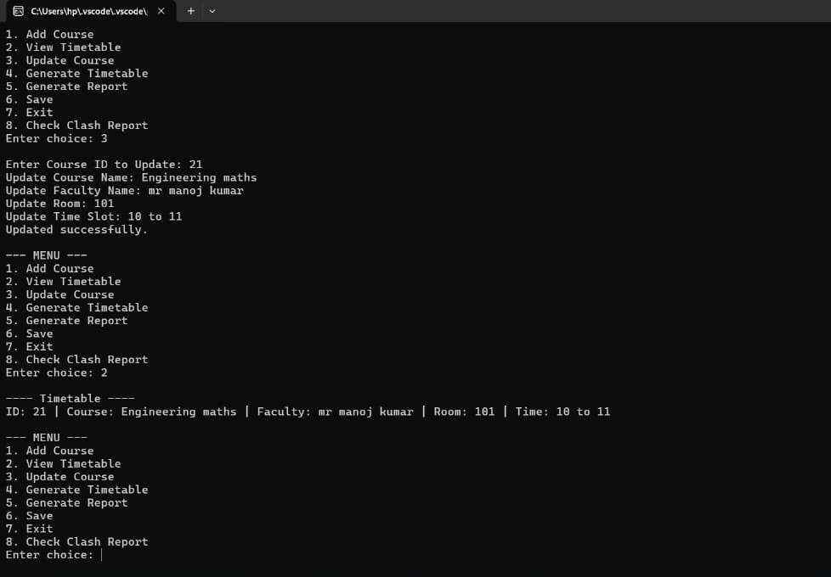
Update course and Generate Timetable module

Slide 8
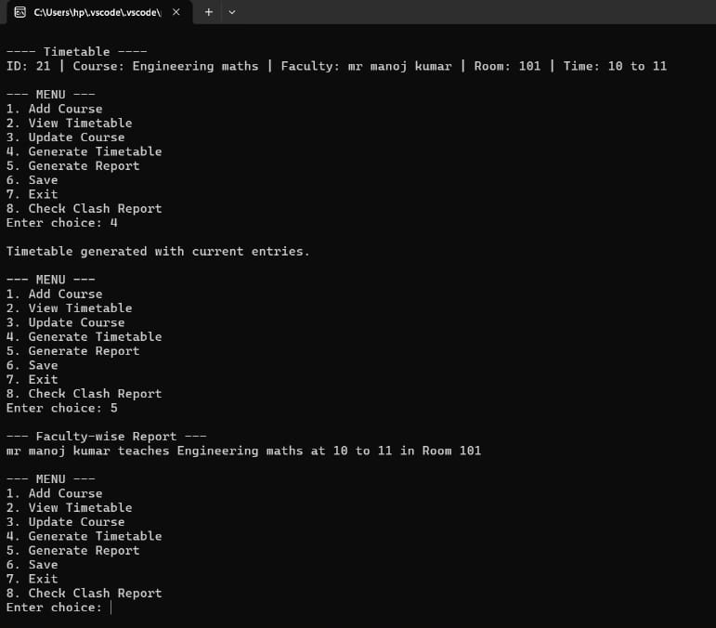
Report Generate module

Slide 9
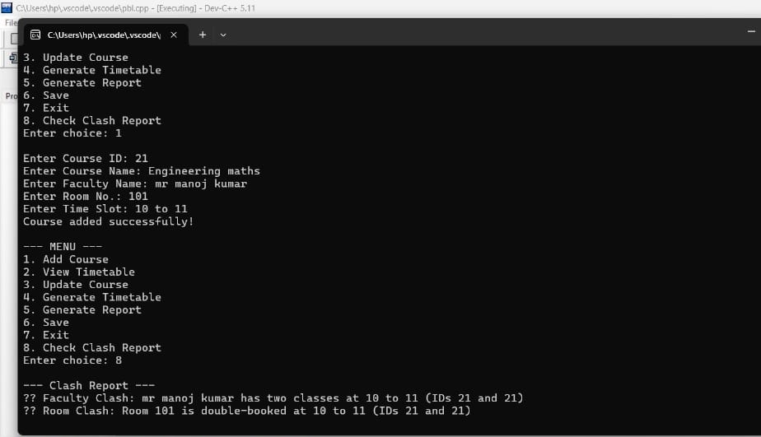
Check clash report

Slide 10
THANK YOU

