Slide 1
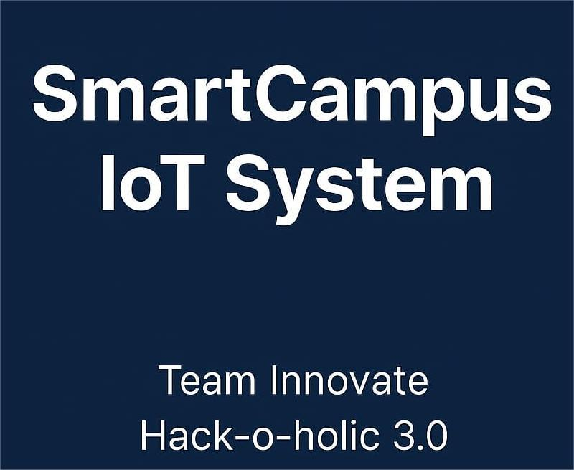

Slide 2
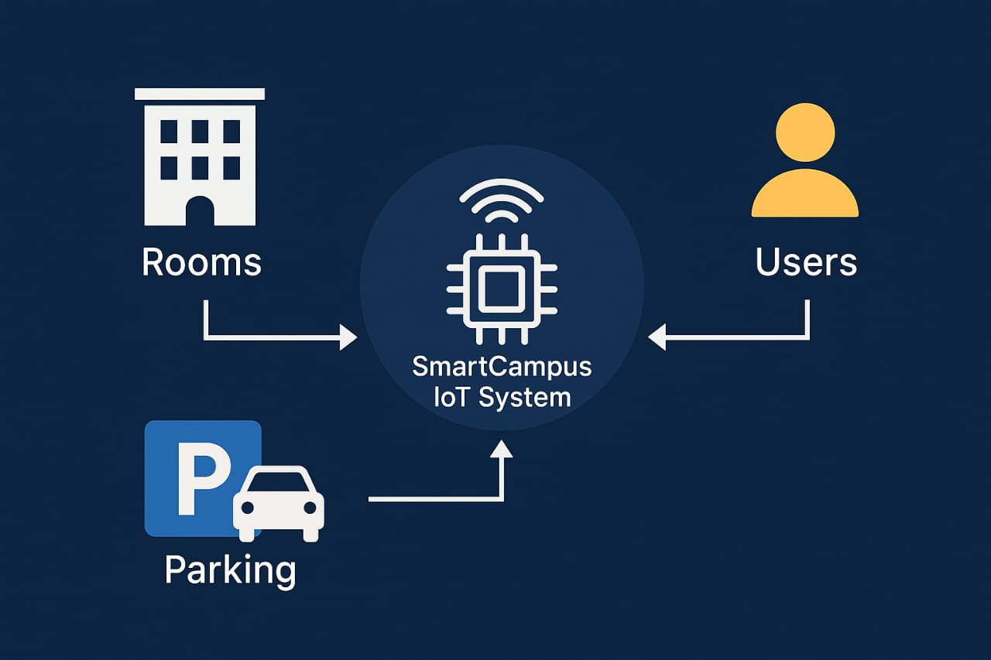

Slide 3

TEAM MEMBERS
1.Sayam Bahuguna
2.Ayush Bhatt
3.Shubham Bhatt
4.Tanishk Rawat

Slide 4
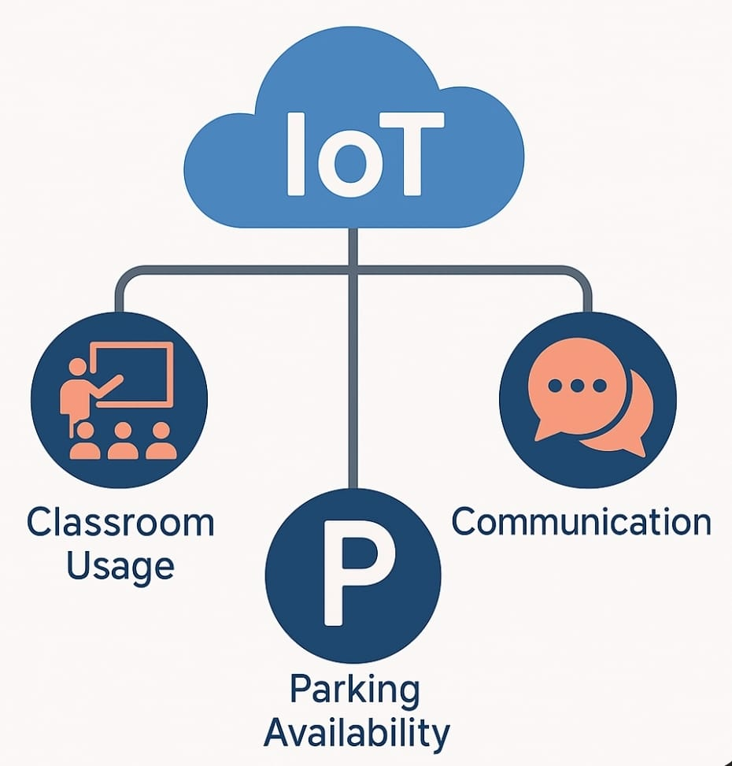
PROBLEM STATEMENT
College campuses often face challenges related to resource management and user convenience. Issues such as inefficient classroom usage, limited parking visibility, and poor communication between facilities and students lead to time wastage and frustration.
There is a need for an integrated system that can monitor and manage campus resources—like room occupancy, parking availability, and student feedback—in real-time using IoT technology. This would improve operational efficiency and enhance the overall campus experience.

Slide 5
Solution overview -Smartcampus Iot System
<: We aim to build a simple and smart system that helps solve common problems in our college campus like:>
1. Classroom Usage Monitoring-Track which classrooms are free or occupied
Helps avoid confusion and saves time
2. Parking Slot Tracker Shows which parking spots are available
Makes parking easier for students and staff
3. Real-Time Notifications-Inform students quickly about class changes or updates
4. Easy Maintenance Reporting Report broken fans, lights, etc. using QR codes or simple forms
Helps fix issues faster
What We’ll Make in Hackathon:A simple app or program that shows data about rooms, parking, and issues
*Basic design to show how the system will work
*Ideas for future upgrades using smart sensors

Slide 6
Workflow Diagram
User checks availability
User books room/parking
System updates file data
Admin monitors bookings

Slide 7
System Architecture / Workflow
🔧 System Architecture (Simulated)
The SmartCampus system is built and tested entirely on a laptop using simple code and mock data.
💻 Key Components:
Simulated Sensor Input:
/Fake data is used to represent room occupancy and parking status.
Basic Processing Logic:
/Simple C or Python code processes the input and updates the system state.
User Interface:
/Console output or basic GUI shows available rooms and parking spots.

Slide 8
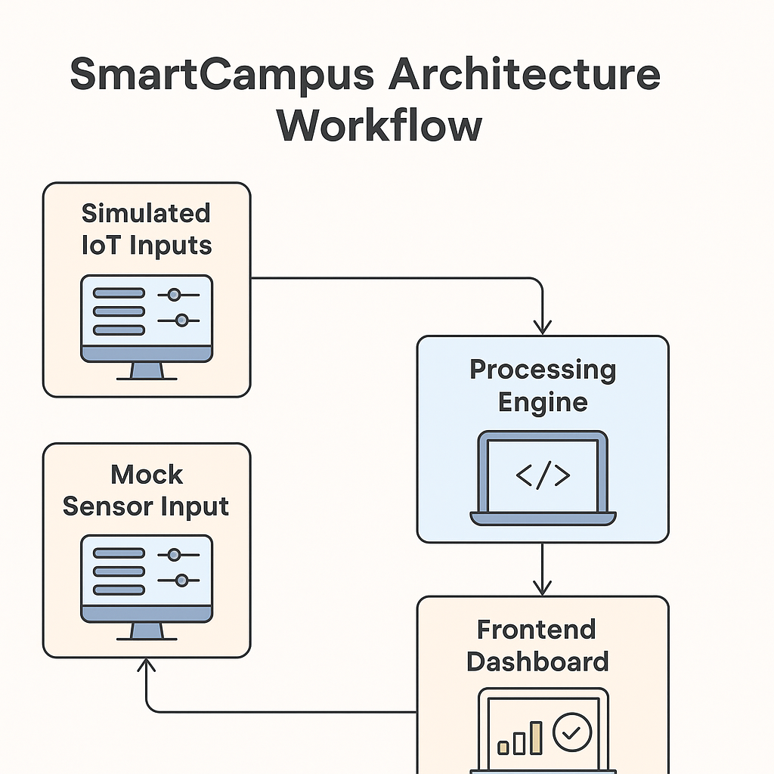
Workflow
1 .Simulation:
User or code simulates room/parking availability.
2.Booking Process:
User books a room or spot via console interface.
3.Update System:
Data is stored/updated in a file.
4.Admin Monitoring:
Admin can check and manage bookings manually.

Slide 9
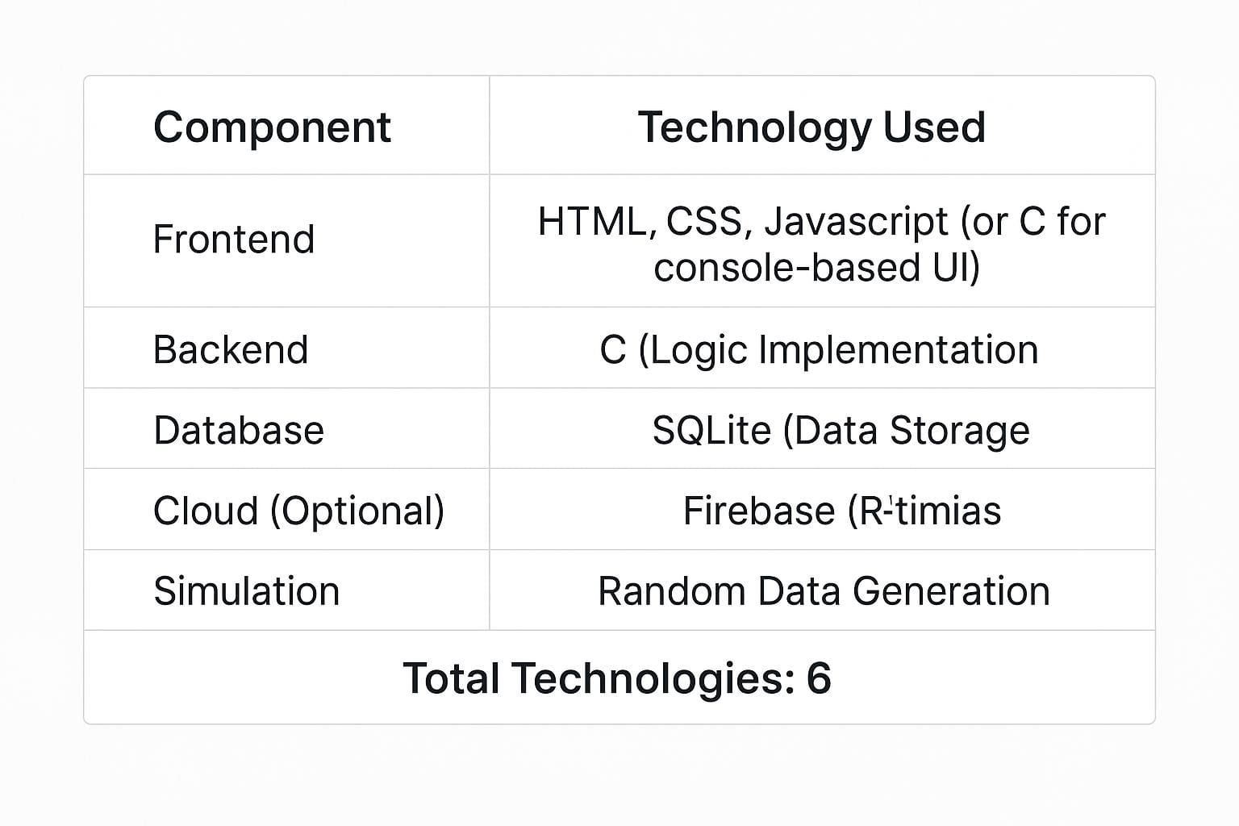
Technology Stack
- Language: C
- File Handling for data storage
- Arrays for resource tracking
- Console-based user interface

Slide 10
System Flow
Step-by-step process:
1. Show available rooms/parking
2. User books
3. Update availability
4. Admin monitors

Slide 11
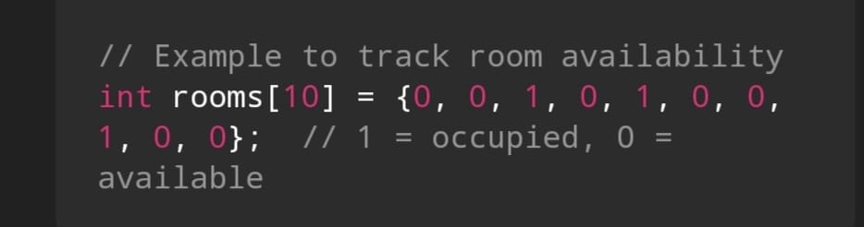
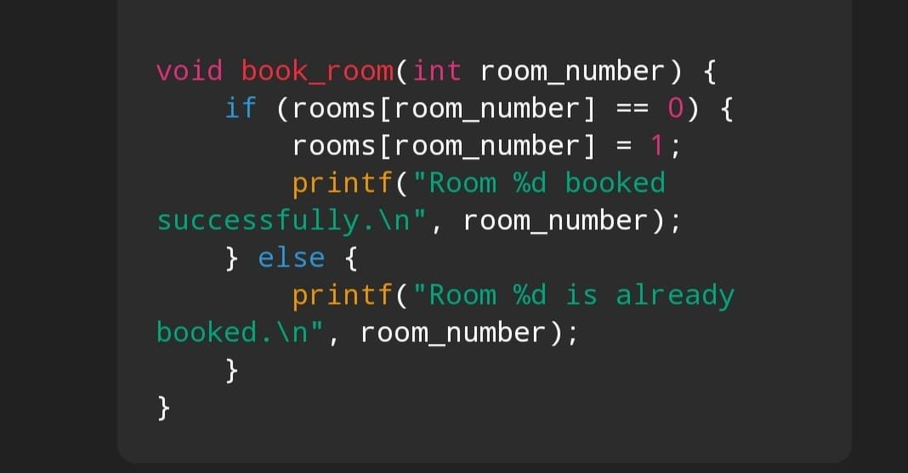
Demo / Screenshots
Example Code Snippet:
int rooms[10] = {0};
// 0=available, 1=booked

Slide 12
Challenges and Learnings
- Simulating IoT with C
- Using file handling to persist data
- Learned efficient resource management with arrays

Slide 13
Future Scope
- Add real IoT sensors for automation
- Develop mobile app for students
- Use AI for usage prediction
- Web-based Admin Dashboard

Slide 14
Conclusion
SmartCampus IoT System improves resource usage through real-time tracking and efficient booking. It saves time and optimizes campus space.

Slide 15
Thank You / Q&A
Thank you for your attention!
Open for questions.

