Slide 1

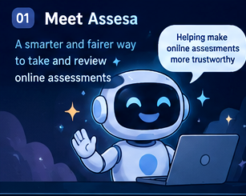
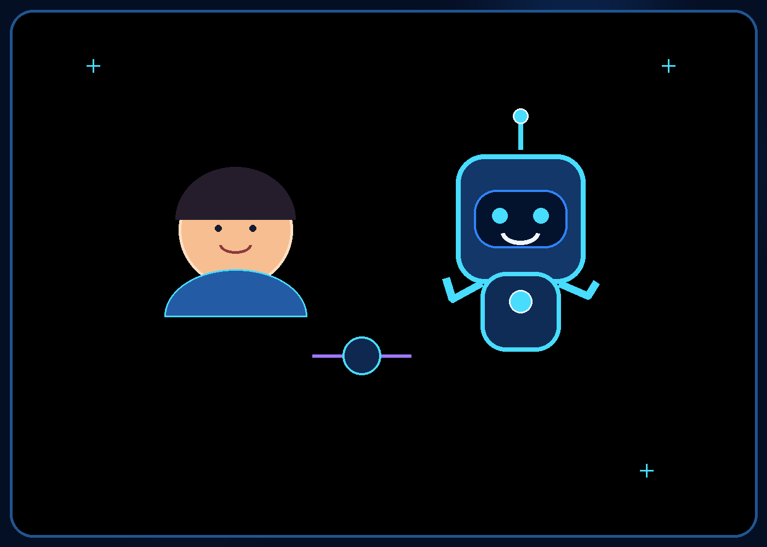

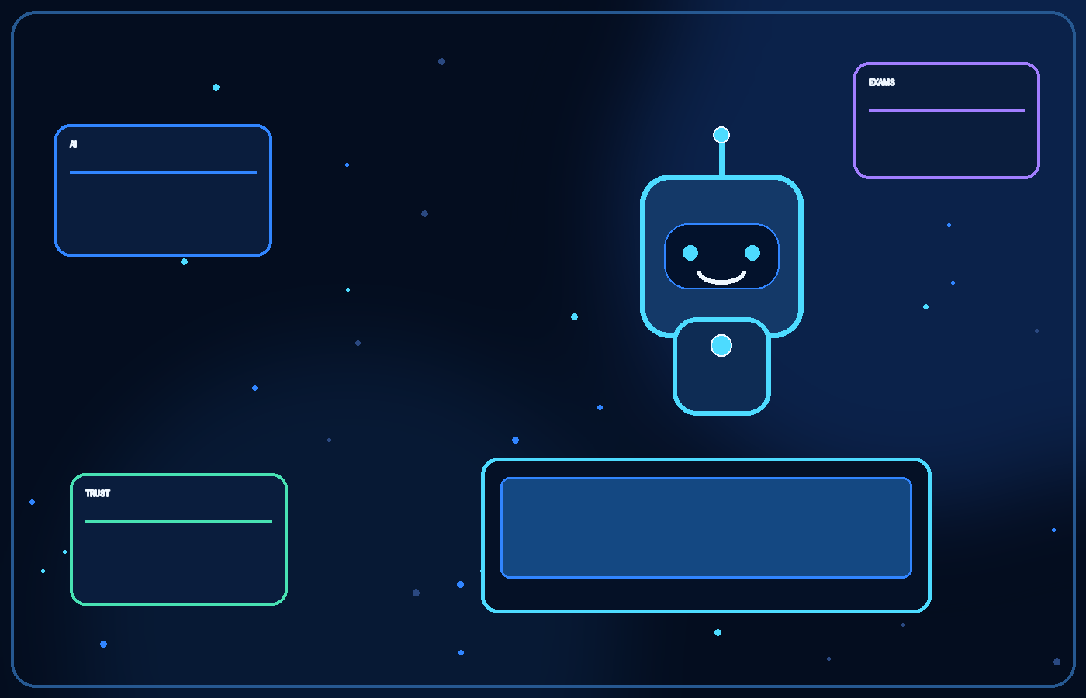


01
MEET ASSESA
Helping make online
assessments more
Assesa
trustworthy
What if an international-level exam could reach the world?
An AI-assisted concept for making large online assessments more trustworthy, reviewable, and accessible.
Designed to support human reviewers—not replace human judgment.
STUDENT-LED CONCEPT • EARLY-STAGE PROPOSAL
AI-supported assessment integrity • Human oversight
ASSESA / STUDENT CONCEPT

Slide 2


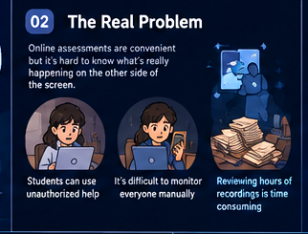
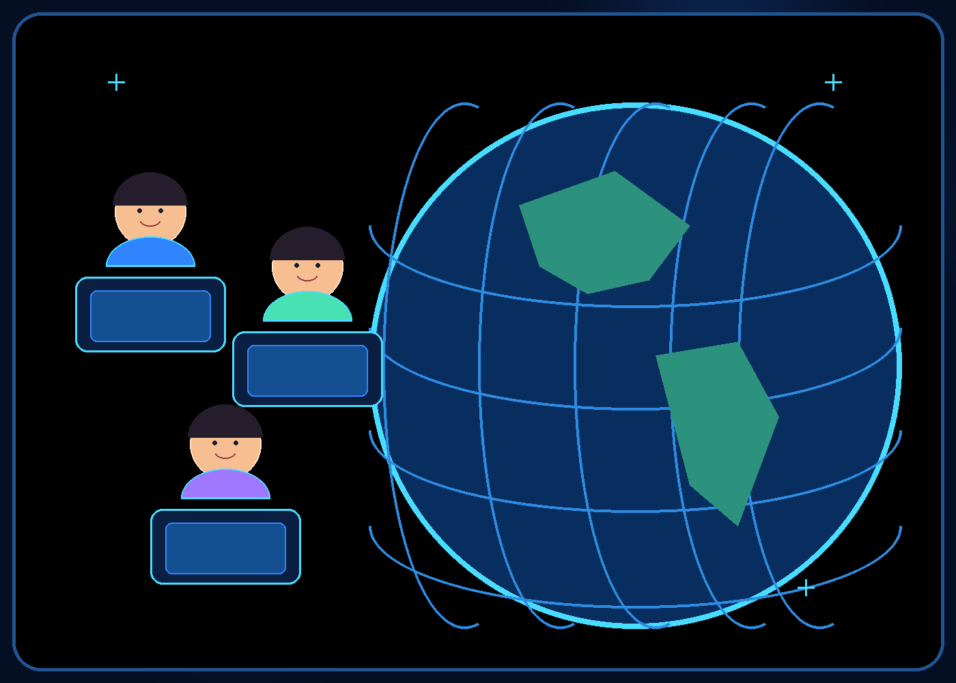

02
Imagine the next International Olympiad
One exam. Thousands of candidates. Dozens of countries.
A talented student in a small town could sit the same high-level online Olympiad as a student in a major city.
Candidates might join from homes, schools, libraries, or supervised local centres—without all travelling to one venue.
If participation grows across countries and time zones, how do organisers maintain confidence that the process is fair?
SCHEMATIC GLOBAL PARTICIPATION MAP
ASSESA / STUDENT CONCEPT

Slide 3

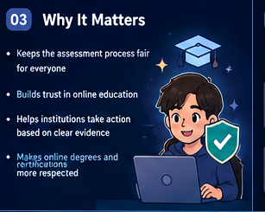
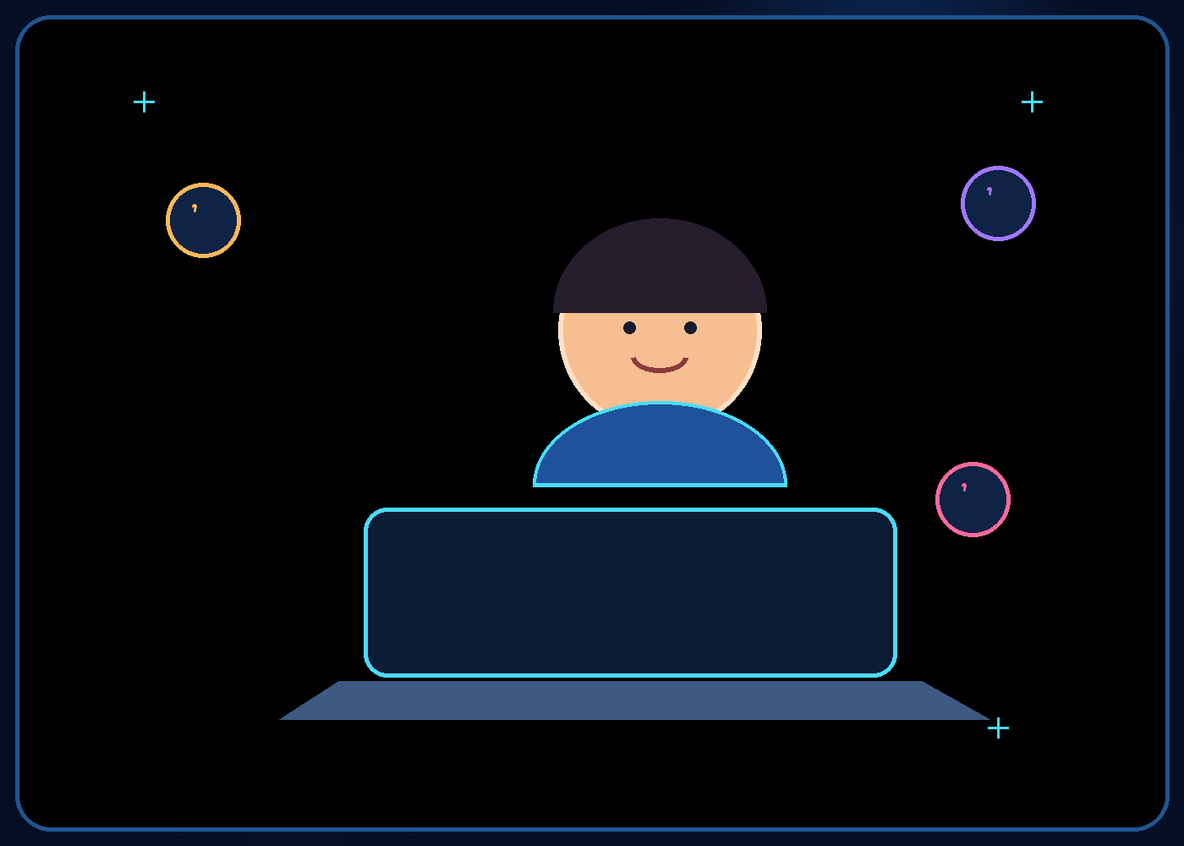
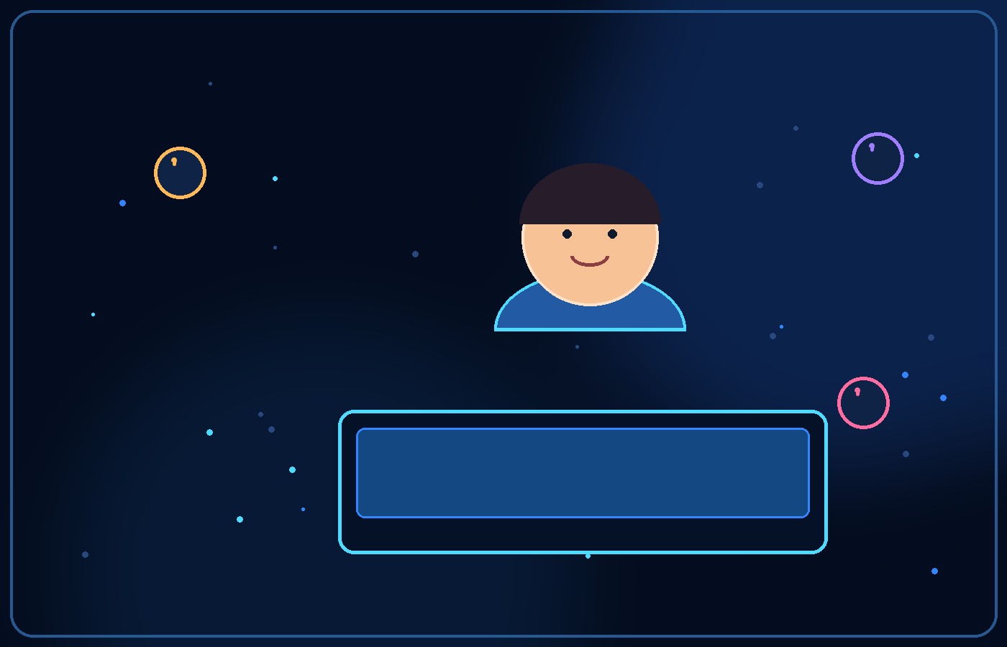
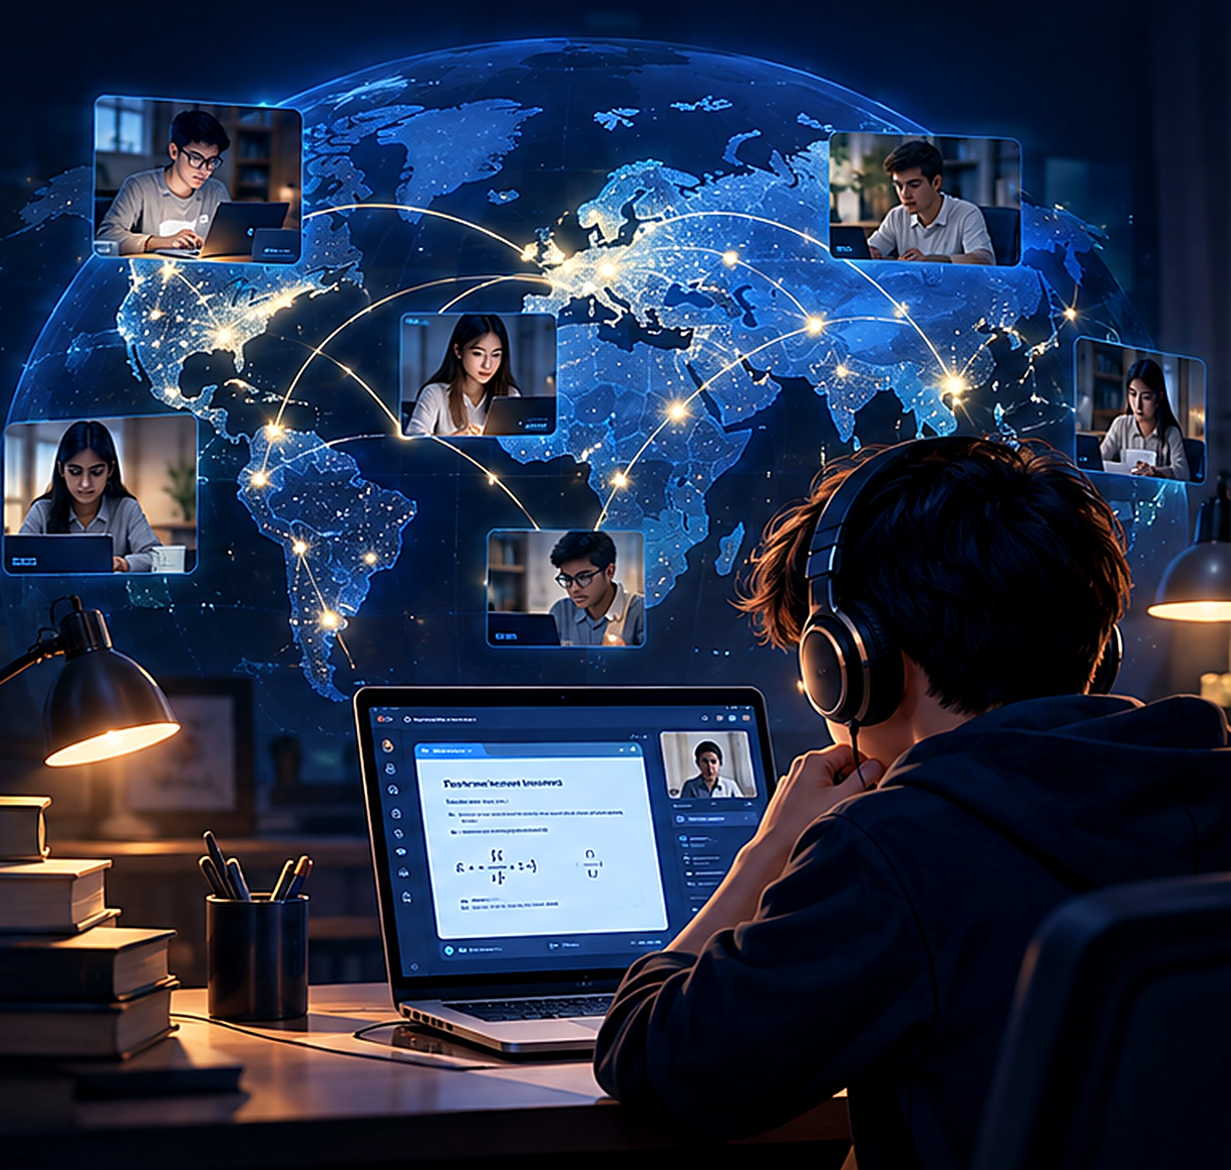
03
The opportunity is enormous—but so is the challenge
Online delivery can widen access. Trust has to scale with it.
More students could participate without the cost and logistics of bringing everyone to a physical venue.
Organisers could reach remote regions and run multiple sessions across time zones.
But a webcam shows only a small part of the room, and reviewing every recording manually does not scale easily.
Assesa imagines helping reviewers find the moments that deserve attention—not automatically declaring someone guilty.
ASSESA / STUDENT CONCEPT

Slide 4
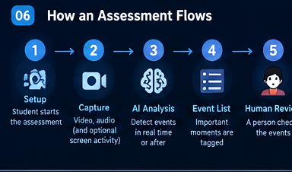
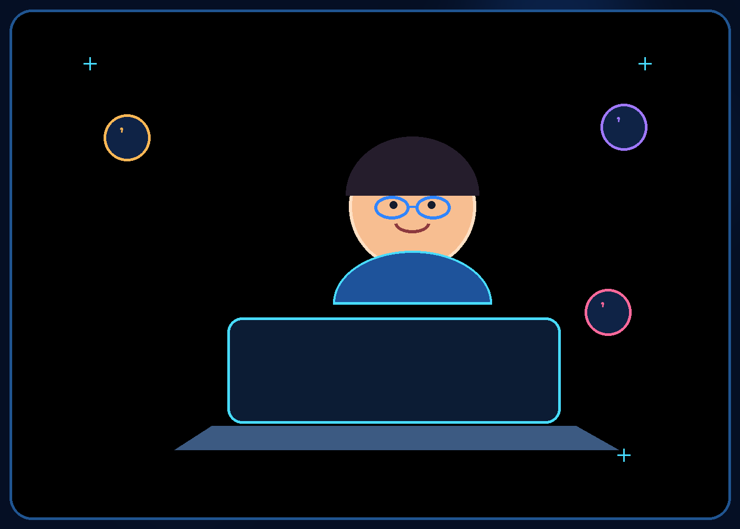

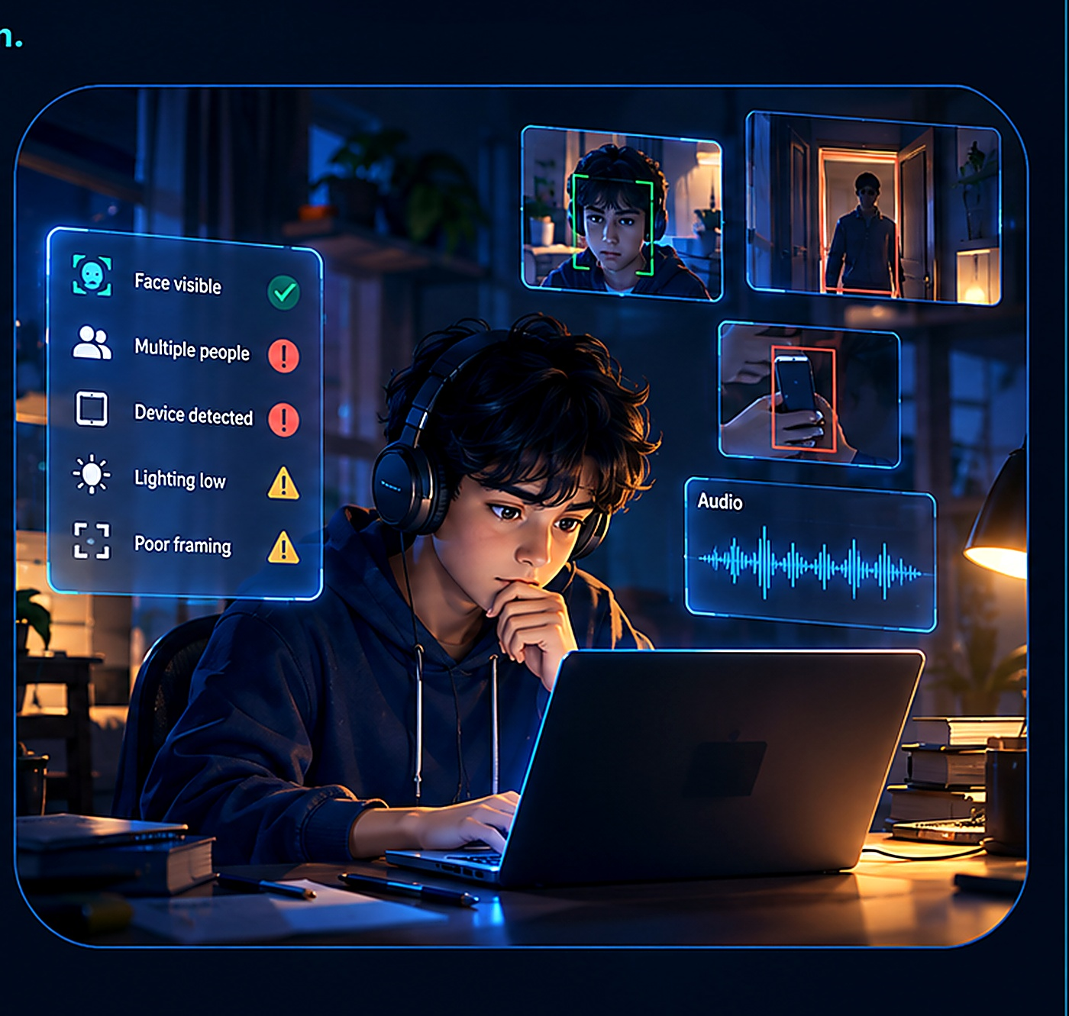
04
The problem: a webcam is only a small window
An online exam is happening in a real room, not just on a screen.
A candidate may look away to think, adjust a device, or react to a noise outside the room.
A phone or another person might appear—but a single frame cannot explain the full context.
Lighting, camera angles, shared rooms, and internet quality vary widely.
The same visible signal can mean different things in different circumstances.
ASSESA / STUDENT CONCEPT

Slide 5
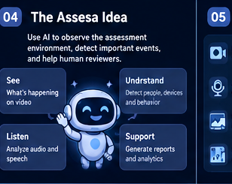
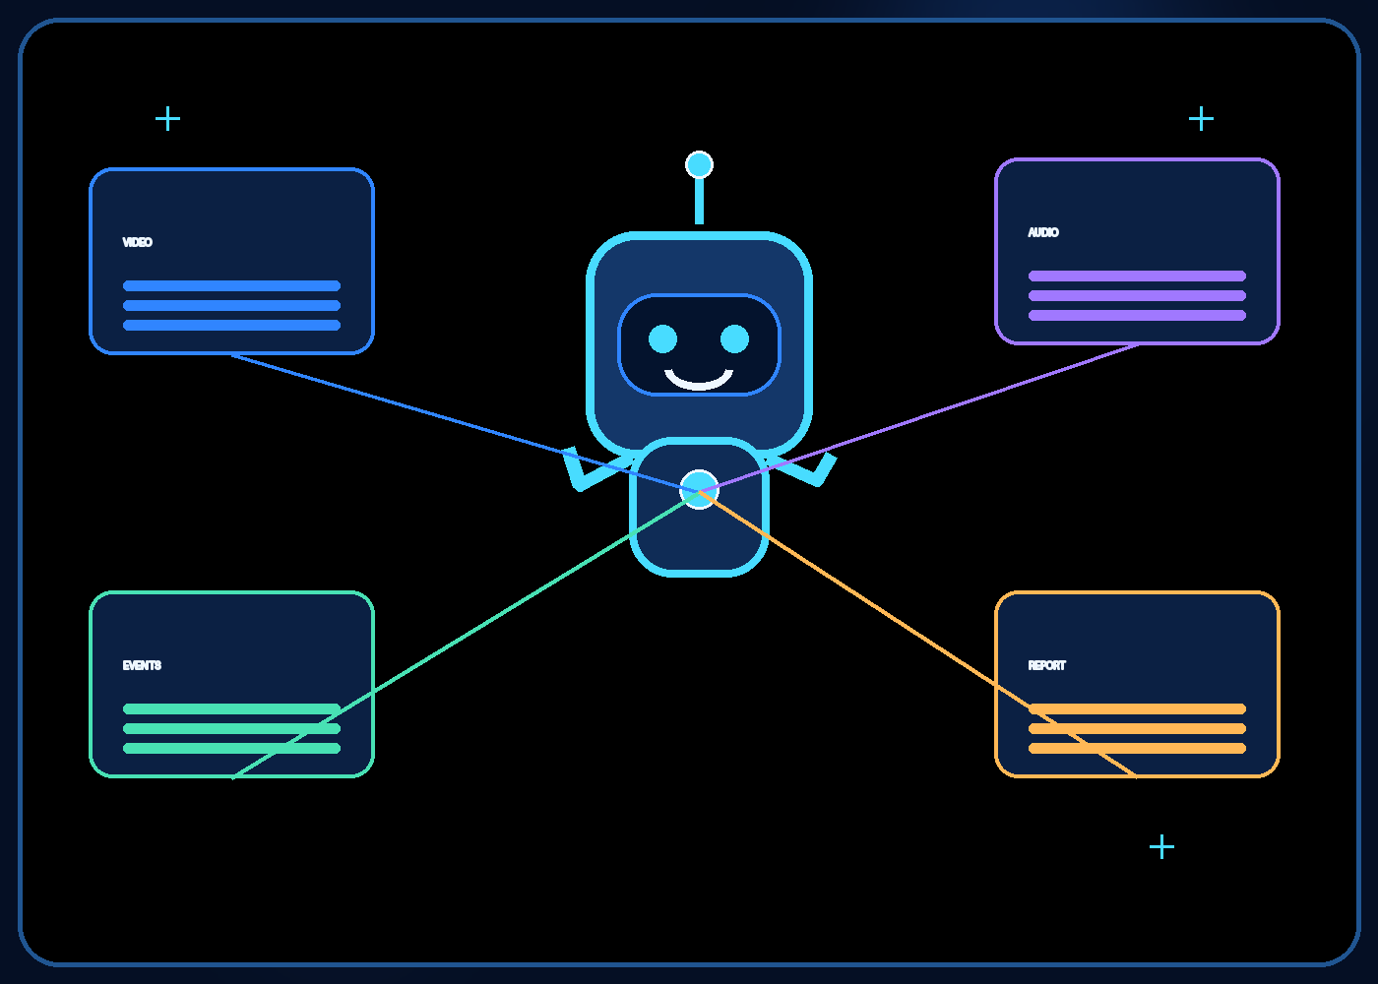
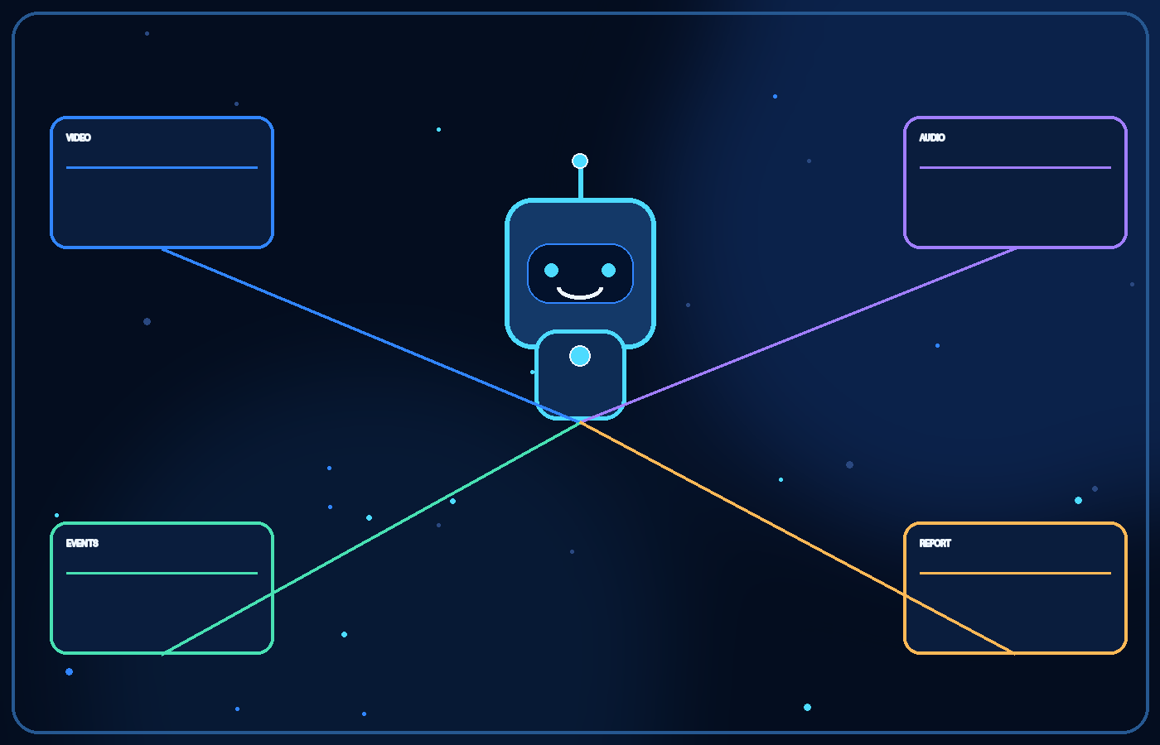
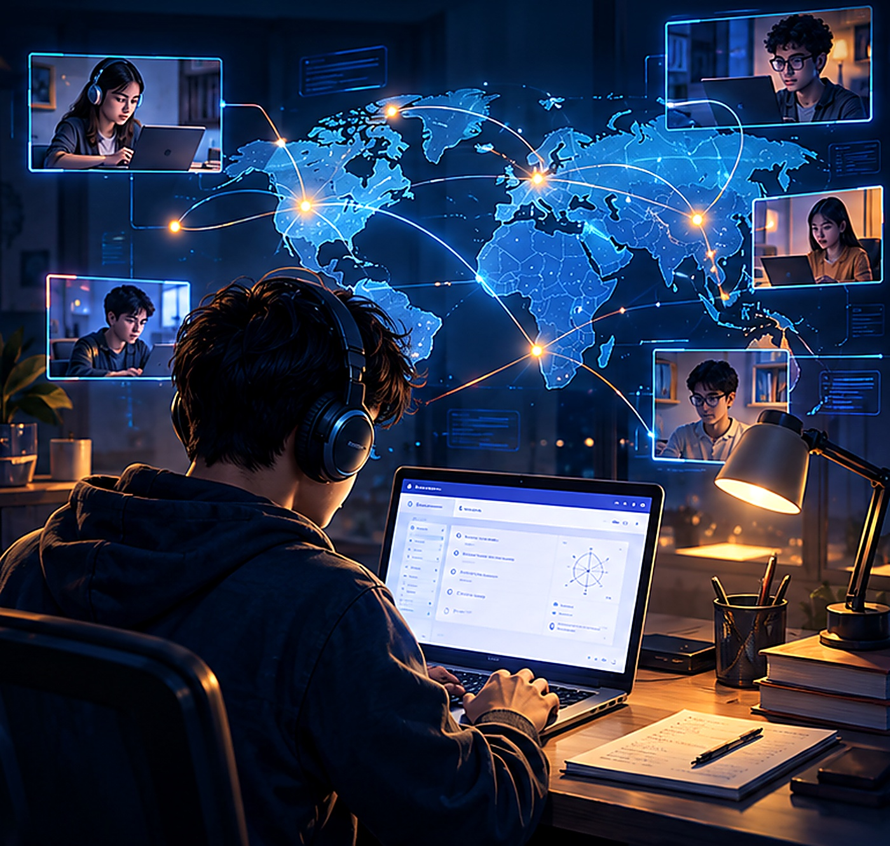
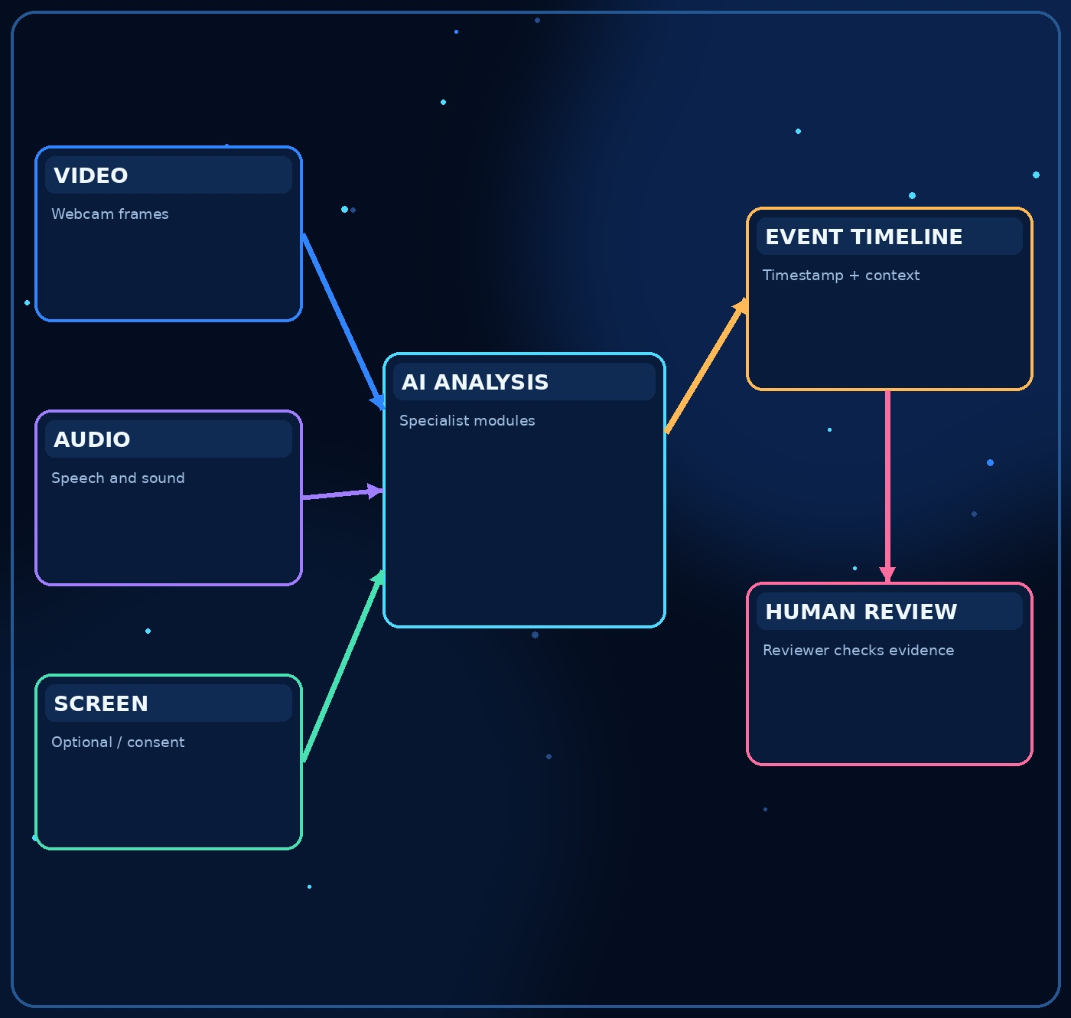
05
The central idea behind Assesa
Turn scattered signals into reviewable evidence.
Assesa is a proposed platform that analyses selected video, audio, and—where supported and consented to—screen signals.
It could mark noteworthy events with timestamps and context, then help a human reviewer inspect them.
The goal is clearer review and better-designed assessments, not an AI system that claims to read intent.
A detected event is a clue, not proof of cheating.
ASSESA / STUDENT CONCEPT

Slide 6

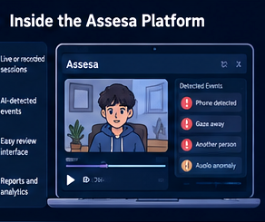
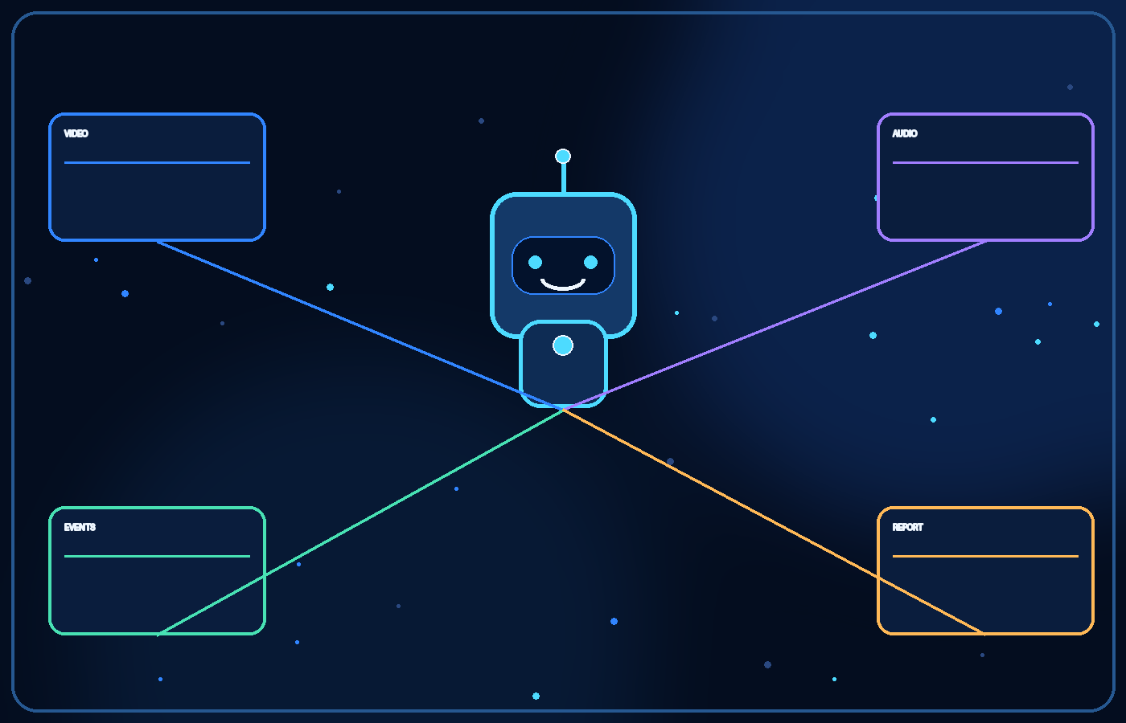
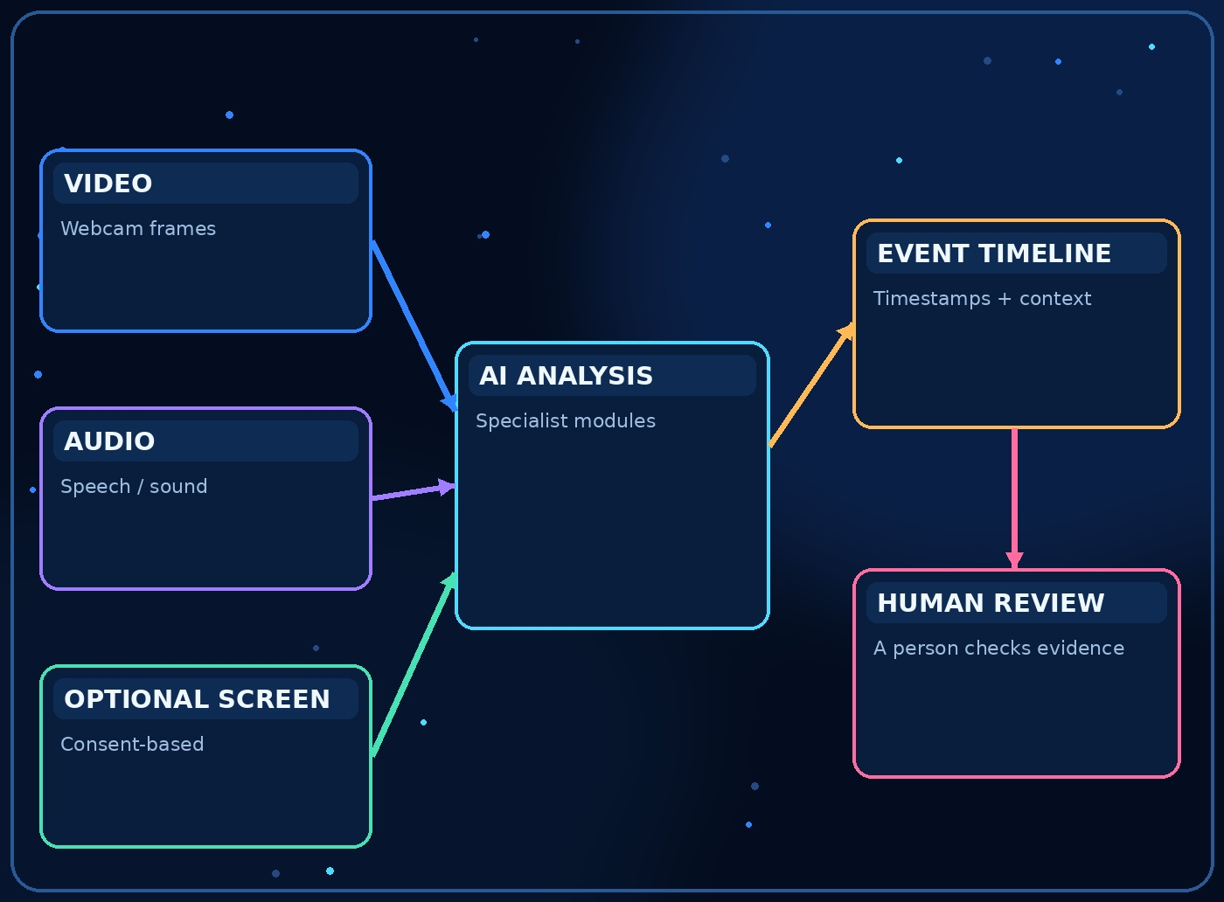



06
The main structure of Assesa
A modular platform, not one giant AI model.
1. Input layer: webcam video, microphone audio, and optional consent-based screen data.
2. Specialist analysis modules: vision, audio, screen activity, and video-quality checks.
3. Event layer: combines observations into a timestamped timeline with confidence and context.
4. Review layer: a human checks the evidence and adds notes.
5. Reporting layer: session summaries and privacy-protected aggregate trends.
INPUT
AI
EVENTS
REVIEW
REPORT
ASSESA / STUDENT CONCEPT

Slide 7

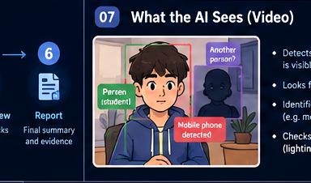
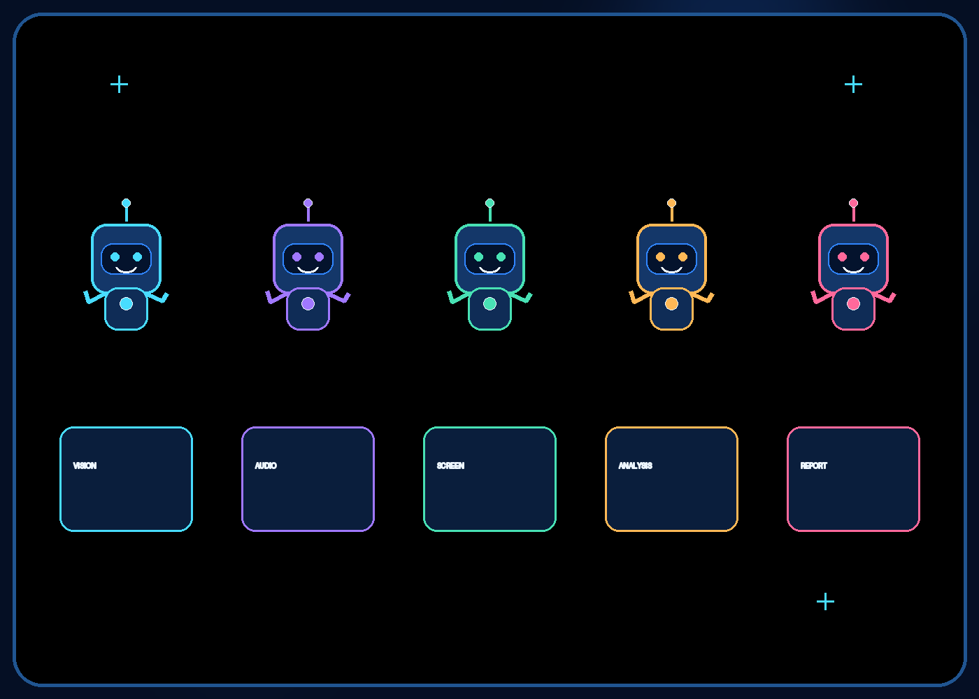
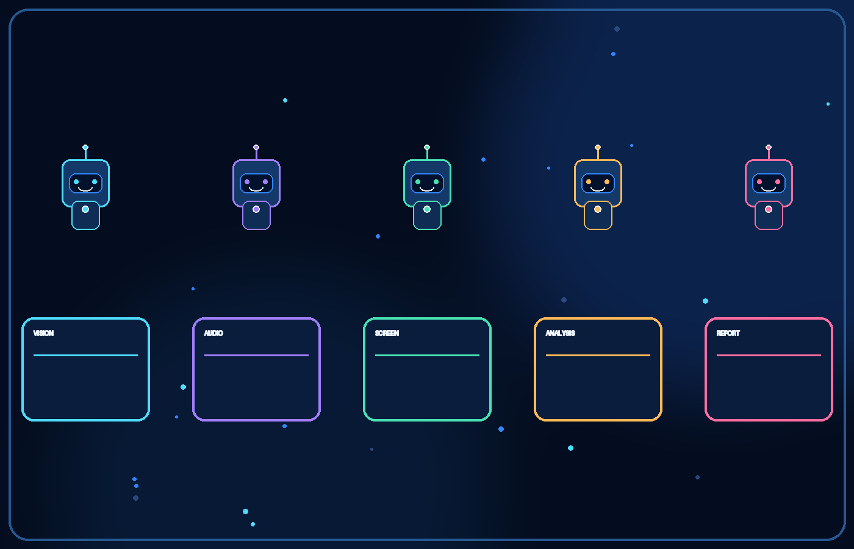
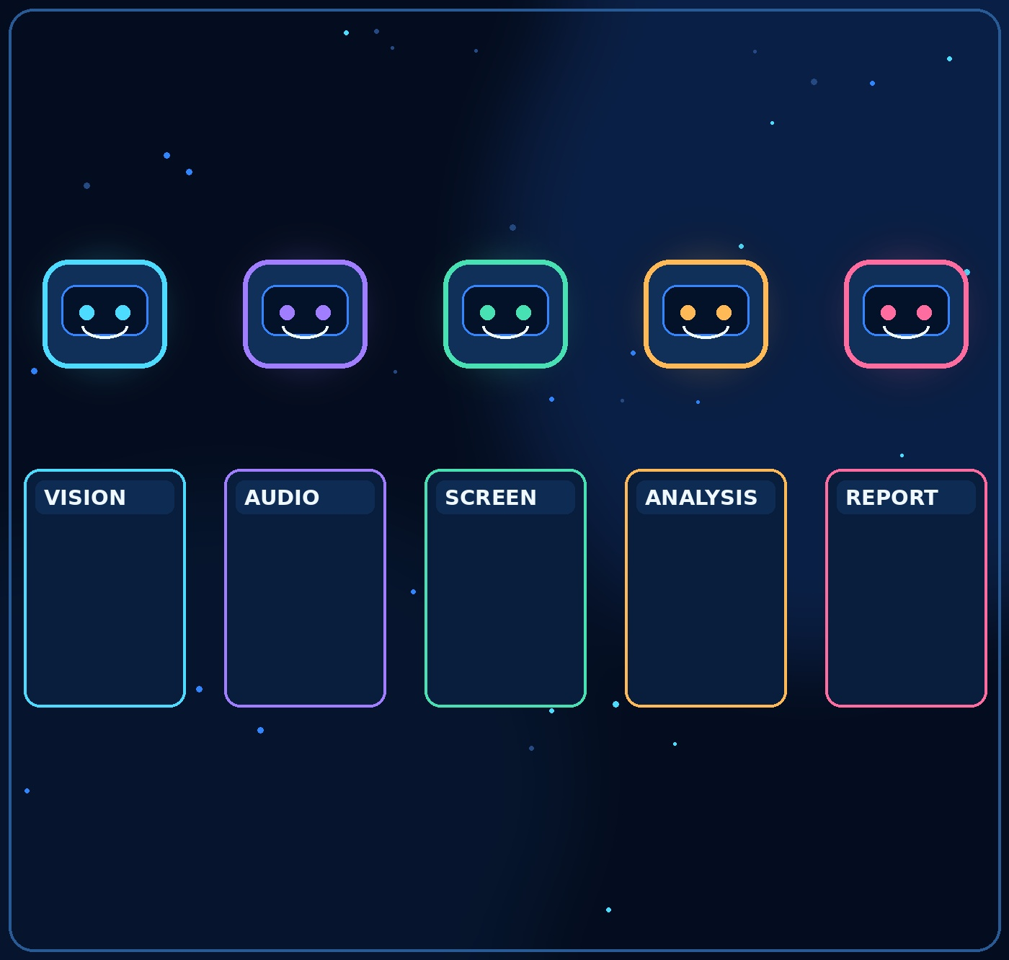



07
Meet the specialist AI agents
Each agent has a narrow job and known limits.
Vision agent: checks whether the candidate is visible, notices additional people, and detects selected visible devices.
Audio agent: can transcribe speech and flag possible additional voices or unusual audio events.
Screen agent: only if supported and consented to, checks defined browser or application activity.
Analysis agent: organises signals into events; it does not infer guilt from a single observation.
Report agent: creates a readable summary for a human reviewer.
VISION
AUDIO
SCREEN
ANALYSIS
REPORT
ASSESA / STUDENT CONCEPT

Slide 8
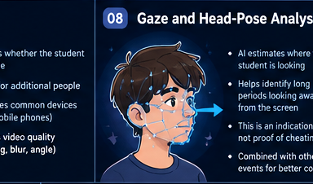
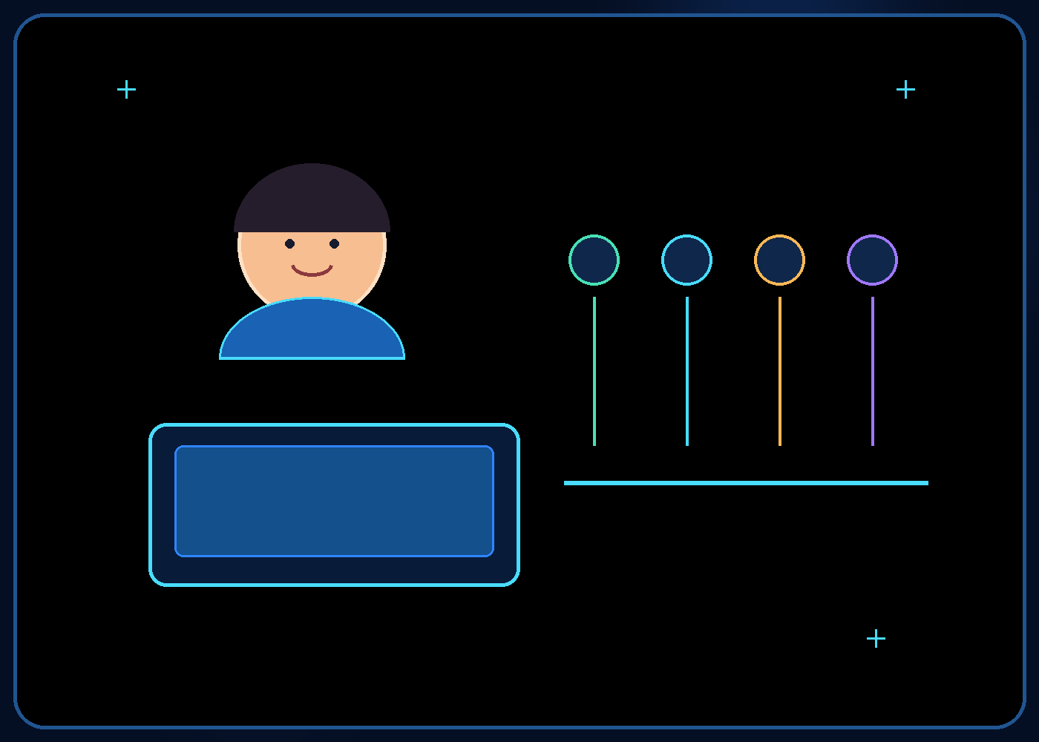
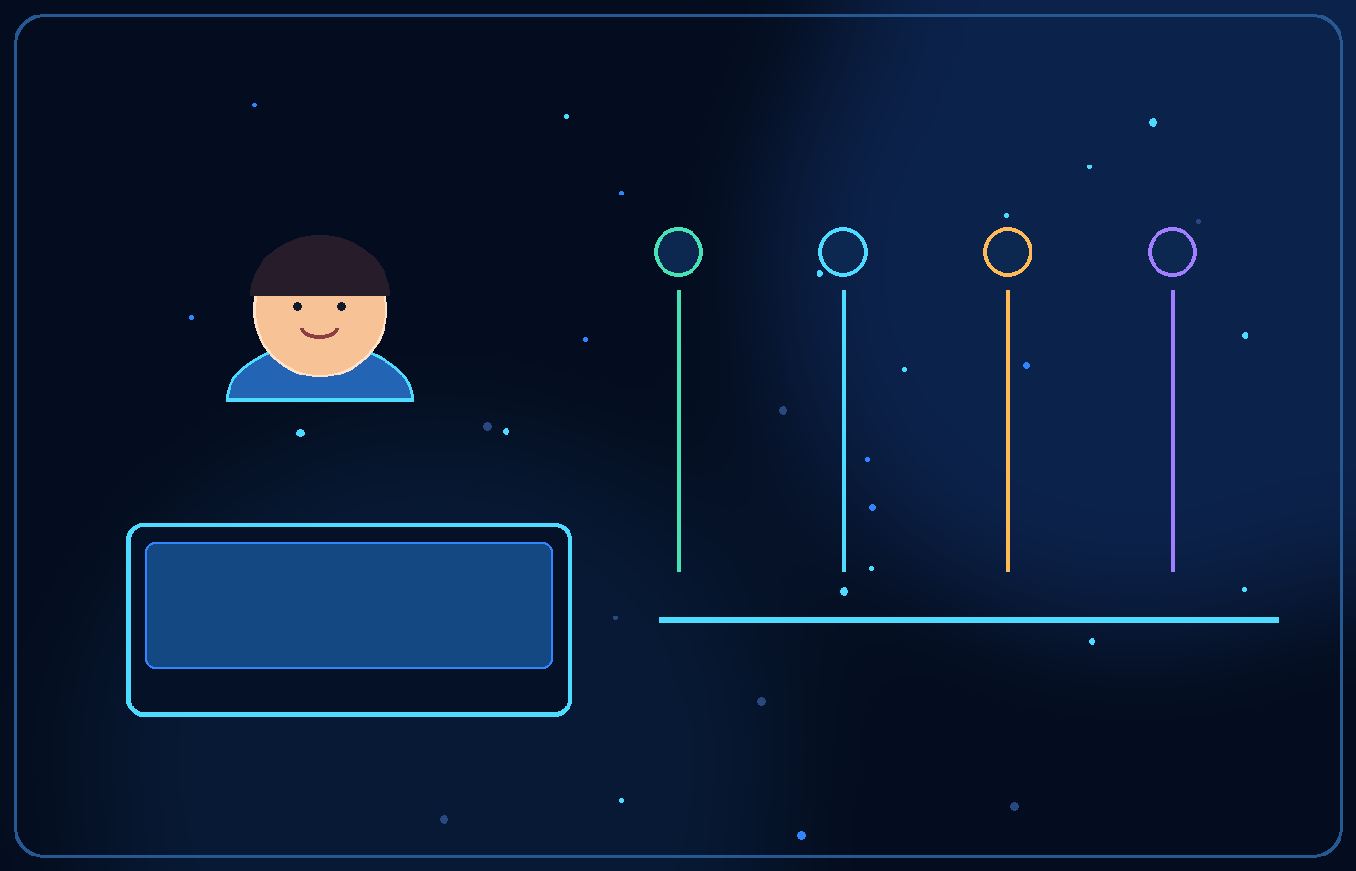

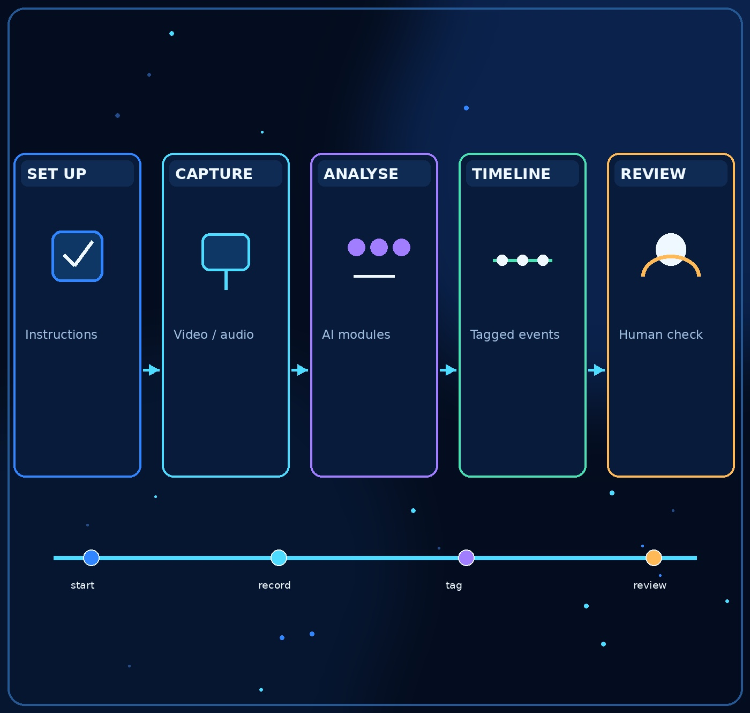
08
How a session might work
From exam start to human-reviewed report.
The candidate receives clear instructions and gives the required consent before any optional monitoring begins.
Video and audio are analysed in real time or after the assessment, depending on the exam design.
The system records selected events with timestamps instead of forcing a reviewer to watch every second equally.
A trained reviewer checks context, records a decision, and can dismiss false alarms.
ASSESA / STUDENT CONCEPT

Slide 9
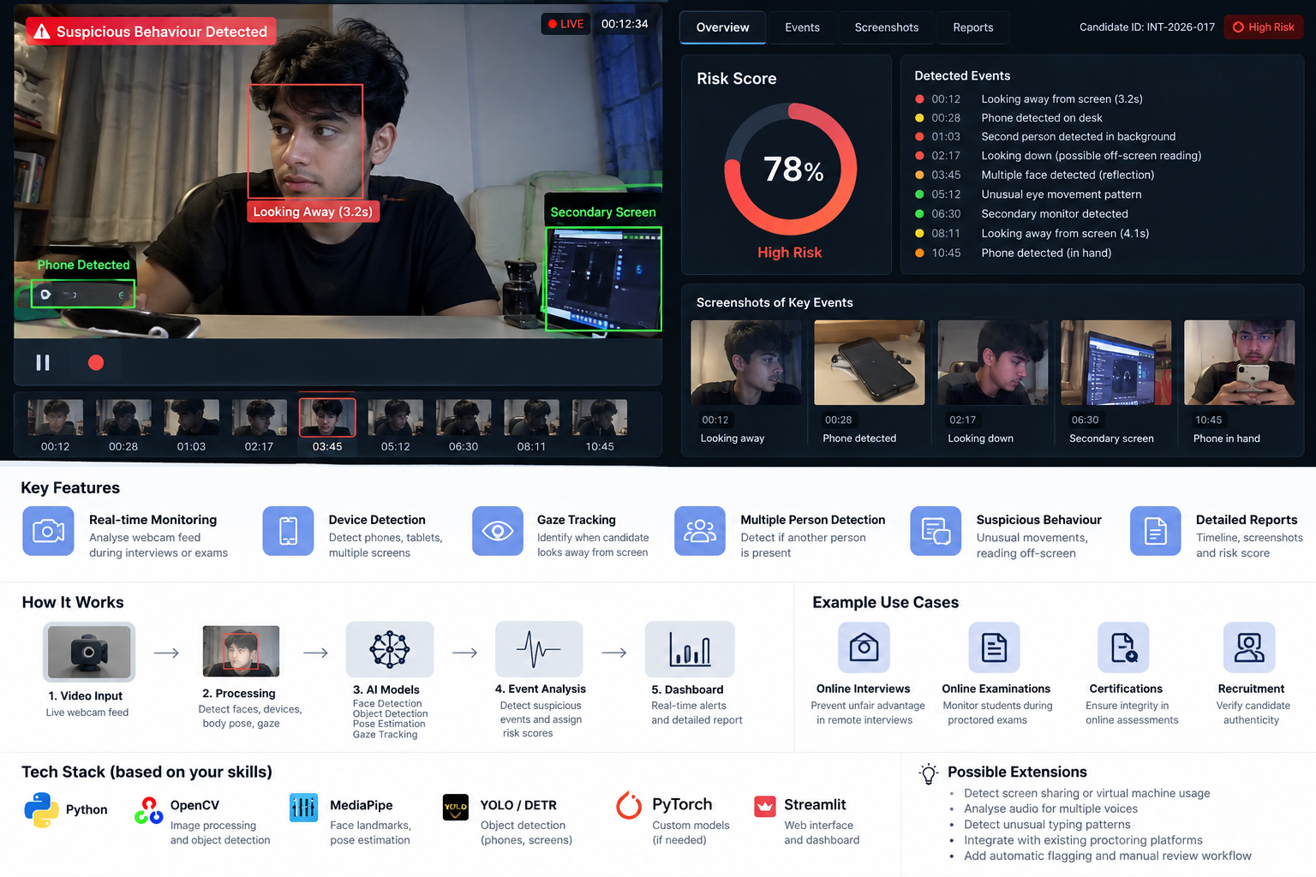

Slide 10

10
The Assesa workflow, end to end
One assessment becomes a traceable review process—not an automatic verdict.
01
02
03
04
05
06
PREPARE
CAPTURE
ANALYSE
STRUCTURE
REVIEW
REPORT
Rules, access,
consent
Permitted video,
audio, optional screen
Specialist models
check narrow signals
Create time-stamped
event records
Human checks
context and policy
Session summary
and permitted trends
Every event should carry five pieces of context
TIMESTAMP
SOURCE
OBSERVATION
QUALITY / CONFIDENCE
REVIEW STATUS
This structure makes evidence easier to inspect and easier to challenge.
ASSESA / STUDENT CONCEPT

Slide 11

11
Before, during, and after the assessment
Different people take different actions at each stage.
BEFORE
DURING
AFTER
Institution + candidate
Assesa platform
Reviewer + institution
Define allowed signals and session rules.
Capture only permitted signals.
Inspect clips and context around flagged moments.
Explain monitoring and obtain required consent.
Run selected modules and monitor input quality.
Record the rationale and outcome under policy.
Check camera, microphone, browser support, and instructions.
Optionally surface time-sensitive events when technically feasible.
Use privacy-protected aggregate measures to improve the process.
The platform prepares review material; authorised people make consequential decisions.
ASSESA / STUDENT CONCEPT

Slide 12

12
Goal 1 — Unified
Bring permitted observations into one review trail, with source and context intact.
PERMITTED INPUTS
ONE REVIEW WORKSPACE
Webcam video
COMMON EVENT RECORD
Reviewer queue
Frames, visibility, selected devices
Events waiting for context
Time
00:11:24
Source
Webcam • frame
Microphone audio
Session report
Speech / sound events where allowed
Observation
Phone-like object detected
What was observed and resolved
Quality
Partially occluded
Optional screen
Confidence
Uncalibrated model output
Aggregate trends
Supported browser or application signals
Status
Awaiting human review
Process and quality measures
Unified does not mean collecting everything. It means connecting only permitted signals without losing provenance.
ASSESA / STUDENT CONCEPT

Slide 13

13
Goal 2 — Accessible
Make the workflow usable across different devices, rooms, and institutional resources.
REAL CONDITIONS VARY
ROOM & LIGHT
DESIGN RESPONSES
1
Bright, dim, shared, or cluttered spaces
Quality before inference
If a feed is poor, say so instead of over-interpreting it.
DEVICE & NETWORK
Graceful alternatives
Support post-assessment review when live processing is not feasible.
2
Different cameras, microphones, speeds
Clear instructions
Tell candidates what is monitored and how to prepare.
3
PEOPLE & NEEDS
Glasses, camera angle, accessibility needs
Accessible reviewer UI
Keyboard access, readable contrast, clear labels, assistive technology testing.
Here, “accessible” means practical to adopt across varied settings; formal accessibility still needs dedicated design and testing.
ASSESA / STUDENT CONCEPT

Slide 14

14
Goal 3 — Real-time
Surface useful prompts promptly when the setup supports it—not instant accusations.
1
CAPTURE
2
CHECK QUALITY
3
ANALYSE
4
CREATE EVENT
5
QUEUE FOR REVIEW
Webcam / mic
Blur, gaps, visibility
Narrow model task
Time + source + context
Optional live prompt
What “real-time” requires
Low enough processing latency • stable input • device/browser compatibility • clear escalation rules
If any dependency fails, mark the limitation and preserve a post-assessment review path. Live processing is a design goal, not a guarantee.
ASSESA / STUDENT CONCEPT

Slide 15

15
Goal 4 — Analytics
Measure review operations and system quality—not a student's character or intent.
SESSIONS REVIEWED
EVENTS RESOLVED
MEDIAN REVIEW TIME
QUALITY WARNINGS
—
Workload
—
Queue throughput
—
Review effort
—
Input reliability
EVENTS BY CATEGORY • EXAMPLE DISPLAY
REVIEW OUTCOMES • EXAMPLE DISPLAY
Dismissed
Needs context
Escalated
Quality issue
Visibility
Device
Audio
Quality
Other
All measures and bars are illustrative UI placeholders; no Assesa performance data is being claimed.
ASSESA / STUDENT CONCEPT

Slide 16

16
Dashboard walkthrough 1 — Session overview
The first screen should orient a reviewer before asking them to judge an event.
WHAT THE REVIEWER SHOULD LEARN
SESSION OVERVIEW / EXAMPLE MOCKUP
LIVE / POST-SESSION
1
Which session is open?
CAMERA PREVIEW
SESSION HEALTH
Video quality
Good
2
Is the video/audio usable?
Audio input
Available
Screen integration
Optional
3
Are any events awaiting review?
Candidate visibility + feed quality
4
Where can I inspect evidence?
REVIEW QUEUE
03
Events to inspect
—
Review status
—
Model quality
Avoid presenting an unvalidated risk percentage as the probability that a candidate cheated.
ASSESA / STUDENT CONCEPT

Slide 17

17
Dashboard walkthrough 2 — Event log and evidence
A useful event row explains what was observed, where it came from, and what to inspect next.
TIME
OBSERVATION
SOURCE / QUALITY
SELECTED EVIDENCE • MOCKUP
00:11 • relevant clip
00:11
Phone-like object
Webcam • partly blocked
Before / after context helps explain the alert.
00:18
Possible extra voice
Audio • noisy segment
00:26
Video quality warning
Video • low light
REVIEW CONTEXT
00:35
Reviewer note
Human input • verified
Observation is not a misconduct finding.
Show confidence and input-quality limits.
Link to the source clip and policy.
Example rows are fictional. Model confidence must be calibrated and explained before operational use.
ASSESA / STUDENT CONCEPT

Slide 18

18
Reviewer workspace — inspect, decide, document
The mockup keeps the evidence, event context, and reviewer action in one place.
REVIEW WORKSPACE / FICTIONAL SESSION A-014
MOCKUP ONLY
VIDEO / AUDIO EVIDENCE
EVENT QUEUE
CONTEXT & ACTION
Phone-like object
Selected event: phone-like object
Source: webcam clip • 00:11
Quality: partly occluded
Model output: requires review
00:11
Possible extra voice
00:18
Dismiss / no issue
00:09 ─────●───── 00:14
Low video quality
Need more context
00:26
Escalate under policy
Reviewer notes and audit trail
Record rationale • reviewer • timestamp • follow-up
A real deployment would require access controls, retention rules, and an appeal process.
ASSESA / STUDENT CONCEPT

Slide 19

19
From a flagged event to a documented outcome
A detection opens a question. It does not answer the question by itself.
1
FLAG
2
CHECK
3
CONTEXT
4
DECIDE
5
AUDIT
Model records
observation
Review clip and
input quality
Check exam rules
and permitted materials
Authorised person
records rationale
Outcome + timestamp
+ follow-up
EXAMPLE — PHONE-LIKE OBJECT AT 00:11
The reviewer checks the clip, visibility, allowed-materials policy, and any explanation before dismissing, requesting context, or escalating.
This is a proposed review process; final actions depend on institutional policy and due process.
ASSESA / STUDENT CONCEPT

Slide 20

20
Proposed differentiation — connect signals to review
The hypothesis is that Assesa's value comes from the workflow around the models, not from one detector.
A POSSIBLY FRAGMENTED PROCESS
ASSESA'S PROPOSED WORKFLOW
Video, audio, screen logs, and notes may be separate.
Join permitted signals into a time-stamped event trail.
Reviewer searches for the relevant moment manually.
Link each event to its source and relevant clip.
Context and technical quality may be documented inconsistently.
Keep reviewer notes, rationale, and resolution together.
Operational trends may need manual aggregation.
Summarise review workload and system-quality patterns.
These are proposed differentiators to validate with institutions—not proven competitive advantages.
ASSESA / STUDENT CONCEPT

Slide 21
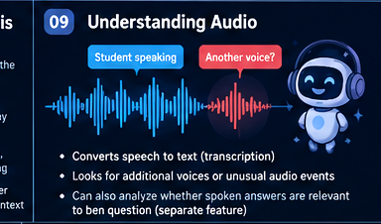

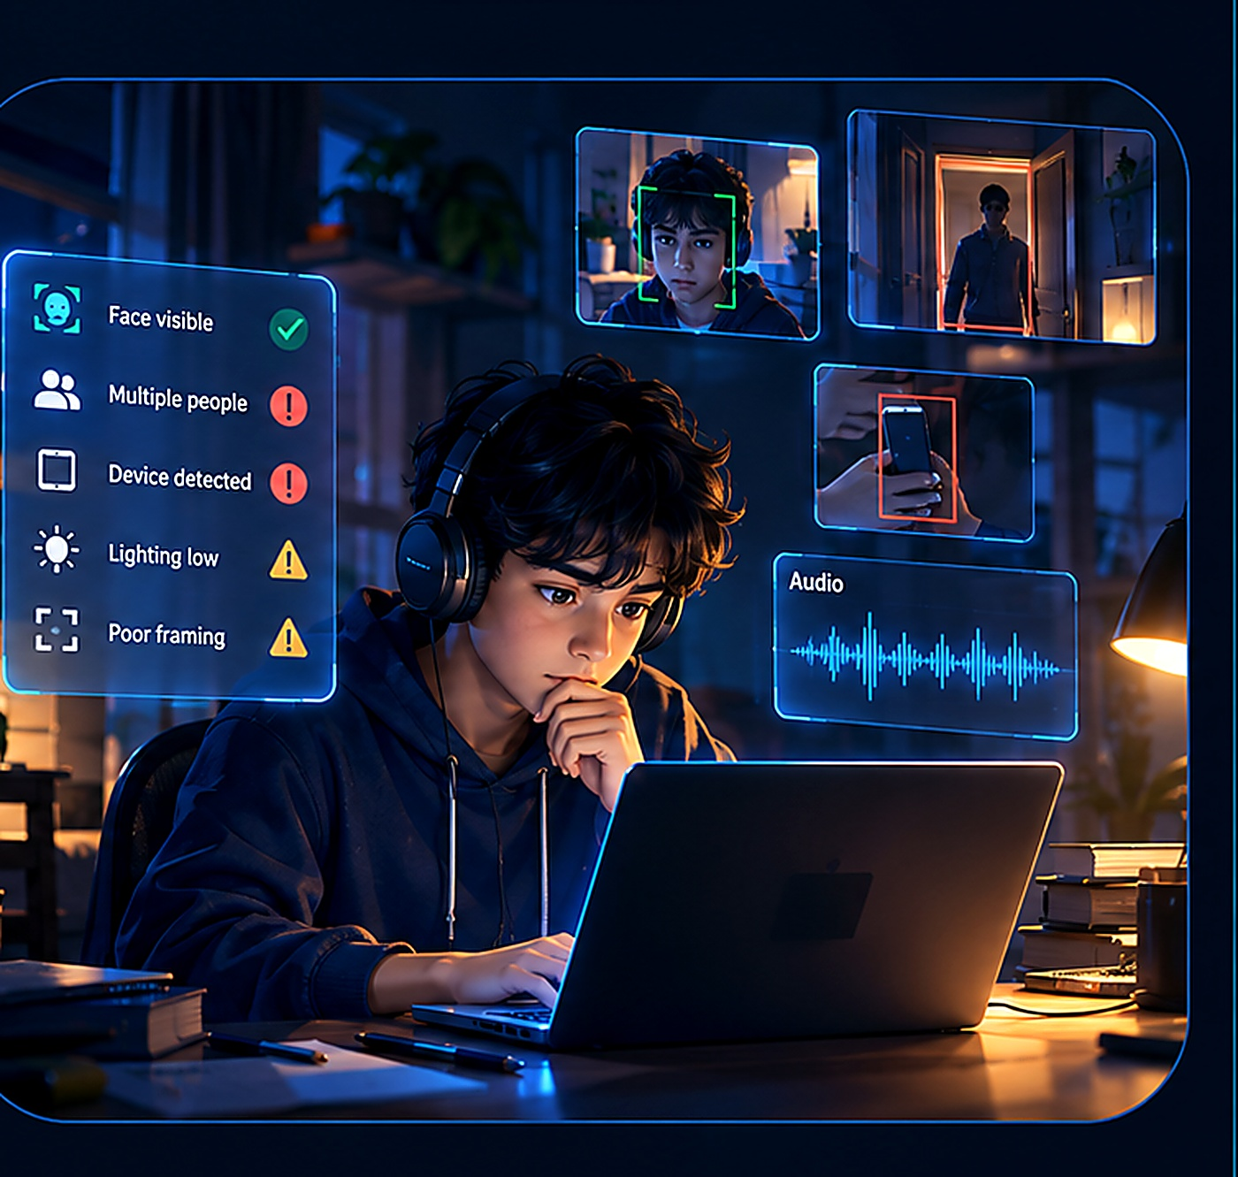
21
Inside the vision module
Ask specific questions about the video—not everything about the room.
Is the candidate visible enough for the session to be reviewed?
Does another person enter the camera view?
Is a selected device, such as a mobile phone, visibly present?
Is the video too dark, blurry, blocked, or poorly framed to assess reliably?
These are targeted detections. They are not full scene understanding and cannot establish why something happened.
ASSESA / STUDENT CONCEPT

Slide 22

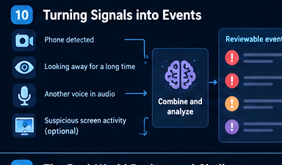
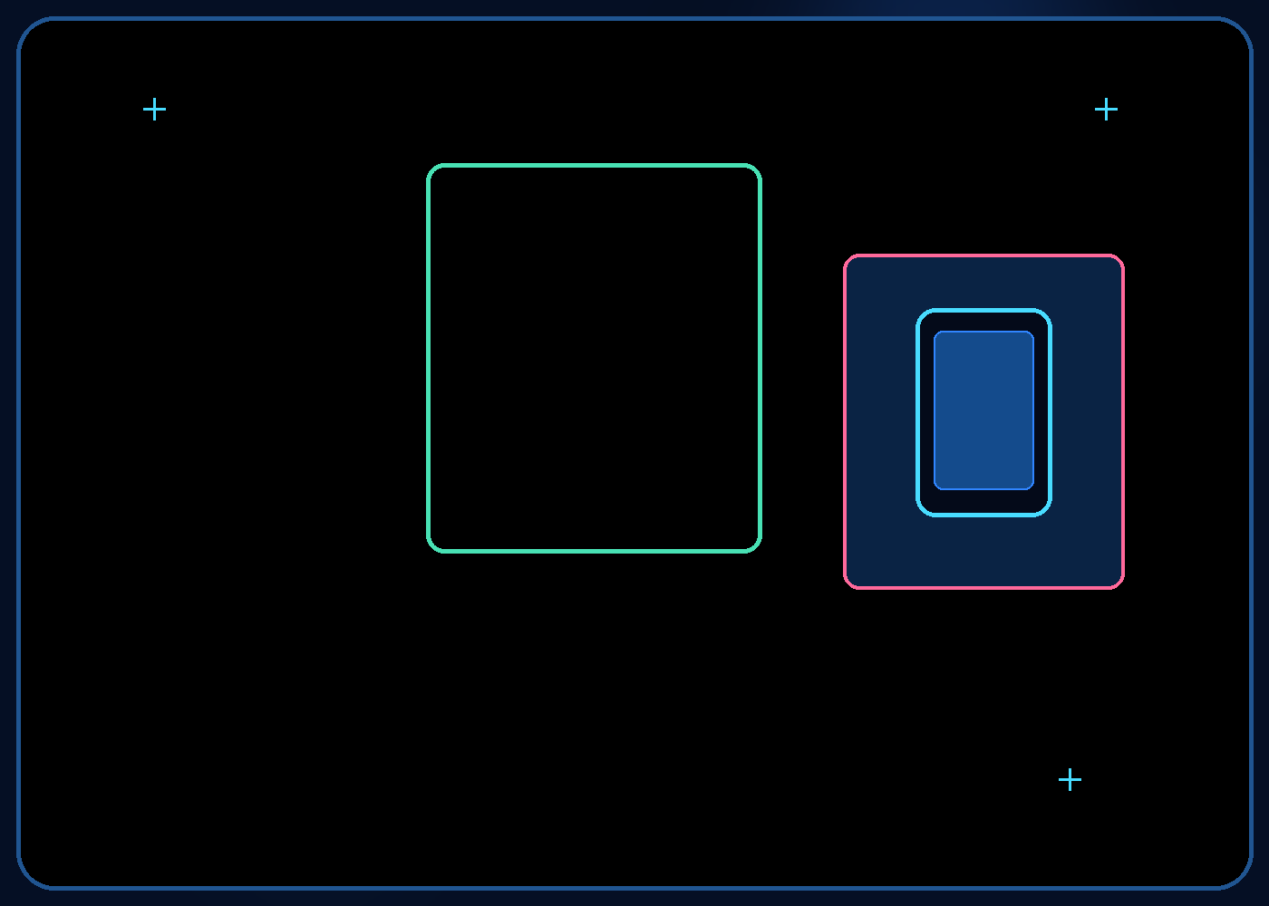
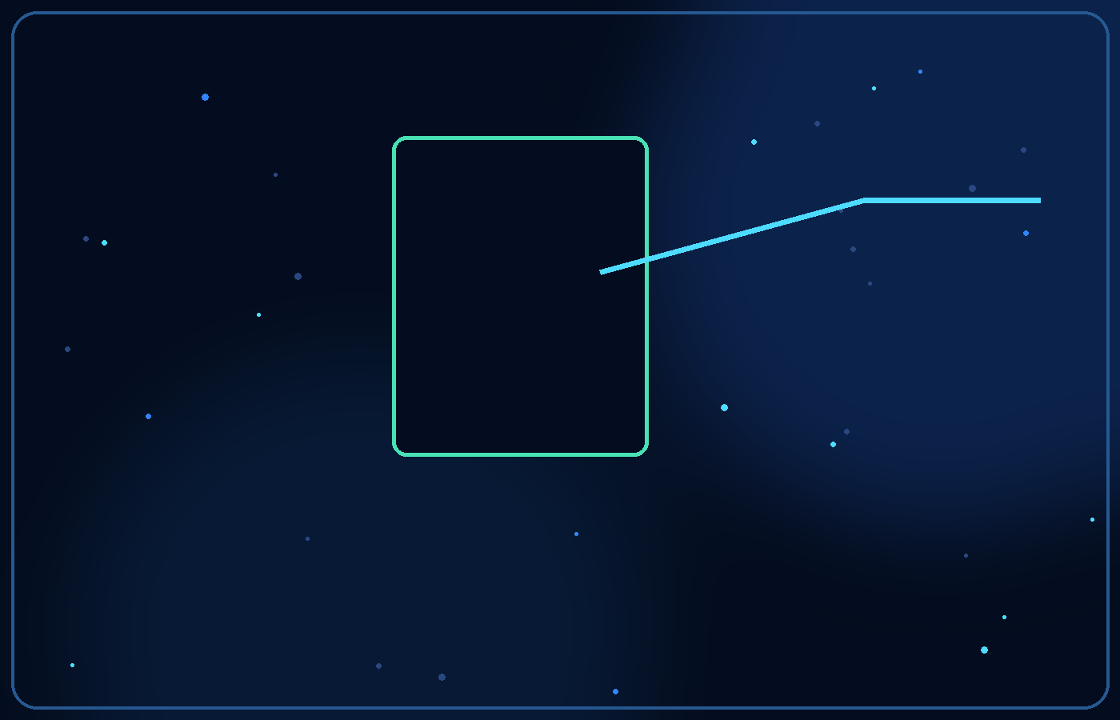
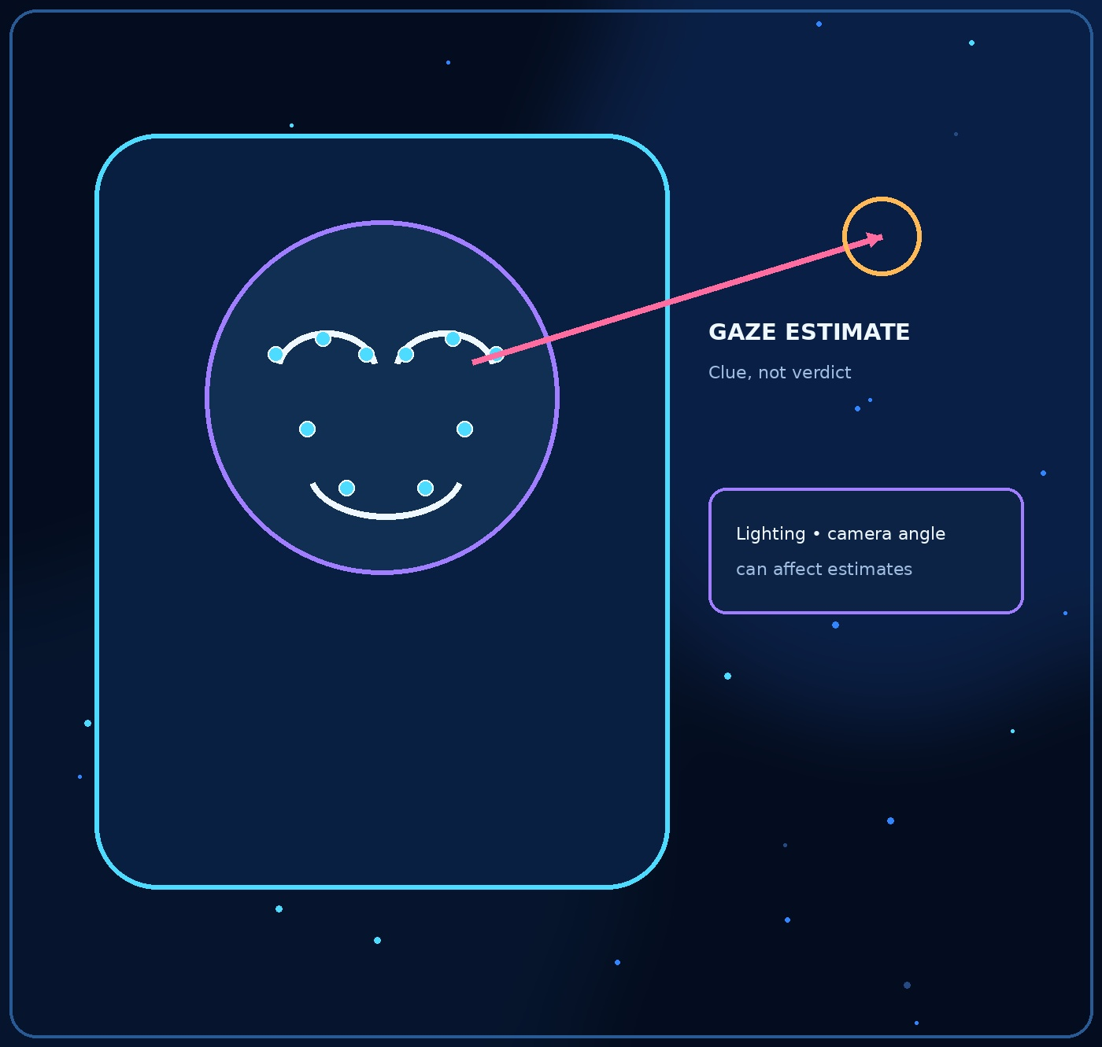



22
Gaze and head pose: useful, but easy to misread
Looking away is not the same as cheating.
A model may estimate face landmarks, head direction, or approximate gaze direction from video.
These signals might help locate repeated patterns for review, but they are affected by camera placement, glasses, lighting, disability, and natural thinking behaviour.
A gaze estimate should never be treated as a standalone cheating verdict.
Assesa should make uncertainty visible and allow reviewers to ignore unreliable estimates.
ASSESA / STUDENT CONCEPT

Slide 23

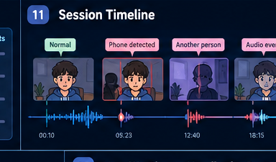
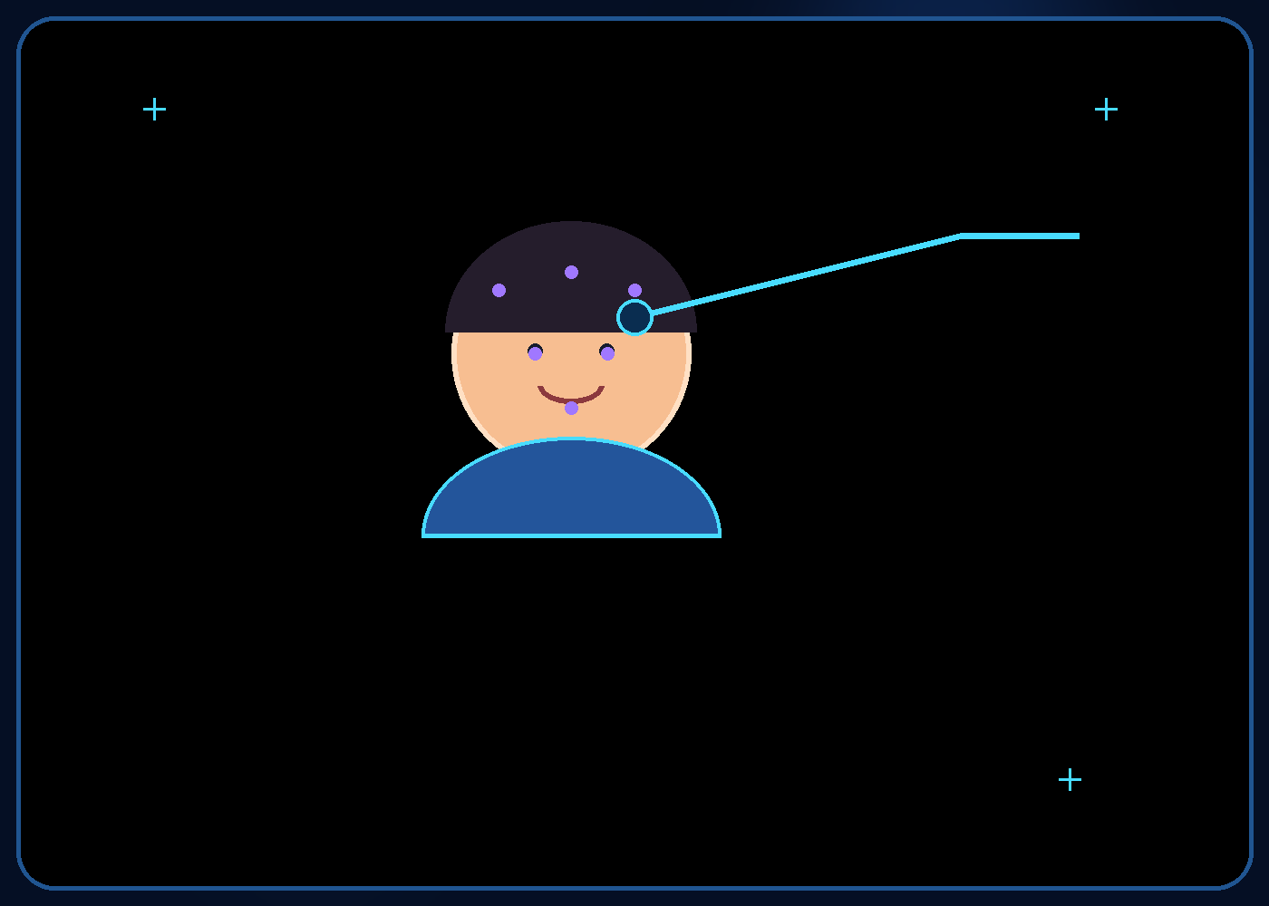
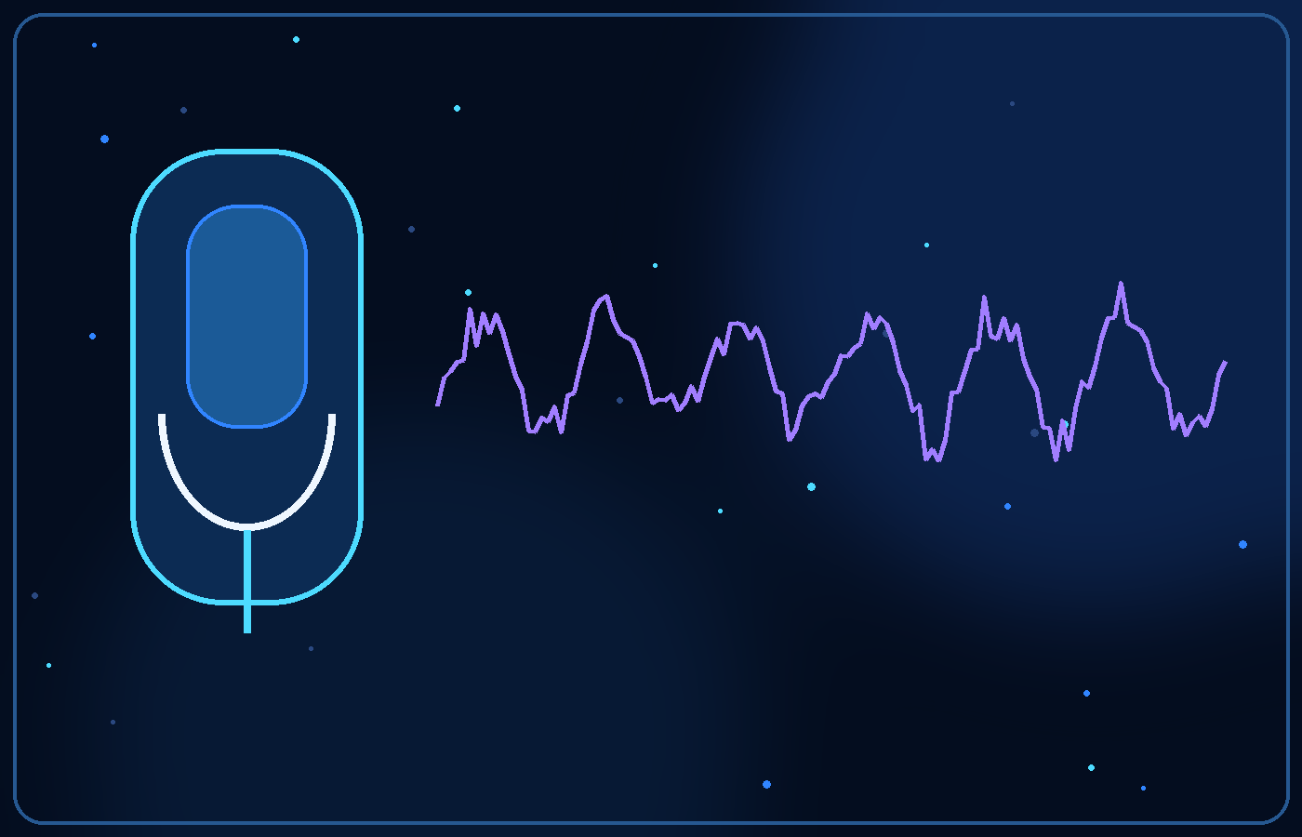
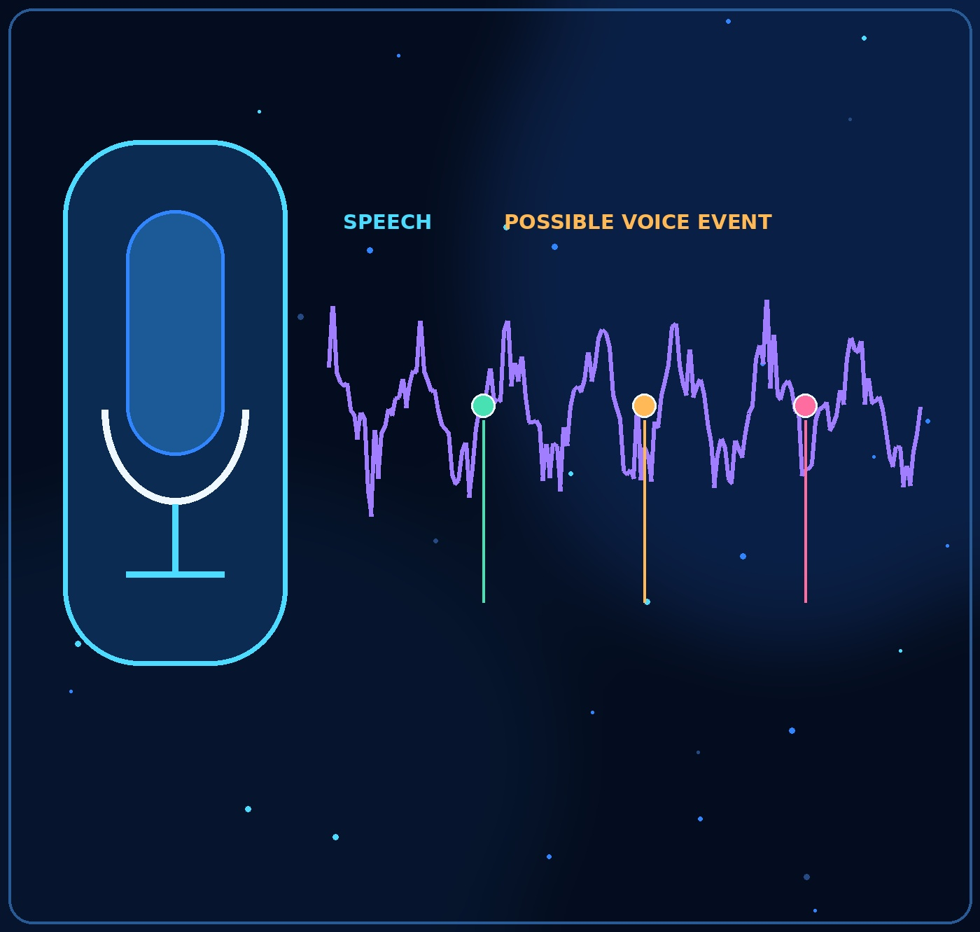



23
Audio: speech can carry more than one signal
Transcription and audio-event analysis are separate tasks.
Speech-to-text converts spoken words into a written transcript, where appropriate and permitted.
A separate audio module could flag possible additional voices, long interruptions, or other defined events.
Answer relevance or communication quality would be a separate feature with a different purpose and evaluation standard.
Background speech or a transcript alone does not prove that a candidate received help.
ASSESA / STUDENT CONCEPT

Slide 24
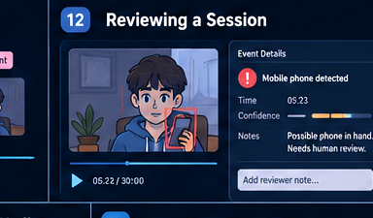
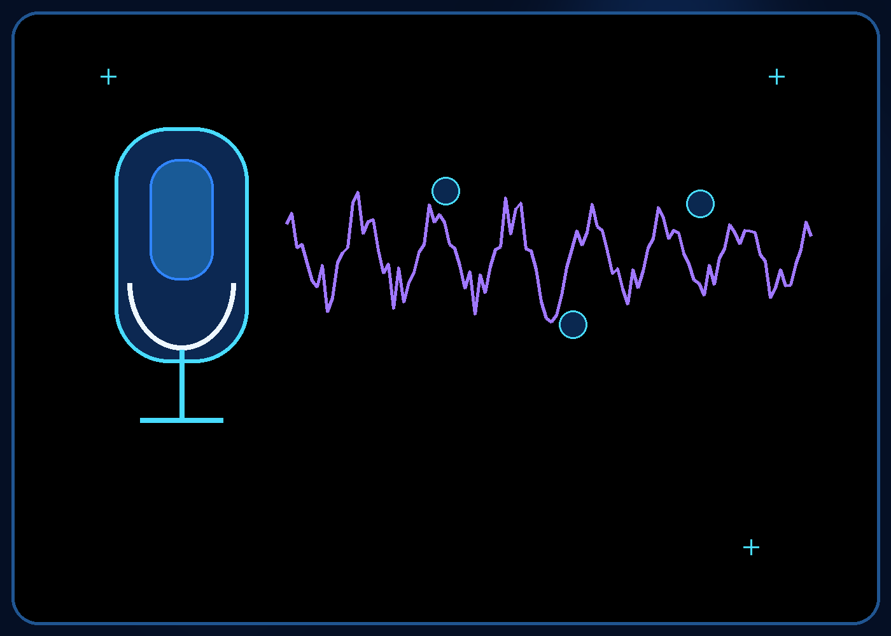
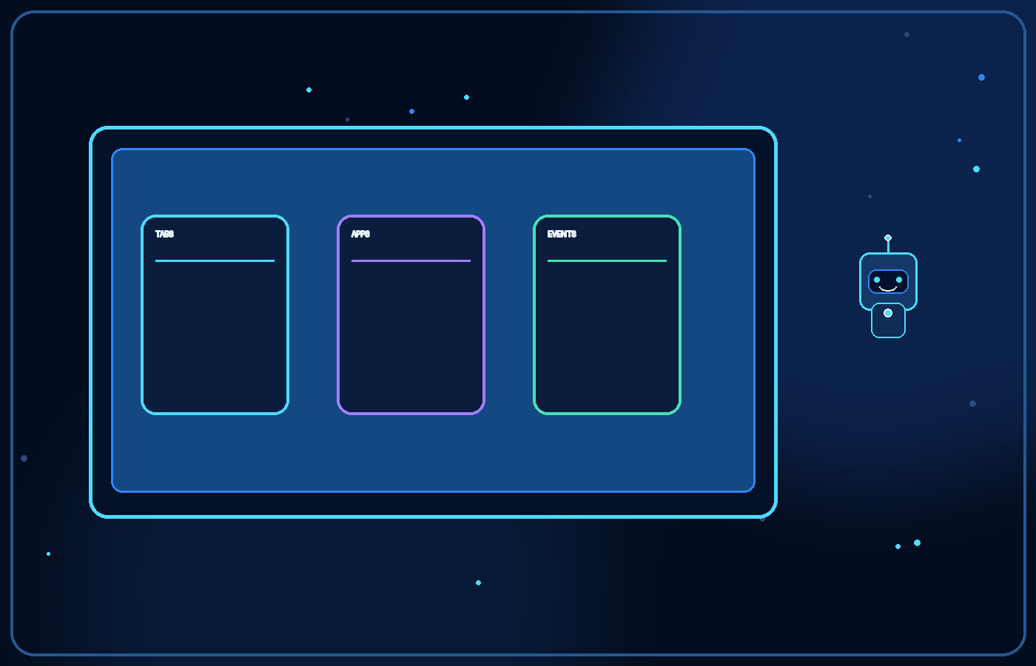
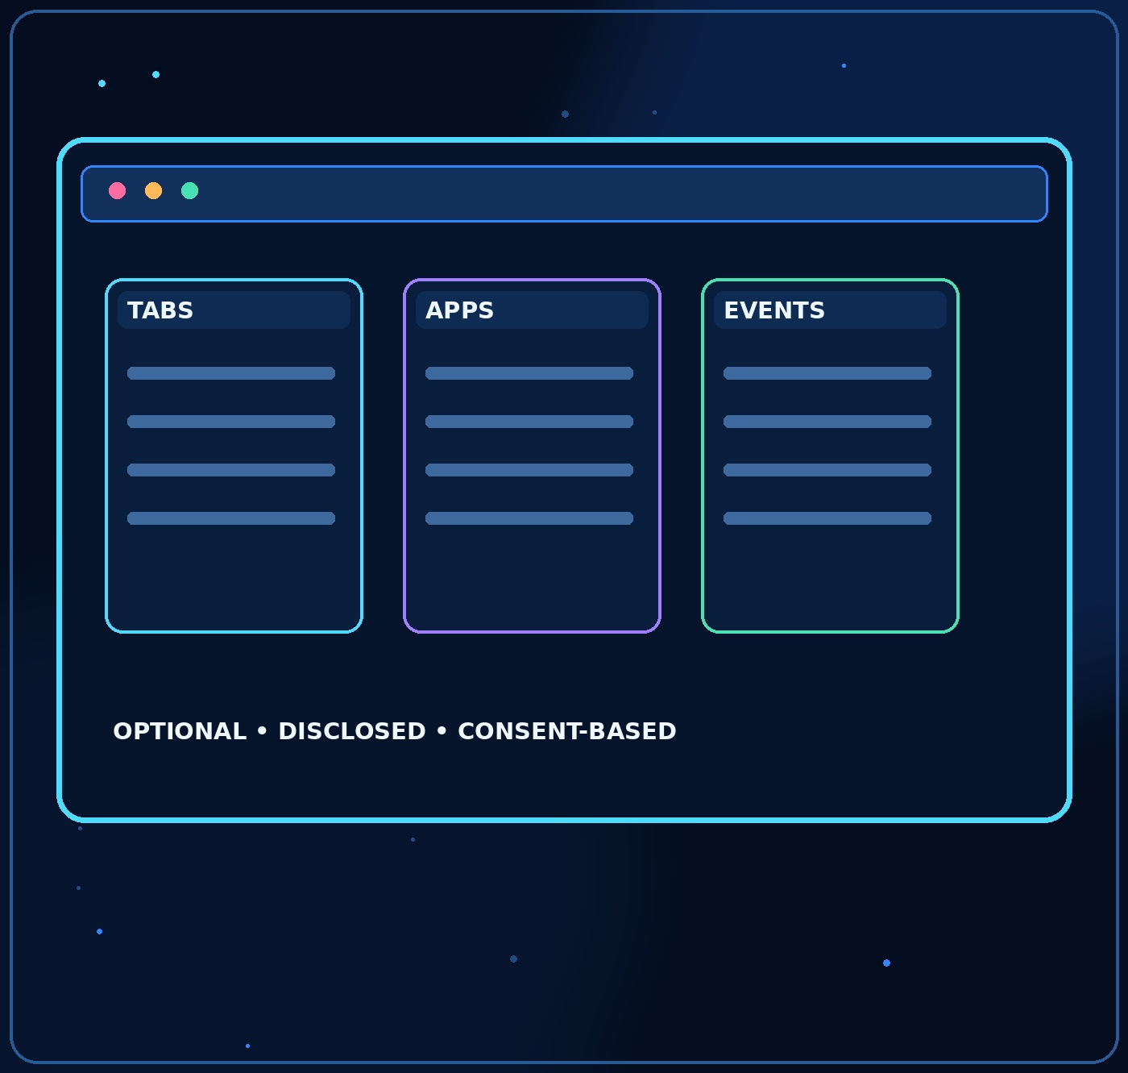
24
Optional screen monitoring
Use the least intrusive method that fits the exam.
Webcam-based analysis is the baseline concept; screen monitoring is an optional layer.
Where technically supported, a browser integration could report defined events such as switching tabs or opening restricted pages.
It must be disclosed in advance, consent-based, limited to the assessment, and designed around data minimisation.
Some devices or browsers may not support the same signals, so the system must state its limits.
ASSESA / STUDENT CONCEPT

Slide 25

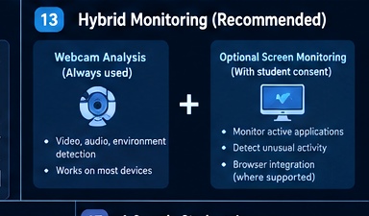
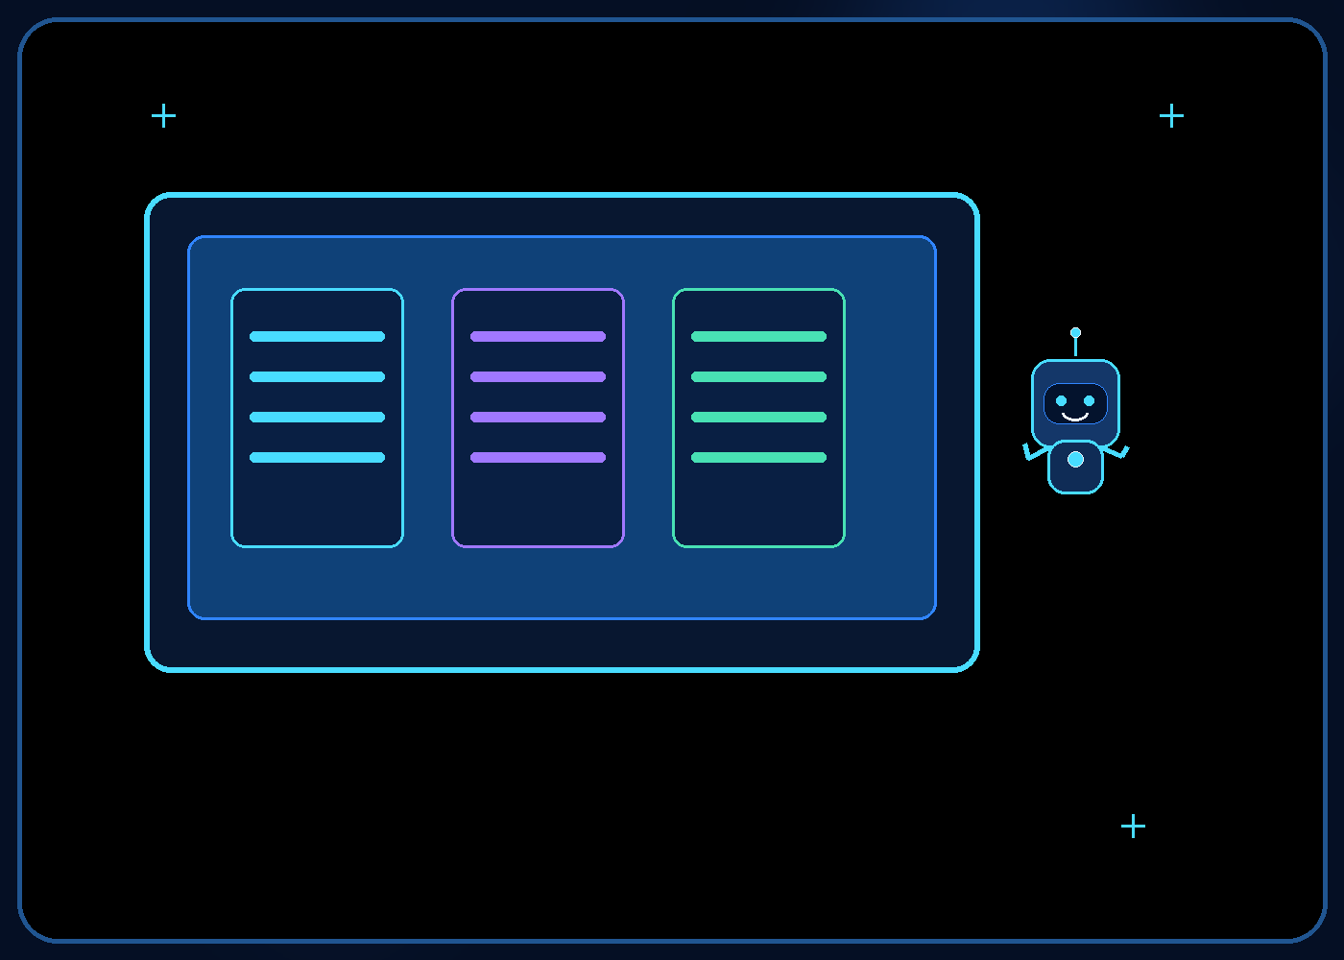
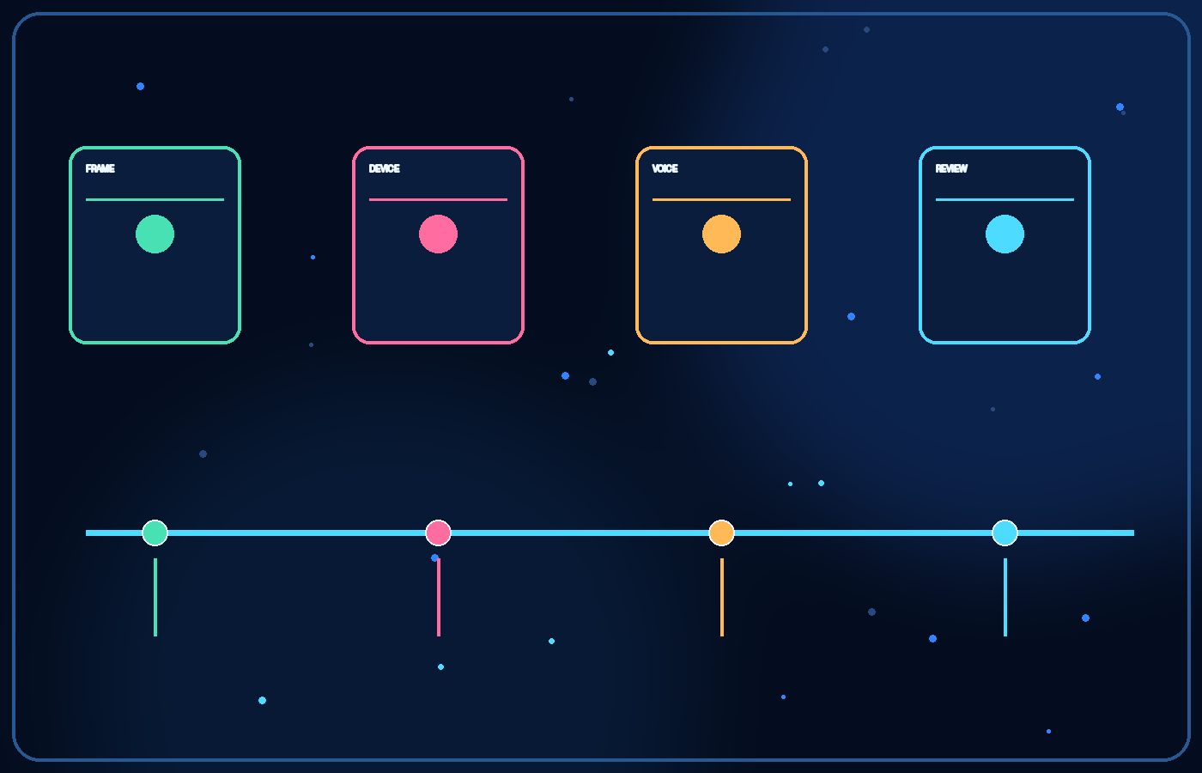
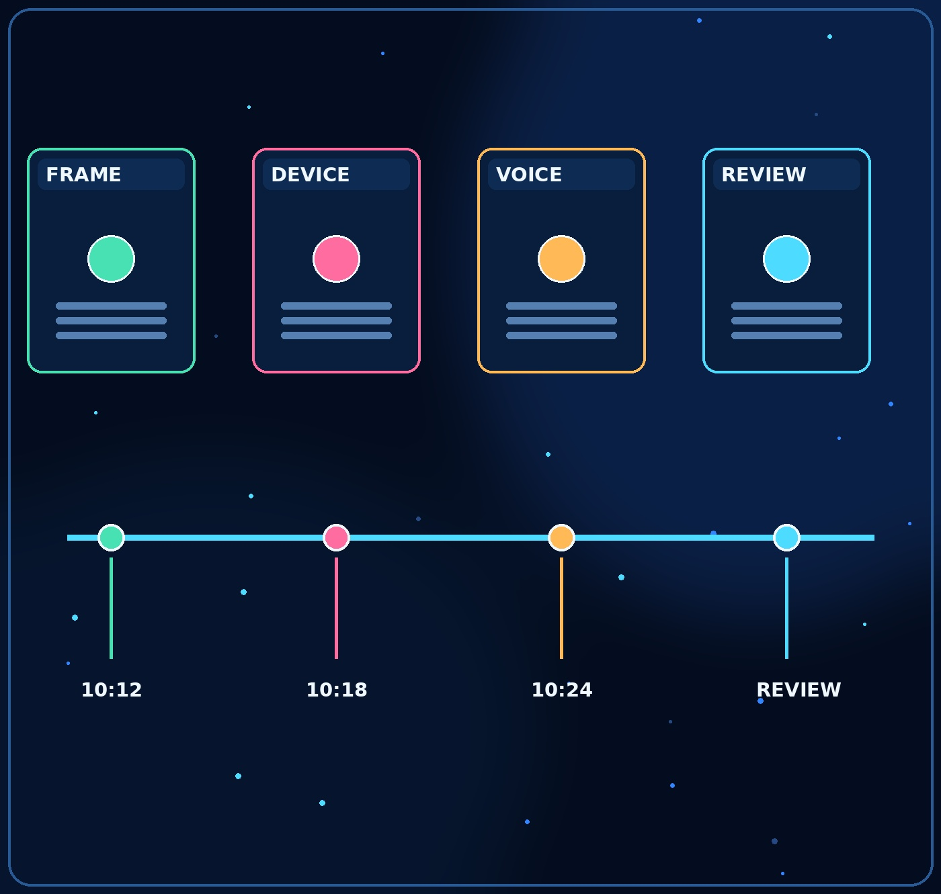



25
From raw signals to a timeline
A reviewer needs context, not a wall of alerts.
Example: 10:12—candidate briefly leaves the frame; 10:18—another voice may be audible; 10:24—a phone-like object appears.
Each event should include its timestamp, confidence, and the relevant clip or evidence source.
Events can be grouped so the reviewer can compare what happened before and after.
These are fictional examples to explain the interface—not real detections or measured performance.
ASSESA / STUDENT CONCEPT

Slide 26
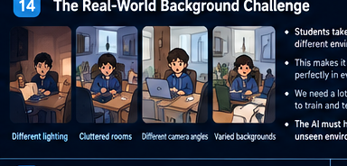
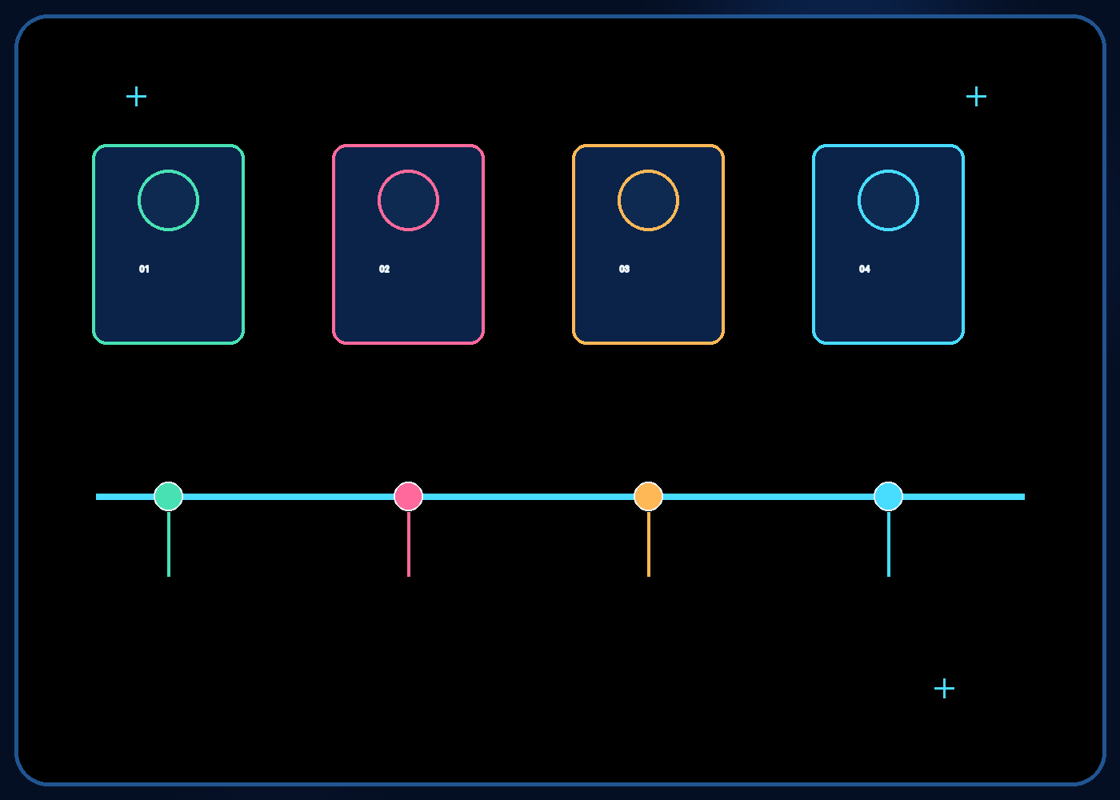
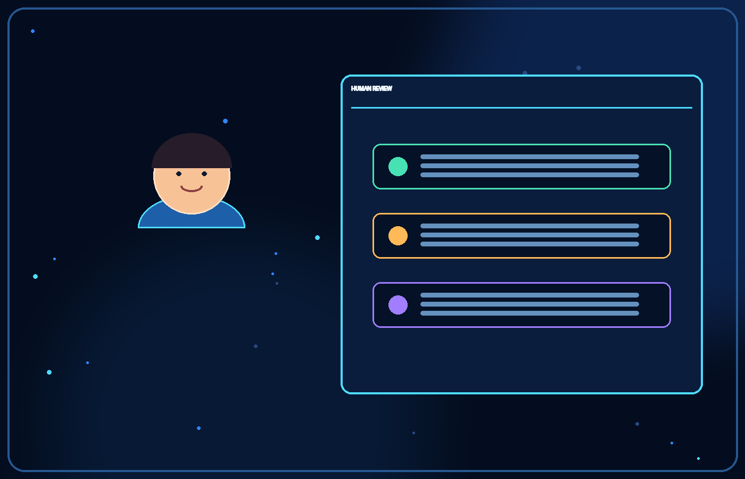


26
The reviewer remains responsible
AI organises evidence; a person evaluates it.
The reviewer can open the relevant clip, inspect the timestamp, read the system’s explanation, and add notes.
They can dismiss an event when the evidence is weak or there is a reasonable explanation.
A consequential decision should follow the institution’s policy and a fair review process.
Assesa should support appeals and audit trails rather than silently making final disciplinary decisions.
ASSESA / STUDENT CONCEPT

Slide 27




27
The hard part: students do not all look the same on camera
Real-world variation is one of the biggest technical challenges.
Candidates may sit exams in bright rooms, dim rooms, shared spaces, or against cluttered backgrounds.
Webcams differ in resolution, angle, frame rate, and image quality; people may wear glasses or head coverings.
A model trained on a narrow set of examples may work well in familiar settings and fail elsewhere.
The goal is not to eliminate all variation—it is to measure where the system is unreliable and avoid unfair conclusions.
ASSESA / STUDENT CONCEPT

Slide 28







28
How we could approach the data challenge
Start with existing models, then test the gaps honestly.
Begin with pretrained computer-vision and audio models instead of training every component from scratch.
Use lawful, representative, permissioned data and carefully designed test cases; do not assume access to real student recordings.
Data augmentation can simulate some variation, such as brightness, blur, and camera framing, but cannot replace real-world evaluation.
Test on unseen environments and report false alarms, missed events, and cases where the model should abstain.
ASSESA / STUDENT CONCEPT

Slide 29







29
The neural network, in plain English
A model learns patterns from examples—it does not understand like a person.
A neural network is a set of connected mathematical units that transform input into a prediction.
During training, examples help adjust internal parameters so predictions better match the training targets.
At assessment time, the model might output a label such as ‘person detected’ with a confidence score.
The score is not certainty, and performance can change when real conditions differ from training data.
ASSESA / STUDENT CONCEPT

Slide 30







30
A possible technical architecture
A proposed stack—not a claim that Assesa has been built.
Python could coordinate the pipeline; OpenCV could handle video frames and image processing.
A face-landmark tool such as MediaPipe and an object detector from the YOLO family could be evaluated for vision tasks.
Whisper or another speech-recognition model could be tested for transcription, subject to language and privacy requirements.
A lightweight web interface could present timelines and reports; each component would need benchmarking before selection.
ASSESA / STUDENT CONCEPT

Slide 31







31
What institutions could learn from aggregate analytics
Improve exam design without turning students into a surveillance score.
Session reports could show what events were flagged and how reviewers resolved them.
Aggregated, privacy-protected trends might reveal poor camera instructions, confusing rules, or recurring technical problems.
Institution-level analytics should avoid unnecessary personal profiling and use access controls, retention limits, and minimum group sizes.
A dashboard should show uncertainty and limitations—not just colourful charts.
ASSESA / STUDENT CONCEPT

Slide 32







32
Privacy, fairness, and limitations
A trustworthy tool must be careful about what it collects and claims.
Explain monitoring clearly, obtain appropriate consent, secure data, restrict access, and set deletion schedules.
False positives and missed detections are inevitable risks; different environments and users may experience different error rates.
Gaze, visible devices, additional voices, or unusual screen activity are not individually proof of misconduct.
Human review, accessibility, appeal pathways, and independent testing are core requirements—not optional extras.
ASSESA / STUDENT CONCEPT

Slide 33




33
A realistic development roadmap
Build narrowly, evaluate carefully, expand only if evidence supports it.
Phase 1—prototype: demonstrate a small number of targeted detections on permitted sample data.
Phase 2—controlled evaluation: test different rooms, devices, lighting conditions, and languages; measure errors.
Phase 3—review workflow: build the event timeline, evidence clips, notes, and reporting interface.
Phase 4—limited institutional pilot only after privacy, fairness, security, and operational requirements are reviewed.
ASSESA / STUDENT CONCEPT

Slide 34


34
The vision: high-level exams with wider access
A future worth exploring—if fairness and trust scale with participation.
Imagine an international Olympiad where more students can participate regardless of location, while organisers still have a practical way to review concerns.
Assesa is one concept for helping that happen: specialist modules, explainable events, and human-led decisions.
The next step is not to claim success. It is to prototype, test the difficult cases, and learn where the idea does—and does not—work.
All people, environments, interface mockups, and sample events shown are illustrative or AI-generated. Any resemblance to real people or situations is purely coincidental.
Disclaimer: Assesa is a student concept, not a validated or deployed product. All people, environments, illustrations, interface mockups, maps, and sample events in this presentation are illustrative, AI-generated, or hypothetical unless explicitly stated otherwise. No actual student recordings, verified performance metrics, or institutional deployments are represented. Any resemblance to real people or situations is purely coincidental.
Concept only • No verified product results or institutional deployment are claimed.
Concept-stage proposal • Illustrations and example events are AI-generated / hypothetical unless stated otherwise
ASSESA / STUDENT CONCEPT

