Slide 1


QuizEZ
AI Powered
Quiz Generator
Team 1
Sampurna Ghosh (61681)
Padmashree V Hegde (61692)
Sahana M S (61682)
Navaprettam N (61693)
Sayan Paul (61679)
Feb | 2025
Notes:
1

Slide 2
Problem Statement
Business Challenge
Solution
Project Flow Diagram
Architecture
Phases
Technologies and Tools Used
Key Results and Benefits
Conclusion
Future Scopes
Demonstration
Outline

Slide 3

Problem Statement
Current educational tools and quiz platforms fail to provide personalized, engaging, and dynamic learning experiences that cater to the unique needs of individual learners. Most existing quiz applications focus solely on static questions or generalized quizzes, leaving users with limited opportunities for dynamic and spontaneous quiz generation.
As existing quiz systems lack personalization and real-time feedback, limiting effective learning. There’s a need for an AI-powered solution that generates adaptive quizzes based on user requirements.
03

Slide 4
Business Challenges
Difficulty in Creating Dynamic Quizzes
Content Accuracy and Quality
API Latency
Cross-Platform Integration
Scaling the System
04

Slide 5
Our Solutions
We built a user-friendly quiz generator with Next.js, React and GenAI enabling dynamic, personalized quizzes.
The app automates quiz creation, view details, improving engagement and learning insights.
Built on Next.js and cloud infrastructure, our app scales seamlessly to handle traffic surges and large datasets, ensuring consistent performance even during peak usage times.
05

Slide 6

Project Flow (User)
Sign up
Success
Sign In
Forgot Password
Send
OTP
Verification
Change Password
Auth & Success
User Dashboard
Create Quiz
Request
Generative AI
Database
06
Response

Slide 7
Project Flow (Admin)
Login
Quizzes
Success
Admin Dashboard
Database
Users
07

Slide 8
Architecture Diagram
Token generation
Authentication API
HTTP Cookies
PostgreSQL
POST request
Login/Register
POST/
GET
GET/
DELETE
Users
GET / DELETE
PostgreSQL
Front End
NextJS
React
Admin
GET / DELETE
Quiz & Questions API
POST / GET
PostgreSQL
POST
Generating Quiz
POST
External API
08
Gemini
Users

Slide 9
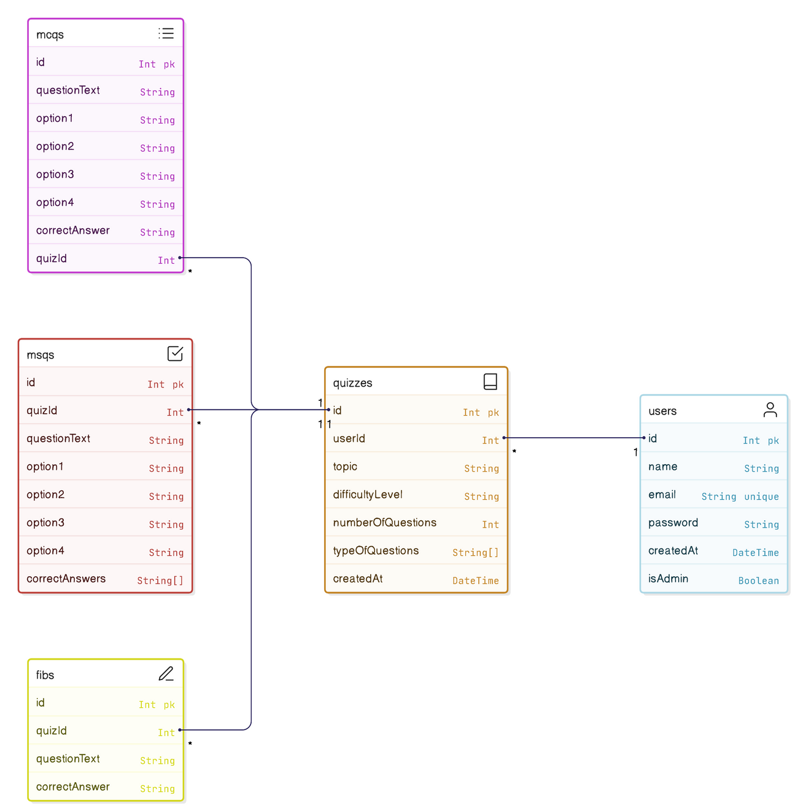
Database
Diagram
09

Slide 10
Phases
Phase 1: Initial Development:
- Research and planning phase.
- Develop initial MVP (minimum viable product) of the quiz generator app with basic features (User Registration & Authentication,Quiz Creation, Quiz Management,User Interface,Basic Admin Panel,Downloading Quizzes generated,Data Storage ).
Phase 2: Enhancement & Optimization
- User profiles enhancements and Progress Tracking (No. of quizzes generated)
- Refine UI with interactive elements.
10

Slide 11
Phases & Timeline
Phase 3: Deployment
- Prepare for scaling and deployment to cloud infrastructure.
Phase 4: Continuous Improvement(To be done)
- Monitor user feedback and performance.
- Provide regular updates based on user input
11

Slide 12















Technologies and Tools Used
12

Slide 13
Key Results and Benefits
Streamlined Quiz Creation
Personalization and Adaptability
Engagement and Interactivity
Inclusion of GenAI
Increase efficiency
Future-ready
13

Slide 14
Conclusion
In summary, our quiz generation app, developed using Next.js, React, and GenAI, combines AI-driven personalization with scalable, responsive technology. The project emphasized the importance of user feedback, collaboration, and addressing challenges like scaling and performance optimization, ultimately delivering a more dynamic learning experience.
15

Slide 15
Future Scopes
Generating quiz from video content
Multiplayer quiz features for group learning.
Content Accuracy and Quality
Detailed analytics dashboards for users.
Gamification
Data Privacy and Security
Monetization and Business Model
16

Slide 16
Demonstration

