Slide 1

SWAMI VIVEKANANDA INSTITUTE OF MODERN SCIENCE
NAME With ROLL NO:- SAYAN ADHIKARY - 26401222033
SAWAN KUMAR MURMU - 26401222029
SUDHANGSU SHEKHAR BAIRAGI - 26401222092
SUDIP UTTHASINI - 26401222009
SAMIRAN BHATTACHARYA - 26401222024
DEPARTMENT: - DEPARTMENT OF COMPUTER APPLICATION
SEMESTER: - 1st YEAR:- 3rd
PAPER NAME: Industrial Training & Minor Project
PAPER CODE: BCAD581
COLLEGE CODE :264
UNIVERSITY NAME: MAULANA ABUL KALAM AZAD UNIVERSITY OF TECHNOLOGY
Submitted by Sayan Adhikary and Team

Slide 2
Introduction
Objective
Literature Review
Hardware And Software used
Technologies used in backend
Technologies used in Frontend
Application Used
Data flow diagram
Database table
Home page
Signup page
Login page
Notification & Chat Area
Key Features
Conclusion
References
CONTENT

Slide 3
Chat Application Overview
The Chat Application is a cutting-edge communication platform designed to enhance real-time interaction and collaboration. It supports instant messaging, multimedia sharing, and one-to-one communication, providing a seamless user experience.
Key Features:
Real-time messaging with message synchronization.
Support for multimedia sharing (images, videos).
Group chat for collaborative teamwork.
Customizable profiles and dynamic animations.
Secure communication with end-to-end encryption.
Technology Stack:
Frontend: HTML, CSS, JavaScript for interactive and responsive design.
Backend: PHP for efficient server-side logic.
Database: MySQL for managing real-time data.
Vision:
To revolutionize communication by offering a unified, scalable, and secure platform that transcends geographical barriers and fosters meaningful interactions.
Introduction

Slide 4
Objective
Deliver a seamless and secure platform for real-time communication.
Enhance user productivity through instant messaging, multimedia sharing, and group collaboration.
Prioritize privacy with robust encryption and secure authentication.
Purpose
Foster meaningful connections across devices and platforms.
Provide a user-friendly, customizable, and inclusive communication experience.
Bridge distances and support diverse communication needs.
Drive innovation by continuously evolving with user feedback and emerging technologies.
Objective

Slide 5
Overview
Essential in modern communication with features like text messaging, multimedia sharing, and encryption.
User Experience & Mobile Accessibility
Principles: Clarity, simplicity, responsiveness.
Mobile optimization: Seamless design, faster load times, secure authentication.
Security & Privacy
Measures: End-to-end encryption, data minimization, secure servers, and user education.
User Engagement & Personalization
Strategies: Onboarding, loyalty programs, social media integration.
Personalization: Data-driven insights for tailored user experiences.
Challenges & Opportunities
Challenges: Market competition, scalability, user trust.
Opportunities: AI, global reach, sustainability, and strategic collaborations.
Conclusion
Focus on features, usability, and security to drive innovation and user engagement.
Literature Review

Slide 6
Hardware and Software used
Hardware Requirements
Software Requirements
Client Machine | Server Machine
HDD: 500 GB | HDD: 500 GB
Processor: Pentium 4 or Newer | Processor: Dual Core or Newer
Memory: 4 GB | Memory: 4 GB
Client Machine | Server Machine
Browser: Any Standard Browser | Software: Compass
Client-Side Technologies: HTML, CSS, JavaScript | Database: MySQL

Slide 7

Technologies Used In Backend​
Backend Technology - PHP and MySQL
PHP (Hypertext Preprocessor)
Description:
A widely-used, open-source, server-side scripting language ideal for creating dynamic web applications.
Key Features:
Server-Side Execution: Secure and efficient processing on the server.
Embedded in HTML: Easy integration of dynamic content in static pages.
Platform Independent: Runs on Windows, Linux, macOS, and more.
Database Integration: Seamless connectivity with databases like MySQL.
Extensive Libraries: Built-in functions for arrays, strings, and sessions.
Advantages:
Easy to learn and use.
Open-source and cost-effective.
Supports robust frameworks (e.g., Laravel, Symfony).
Disadvantages:
Performance issues in high-concurrency environments.
Dynamic typing can lead to runtime errors.
Security vulnerabilities if not configured properly.

Slide 8

MySQL (Relational Database Management System)
Description:
An open-source RDBMS designed for performance, scalability, and reliability.
Key Features:
Relational Database: Organizes data in structured tables.
Cross-Platform: Runs on Windows, Linux, macOS, and UNIX.
Secure: Robust authentication and encryption options.
Scalable: Handles large datasets efficiently.
Web Integration: Powers dynamic websites and applications.
Advantages:
Free and open-source.
High performance for small-to-medium applications.
User-friendly interface with tools like phpMyAdmin.
Disadvantages:
Limited compliance with advanced SQL standards.
Performance challenges under heavy loads.
Scalability requires manual intervention (e.g., sharding).

Slide 9

Technologies Used In Frontend
Frontend Technology - HTML, CSS, and JavaScript
HTML (HyperText Markup Language)
Description:
The standard language for creating the structure of web pages.
Key Features:
Semantic Elements: Organize content with meaning (e.g., <header>, <article>).
Hyperlinking: Seamlessly link pages with <a> tags.
Media Support: Integrate images, videos, and audio.
Flexible Layouts: Combine with CSS for advanced layouts.
Advantages:
Simple and easy to learn.
Compatible with all browsers.
Forms the foundation of web pages.
Disadvantages:
Limited styling capabilities.
Requires CSS and JavaScript for dynamic behavior.

Slide 10
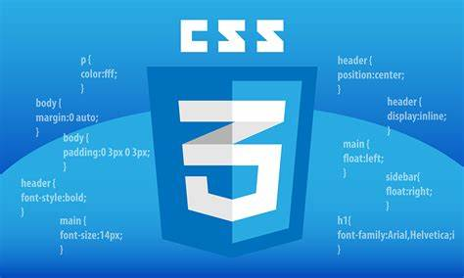
CSS (Cascading Style Sheets)
Description:
A stylesheet language used to style and design web pages.
Key Features:
Selectors: Target specific elements for styling.
Responsive Design: Create layouts that adapt to screen sizes using media queries.
Animation: Add interactivity with transitions and animations.
Framework Support: Compatible with frameworks like Bootstrap and Tailwind CSS.
Advantages:
Enhances visual presentation.
Enables responsive designs for different devices.
Separates content (HTML) from design (CSS).
Disadvantages:
Can become complex for large-scale projects.
Browser compatibility issues may arise.

Slide 11

JavaScript (JS)
Description:
A programming language that adds interactivity and dynamic features to web pages.
Key Features:
DOM Manipulation: Update and interact with HTML and CSS dynamically.
Event Handling: Respond to user actions like clicks and keypresses.
APIs: Integrate external services and features (e.g., maps, payment systems).
Frameworks & Libraries: Leverage React, Angular, or Vue.js for advanced applications.
Advantages:
Adds interactivity to static pages.
Works seamlessly with HTML and CSS.
Widely supported and constantly evolving.
Disadvantages:
Can be misused, leading to poor performance.
Requires proper testing to avoid security vulnerabilities.

Slide 12
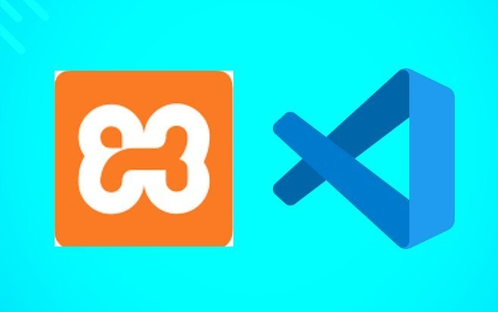
APPLICATIONS USED
XAMPP
What: Free, open-source package that includes Apache, MySQL, PHP, and Perl.
Purpose: Used for local development and testing of web applications.
Key Features: Easy installation, database management with phpMyAdmin, cross-platform support.
Visual Studio Code (VS Code)
What: Free, open-source code editor by Microsoft.
Purpose: Lightweight editor for web and cloud development.
Key Features: Code completion, debugging, Git integration, customizable extensions.

Slide 13
Data Flow Diagram (DFD) for a Chat Application:
Components:
Process: Represents system actions like sending/receiving messages, user authentication, etc.
Data Flow: Arrows showing how data moves between components (e.g., messages from user to server).
Data Store: Repositories like message history and user profiles.
Terminator: External entities such as users or third-party services interacting with the system.
Levels of DFD:
Level 0 (Context Diagram): High-level view of the system with interactions between external entities and the system.
Level 1 DFD: Breaks the system into main processes (e.g., user login, send/receive message).
Level 2 DFD: Further decomposition of processes into detailed sub-processes (e.g., message validation, network check).
Example DFD Flow:
User A sends a message → Send Message Process → Message Database → Receive Message Process → User B receives the message.
Data Flow Diagram

Slide 14

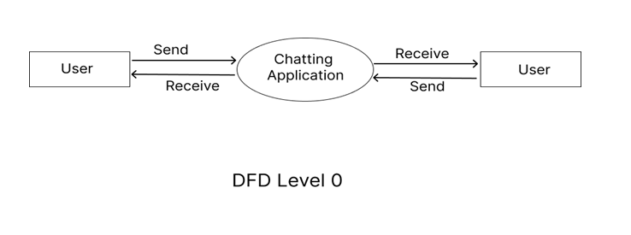
Context Level DFD

Slide 15
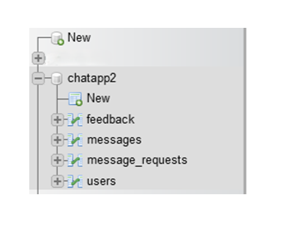
Database Tables

Slide 16
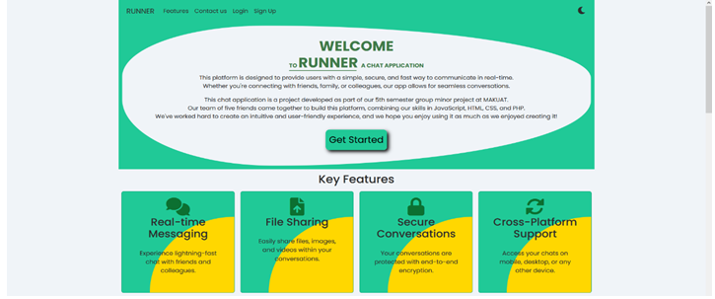
Homepage

Slide 17
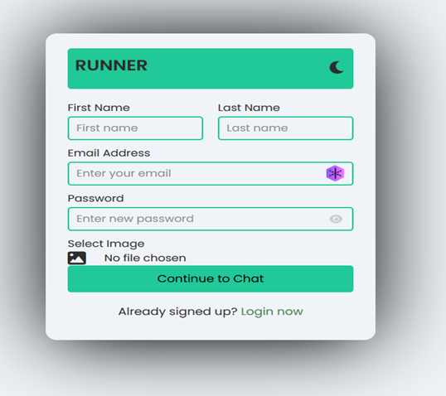
Signup page

Slide 18
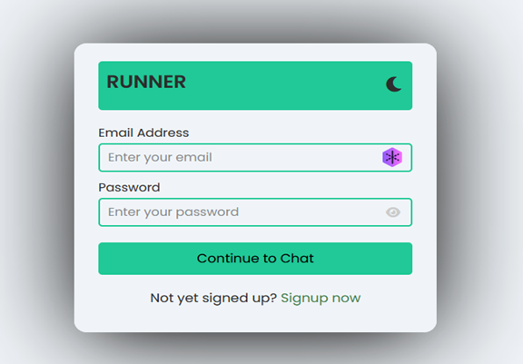
Login page

Slide 19
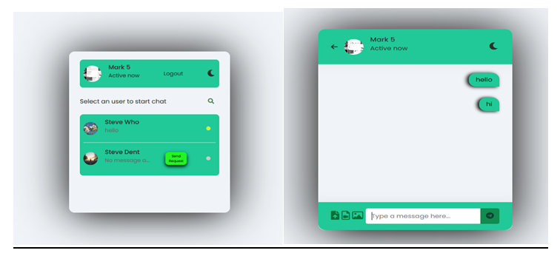
Notification & Chat Area

Slide 20
User Authentication:
Secure login and registration process.
Password hashing and session management.
User role management for privacy and permissions.
Real-Time Messaging:
Instant message delivery without delays.
Real-time updates on message status (sent, delivered, read).
Notifications for new messages or activities.
Key Features

Slide 21
The Chat Application project has successfully transformed communication by offering real-time messaging, seamless user interaction, and advanced features like customizable chat rooms and real-time notifications. Despite challenges, the project was delivered with a strong focus on user experience, reliability, and innovation. This platform sets a new standard in digital communication, overcoming limitations of traditional messaging systems and laying the foundation for future technological advancements in communication. The application is poised for continuous improvement, offering endless opportunities for new features and enhanced user satisfaction.
CONCLUSION

Slide 22
https://www.geeksforgeeks.org/online-group-chat-application-using-php/
https://www.codingnepalweb.com/chat-web-application-using-php/
https://www.youtube.com/playlist?list=PLu0W_9lII9ahR1blWXxgSlL4y9iQBnLpR
https://www.youtube.com/playlist?list=PLu0W_9lII9aikXkRE0WxDt1vozo3hnmtR
https://www.youtube.com/playlist?list=PLu0W_9lII9agq5TrH9XLIKQvv0iaF2X3w
https://hackr.io/blog/php-projects
https://www.youtube.com/playlist?list=PLfEr2kn3s-bo4LwlbyZugHPavhcdW8YMC
References

Slide 23
Thank you!

