Slide 1


ML- The Effective Clustering for Recommendation Engine
Sayan Banerjee
12/20/2019
Notes:
SHORT TITLE

Slide 2
Clustering for Recommendation
What is the role of ”Clustering” in recommendation?
We have some sort of information about a target user.
We have historical information about many users and based on the similar information which is available for the current target user we have divided our whole user base into certain number of groups.
Now we can map our current user to a precalculated group by some calculations and recommend products which is/are popular/favorable in that group.
The question is, we don’t know the reaction of the user on our recommendation because that would be based on our action/recommendation to the user.
Only information we have at the time of mapping the current user to a precalculated group is, some demographic/session-based information about the user.
So what we are doing is we are mapping the user to a group where the other users have broadly similar kind of demographic information and hoping that they all will have similar reactions to the similar recommendations.

Slide 3
Effective Clustering for Recommendation
Can we do better?
Isn’t it make more sense if we find a way to put users in the same group who tend to have similar reactions to the similar products?
And also have ability to map the current user to a group where the other users tends to have similar reactions to similar recommendations based on only the available demographic/session-based information about the user.
Well, now we have ability to do just this, in a scalable, sustainable and adaptable way.
Let me explain it to you with a toy example.

Slide 4
Toy Example - Data
Suppose you have 9 datapoints which represents your whole historical user database.
Historically you have sold 2 products. “Product-A” and ”Product-B”.
1 – Positive Reaction to a product, 0 – Negative/No Reaction to a product.
Blue columns are the information which were/are/will be available from a session and red columns are the reaction of the user to a product in a session.
I can only afford one cluster which may have less than 3 data points.
Lead Days | Number of People | Language | Product-A | Product-B
10 | 1 | Spanish | 0 | 1
12 | 2 | Spanish | 0 | 1
35 | 1 | English | 1 | 1
25 | 2 | English | 1 | 0
1 | 1 | English | 1 | 1
7 | 2 | English | 1 | 0
3 | 2 | English | 1 | 0
14 | 3 | Spanish | 1 | 0
5 | 1 | English | 1 | 1

Slide 5
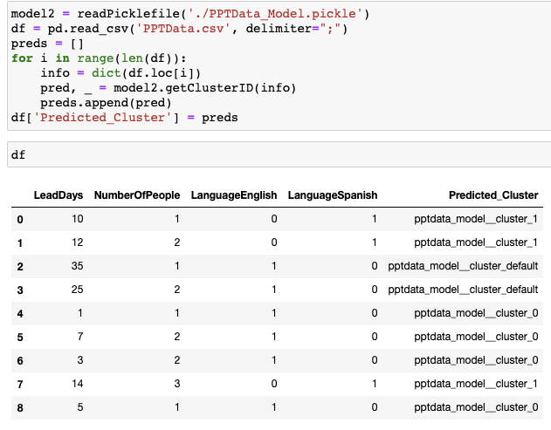
Conventional Way – Using Only Blue Columns

Slide 6
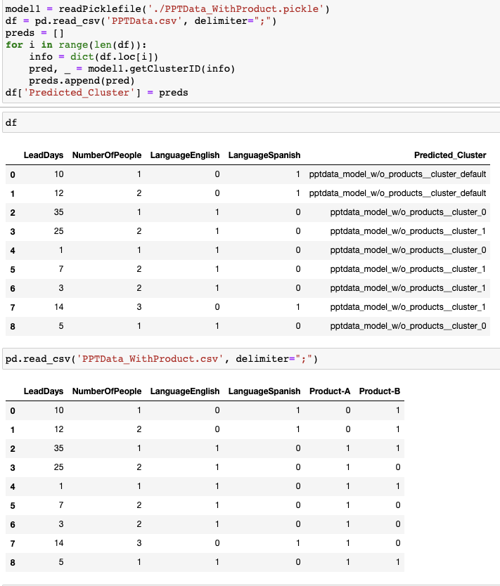
Effective Way – Using Blue and Red Columns Together at Training, but Only Blue Columns at Inference

Slide 7
Appendix

Slide 8
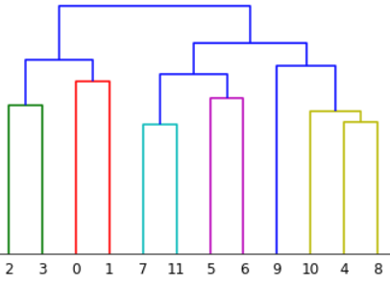












Clustering Using CLTree and Hierarchical Clustering
Min members: 750
3100
2200
900
600
1200
300
1000
600
300
900
400
ID: 6
Cluster - 0
$Rep.Vec.[⋯$]
Cluster - 1
ID: 7
ID: 0
ID: 1
ID: 5
$Rep.Vec.[⋯$]
$Rep.Vec.[⋯$]
$Rep.Vec.[⋯$]
$Rep.Vec.[⋯$]
Cluster - 1
Cluster - 0
Cluster - 0
Cluster - 1
ID: 11
ID: 4
Cluster - 2
Cluster - 0
Cluster - 1
Cluster - 2
Cluster - 0
$Rep.Vec.[⋯$]
$Rep.Vec.[⋯$]
Cluster - 1
Cluster - 2
ID: 8
Cluster - 2
ID: 2
ID: 3
$Rep.Vec.[⋯$]
Cluster - 2
$Rep.Vec.[⋯$]
$Rep.Vec.[⋯$]
Cluster - 0
Cluster - 0
ID: 9
ID: 10
After Cluster Assignment, basic pruning of the tree to make search space optimized.
$Rep.Vec.[⋯$]
$Rep.Vec.[⋯$]
Cluster - 2
Cluster - 2

Slide 9
Search Space Optimization: pruningRedundantNodes() - 1
Att.: A, Cut value = x
Att.: A, Cut value = x
Att.: B, Cut value = y
Cluster - 3
y < z and y’ <= y, so y’ < z
Att.: B, Cut value = z
Cluster - 3
Cluster - 1
Att.: B, Cut value = z
Cluster - 1
Cluster - 2
Cluster - 1
Cluster - 2

Slide 10
Search Space Optimization: pruningRedundantNodes() - 2
Att.: A, Cut value = x
Att.: A, Cut value = x
Cluster - 1
Att.: B, Cut value = y
z <= y and y’ > y, so y’ > z
Cluster - 1
Att.: B, Cut value = z
Att.: B,
Cut value = z
Cluster - 3
Cluster – 2
Cluster - 3
Cluster - 2
Cluster - 3

