Slide 1


A Personalization Framework Through Tree Based Clustering
Sayan Banerjee
02/18/2020
Notes:
SHORT TITLE

Slide 2
Clustering and Personalization
What is the task of “Clustering”?
It is a task of finding the intrinsic structure of data by organizing data objects into similarity groups or clusters.
It is a type of unsupervised machine learning because no class labels denoting a priori partition.
Clustering is difficult because in the absence of ground truth, quality of the result of clustering is in the eye of the beholder.
What is “Personalization”?
Personalization consists of tailoring a service or a product to accommodate specific individuals, groups or segments of individuals.
What is “Personalized Recommendation”?
A personalized product recommendation isn't based on an assumption or guess. Personalized recommendations are based on user behavior.
How Clustering works as Personalization Component with Recommendation Engine?
We map user to a precalculated group by some calculations and recommend products which is/are popular/favorable in that group.

Slide 3
Various Data Availability Scenarios
Scenario 1:
No end-user data available for an entity.
Scenario 2:
Only the demographic and/or session based information available for a set of end-users for an entity.
No mappable reaction/action/activity/shopping/buying behavior available for end-users.
Scenario 3:
The demographic and/or session based information available for a set of end-users for an entity.
Mappable reaction/action/activity/shopping/buying behavior available for end-users.

Slide 4
Details of The Problem Statement
Premise:
Recommendation Engine using Multi-Arm Bandit (MAB) algorithm.
Anonymous end-user (almost always).
Properties from all over the world of all possible types and very different from each other with very different customer base on their own.
What we know so far:
MAB produces the ordered list (sub list) of recommended products given a list of products, their respective statistics and end-user “personalization” category (a label given to the end user which is a function of information available by the time of transaction.)
This is a proven fact that if a “personalization” category has a similar buying/shopping trend, the MAB will produce personalized offers for that category in a fairly short time.
Satisfying Criteria:
Segments/Clusters have to be mutually exclusive and collectively exhaustive.
Scalable and fast at cluster prediction.

Slide 5
Proposed Technique
The proposed technique is a 4 step process:
Divide – Assign - Conquer – Simplify.
Divide: Divide the historical end-user data into small groups using the CLTree Algorithm
Paper: “Clustering Via Decision Tree Construction” by Bing Liu , Yiyuan Xia, and Philip S. Yu http://web.cs.ucla.edu/~wwc/course/cs245a/CLTrees.pdf
Assign: Assign a representation vector to each of the small groups created from step 1. Representation vector is a vector that represents the data in the group,
Average Shopping/Buying Behavior of all the members of the underlying group.
Average of demographic/”session” based information of all the members of the underlying group.
Centroid of the “hyper rectangle” of the group.
Conquer: Use agglomerative clustering with a qualification criteria on representation vectors of all small groups to bring them together (merge) to form a manageable set of qualified groups/clusters.
Simplify: Simplify the trained model into a Binary Search Tree which will be used at the time of generating label prediction.

Slide 6
Dividing the Data Into Small Meaningful Groups Using CLTree

Slide 7
Gentle Introduction of CLTree
CLTree stands for Clustering Based on decision Tree.
Uses a mechanism which is more popular in supervised learning problems named “decision tree construction” with some modifications.
It has two types of nodes,
Decision Node
Leaf Node
The algorithm isolates “data region” from “empty regions” by introducing uniformly distributed virtual points.
It uses 2 metrics jointly to identify best cut value and best attribute at each decision node.
Information Gain
Relative Density
Information Gain alone, is not enough
The cut with the best information gain tends to cut into clusters.
2 stopping conditions,
If the total number of data points at current node is less than externally provided minimum points required to make a further cut.
There is no cut possible to improve the information gain from current node.

Slide 8
Two Modifications to the Decision Tree Algorithm(1):
Compute the number of N points on the fly:
The information gain evaluation in only needs the frequency or the number of points of each class on each side of a possible cut (or split).
EX.:
The space has 25 data (actual) points and 25 virtual points. Assume the system is evaluating a possible cut P.
The number of virtual points on the LHS of P is 25 * 4/10 = 10. The number of actual points is 3.
Likewise, the number of virtual points on the RHS of P is 15 (= 25 - 10), and the number of actual points is 22.
With these numbers, the information gain at P can be computed.
By computing the number of virtual points, we essentially guarantee their uniform distribution in the current space.
Actual Points
P
Virtual Points.
Note: Virtual Points are not actually gets added to dataset. These are shown here for visualization
1
4
10

Slide 9
Two Modifications to the Decision Tree Algorithm(2):
Only Information-Gain criterion is not Enough.
The cut with the best information gain tends to cut into clusters. This results in severe loss of data points in clusters.
The gain criterion does not look ahead in deciding the best cut.
d1_cut1
The new criterion made the d1_cut2, d2_cut2 and d2_cut3 possible.
The end goal is to, as much as possible, isolate dense region from sparse region at each iteration
d1_cut1
d2_cut1
Recognizing the empty regions is very important for clustering. Relying on only information-gain will result in severe fragmentation of clusters (each
cluster is cut into many pieces) and loss of data points.
d1_cut2
d2_cut1
d2
d2
d2_cut3
d2_cut2
d1
d1
***For more detail explanations, please look into slide 42-44 in appendix section.

Slide 10
Initial Tree Obtained from CLTree Algorithm
Root Node
Decision Node.
Each Decision Node has an attribute and value on which the next cut has happened to separate the current data into “dense” and “sparse/empty” region.
ID: 6
ID: 7
ID: 0
ID: 1
ID: 5
ID: 11
ID: 4
A Leaf Node.
Each Leaf Node has a unique subset of the actual data.
ID: XX
ID: 8
ID: 2
ID: 3
ID: 9
ID: 10

Slide 11
Some of The Advantages of Using CLTree
CLTree is able to find clusters in the data without making prior assumptions or using any input parameters.
Most existing methods require the user to specify the number of clusters/groups or density thresholds in advance.
It provides descriptions of the resulting groups/subgroups in terms of hyper rectangle regions.
It deals with the outliers effectively.
Outliers are the data points in a relatively empty region.
CLTree is able to separate outliers from dense data regions since it naturally identifies sparse and dense regions.

Slide 12
Assigning a Representation Vector to Each Small Groups at Each Leaf

Slide 13












CLTree After Assignment of Representation Vectors
A representation vector assigned to each leaf nodes. The purpose of the representation vector is to represent the data points in each leaf node.
$Rep.Vec.[⋯$]
ID: 6
$Rep.Vec.[⋯$]
ID: 7
ID: 0
ID: 1
ID: 5
$Rep.Vec.[⋯$]
$Rep.Vec.[⋯$]
$Rep.Vec.[⋯$]
$Rep.Vec.[⋯$]
ID: 11
ID: 4
$Rep.Vec.[⋯$]
$Rep.Vec.[⋯$]
ID: 8
ID: 2
ID: 3
$Rep.Vec.[⋯$]
$Rep.Vec.[⋯$]
$Rep.Vec.[⋯$]
ID: 9
ID: 10
$Rep.Vec.[⋯$]
$Rep.Vec.[⋯$]

Slide 14
Merging Small Groups to Form Manageable and Meaningful Set of Clusters

Slide 15
Conquering Leaf Nodes to Make Clusters
Goal is to merge leaves together to form manageable number of groups where each group will have externally provided minimum data points.
Recommendation engine is sensitive towards the amount of traffic each cluster/category gets before a certain point
Agglomerative Hierarchical clustering is used to merge the leaves.
Notes:
One thing to notice here, recommendation engine is sensitive towards the amount of traffic each cluster/category gets before a certain point, our goal is to make sure each cluster to have members close to that value.

Slide 16
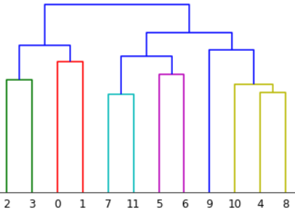











Assigning Clusters to Leaves Using Hierarchical Clustering
310
220
90
100
120
60
30
90
30
60
Min members: 75
40
ID: 6
$Rep.Vec.[⋯$]
Cluster - 1
ID: 7
ID: 0
ID: 1
ID: 5
$Rep.Vec.[⋯$]
$Rep.Vec.[⋯$]
$Rep.Vec.[⋯$]
$Rep.Vec.[⋯$]
Cluster - 1
Cluster - 0
Cluster - 0
Cluster - 1
ID: 11
ID: 4
$Rep.Vec.[⋯$]
Cluster - 0
Cluster - 1
Cluster - 2
$Rep.Vec.[⋯$]
Cluster - 1
Cluster - 2
ID: 8
ID: 2
ID: 3
$Rep.Vec.[⋯$]
Cluster - 2
$Rep.Vec.[⋯$]
$Rep.Vec.[⋯$]
Cluster - 0
Cluster - 0
ID: 9
ID: 10
$Rep.Vec.[⋯$]
$Rep.Vec.[⋯$]
Cluster - 2
Cluster - 2

Slide 17
Optimization of Search Space and Simplification of Trained Model

Slide 18
Search Space Optimization - 1
After Cluster Assignment, reformation of the tree using this information makes search space optimized.
ID: 6
Cluster - 0
Cluster - 1
ID: 7
ID: 0
ID: 1
ID: 5
Cluster - 1
Cluster - 0
Cluster - 0
Cluster - 1
Cluster - 2
ID: 11
Cluster - 0
ID: 4
Cluster - 1
Cluster - 2
ID: 8
Cluster - 2
ID: 2
ID: 3
Cluster - 2
Cluster - 0
Cluster - 0
ID: 9
ID: 10
Cluster - 2
Cluster - 2

Slide 19
Search Space Optimization - 2
Before:
After:
Att.: A, Cut value = x
Att.: A, Cut value = x
Att.: B, Cut value = y
Cluster - 3
y < z and y’ <= y, so y’ < z
Att.: B, Cut value = z
Cluster - 3
Cluster - 1
Att.: B, Cut value = z
Cluster - 1
Cluster - 2
Cluster - 1
Cluster - 2

Slide 20
End Product as Multi-dimensional BST
Arrival Weekday: 2, Lead Days: 20,
Guest Qty.: 1
End user Session Data
Root
Output
Arrival Weekday in ( 2 - 4)
Arrival Weekday in (1, 5 -7)
Cust Cat. ID.: 4
Node 1
Node 2
Lead Days >= 14
Lead Days < 10
Lead Days >= 10
Lead Days < 14
Node 3
Node 4
Node 5
Node 6
Guest Qty == 2
Guest Qty != 2
Guest Qty == 2
Guest Qty != 2
Guest Qty == 2
Guest Qty != 2
Guest Qty == 2
Guest Qty != 2
Cust Cat. ID.: 1
Cust Cat. ID.: 2
Cust Cat. ID.: 3
Cust Cat. ID.: 4
Cust Cat. ID.: 5
Cust Cat. ID.: 2
Cust Cat. ID.: 3
Cust Cat. ID.: 4

Slide 21
In the Absence of Any Data
Need to use Rule Based Clustering for personalization.
Need a scalable way to implement variety set of rules depending underlying property.
Rules can come from the entity itself or from Sabre or from any other sources.
Rules have to be “mutually exclusive and collectively exhaustive” in the space.
Once the rules are “mutually exclusive and collectively exhaustive”, we can exploit the functionality of classic “Decision Tree” for classification to create a standardize way to create rule based clustering.
Our solution framework package can create a “Decision Tree” from the rules provided.

Slide 22
Where To Get the Code
The entire end to end pipeline is available at Sabre Bitbucket. https://git.sabre.com/users/sg0302957/repos/shs_athena_personalization_framework/browse
This is a solution framework, please feel free to use it.
There are detailed documentation at the repo.
If you need any further explanation or need access to the repo please contact me at
sayan.banerjee@sabre.com

Slide 23
Thank You
Many special thanks to,
Hande (Valerie) Tuzel (2nd active contributor)
Sean Dillon
Gerald Rossi
Cuneyd Kaya
Richard Ratliff
Ross Darrow
Eben Hewitt

Slide 25
Appendix

Slide 26
Assigning a Representation Vector to Each Leaf
There is no restriction or assumption what can be the representation vector of a leaf as long as it represents the data points or the sub-space enclosed by the leaf in the space.
3 proposed ways for varying scenarios of data availability, theoretical and practical preferences,
Average Shopping/Buying Behavior of all the members of a underlying sub-group/leaf:
If buying/shopping behavior/record available for all the data points/persons/customers at each leaf,
we can take the average of those and assign it to each leaf as Representation Vector of the respective Leaf.
Average of demographic/”session” based information of all the members of the underlying group.
In the absence of the buying/shopping behavior/record we can reuse the data which each leaf/group already has.
We can take average of all the attributes within each leaf and assign that vector to each leaf as Representation Vector
of the respective Leaf.
Centroid of the “hyper rectangle” of each leaf/group.
Geometrically each leaf of the CLTree is a hyper rectangle, and every dimension is bound by a hard min and max value.
Hence, we can easily calculate “centroid” of all the leaves and assign that vector to each leaf as Representation Vector
of the respective Leaf.

Slide 27
Defense/Protection Against Outliers
In clustering there is a common occurrence of a problem that there may be few data points scattered across the hyper-plane which are not close to any well-formed groups.
Now the question is how to handle it?
“min_members” indirectly controls how many minimum data points we would need to identify a group as a well-formed cluster.
We don’t want to violate the integrity of well formed clusters to include some outliers, so one of the better way of handling this kind of scenario is to form a separate group of outliers.
This way we are eliminating any possibility of outliers in well-formed clusters by merging one to another. The size of this group of outliers might be much less than the chosen “min_members” parameter.

Slide 28
Some Other Utility Functionalities Provided
This is not a solution but a solution framework. Can be used in which ever way fits/follows the purpose and data availability.
Data Preparation pipeline is essential part of any Machine Learning Pipeline and Automatic data preparation pipeline is part of the framework.
Seasonality Detection: (**OPTIONAL** )
Grouping together few months together based on some criteria (booking/traffic trend/sales statistics etc.) and
use each group as a category rather than each month as a category.
Three Approaches:
Discrete: Group together months based on similarity irrespective of adjacency.
Continuous: Group together months only if they are adjacent to each other.
Manual: An entity always has a choice to provide us “month groups” externally.

Slide 29
How to Run The Framework

Slide 30
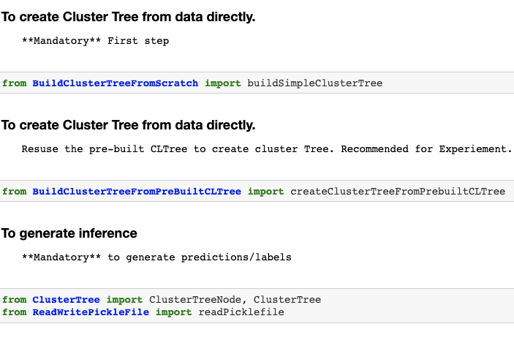
Setting Up The Environment

Slide 31
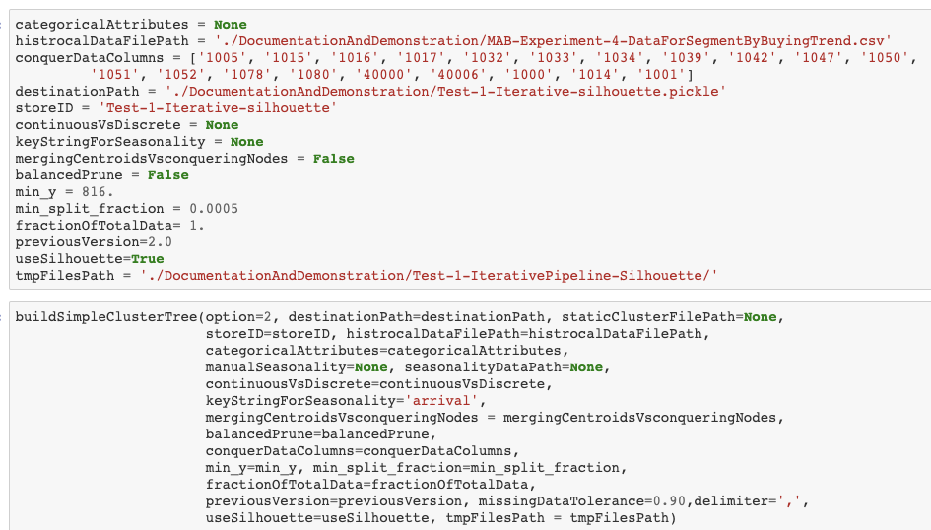
Training Code

Slide 32
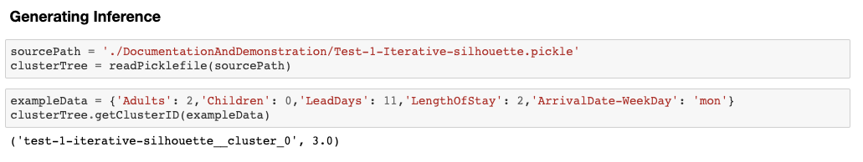
Generating Prediction

Slide 33
Effective Clustering for Recommendation
Doesn’t it make more sense if we find a way to put users in the same group who tend to have similar reactions to the similar products?
And also have ability to map the current user to a group where the other users tends to have similar reactions to similar recommendations based on only the available demographic/session-based information about the user.
Well, now we have ability to do just this, in a scalable, sustainable and adaptable way.
Let me explain it to you with a toy example.

Slide 34
Toy Example - Data
Suppose you have 9 datapoints which represents your whole historical user database.
Historically you have sold 2 products. “Product-A” and ”Product-B”.
1 – Positive Reaction to a product, 0 – Negative/No Reaction to a product.
Blue columns are the information which were/are/will be available from a session and red columns are the reaction of the user to a product in a session.
I can only afford one cluster which may have less than 3 data points.
Lead Days | Number of People | Language | Product-A | Product-B
10 | 1 | Spanish | 0 | 1
12 | 2 | Spanish | 0 | 1
35 | 1 | English | 1 | 1
25 | 2 | English | 1 | 0
1 | 1 | English | 1 | 1
7 | 2 | English | 1 | 0
3 | 2 | English | 1 | 0
14 | 3 | Spanish | 1 | 0
5 | 1 | English | 1 | 1

Slide 35
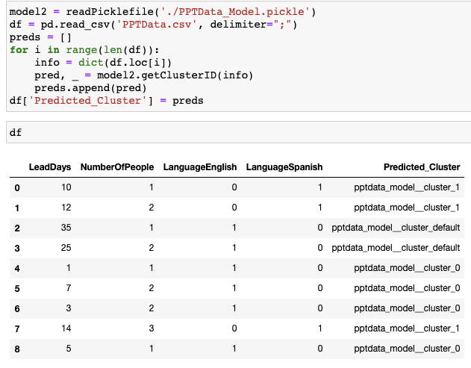
Conventional Way – Using Only Blue Columns

Slide 36
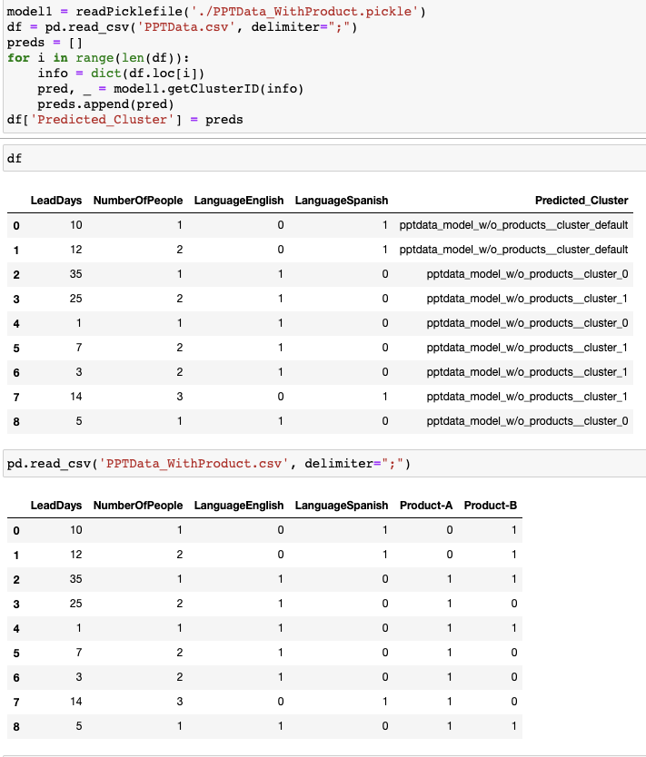
Effective Way – Using Blue and Red Columns Together at Training, but Only Blue Columns at Inference

Slide 37
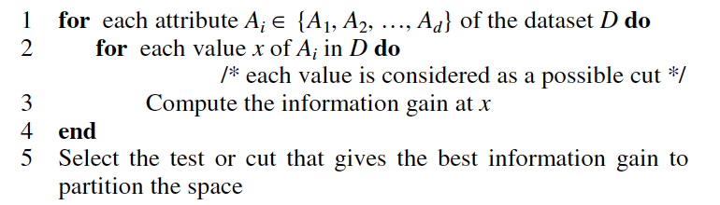
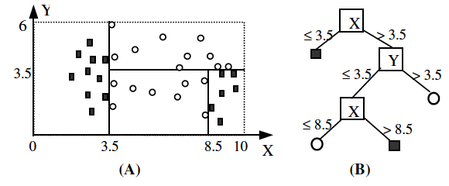
Prerequisite: Gentle Introduction of Decision Tree
Supervised learning algorithm where there is correct label/real value associated with every data row.
A Decision Tree has 2 types of nodes, 1. Decision Nodes, 2. Leaf Nodes.
A decision node specifies some test on a single attribute.
A leaf node indicates a class or some Y-value.
The algorithm for building a decision tree uses the divide and conquer strategy to recursively partition the data to produce the tree.
Each successive step greedily chooses the best cut to partition the space into two parts in order to obtain purer regions.
A commonly used criterion (or purity function) for choosing the best cut is the information gain.
A serial of tests (or cuts) from the root node to a leaf node represents a hyper-rectangle.
Ex. Let’s say, a data is be represented by X > 3.5, Y > 3.5 → Class and everything else is of Class

Slide 38
Base Intuition Behind CLTree
1. Figure-A gives a 2-dimensional space,
which has 24 data (Y) points. Two clusters exist in the space.
A
B
3. CLTree is a technique to solve the problem. This is done by not adding any N point to the space but computing them when needed. Hence, CLTree is able to produce the partition in Figure-C with no N point added to the data.
2. We then add some uniformly distributed N points (represented by “o”) to the data space (Figure-B). With the augmented dataset, we
can run a decision tree algorithm to obtain a partitioning of the
space (Figure-B). The two clusters are identified.
C

Slide 39
Introducing N Points
Give each data point in the original dataset the class Y.
Introduce some uniformly distributed “non-existing” N points.(We do not physically add these N points to the original data, but only assume their existence.)
The number of N points for the current node E is determined by the following rule:
If the number of N points inherited from the parent node of E is less than the number of Y points in E then
the number of N points for E is increased to the number of Y points in E
Else
the number of inherited N points is used for E
Ex:
Node P
P has two children nodes L and R. Assume P has 1000 Y points and thus 1000 N points, stored in P.Y and P.N respectively. Assume after splitting, L has 20 Y points and 500 N points, and R has 980 Y points and 500 N points. According to the above rule, for subsequent partitioning, we increase the number of N points at R to 980. The number of N points at L is unchanged.
P.Y = 1000
P.N = 1000
Node L
Node R
L.Y = 20
L.N = 500
R.Y = 980
R.N = 500
R.N = 980

Slide 40
The New Criterion for Acquiring a Cut
The Basic Idea:
For each dimension_i, based on the first cut found using the information-gain criterion, we look ahead (at most 2 steps) to find a better cut c_i that cuts less into cluster regions, and to find an associated region r_i that is relatively empty (measured by relative density, see below). c_i of the dimension_i whose r_i has the lowest relative density is selected as the best cut. The intuition behind this modified criterion is clear. It tries to find the emptiest region along each dimension to separate clusters.
Relative Density:
The relative density of a region r is computed with r.Y / r.N, where r.Y and r.N are the number of Y points and the number of N points in r respectively.
Step By Step:
Find the initial cuts for each dimension_i, we use the information-gain criterion to find the first best cut point di_cut_1. If we cannot find di_cut_1 with any gain for a dimension, we ignore this dimension subsequently.
Look ahead to find better cuts based on the first cut. We find a better cut on each dimension_i by further gain evaluation in respective lower density regions. Our objectives are to find:
a cut that cuts less into clusters (to reduce the number of lost points)
an associated region with a low relative density (relatively empty).
Select the overall best cut by comparing the relative densities (r_density_i) of the low density regions identified in step 2 of all dimensions. The best cut in the dimension that gives the lowest r_density_i value is chosen as the best cut overall. In our example, the relative density between d2_cut2 and d2_cut3 is clearly lower than that between d1_cut2 and the right space boundary, thus d2_cut3 is the overall best cut.

Slide 41
Algorithm to Evaluate Cut at Each Node
for each attribute A_i ∈ {A_1, A_2, …, A_d} do
di_cut1 = the value (cut) of Ai that gives the best gain on dimension_i
di_cut2 = the value (cut) of Ai that gives the best gain in the LRD_i region produced by di_cut1
if the relative density between di_cut1 and di_cut2 is higher than that between di_cut2 and boundary_i then
r_density_i = y_i /n_i, where y_i and n_i are the numbers of Y points and N points between di_cut2 and boundary_i
else
di_cut3 = the value (cut) that gives the best gain in the LRD_i region produced by di_cut2
/* Realize LRD_i here is the region between di_cut1 and di_cut2 */
r_density_i = y_i/n_i, where y_i and n_i are the numbers of Y points and N points in the region between di_cut1 and di_cut3 or di_cut2 and di_cut3 that has a lower proportion of Y points (or a lower relative density).
end if
end for
bestCut = di_cut3 (or di_cut2 if there is no di_cut3) of dimension i whose r_density_i is the minimal among the d dimensions.

Slide 42
What Happens at Each Node When Evaluating Cuts(1)
d1_cut1(Acquired by Information Gain on d1 on the whole space)
d1_cut1
d1_cut2 (Acquired by Information Gain on d1on the Lower Density Region Subspace)
d1_cut1
d2
d2
d2
Lower Density Region for d1_cut1
d1
d1
d1

Slide 43
What Happens at Each Node When Evaluating Cuts(2)
d2_cut1(Acquired by Information Gain on d2 on the whole space)
d1_cut1
d2_cut1
d1_cut2
d1_boundary
d2
d2
d2
Lower Density Region for d2_cut1
Lower Density Region for d1_cut2
d1
d1
d1

Slide 44
What Happens at Each Node When Evaluating Cuts(3)
d2_cut1
d2_cut1
d2_cut1
d2_cut3 (Acquired by Information Gain on d2 on the Lower Density Region Subspace)
d2
d2
d2
Lower Density Region for d2_cut2
d1
d1
d1
d2_cut2
d2_cut2
Note: The final best cut at this level gets decided among [d1_cut2, d2_cut3] by lowest of lower relative density acquired by subsequent cuts.
d2_cut2 (Acquired by Information Gain on d2 on the Lower Density Region Subspace)

Slide 45
Gentle Introduction To Agglomerative Clustering
Agglomerative Hierarchical clustering Technique:
In this technique, initially each data point is considered as an individual cluster. At each iteration, the similar clusters merge with other clusters until one cluster or K clusters are formed or some other terminating condition is met.
The basic algorithm of Agglomerative is straight forward.
Compute the proximity matrix
Let each data point be a cluster
Repeat: Merge the two closest clusters and update the proximity matrix
Until only a single cluster remains
The Hierarchical clustering Technique can be visualized using a Dendrogram.
We are using “Ward’s Method” to calculate similarity between 2 groups/clusters at each iteration.

Slide 46
Search Space Optimization: pruningRedundantNodes() - 1
Att.: A, Cut value = x
Att.: A, Cut value = x
Att.: B, Cut value = y
Cluster - 3
y < z and y’ <= y, so y’ < z
Att.: B, Cut value = z
Cluster - 3
Cluster - 1
Att.: B, Cut value = z
Cluster - 1
Cluster - 2
Cluster - 1
Cluster - 2

Slide 47
Search Space Optimization: pruningRedundantNodes() - 2
Att.: A, Cut value = x
Att.: A, Cut value = x
Cluster - 1
Att.: B, Cut value = y
z <= y and y’ > y, so y’ > z
Cluster - 1
Att.: B, Cut value = z
Att.: B,
Cut value = z
Cluster - 3
Cluster – 2
Cluster - 3
Cluster - 2
Cluster - 3

Slide 48
Search Space Optimization: pruningRedundantNodes() - 2
Att.: A, Cut value = x
Att.: A, Cut value = x
Cluster - 1
Att.: B, Cut value = y
z <= y and y’ > y, so y’ > z
Cluster - 1
Att.: B, Cut value = z
Att.: B,
Cut value = z
Cluster - 3
Cluster – 2
Cluster - 3
Cluster - 2
Cluster - 3

Slide 49
Inference Model: Multi-Dimensional BST
For all scenarios and their respective solutions, no matter how it is created get morphed into a simple Binary Search Tree.
Once the clustering scheme has been built, we don’t need this whole complex structure for assigning an end-user to a predefined cluster label.
At inference, we need something, fast, accurate and light weight.
There are couple of functions and an “Attribute” class build to support the process of translating the existing CLTree into a simple multi dimensional BST. At each level it checks on an attribute and based on the value the pointer moves to respective branch.
Things to remember is, it is a multi-attribute BST, it can support any type of attribute and any type of comparison, {<=, >, op code: 1}, {!=, ==, Op. Code: 2} and {not in, in, !=, Op. Code: 3}.
We save the final BST in a binary format to get retrieved and use of inference at transaction time.
As we were building this final BST, we also make strategies for missing data at inference time.
The final model has a very simple API, need only 2 basic python class definitions, ability to read pickle file and input in a dictionary format. That’s set.

