Slide 1
Road Accident Data Analysis Project
By Sayan Chandra
Tools: Excel (Pivot Tables, Charts, Dashboard)
[Space for LinkedIn/Email]

Slide 2
Project Objective & Approach
• Objective: Analyze accident data to identify key trends across years, location, and time.
• Tools Used: Excel for cleaning, analysis, and visualization.
• Process: Data Cleaning → Pivot Tables → Charting → Dashboard Creation.
Skills Used: Excel | Pivot Tables | Dashboard | Data Visualization

Slide 3
Dataset Overview
• Time Period: 2021–2022
• Total Casualties: 417,883
• Dimensions: Year, Month, Location, Time of Day, Vehicle Type.
• Sheets: Dashboard (KPIs), Data Analysis (Pivot Tables).
Skills Used: Excel | Pivot Tables | Dashboard | Data Visualization

Slide 4
Data Cleaning & Preparation
• Removed duplicates and blanks.
• Standardized Urban/Rural, Daylight/Darkness fields.
• Built pivot tables for accident counts and KPIs.
• Created visual dashboards with slicers.
Skills Used: Excel | Pivot Tables | Dashboard | Data Visualization

Slide 5
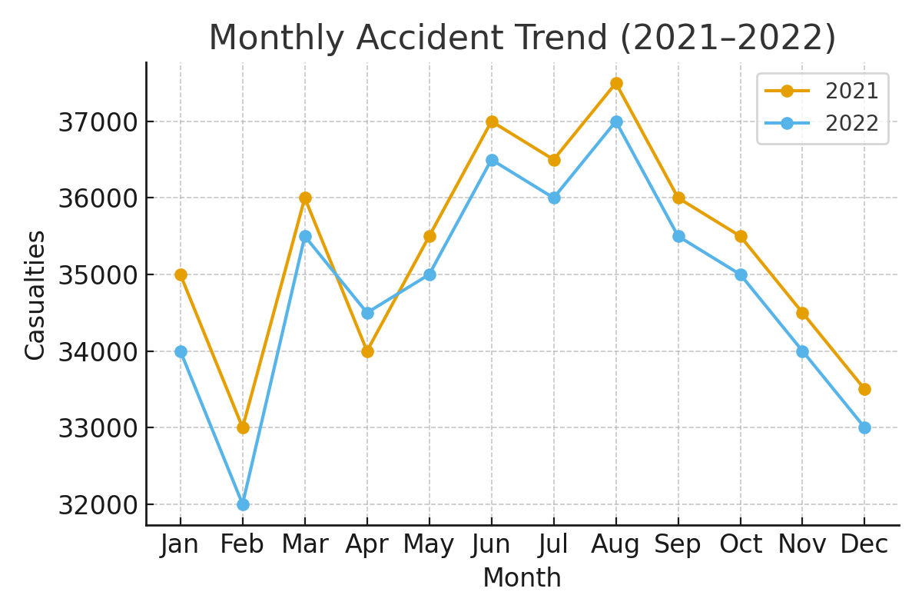
Monthly Accident Trend (2021–2022)
The monthly accident trend shows consistent patterns across both years with minor fluctuations.
Skills Used: Excel | Pivot Tables | Dashboard | Data Visualization

Slide 6
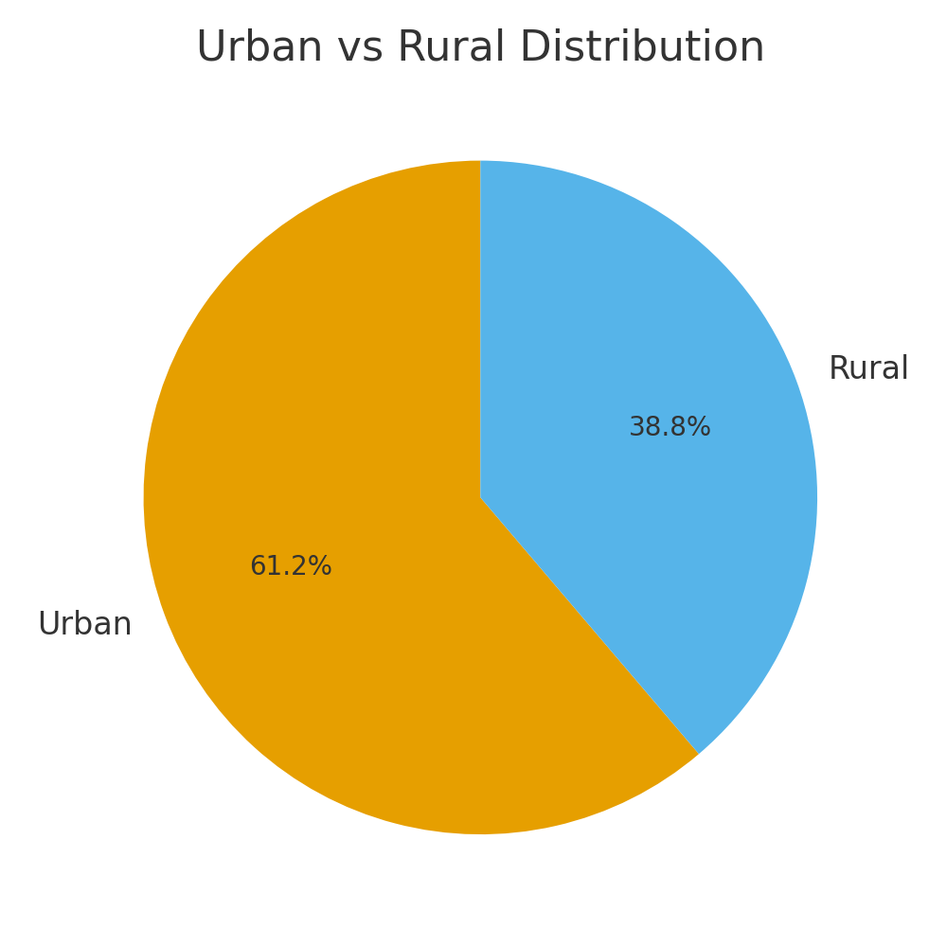
Urban vs Rural Accidents
Urban regions contribute ~61% of accidents, while rural areas account for ~39%.
Skills Used: Excel | Pivot Tables | Dashboard | Data Visualization

Slide 7
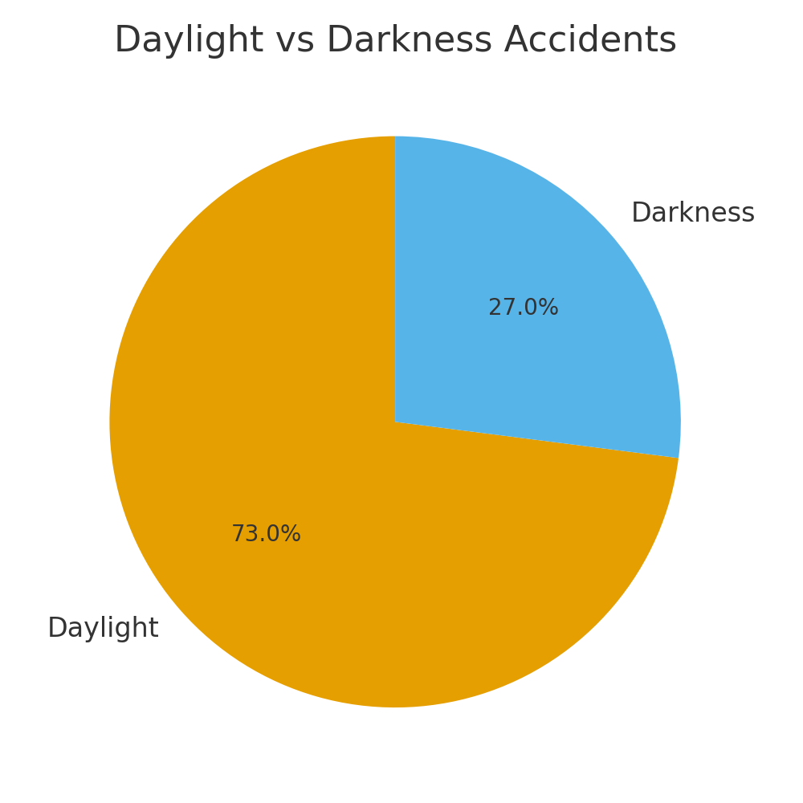
Accidents by Time of Day
Most accidents (~73%) happen during daylight compared to 27% in darkness.
Skills Used: Excel | Pivot Tables | Dashboard | Data Visualization

Slide 8
Excel Dashboard Overview
Interactive Excel Dashboard from the 'Dashboard' sheet showing KPIs and trend charts.
It visualizes accident counts, trends, and location-based breakdowns.
Skills Used: Excel | Pivot Tables | Dashboard | Data Visualization

Slide 9
Key Insights & Findings
• Total Casualties: 417,883
• Urban: 61% | Daylight: 73%
• Yearly patterns stable.
• Urban and daylight accidents dominate overall statistics.
• Useful for safety planning and awareness.
Skills Used: Excel | Pivot Tables | Dashboard | Data Visualization

Slide 10
Conclusion & Skills Demonstrated
• Developed complete Excel data project.
• Used Pivot Tables and Charts effectively.
• Designed analytical dashboard.
• Showcased skills in Excel, Data Cleaning, and Visualization.
• [Placeholder for LinkedIn/Email].
Skills Used: Excel | Pivot Tables | Dashboard | Data Visualization

