Slide 1
Internet Routing Protocols

Slide 2
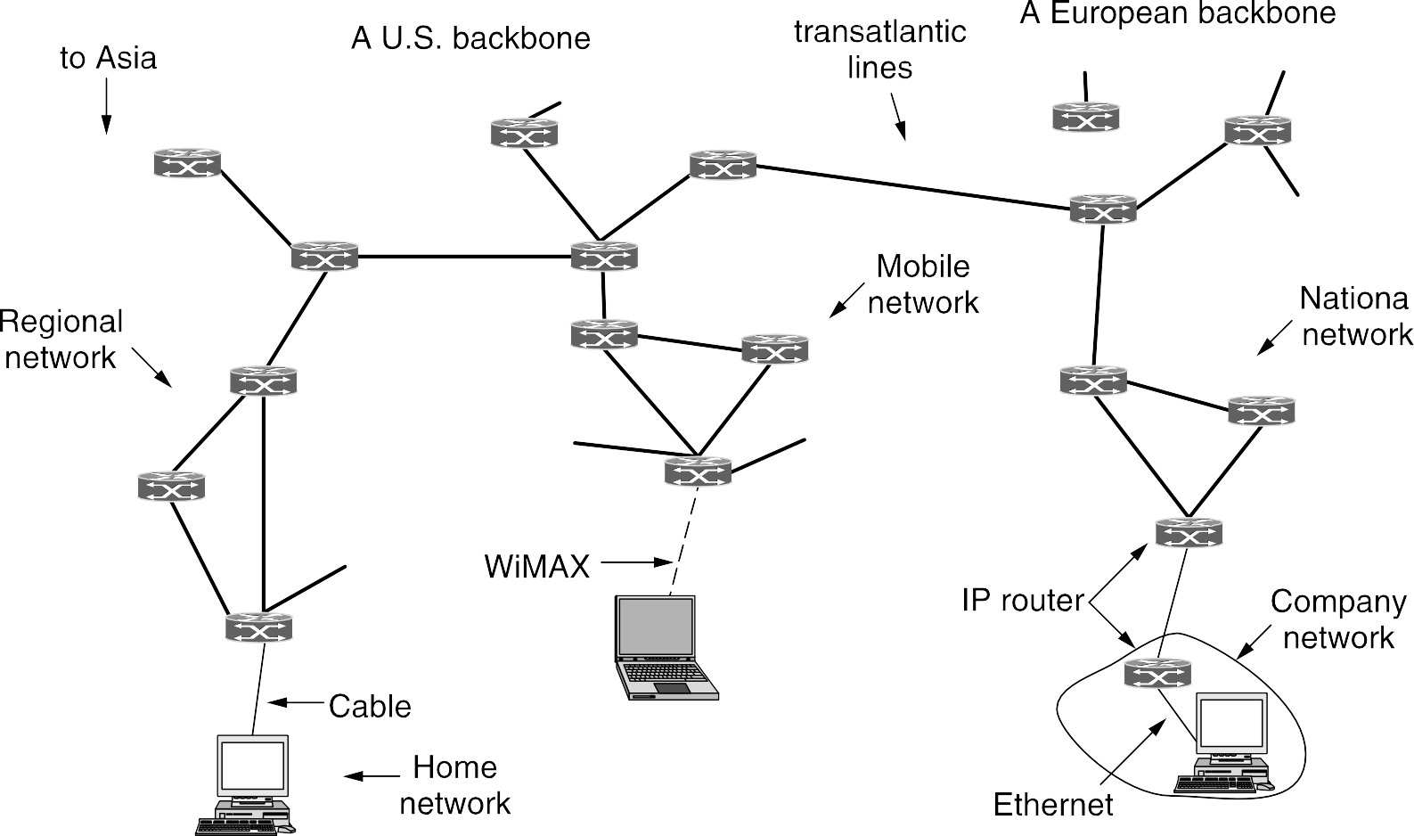

The InternetArchitecture
The glue that holds the whole Internet together is the network layer protocol, IP (Internet Protocol).

Slide 3
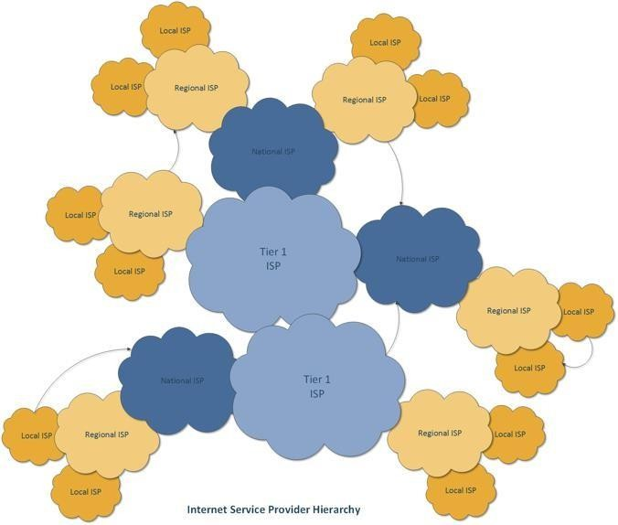
Internet Architecture
Autonomous Systems (AS) – A set of LANs for an administrative domain, identified by a unique AS number, and the routing policies are controlled by a single administrator.
Local Area Network (LAN) – A set of devices with a common layer 3 gateway

Slide 4
Routing Protocols Sofar
Link state routing: "tell about your neighbors to everyone".
  Each node collects information about all its neighbors and the link metrics.
  This LSA (link state announcement) of every node is flooded through the entire network.
  So, at the end of it, each node has complete view of the network graph.
  Each node then independently runs Dijkstra's shortest path algorithm to get the shortest path to every destination, based on which it figures out the next hop for every destination.
Distance vector routing: "tell about everyone to your neighbors".
  Every node exchanges a distance vector containing its estimate of distance to each destination, with its neighbors.
  Upon receiving a neighbor's distance vector, a node updates its distance vector by adding link cost to neighbor.
  If a better path is found through the neighbor, it updates its best route.

Slide 5
Routing in theInternet
Generic Routing Algorithms (Dijkstra / Bellman-Ford) – idealization
  All routers are identical
  Network is flat.
    Not true in Practice
Hierarchical routing
  Internet = network of networks
  Each network admin may want to control routing in its own routing network.
  Hierarchical routing solves
    Scale problems
    Administrative autonomy.

Slide 6
Routing in theInternet
Intra-AS (Intra Domain) Routing Protocols: Routing within an AS. Sometimes, they are called as Interior Gateway Protocols (IGP)
  Routing Information Protocol (RIP)
  Open Shortest Path First (OSPF)
  IGRP: Interior Gateway Routing Protocol (Cisco propr.)
Inter-AS (Inter Domain) Routing Protocols: Routing among the various ASes based on peering relationship. These are known as Exterior Gateway Protocols (EGP)
  Border Gateway Protocol (BGP).

Slide 7
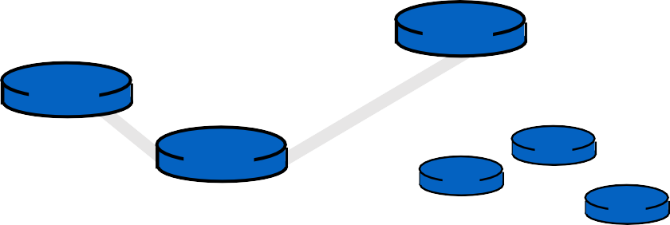
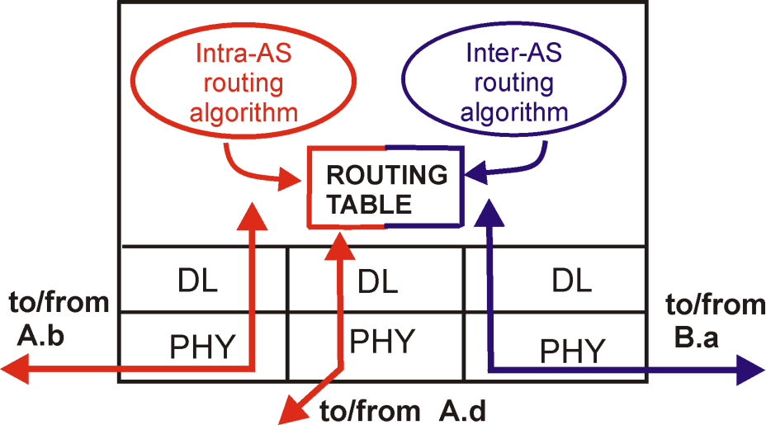
Intra-AS and Inter-ASRouting
C.b
Gateways:
perform inter-AS routing
amongst themselves
perform intra-AS routers with other routers in their AS
B.a
A.a
b
C
A.c
c
a
a
b
a
b
B
d A
c
network layer link layer
physical layer
inter-AS, intra-AS
routing in gateway A.c

Slide 8
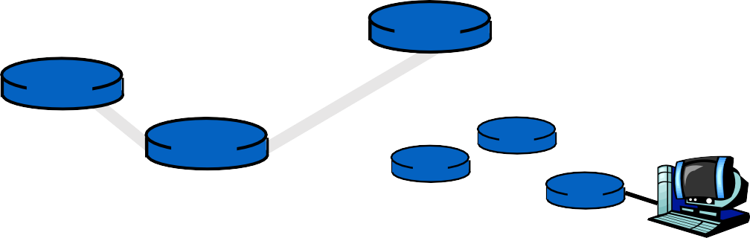

Intra-AS and Inter-AS Routing
Inter-AS
C.b
routing between B.a A and B
A.a
Host
h2
b
C
A.c
c
a
Host
h1
a
b
a
b
B
d
c
Intra-AS routing
within AS B
A
Intra-AS routing within AS A

Slide 9
Why different Intra- and Inter-ASrouting?
Policy: Inside an AS, one administrator sets all link costs, so there are no competing interests. Between ASes, each AS decides which routes it accepts and which traffic it will carry, usually for business reasons (customer, peer, provider).
Scale: Inside an AS, every router can know the full topology. Between ASes only reachable prefixes are exchanged, so a link failure inside one AS is not flooded across the Internet.
Privacy: ASes do not want to reveal their internal topology to competitors. Link-state routing across ASes would require it.
Performance: Inside an AS, routing can simply minimise a metric (OSPF: shortest path). Between ASes, policy can override distance: an AS may prefer a longer route through a paying customer to a shorter one through a provider it must pay.

Slide 10
Routing InformationProtocol
A distance vector protocol, included in BSD Unix (the routed daemon) in the early 1980s. Metric: hop count.
A route may be at most 15 hops; 16 means unreachable (infinity). Why so small?
          To limit count-to-infinity: a failed route counts up only to 16, so bad news settles within about 15.
            Each router sends its distance vector to its neighbors every 30 s in a Response message (an advertisement).
            One message lists at most 25 destinations (prefixes): 4 (RIP Header) + 25 × 20 (Route Entry) = 504 bytes of RIP data.
            With UDP (8 Bytes) and IP headers (20 Bytes) the packet is 532 bytes.

Slide 11
RIP: Link Failure andRecovery
If no advertisement is heard from a neighbour for 180 s, the neighbor or link is declared dead.
Routes through that neighbor are set to 16 (unreachable).
The router sends a triggered update to its neighbors at once, without waiting for the 30 s timer.
Neighbors whose tables change send triggered updates in turn, so the failure spreads quickly once detected. Detection itself can take up to 180 s.
Split horizon: a router does not advertise a route back to the neighbor it learned it from. With poisoned reverse, it advertises that route back as 16 instead.
  This stops ping-pong (count-to-infinity) between two routers.
  Loops of three or more routers can still count to infinity; the 16-hop limit ensures the counting stops.

Slide 12
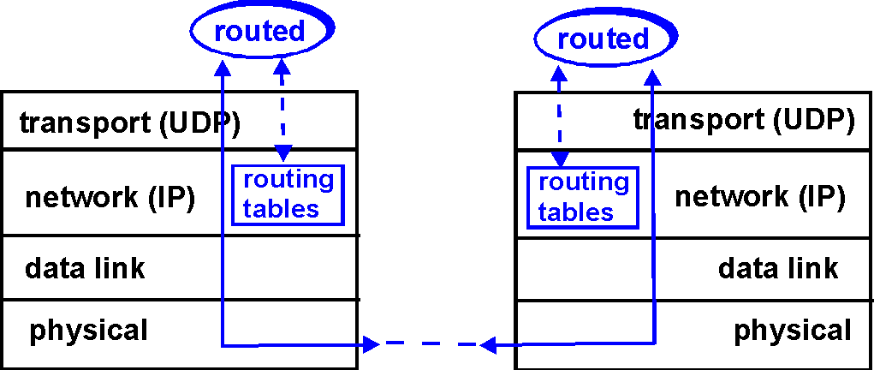
RIP TableProcessing
RIP routing tables managed by application-level process called route-d (daemon) advertisements sent in UDP packets, periodically repeated
RIP uses the UDP as its transport protocol, and is assigned the reserved port number 520.

Slide 13
Open Shortest Path First(OSPF)
Link-state routing: each router floods its link states to all routers in the AS, and each router runs Dijkstra (shortest path first) on the full map.
Open: a public IETF standard (OSPFv2, RFC 2328).
Adapts quickly to topology changes: Hello messages detect failures (dead after 40 s by default), and changes are flooded at once. No count-to-infinity.
Each link has an administrator-set cost (often based on bandwidth), not just a hop count.
Equal-cost multipath: if several paths have the same cost, traffic is split across them (RIP keeps only one).
Hierarchical: large ASes are divided into areas.
Runs directly over IP (IP Protocol field = 89), with no TCP or UDP header. OSPF provides its own reliability (acknowledged updates, sequence numbers) and reaches all neighbours at once by multicast (224.0.0.5).

Slide 14
















OSPFOperation
(a) An autonomous system. (b) A graph representation of (a).

Slide 15
OSPF Operation
OSPF represents the AS as a directed graph: routers and networks are nodes, and each link has a cost in each direction.
Using link-state routing, every router builds the same map of the whole AS and runs Dijkstra on it to find the shortest paths from itself to every destination.
From each shortest path, the router keeps only the first hop. That next hop is what goes into its forwarding table.
ECMP (Equal-Cost Multipath): if several paths to a destination have the same lowest cost, the router keeps all their next hops and splits traffic among them, balancing the load.
      Traffic is split per flow, not per packet: all packets of one connection take the same path, so they arrive in order.

Slide 16
OSPF Operation – Large ASes
Large ASes are hard to run as one OSPF network: every router would store the whole AS map, every link change would be flooded to every router, and every router would rerun Dijkstra on the full graph.
OSPF therefore lets an AS be divided into numbered areas. Each area is a connected group of networks and routers.
Link-state messages are flooded only within their area. Each router holds the map of its own area only, and runs Dijkstra on that smaller graph.
Outside an area, its destinations (prefixes and costs) are visible, but its internal topology is not.
A link change inside an area does not trigger recomputation in the others.
Each link belongs to exactly one area. A router may have interfaces in several areas (covered on the next slide).
Routers whose interfaces all lie in one area are called internal routers.

Slide 17
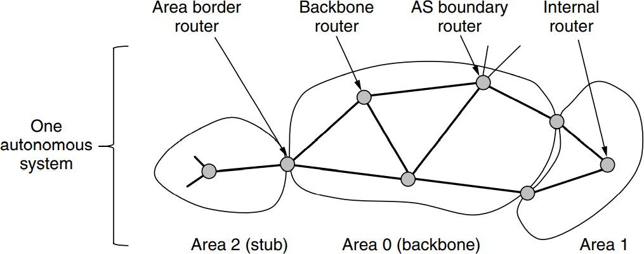
OSPFOperation – Large ASes
The relation between ASes, backbones, and areas in OSPF.

Slide 18
OSPF Operation – Backbone and Areas
Every AS has a backbone area, called area 0.
The routers in this area are called backbone routers.
All areas are connected to the backbone, so it is possible to go from any area in the AS to
any other area in the AS via the backbone.
As with other areas, the topology of the backbone is not visible outside the backbone.
Traffic between two areas always passes through the backbone (area to area 0 to area), never directly from one area to another.
Each router that is connected to two or more areas is called an area border router. It must also be part of the backbone.
The job of an area border router is to summarize the destinations in one area and to inject this summary into the other areas to which it is connected.

Slide 19
OSPF Operation – Area Summaries and Stub Areas
An area border router's summary gives each destination in the area and its cost, but not the area's internal topology.
The costs let routers in other areas choose the best area border router for entering the area.
Not passing the topology reduces flooding traffic and keeps other areas' shortest-path computations small.
An area on the edge of the AS does not need routes to destinations outside the AS. It can be configured as a stub area:
  its border router sends it a single default route instead ("for anything outside the AS, go to me"); routes to the other areas of the AS are still sent into it;
  it may have more than one border router.

Slide 20
OSPF Operation – Boundary Routers
An AS boundary router connects the AS to other ASes. It learns routes to external destinations (usually from BGP) and injects them into the whole AS, except stub areas.
Inside the AS, each external destination appears as a prefix reachable through that AS boundary router, with an advertised cost.
The same external destination may be injected by more than one AS boundary router; each OSPF router then chooses among them using the advertised costs.
Summary of router types:
  Internal router: all its interfaces are in one area.
  Area border router: connects two or more areas; always also in the backbone.
  Backbone router: has an interface in area 0.
  AS boundary router: exchanges routes with other ASes.
One router can have several roles. Every area border router is also a backbone router, and an AS boundary router can sit in any area, including the backbone.

Slide 21
OSPF Operation – Finding Neighbours and Flooding Link States
HELLO messages: every router sends HELLOs on all its OSPF interfaces every 10 s by default: directly on point-to-point links, and by multicast to all OSPF routers (224.0.0.5) on LANs.
  Each HELLO lists the neighbors the sender has heard from. When a router sees its own ID in a neighbor's HELLO, the two know they can communicate in both directions.
  If no HELLO arrives from a neighbor for 40 s, the neighbour is declared down.
On a LAN, all routers are neighbors, but each exchanges link-state information only with the LAN's designated router, not with every other router.
LINK STATE UPDATE messages carry a router's link states: its links and their costs. They are flooded to all routers in the area:
  at once, when a link goes up or down or a cost changes;
  otherwise every 30 minutes, as a refresh.
Updates are acknowledged, so flooding is reliable. Each link state carries a sequence number, so a router can tell whether an incoming copy is newer or older than the one it holds.

Slide 22
OSPF Operation –Synchronising a New Neighbor
Why needed: a router that has just started, or whose link has just come up, has missed earlier floods. Without help it would wait up to 30 minutes for the periodic refreshes.
When two routers first become adjacent, they synchronize their link-state databases:
  DATABASE DESCRIPTION: each sends a list of the link-state entries it holds: their IDs and sequence numbers only, not the full contents.
  By comparing sequence numbers, each router finds the entries it is missing or holds an older copy of.
  LINK STATE REQUEST: it asks its neighbor for just those entries.
  LINK STATE UPDATE: the partner sends them, and each is acknowledged.
Once synchronized, the two have identical databases. From then on, changes reach them by normal flooding.
Sending the list first means only the missing entries are transferred, not the whole database.
All OSPF messages travel directly in IP packets (protocol 89).

Slide 23
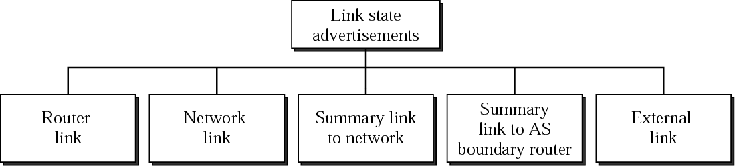
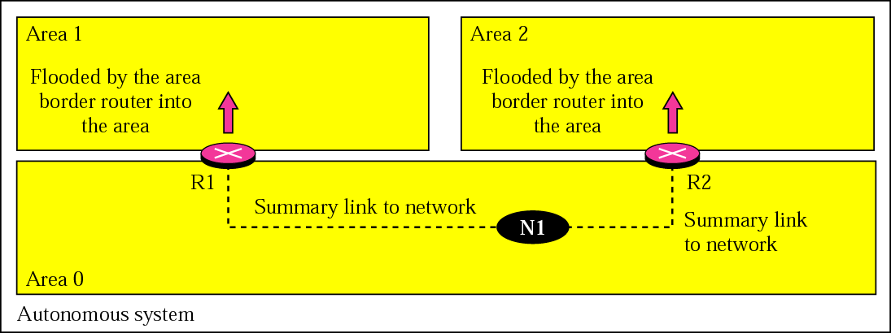
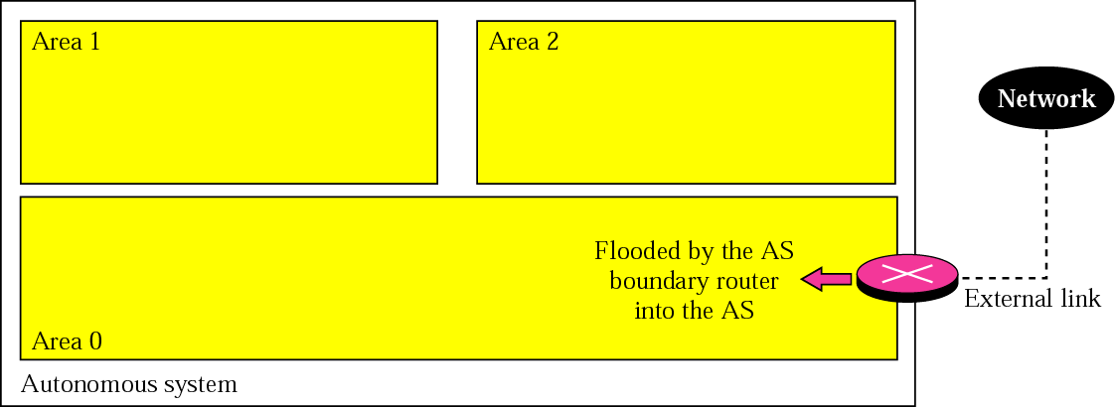
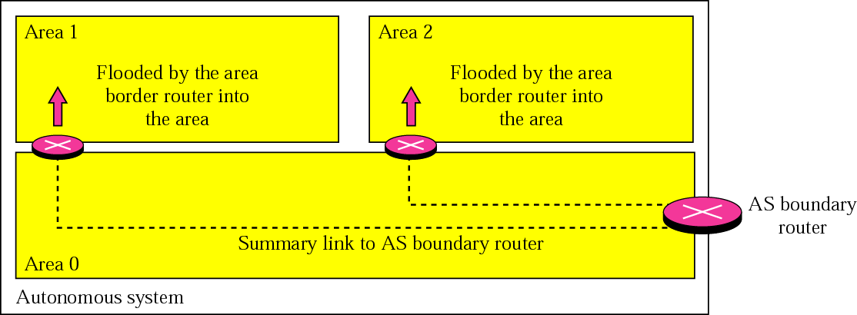
OSPF: Link StateAdvertisement
Summary link to Network
External Link
Summary link to AS boundary router

Slide 24
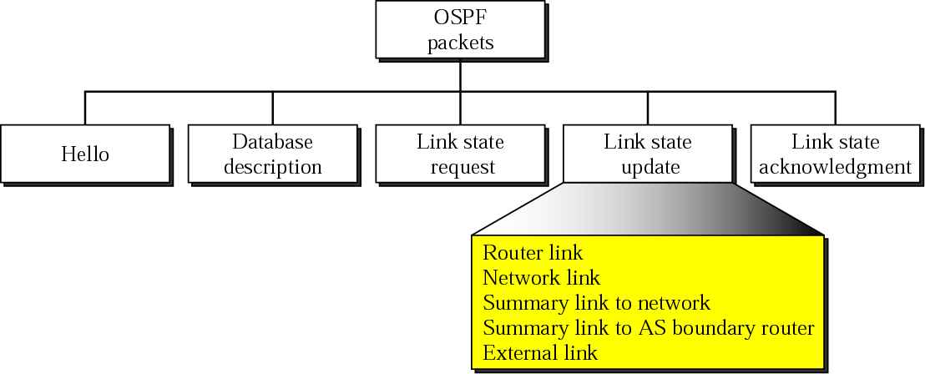
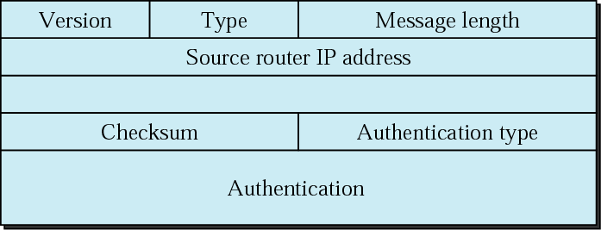








Types of OSPF Packets and HeaderFormat
Area ID

Slide 25
Border Gateway Protocol(BGP)
BGP is the inter-AS routing protocol of the Internet. The current version is 4 (BGP-4);
BGP assumes the Internet is an arbitrary mesh of ASes, each identified by an AS number.
How BGP allows any topology: each route carries the list of ASes it has passed through (the AS path). An AS that sees its own number in a path rejects the route, so loops are detected. BGP is therefore called a path vector protocol.
BGP routers exchange routes over TCP (port 179).
Two kinds of traffic, from one AS's point of view:
  Local traffic: starts or ends inside the AS.
  Transit traffic: passes through the AS, with both source and destination outside it.
Each AS decides by policy whether to carry transit traffic, and for whom.

Slide 26
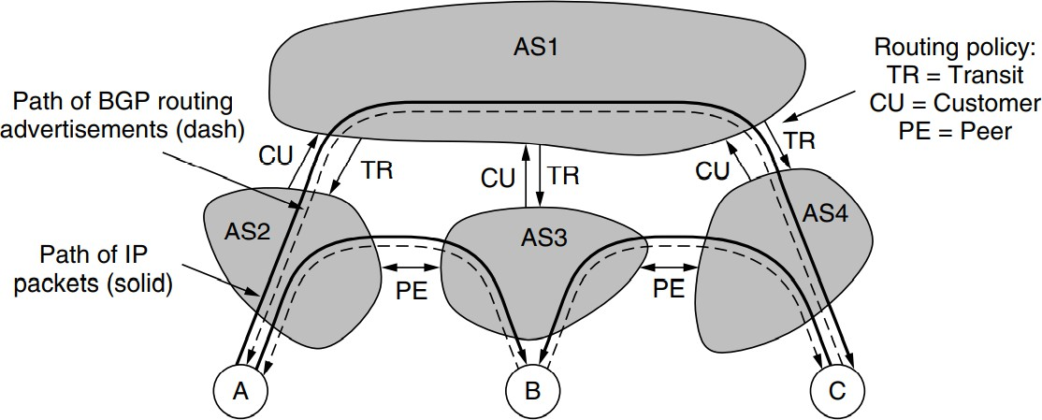
Traffic through an AS
Routing policies between four ASes

Slide 27
Border Gateway Protocol(BGP)
There are four Ases that are connected. The connection is often made with a link at IXPs (Internet eXchange Points), facilities to which many ISPs have a link for the purpose of connecting with other ISPs.
AS2, AS3, and AS4 are customers of AS1. They buy transit service from it.
When source A sends to destination C, the packets travel from AS2 to AS1 and finally to AS4.
The routing advertisements travel in the opposite direction to the packets.
AS4 advertises C as a destination to its transit provider, AS1, to let sources reach C via AS1.
Later, AS1 advertises a route to C to its other customers, including AS2, to let the customers know that they can send traffic to C via AS1.

Slide 28




















































Transit vs. Peering
Transit: the provider charges its customers for Internet access, in return for forwarding packets on behalf of customers to destinations
Peering: two ASes (typically ISPs) provide mutual access to a subset of each other’s routing tables, although a business deal, does not involve financial settlement in general.
C’_{P}
Transit ($$$)
ISP
P
Transit ($$)
Peering
Transit ($$$)
Z
Peering
ISP
X
Peering
Y
Peering between Tier-1 ISPs ensures that they have explicit default-free routes to all Internet destinations (prefixes)
Two As's sometimes set up a transit-free link between each other to forward packets for their direct customers and thus avoid paying transit costs to their respective providers
Transit ($)
Transit ($$)
Transit ($$)
C
1
C
3
Z’s customers
Y’s customers
C
2
A route advertisement from B to A for a destination prefix is an agreement by B that it will forward packets sent via A destined for any destination in the prefix.
The importing/exporting routes is defined by the decisions targeted towards making or saving money

Slide 29
Border Gateway Protocol(BGP)
To implement peering, two ASes send routing advertisements to each other for the addresses that reside in their networks.
Doing so makes it possible for AS2 to send AS3 packets from A destined to B and vice
versa.
Peering is not transitive.

Slide 30
Stub-Network and Multi-homing
Stub-Network: Network that is connected to the rest of the Internet by only one link. Ex: A, B, C
Multi-homing: Networks that are connected to multiple ISPs, mainly to improve reliability, since if the path through one ISP fails, the company can use the path via the other ISP.
In this case, the company network is likely to run an interdomain routing protocol (e.g., BGP) to tell other ASes which addresses should be reached via which ISP links.

Slide 31
BGP Routing
BGP is a form of distance vector protocol,
  Policy, instead of minimum distance, is used to pick which routes to use.
  Instead of maintaining just the cost of the route to each destination, each BGP router keeps track of the path used. This approach is called a path vector protocol.
  The path consists of the next hop router (which may be on the other side of the ISP, not adjacent) and the sequence of ASes, or AS path, that the route has followed (given in reverse order).
  Pairs of BGP routers communicate with each other by establishing TCP connections.
  Operating this way provides reliable communication and also hides all the details of the
network being passed through.

Slide 32
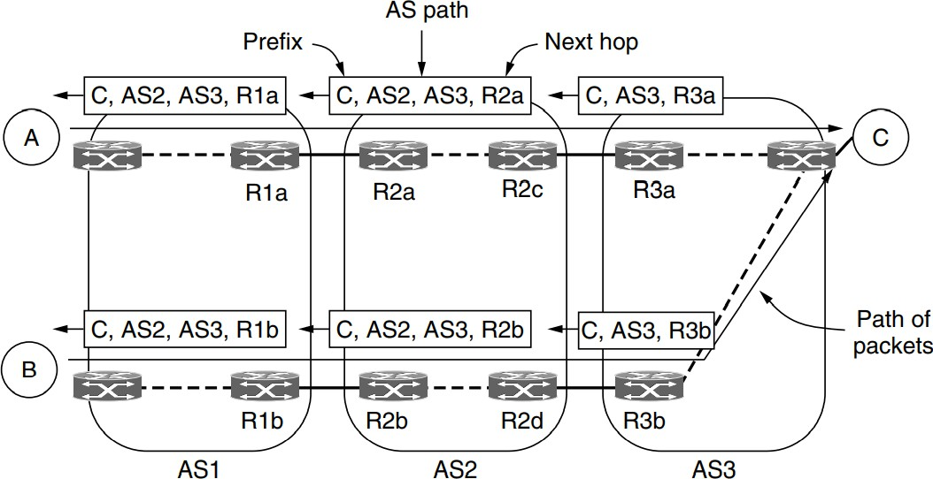
BGP Routing

Slide 33
BGP Routing
The rule is that each router that sends a route outside of the AS prepends its own AS
number to the route.
When a router receives a route, it checks to see if its own AS number is already in the AS path. If it is, a loop has been detected and the advertisement is discarded.
iBGP: The task of propagating BGP routes from one side of the ISP to the other is handled by a intra-domain variant of BGP protocol called iBGP (internal BGP) to distinguish it from the regular use of BGP as eBGP (external BGP).

Slide 34



BGP UPDATE Message Propagation
110.23/1
6
AS 10
111.25/1
AS 51
AS 59
AS_PATH | 10
NLRI | 110.23/16
NLRI | 111.25/16
AS 138
6
AS 228
AS 782

Slide 35
BGP UPDATE Message Propagation
110.23/1
6
AS 10
111.25/1
6
AS 51
AS 59
AS_PATH | 10 51
NLRI | 110.23/16
NLRI | 111.25/16
AS 138
AS 228
AS 782

Slide 36
BGP UPDATE Message Propagation
110.23/1
6
AS 10
111.25/1
6
AS
AS
59
51AS_PATH
10 51 59
NLRI
110.23/16
NLRI
111.25/16
AS 138
AS 228
AS 782

Slide 37
BGP UPDATE Message Propagation
110.23/1
6
AS 10
111.25/1
6
AS 51
AS 59
AS 138
AS_PATH | 10 51 59 138
NLRI | 110.23/16
NLRI | 111.25/16
AS 228
AS 782

Slide 38
BGP UPDATE Message Propagation
110.23/1
6
AS 10
111.25/1
6
AS 51
AS 59
AS 138
AS 228
AS 782
AS_PATH | 10 51 59 138 228
NLRI | 110.23/16
NLRI | 111.25/16

Slide 39
BGP UPDATE Message Propagation
110.23/1
6
AS 10
111.25/1
AS 51
AS 59
6
AS 138
AS_PATH | 10 51 59 138 228 782
NLRI | 110.23/16
NLRI | 111.25/16
AS 228
AS 782

Slide 40
Limitation of traditional IP routing
Header analysis performed at each hop
Increased demand on routers
Utilizes the best available path
Some congested links and some underutilized links!
  Degradation of throughput
  Long delays
  More losses
No QoS
  No service differentiation
  Not possible with connectionless protocols

Slide 41
Need for MPLS
Rapid growth of Internet
New latency dependent applications
Quality of Service (QoS)
  Less time at the routers
Traffic Engineering
  Flexibility in routing packets
Connection-oriented forwarding techniques with connectionless IP
  Utilizes the IP header information to maintain interoperability with IP based networks
  Decides on the path of a packet before sending it

Slide 42
Multi Protocol Label Switching(MPLS)
Multi Protocol – supports protocols even other than IP
  Supports IPv4, IPv6, IPX, AppleTalk at the network layer
  Supports Ethernet, Token Ring, FDDI, ATM, Frame Relay, PPP at the
link layer
Label – short fixed length identifier to determine a route
  Labels are added to the top of the IP packet
  Labels are assigned when the packet enters the MPLS domain
Switching – forwarding a packet
  Packets are forwarded based on the label value
  NOT on the basis of IP header information

Slide 43
MPLS Background
Integration of layer 2 and layer 3
  Simplified connection-oriented forwarding of layer 2
  Flexibility and scalability of layer 3 routing
MPLS does not replace IP; it supplements IP
Traffic can be marked, classified and explicitly routed
QoS can be achieved through MPLS

Slide 44
IP versus MPLS
Routing decisions
  IP routing – based on destination IP address
  Label switching – based on labels
Entire IP header analysis
  IP routing – performed at each hop of the packets path in the network
  Label switching – performed only at the ingress router
Support for unicast and multicast data
  IP routing – requires special multicast routing and forwarding algorithms
  Label switching – requires only one forwarding algorithm

Slide 45
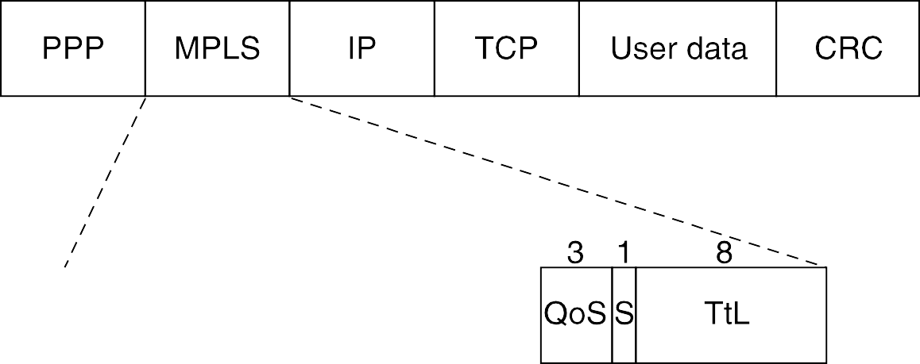
MPLS HeaderFormat
Label: 20-bit label value
QoS: indicates the class of service
S: bottom of stack indicator
  1 for the bottom label, 0 otherwise
TTL: time to live

Slide 46
Forwarding Equivalence Class (FEC)
A group of packets that require the same forwarding treatment across the same path
Packets are grouped based on any of the following
  Address prefix
  Host address
  Quality of Service (QoS)
FEC is encoded as the label

Slide 47
Labels
A short, fixed length identifier (20 bits)
Sent with each packet
Local between two routers
Can have different labels if entering from different routers
One label for one FEC
Decided by the downstream router (the receiver)
  LSR (Label Switching Router) binds a label to an FEC
  It then informs the upstream LSR (the sender router) of the binding

Slide 48






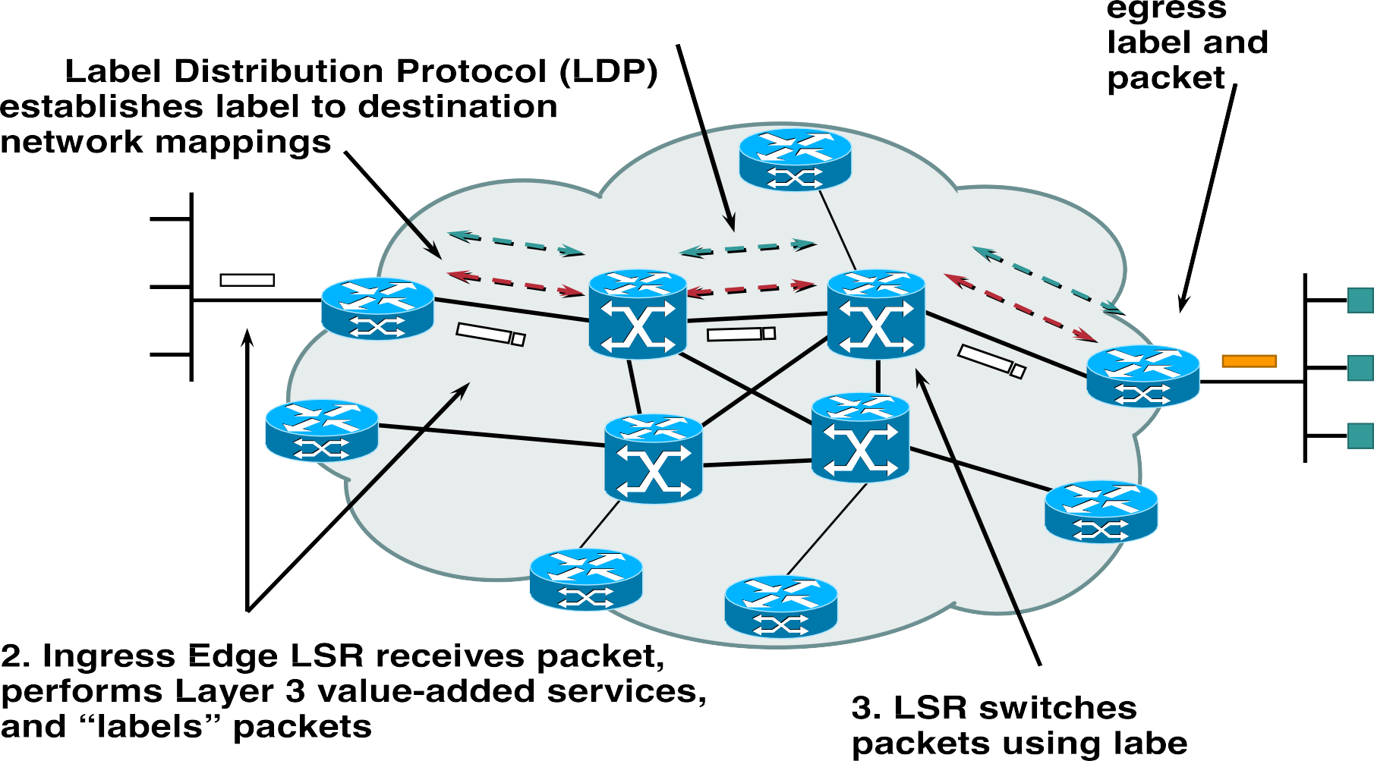



MPLS Operation
Source: cisco.com

Slide 49



















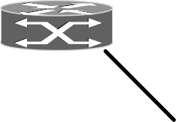





MPLS Forwarding
18-10-
2020
IIITG/Summer 2020/CS352
50

Slide 50
Label Stacking
A packet may carry multiple labels, organized as a last-in-first-out stack
A label may be added to/removed from the stack at any LSR
Processing always done on the top label
Allow the aggregation of LSPs into a single LSP for a portion of the route, creating a tunnel
  At the beginning of the tunnel, the LSR assigns the same label to packets from
different LSPs by pushing the label onto each packet’s stack
  At the end of the tunnel, the LSR pops the top label

Slide 51
MPLS versus Virtual CircuitSwitching
Virtual Circuit Switching | MPLS
It is not possible to group several distinct paths with different endpoints onto the same virtual-circuit identifier because there would be no way to distinguish them at the final destination. | Label aggregation is possible in MPLS. Each flow can have its own set of labels and the routers group multiple flows (belongs to the same FEC) and use a single label for them.
Has to set up many label switching paths, one for each of the different labels when many packets with different labels need to follow a common path to some destination. | Can operate at multiple levels at once by adding more than one label to the front of a packet through label stacking.
When a user wants to establish a connection, a setup packet is launched into the network to create the path and make the forwarding table entries. | MPLS does not involve users in the setup phase.

