Slide 1
Final Project Presentation: Our App name is: HealthCare_APP_Group_Assignment_Group 5
Presented by: Dinesh Kumar Reddy, Hayden Sanders,
Hemanth Kumar Katrakuti,
Sayan Banerjee,Thameem Ashiq Shaik,Vishal Reddy Chewalla
12/17/2023
Notes:
This is a presentation template for a Getting Started with Splunk Workshop. The slides are intended to be customized to your own environment and agenda. Notes conveying purpose and example usage are presented on the slides directly. Good luck and have fun!

Slide 2
Introductions
The importance of Splunk analysis in the rapidly changing field of healthcare analytics cannot be emphasized. Professionals may get deep insights into the complexities of healthcare data by utilizing Splunk's capability, which enables them to identify significant patterns, trends, and correlations. Real-time analysis and decision-making are necessary in the dynamic field of healthcare, and Splunk is an essential tool for doing this. Healthcare professionals may improve patient outcomes, increase operational efficiency, and find crucial insights that lead to game-changing developments in the industry by using Splunk analysis. The synthetic healthcare dataset that is provided here gains even more value because it offers the perfect setting for using Splunk's capabilities in healthcare data exploration, in addition to facilitating conventional analytical methodologies.

Slide 3
Educational Importance, and the Role of Splunk Synthetic Dataset:
This project addresses the critical need for diverse and practical healthcare data in educational and research contexts. The synthetic dataset not only serves as a platform for practicing data manipulation and predictive modeling but also ensures a secure environment by eliminating concerns related to sensitive healthcare information. It fosters innovation and knowledge sharing, enabling the development and testing of predictive models and encouraging insightful data visualizations. In the evolving landscape of healthcare analytics, the importance of Splunk analysis cannot be overstated. Splunk serves as a pivotal tool for deriving comprehensive insights into healthcare data, enhancing operational efficiency, and uncovering critical patterns and correlations in real-time. The synthetic healthcare dataset becomes an invaluable asset by providing an ideal environment for harnessing the capabilities of Splunk in healthcare data exploration.

Slide 4

Dataset and its objectives
This comprehensive healthcare dataset encompasses a myriad of columns, each providing specific details crucial for holistic patient analysis and healthcare modeling. Ranging from fundamental patient information such as name, age, and gender to critical medical indicators like blood type and primary medical condition, the dataset offers a rich repository for in-depth data analysis. With additional insights into the date of admission, attending doctor, healthcare facility details, insurance provider, billing amounts, room assignments, admission types, discharge dates, prescribed medications, and medical test results, this dataset becomes a versatile resource for various healthcare-related tasks. The inclusion of diverse parameters, expressed in both categorical and numerical formats, empowers practitioners to explore a multitude of scenarios, making it an ideal dataset for modeling, predictive analytics, and gaining nuanced insights into healthcare trends and patient outcomes.

Slide 5
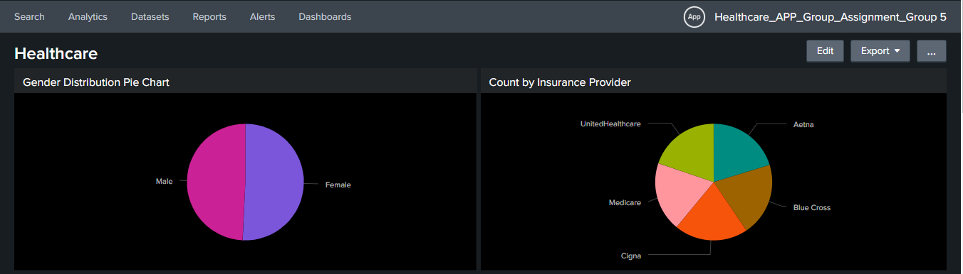
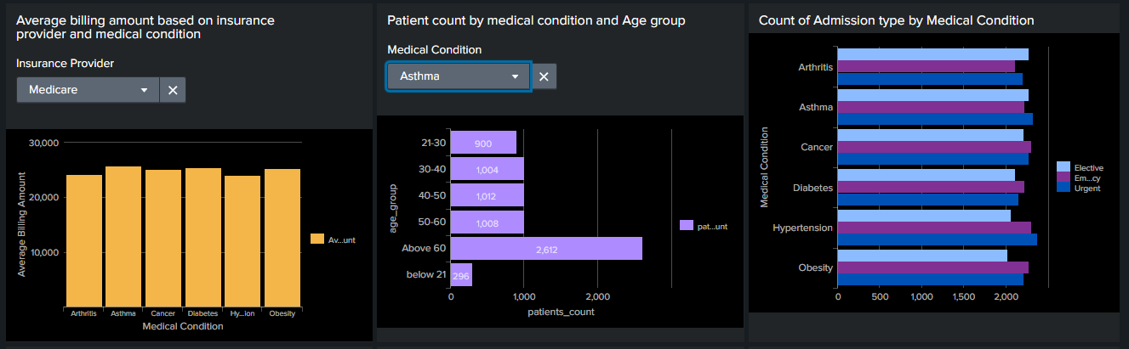
Exploring Synthetic Healthcare Data: Report and Dashboard Planning

Slide 6
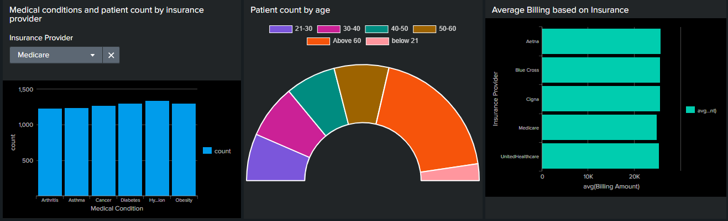
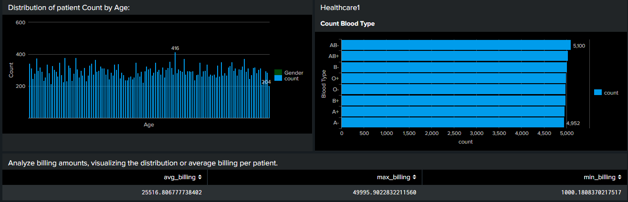
Exploring Synthetic Healthcare Data: Report and Dashboard Planning

Slide 7
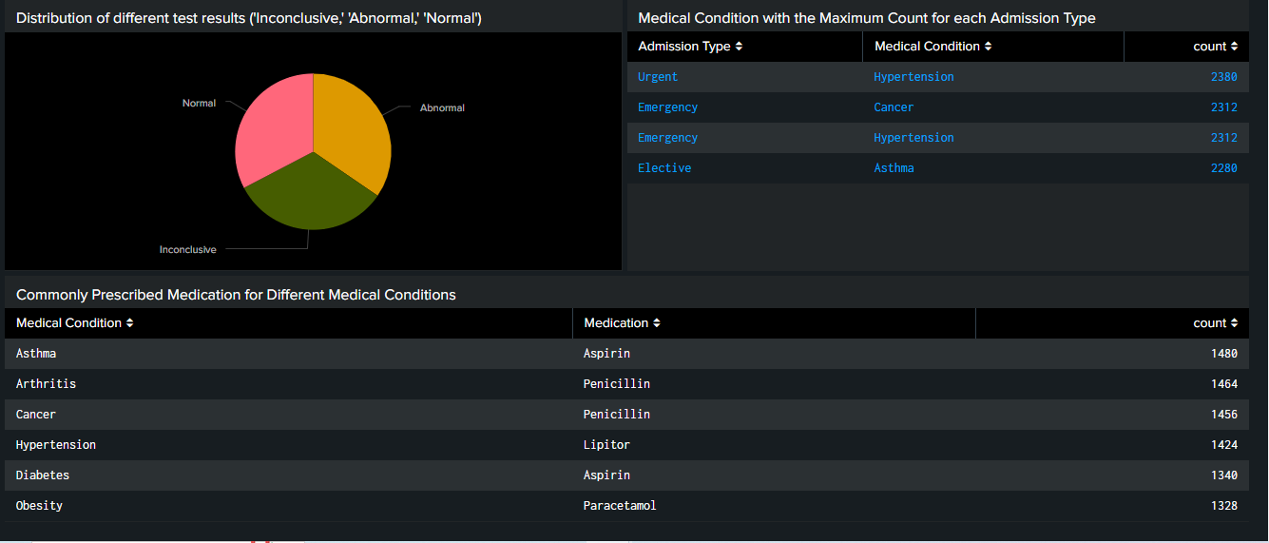
Exploring Synthetic Healthcare Data: Report and Dashboard Planning

Slide 8
CONCLUSION
In conclusion, this meticulously constructed synthetic healthcare dataset proves to be an invaluable resource for individuals interested in advancing their skills in data science, machine learning, or data analysis within the healthcare sector. Developed using Python's Faker package, the dataset serves as a pragmatic yet privacy-conscious alternative, driven by the demand for diverse and readily accessible healthcare data for educational and research purposes. Encompassing columns that detail essential patient information, admission specifics, and medical services, the dataset is well-suited for a range of research and modeling applications. Additionally, leveraging tools such as Splunk can significantly enhance the analysis of this dataset. Splunk's capabilities in data visualization, search, and monitoring can facilitate a deeper understanding of patterns, trends, and anomalies within the healthcare data, offering users a powerful platform to extract actionable insights. The primary aim is to foster innovation, education, and the exchange of information in the realm of healthcare analytics, providing users with a hands-on experience and an opportunity to contribute to the evolution of ideas and solutions. Source: https://www.kaggle.com/datasets/prasad22/healthcare-dataset Dashboard: https://splunk.sps.cs.clarku.edu:8000/en-GB/app/Healthcare/healthcare?form.insuranceprovider=UnitedHealthcare&form.medicalcondition=Arthritis

Slide 9
Thank You :)

