Slide 1
IBM UNIVERSITY ENGAGEMENT
PROJECT SUBMISSION
FROM PAPERS
TO CITED INSIGHTS
ResearchLens AI
01
Retrieve
An evidence-grounded
research assistant
Selected PDF passages
02
Synthesize
IBM Granite via watsonx.ai
Exploring Agentic AI with IBM Granite
03
Review
RESEARCH AGENT • PROBLEM STATEMENT 1
Citations and numeric checks
Sayan Ghorai
VIT Bhopal University | 05 November 2026
RESEARCHLENS AI / IBM SKILLSBUILD
01
Notes:
ResearchLens AI is a student-built research-assistance prototype. It uses IBM Granite as the application language model with document-scoped retrieval and custom Python roles. This presentation follows the supplied submission structure while replacing the example project with the actual implementation.
Evidence / provenance: User-provided project context, current application and supplied presentation template.
Prepared for submission on 5 November 2026.

Slide 2
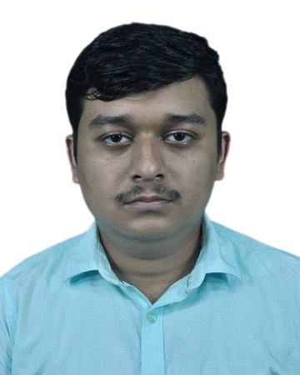
PROJECT PROFILE
Student and project details
Education • Academic and scientific research
PROJECT TITLE
ResearchLens AI
Evidence-grounded research assistance with IBM Granite
University
VIT Bhopal University
Problem statement
No. 1 — Research Agent
Email
sayanghorai639.hitcseaiml2020@gmail.com
Sayan Ghorai
Mobile / WhatsApp
+91 9932813920
RESEARCHLENS AI / IBM SKILLSBUILD
02
Notes:
Student details were provided by the user. The photograph is the supplied passport-style photo. Project domain is education and academic/scientific research, not plant-disease classification: plant-disease papers were demonstration documents, not the scope of the application.
Evidence / provenance: User message: name, email, mobile and photograph; earlier confirmed VIT Bhopal University affiliation; Problem Statement No. 1.
Prepared for submission on 5 November 2026.

Slide 3
CHALLENGE AND OBJECTIVE
Problem statement — Research Agent
Researchers need an organized path from source material to evidence-linked drafts.
THE CHALLENGE
THE OBJECTIVE
Research work is fragmented
Make evidence inspectable
Literature discovery, paper reading, data extraction and reference management require repeated manual effort. Important details can be missed or misattributed.
Assist literature search, summarization, comparison and drafting while keeping selected-paper scope, source passages and PDF page references visible.
Target users: students, academic researchers and project teams.
RESEARCHLENS AI / IBM SKILLSBUILD
03
Notes:
The supplied Research Agent problem statement asks for literature search, paper summaries, reference organization, natural-language question understanding, reports, hypotheses, drafting, citation management and data extraction. The implementation is a bounded assistance workflow, not a claim of fully autonomous research or independently verified scientific conclusions.
Evidence / provenance: 1. Problem Statements(2).pdf, page 1, Research Agent; user-provided ResearchLens project materials.
Prepared for submission on 5 November 2026.

Slide 4
SOLUTION OVERVIEW
Proposed solution
One research workspace, with source evidence alongside every generated draft.
01
02
03
04
Discover
Focus
Generate
Inspect
Search arXiv / Crossref
or upload research PDFs.
Select source papers and
retrieve relevant passages.
Use IBM Granite for a
bounded synthesis action.
Review citations, warnings,
page references and exports.
Question answering • Summaries • Structured extraction • Comparisons
Reports • Untested hypotheses • Research-section drafts
RESEARCHLENS AI / IBM SKILLSBUILD
04
Notes:
Seven task routes are implemented. Search, PDF parsing and local retrieval do not require a Granite generation request. Live synthesis happens after a user action. Five core live features were reviewed; hypotheses and research-section drafting had mocked integration checks but not completed live quality evaluation in the provided record.
Evidence / provenance: ResearchLens app.py / agents.py / workflow.py and local test outputs supplied in this conversation.
Prepared for submission on 5 November 2026.

Slide 5
IMPLEMENTATION
Technology used
A custom Python RAG workflow with IBM-hosted generation.
IBM Granite + watsonx.ai
ibm/granite-4-h-small via the IBM Python SDK
Python 3.12 + Streamlit
Application logic, session controls and research interface
pypdf + fontTools
Page-indexed PDF text extraction and font support
scikit-learn + NumPy
TF-IDF passage retrieval and local ranking
Pydantic + export utilities
Typed records; Markdown, JSON, CSV and BibTeX
IBM Bob + GitHub
Development assistance, version control and project delivery
CURRENT RETRIEVAL: TF-IDF
Optional MiniLM support is not enabled in this demo.
RESEARCHLENS AI / IBM SKILLSBUILD
05
Notes:
The application is implemented directly in Python. Granite is the only application LLM. Semantic retrieval with MiniLM is optional and disabled in the demonstrated configuration. Do not describe the application as using a vector database in the current demo. IBM Bob assisted initial development; subsequent verification and completion used the local Python/Streamlit project.
Evidence / provenance: Verified dependency list and current code/configuration; user-reported development workflow.
Prepared for submission on 5 November 2026.

Slide 6
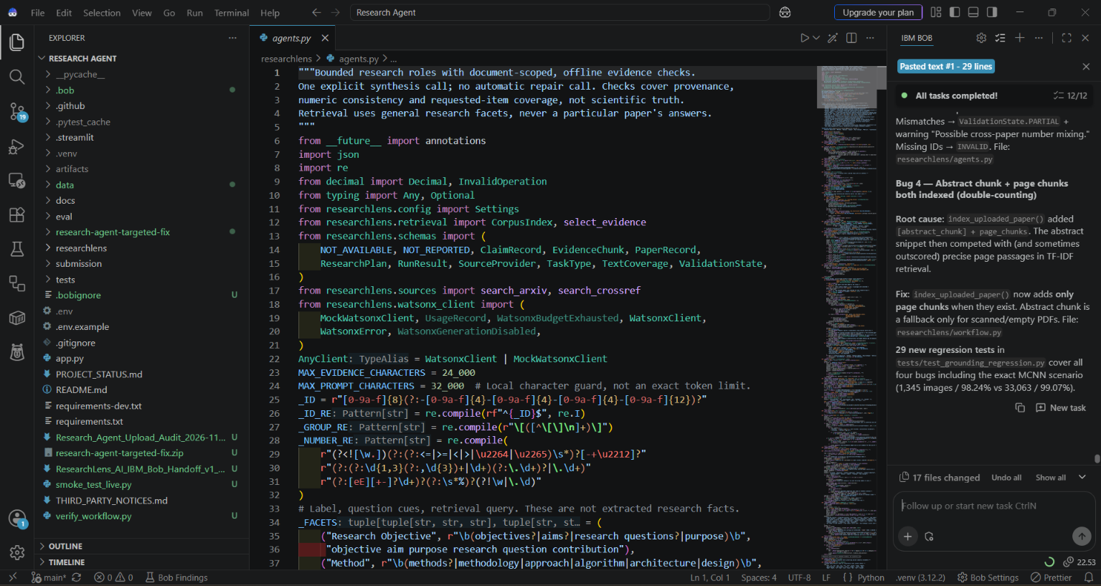
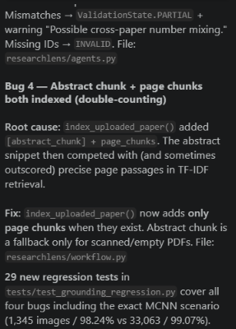
DEVELOPMENT EVIDENCE
IBM Bob–assisted development and review
Project-specific troubleshooting history alongside the implemented Python code.
PROJECT WORKSPACE
BOB TASK DETAIL / ENLARGED
Development assistance shown here; IBM Granite remains the application’s runtime LLM.
RESEARCHLENS AI / IBM SKILLSBUILD
06
Notes:
The user supplied this screenshot from the Research Agent workspace in IBM Bob. It shows researchlens/agents.py open next to a previous Bob task response. The visible response discusses citation validation, abstract/page-chunk indexing and regression tests. The right-hand image is an enlarged crop of the same screenshot, not a separately generated response. This is evidence of IBM Bob-assisted development and troubleshooting; it does not claim that Bob authored every final file or independently prove the historical task’s reported test count. The original validation slide remains the source for the latest user-reported 224 regression tests and 24 UI helper checks. IBM Bob is development assistance, while IBM Granite via watsonx.ai is the application runtime LLM.
Evidence / provenance: User-supplied screenshot image(20261105-110734).png and the user’s description of initial development in IBM Bob followed by local completion and testing.
Prepared for submission on 5 November 2026.

Slide 7
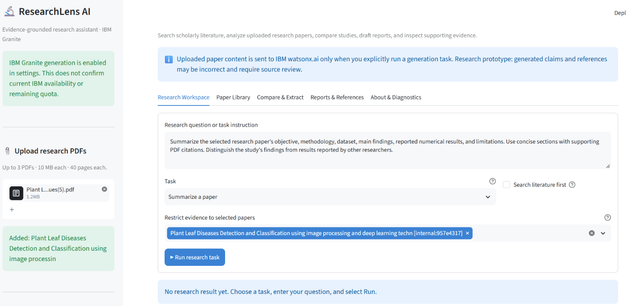
USER INTERFACE
Application components
Five tabs connect discovery, document review and export.
Research Workspace
Choose a task and source papers.
Paper Library
Manage papers and edit metadata.
Compare & Extract
Compare studies or extract six fields.
Reports & References
Download drafts and bibliography.
About & Diagnostics
Inspect configuration and limits.
RESEARCHLENS AI / IBM SKILLSBUILD
07
Notes:
The screenshot is from the user’s local running application, with one uploaded paper, source selection and the summary task visible. It is not a fabricated UI mockup. The five tabs are the project’s real navigation structure.
Evidence / provenance: User screenshot image(20261105-101547).png; current app.py.
Prepared for submission on 5 November 2026.

Slide 8
EXECUTION FLOW
Research workflow
A user-triggered sequence—not an open-ended loop.
1
Choose the task
Select papers and a research question.
2
Retrieve evidence
Use document-scoped TF-IDF search.
3
Generate a draft
Send the bounded evidence to Granite.
4
Check support
Inspect citation IDs and numerical claims.
5
Review and export
Show warnings, pages and draft downloads.
No usable evidence → no generation request. Generation disabled → evidence inspection remains available.
RESEARCHLENS AI / IBM SKILLSBUILD
08
Notes:
PDF ingestion and indexing occur before evidence selection. The workflow chooses selected documents, retrieves bounded passages, asks Granite for synthesis, then runs deterministic checks. The current controlled demo uses one model request per action and no automatic answer-repair request. Source text is treated as data rather than instructions.
Evidence / provenance: ResearchLens code and Stage 9, Stage 14E/14F offline checks; current live-test settings.
Prepared for submission on 5 November 2026.

Slide 9
SYSTEM DESIGN
Architecture blueprint
Local application responsibilities and the IBM inference boundary.
SOURCES
PYTHON APPLICATION
IBM watsonx.ai
Uploaded PDFs
arXiv / Crossref
metadata and abstracts
Streamlit + session library
Granite 4 H Small
Hosted text generation
pypdf → page-aware chunks
TF-IDF → scoped evidence
Custom roles → bounded prompt
Verifier → warnings and exports
Draft for review
Evidence, warnings
and export controls
Credentials stay in private configuration. Uploaded content is not committed to GitHub.
RESEARCHLENS AI / IBM SKILLSBUILD
09
Notes:
This architecture shows the actual custom Python design. PDF ingestion, TF-IDF retrieval and verification run in the application environment; hosted IBM Granite processes the evidence packet only for generation actions. It does not imply that all uploaded PDF bytes are sent to the model, or that local parsing uses IBM document-extraction tokens. App may run locally or on Streamlit Community Cloud; secrets remain private.
Evidence / provenance: Current ResearchLens modules and app.py; local verification and deployment screenshots.
Prepared for submission on 5 November 2026.

Slide 10
AGENT DESIGN
Role of Agentic AI in the solution
Four bounded roles coordinate research assistance.
SEARCH AGENT
READ AGENT
Discover literature
Assemble evidence
Build a query plan and call arXiv / Crossref.
Retrieve relevant passages from the selected papers.
WRITE AGENT
VERIFY AGENT
Create the draft
Check support
Use one bounded Granite synthesis request.
Check citation scope, numeric consistency and gaps.
The verifier checks structure and evidence consistency—not scientific truth.
RESEARCHLENS AI / IBM SKILLSBUILD
10
Notes:
These are specialized Python components, not four independent LLMs. Search and Read are deterministic/local adapters; Write uses Granite; Verify uses deterministic rules. The system should be described as a bounded agentic RAG assistant, not a self-directed team of agents or guaranteed fact-checker.
Evidence / provenance: researchlens/agents.py and workflow.py; tested application architecture.
Prepared for submission on 5 November 2026.

Slide 11
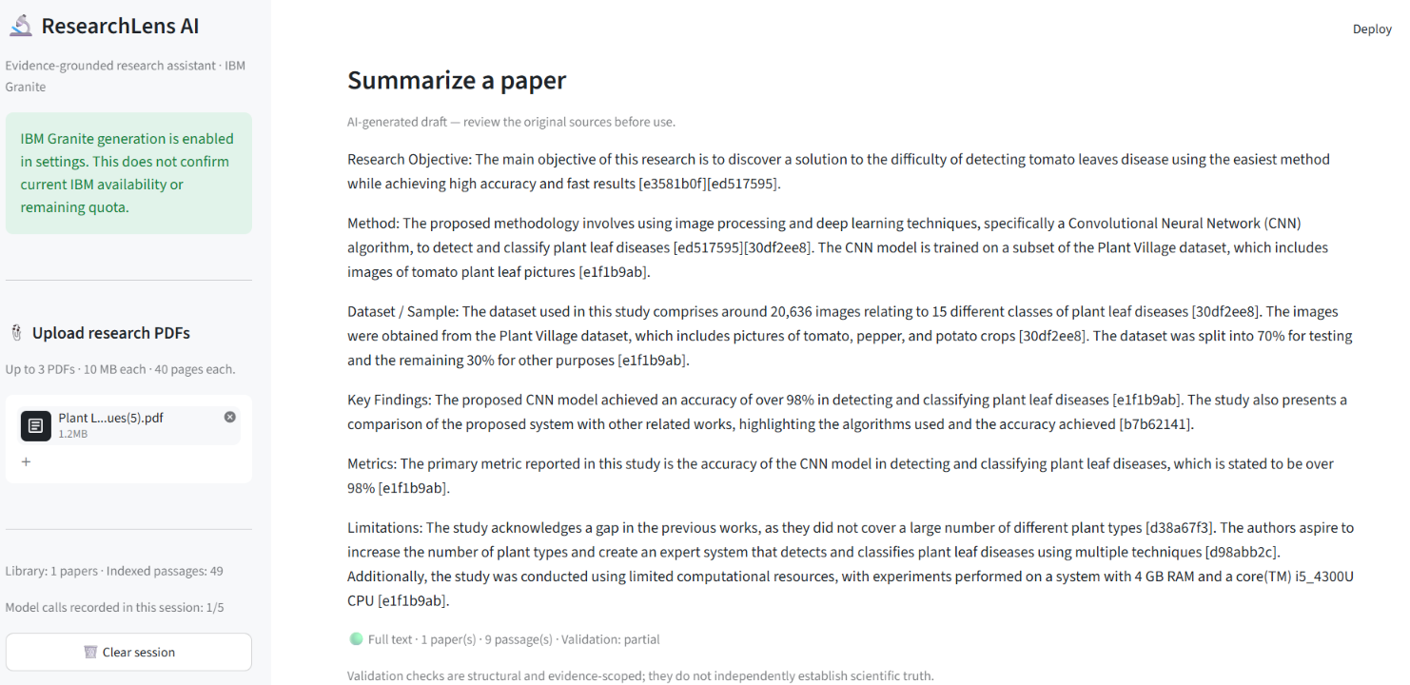
WORKING PROTOTYPE
Demonstration — a source-linked paper summary
Actual local Granite output from the final demonstration.
LOCAL DEMO
1
recorded model call
49
indexed passages
from one PDF
PARTIAL VALIDATION
RESEARCHLENS AI / IBM SKILLSBUILD
11
Notes:
The screenshot is the user’s final local demonstration. One paper was uploaded; the session shows 49 indexed passages and 1/5 recorded calls. The displayed summary is a draft with partial validation, not a gold-standard answer. The screenshot contains known source-attribution and precision limitations, which are disclosed on the following slide. It proves functioning generation and evidence presentation, not scientific accuracy.
Evidence / provenance: User-supplied image(20261105-101729).png and final demo screenshot.
Prepared for submission on 5 November 2026.

Slide 12
EVIDENCE AND LIMITATIONS
Validation and responsible use
Software checks passed; generated scientific claims still require review.
224
24
5
local regression tests passed
offline UI helper checks passed
core features reviewed live
IMPLEMENTED SAFEGUARDS
KNOWN PROTOTYPE LIMITATIONS
Selected-paper evidence scope
Some claims or citations remain inaccurate
Visible citations and PDF page references
Tables and source inconsistencies need review
Review labels and draft / checked exports
Session call limit is not an account-wide cap
Hypotheses and section drafting: implemented and mock-tested; live quality review not completed.
RESEARCHLENS AI / IBM SKILLSBUILD
12
Notes:
The pass counts are from the user’s local PowerShell logs: 224 regression tests and 24 added UI helper checks. They are not research-answer accuracy percentages. Five live-reviewed core features were Q&A, comparison, extraction, summary and report generation, with partial-quality results. The hypothesis and drafting routes were exercised with mocked responses in earlier integration checks, but a later live hypothesis attempt was blocked by the session limit. Do not claim all seven tasks have passed independent live evaluation.
Evidence / provenance: User verification logs and supplied outputs from Stages 9, 14E/14F, prototype UI checks, and 15A–15E.
Prepared for submission on 5 November 2026.

Slide 13
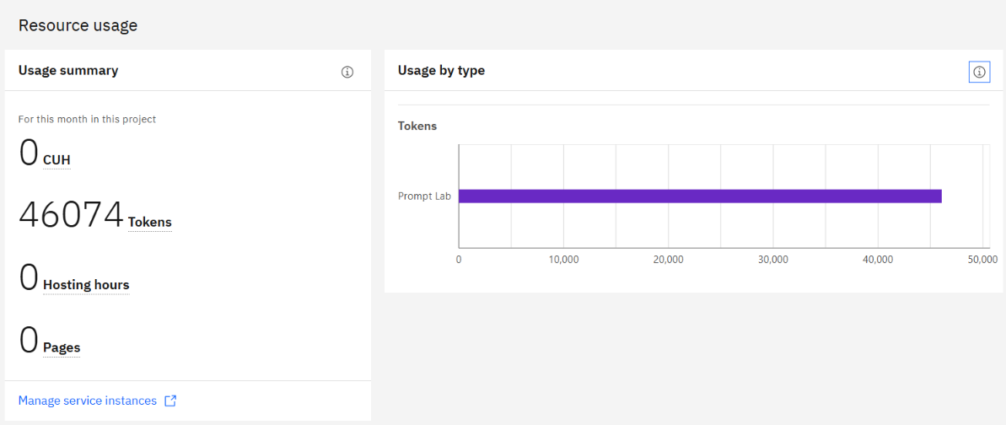
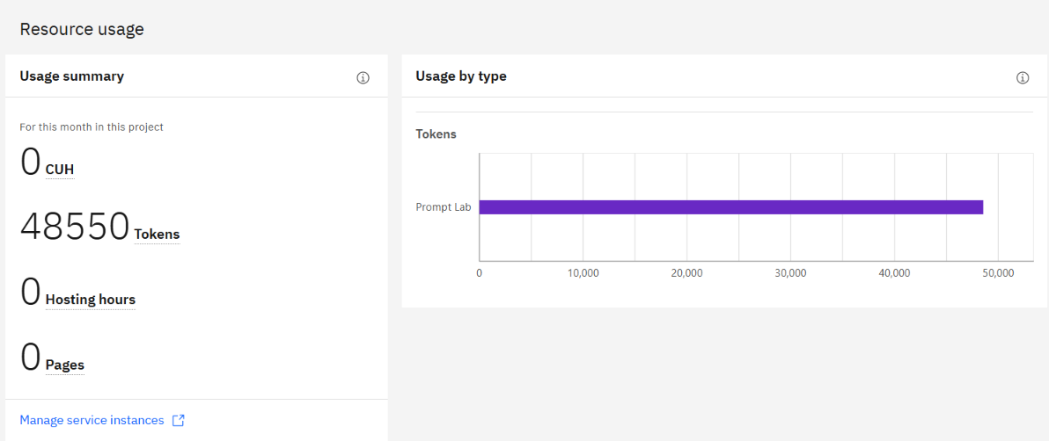
MEASURED RESOURCE USE
Token usage — measured demonstration
IBM project dashboard screenshots, before and after one local summary action.
BEFORE
AFTER
OBSERVED INCREASE
46,074
48,550
2,476
Before prompt
After prompt
48,550 − 46,074 = 2,476 tokens. Dashboard figures are cumulative project usage, not tokens remaining.
RESEARCHLENS AI / IBM SKILLSBUILD
13
Notes:
The before dashboard reads 46,074 Tokens; the after dashboard reads 48,550 Tokens. Their difference is 2,476. This is the observed project-usage increase during the demonstration interval, not an independently reconciled per-request billing total or remaining quota. Other activity and reporting delay could affect a dashboard delta. The final local request used a maximum output setting of 1,000 tokens; this limit does not cap input tokens. No invented input/output breakdown is supplied for this run.
Evidence / provenance: User screenshots Screenshot 2026-11-05 143906.png and image(20261105-101746).png; user demo output showing one recorded call.
Prepared for submission on 5 November 2026.

Slide 14
PROJECT VALUE
Novelty and uniqueness
Practical differentiators within this student prototype.
01
02
03
Evidence-first outputs
Review-aware interface
Budget-aware workflow
Answers remain linked to selected papers, passages and PDF page references.
Draft values, checked fields and validation warnings are separated rather than presented as equally reliable.
Local search and parsing work without generation; explicit user actions control bounded Granite calls.
A research-assistance workflow—not a substitute for reading and evaluating the original sources.
RESEARCHLENS AI / IBM SKILLSBUILD
14
Notes:
These are implementation differentiators, not claims that the project is globally novel or superior to all research tools. The UI fixes preserve review-required drafts without silently calling rejected fields absent from the paper. Warnings are displayed after the answer and retained in exports.
Evidence / provenance: Prototype UI replacement and its 24 checks; final browser screenshots and user-visible export behavior.
Prepared for submission on 5 November 2026.

Slide 15
PROJECT DELIVERY
GitHub and deployment
Versioned project source and a hosted interface are available.
SOURCE REPOSITORY
SayanGhorai / research-agent
https://github.com/SayanGhorai/research-agent
BRANCH: main
41 INITIAL FILES
COMMIT: b48c64d
STREAMLIT COMMUNITY CLOUD
research-agent-w5sphgb24eusjwdykiwlrc.streamlit.app
Hosted interface deployed. The verified AI demonstration is local; cloud AI generation requires private credential configuration.
RESEARCHLENS AI / IBM SKILLSBUILD
15
Notes:
The user’s Git log confirms initial push to main at b48c64d with 41 files. The hosted Streamlit interface was visible, but hosted Granite credentials were not successfully confirmed in the supplied record. Local generation was demonstrated successfully. The presentation deliberately distinguishes these states. Do not put API keys or application passwords into the public repository. The app URL is copied from the provided deployment screenshots, not independently checked at authoring time.
Evidence / provenance: User Git push output and Streamlit deployment screenshots; latest user instruction to use local demo for token measurement.
Prepared for submission on 5 November 2026.

Slide 16
ROADMAP
Future scope
Priorities for a later iteration—not additions claimed in this submission.
1
Stronger citation alignment
Improve per-claim links and distinguish a study’s own results from cited work.
2
Better document understanding
Improve table extraction, bibliography metadata and scanned-document handling.
3
Broader retrieval evaluation
Assess optional semantic retrieval on research papers from additional domains.
4
Safer shared deployment
Add persistent usage controls and expand live evaluation of the remaining tasks.
RESEARCHLENS AI / IBM SKILLSBUILD
16
Notes:
The current submission is frozen after the final demonstration. These items are future work and are not deployed features or completed tests. The remaining research-quality limitations are acknowledged rather than hidden. No second model is part of the submitted application.
Evidence / provenance: User decision to stop accuracy tuning and model additions; observed citation, table and metadata limitations from the live evaluations.
Prepared for submission on 5 November 2026.

Slide 17
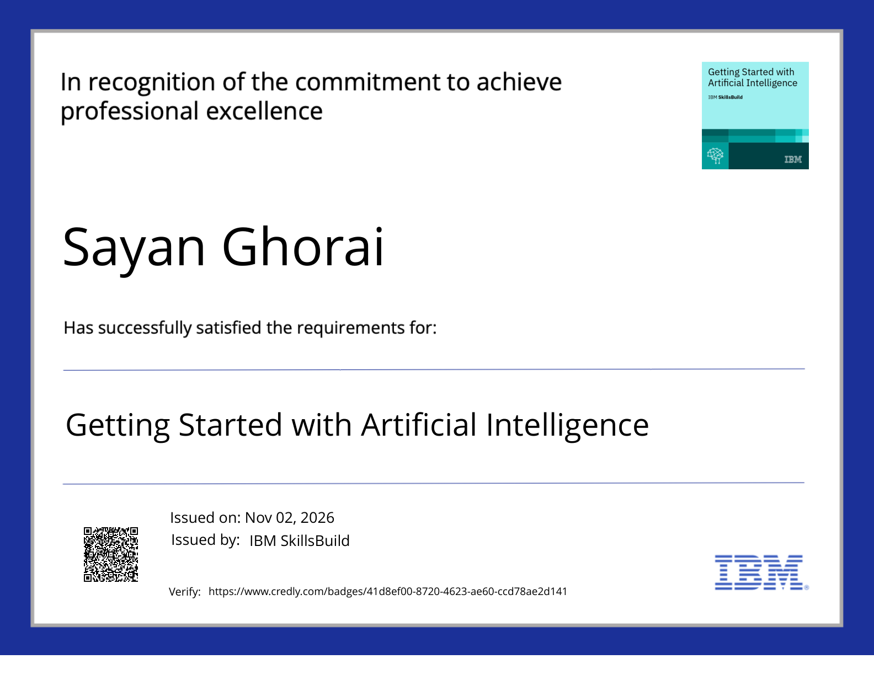
IBM SKILLSBUILD
Certificates earned — Artificial Intelligence
Getting Started with Artificial Intelligence
RECIPIENT
Sayan Ghorai
ISSUED BY
IBM SkillsBuild
ISSUED ON
02 November 2026
View credential
RESEARCHLENS AI / IBM SKILLSBUILD
17
Notes:
This is the supplied IBM SkillsBuild credential, rendered directly from the uploaded PDF. Its displayed title, recipient, issue date and verification URL are preserved. The presentation does not claim independent online verification of the badge.
Evidence / provenance: Getting Started with Artificial Intelligence.pdf, page 1.
Prepared for submission on 5 November 2026.

Slide 18

IBM SKILLSBUILD
Certificates earned — IBM Bob
Lab: Troubleshoot Your Code Using IBM Bob
RECIPIENT
Sayan Ghorai
COMPLETION DATE
20 August 2026
(GMT)
LEARNING HOURS
30 minutes
RESEARCHLENS AI / IBM SKILLSBUILD
18
Notes:
The IBM Bob lab completion certificate is included as provided. The course identifier is ALM-COURSE_4071307. The certificate states a completion date of 20 Aug 2026 GMT and learning hours of 30 minutes. IBM Bob’s role in the project is development assistance, not the runtime model.
Evidence / provenance: Troubleshoot Your Code Using IBM Bob.pdf, page 1.
Prepared for submission on 5 November 2026.

Slide 19
THANK YOU
ResearchLens AI
From research papers to evidence-linked drafts—
with IBM Granite and transparent human review.
Sayan Ghorai | VIT Bhopal University
sayanghorai639.hitcseaiml2020@gmail.com
RESEARCHLENS AI / IBM SKILLSBUILD
19
Notes:
Closing summary. The project is an internship research-assistance prototype. Its source, interface, local Granite demonstration, measured dashboard token increase and certificates are documented in this deck. References are embedded in the relevant slide notes and screenshots.
Evidence / provenance: All project details and images supplied by the user; original submission template used as an organizational guide.
Prepared for submission on 5 November 2026.

