Slide 1
Process Dynamics & Control

Slide 2
Process Dynamics & Control (CH 61016)
Class Teacher: 1. Prof Amar Nath Samanta
2. Prof Amiya K Jana
Class TA
Mr. Shubham Raj Mr. Guru Bhattacharya
Mr. Vishal Kamble
Class Timing
Wednesday : 10 AM to 11 AM
Thursday : 9 AM to 10 AM
Friday : 11 AM to 1 PM
Attendance
Biometric method
Institute Deregistration Rule

Slide 3
Syllabus of PDC (my part only)
Development Process Models
Development of Control Relevant Models
Review of linear Dynamics
Development of controller and observer using state space models
Non-linear system analysis
Phase Plane
Bifurcation
Stability analysis
Feedback linearization of nonlinear systems

Slide 4
Process Dynamics & Control
Books:
1.Process Dynamics & Control -- Seborg, Edgar, Mellichamp
& Doyle
Process Control -- W Bequette
Process Dynamics, Modelling & Control
– B A Ogunnaike & W H Ray
4. Modern Control Engineering -- K Ogata
Software: Knowledge of MATLAB & Simulink desirable

Slide 5
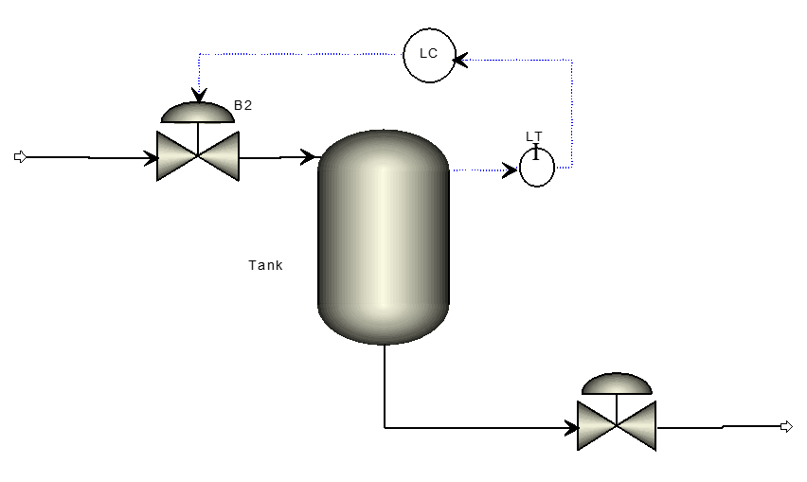
Why study Process dynamics
Let us consider a very simple example of tank level control problem
Option 1:

Slide 6
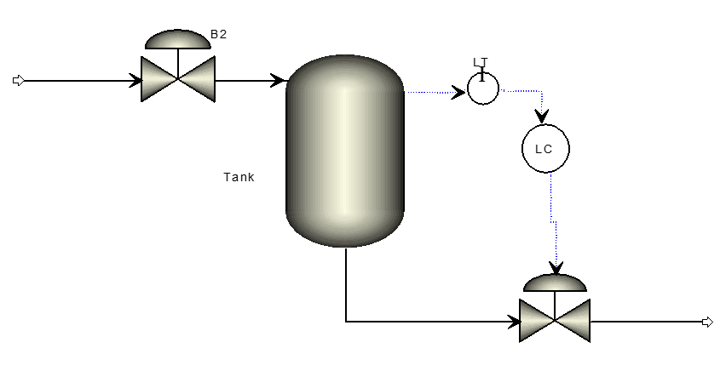
Tank Level problem
Option 2:
Which configuration is better from the control view point and why?

Slide 7
Benchmark Systems to be used for the course
Tank Level System
3 tank in series
Quadruple Tank
Continuous Stirred Tank Heater
Continuous Stirred Tank Reactor system
Isothermal Reactor (Van de Vusse reaction)
Non-isothermal Reactor
Polymerization Reactor
Distillation Column
MATLAB / SIMULINK model will be developed based on nonlinear model

Slide 8
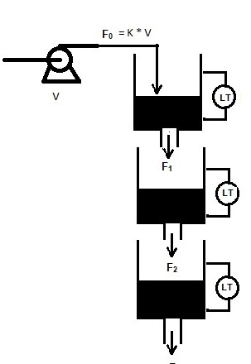
Mathematical Model of tank level system
Control objective:
Control the 3rd tank level by manipulating pump voltage V, where F₀ = K V
Add q₂ input flow on the tanks 2 and set q₂ as manipulated variable.
Which one is difficult to control?
Data for Simulation in Matlab/Simulink
A₁, A₃ = 28 cm² A₂ = 32 cm² V^{s} = 3 V
a₁ = 0.06725 cm² a₂ = 0.05683 cm² a₃ = 0.07089 cm² K=3.14

Slide 9
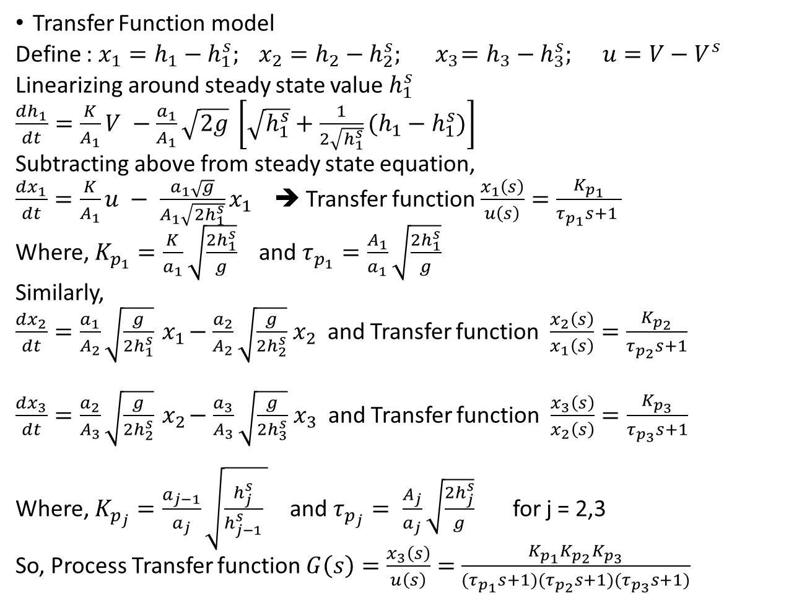
Transfer Function model
Define : $x_{1}=h_{1}−h_{1}^{s}; x_{2}=h_{2}−h_{2}^{s};{ x}_{3}=h_{3}−h_{3}^{s}; u=V−V^{s}$
Linearizing around steady state value $h_{1}^{s}$
$\frac{dh_{1}}{dt}=\frac{K}{A_{1}}V −\frac{a_{1}}{A_{1}}\sqrt{2g} \left[\sqrt{h_{1}^{s}}+\frac{1}{2\sqrt{h_{1}^{s}}}(h_{1}−h_{1}^{s})\right]$
Subtracting above from steady state equation,
$\frac{dx_{1}}{dt}=\frac{K}{A_{1}}u − \frac{a_{1}\sqrt{g}}{A_{1}\sqrt{{2h}_{1}^{s}}}x_{1}$ ➔ Transfer function $\frac{x_{1}\left(s\right)}{u\left(s\right)}=\frac{K_{p_{1}}}{τ_{p_{1}}s+1 }$
Where, $K_{p_{1}}=\frac{K}{a_{1}}\sqrt{\frac{2h_{1}^{s}}{g}}$ and $τ_{p_{1}}=\frac{A_{1}}{a_{1}}\sqrt{\frac{2h_{1}^{s}}{g}}$
Similarly,
$\frac{dx_{2}}{dt}=\frac{a_{1}}{A_{2}}\sqrt{\frac{g}{2h_{1}^{s}}}{ x}_{1}−\frac{a_{2}}{A_{2}}\sqrt{\frac{g}{2h_{2}^{s}}}{ x}_{2}$ and Transfer function $\frac{x_{2}\left(s\right)}{x_{1}\left(s\right)}=\frac{K_{p_{2}}}{τ_{p_{2}}s+1}$
$\frac{dx_{3}}{dt}=\frac{a_{2}}{A_{3}}\sqrt{\frac{g}{2h_{2}^{s}}}{ x}_{2}−\frac{a_{3}}{A_{3}}\sqrt{\frac{g}{2h_{3}^{s}}}{ x}_{3}$ and Transfer function $\frac{x_{3}\left(s\right)}{x_{2}\left(s\right)}=\frac{K_{p_{3}}}{τ_{p_{3}}s+1}$
Where, $K_{p_{j}}=\frac{a_{j−1}}{a_{j}}\sqrt{\frac{h_{j}^{s}}{h_{j−1}^{s}} }$ and $τ_{p_{j}}= \frac{A_{j}}{a_{j}}\sqrt{\frac{2h_{j}^{s}}{g}}$ for j = 2,3
So, Process Transfer function $G\left(s\right)=\frac{x_{3}\left(s\right)}{u\left(s\right)}=$ $\frac{{K_{p_{1}}K}_{p_{2}}K_{p_{3}}}{(τ_{p_{1}}s+1)(τ_{p_{2}}s+1)(τ_{p_{3}}s+1)}$

Slide 10
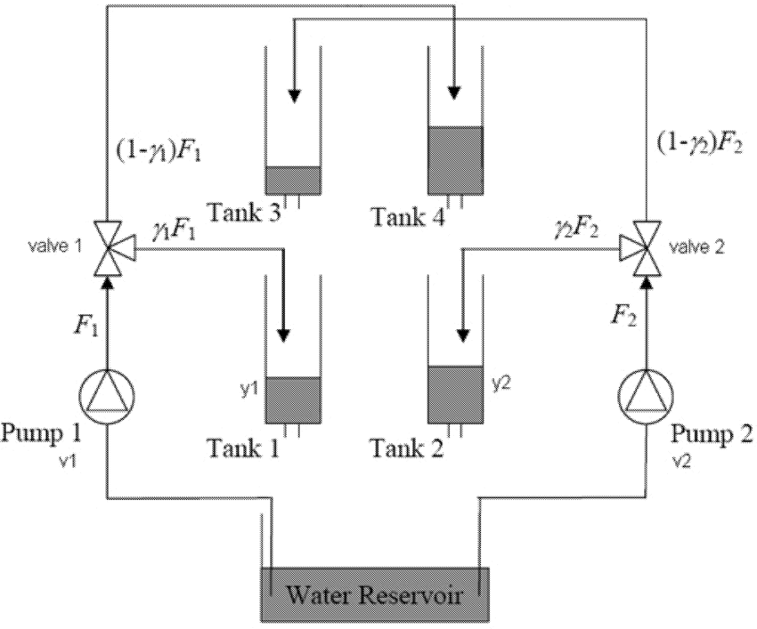
Quadruple Tank problem

Slide 11
Quadruple Tank problem
Control Objective
Both the levels of tank1 and tank2 should be controlled by manipulating voltages to the pumps.
Data for simulation:
A₁, A₃ = 28 cm²
A₂, A₄ = 32 cm²
a₁, a₃ = 0.071 cm²
a₂, a₄ = 0.057 cm²
k₁, k₂ = 3.33, 3.35
v₁, v₂ = 3.0, 3.0
γ₁, γ₂ = 0.7, 0.6

Slide 12
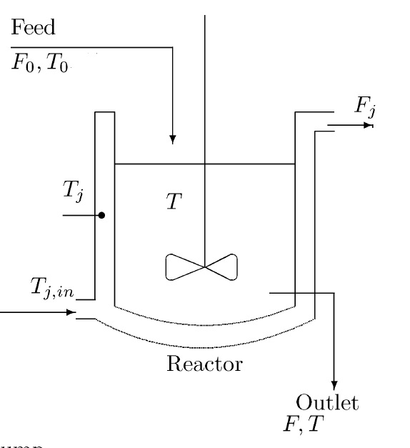
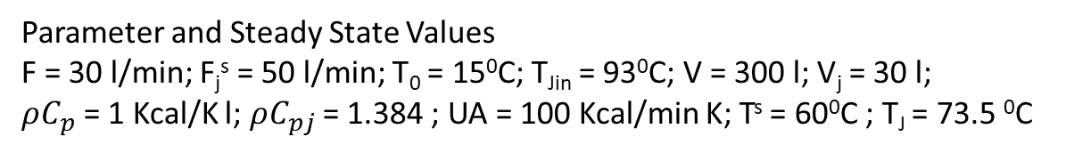
Jacketed heated stirred tank
Assumptions:
Constant hold-up in tank and jacket
Constant heat capacities and densities
Incompressible flow
Parameter and Steady State Values
F = 30 l/min; F_{j}^{s} = 50 l/min; T₀ = 15⁰C; T_{Jin} = 93⁰C; V = 300 l; V_{j} = 30 l;
$ρC_{p}$ = 1 Kcal/K l; $ρC_{pj}$ = 1.384 ; UA = 100 Kcal/min K; T^{s} = 60⁰C ; T_{J} = 73.5 ⁰C

Slide 13
Continuous Stirred Tank Reactor
F_{in}
F_{out}
Assumption:
Exit Condition = Reactor Condition
Isothermal Reaction
Constant volume, i.e, F_{in} = F_{out}=F
Only reactant A in feed is consumed, i.e, other reactant is in large excess. No product in the feed

Slide 14
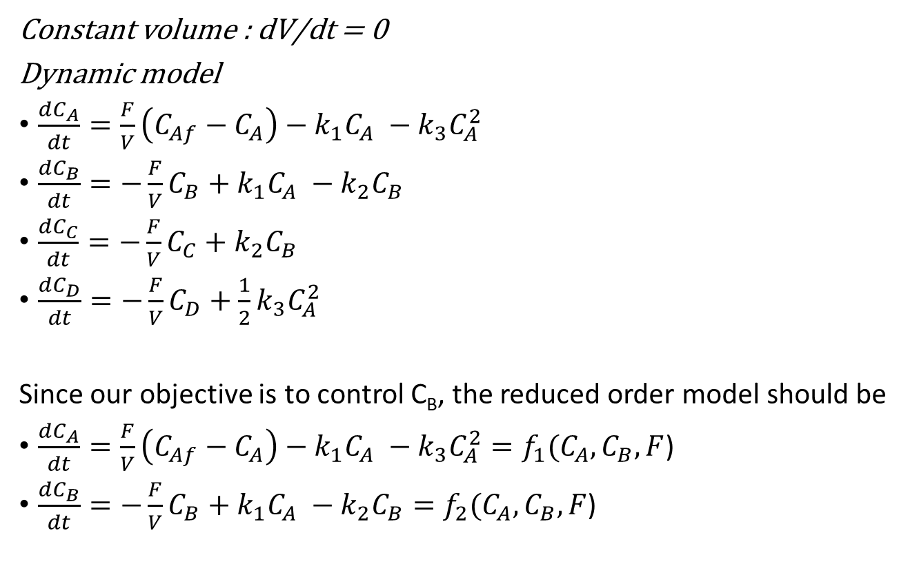
Continuous Stirred Tank Reactor
Constant volume : dV/dt = 0
Dynamic model
$\frac{dC_{A}}{dt}=\frac{F}{V}\left(C_{Af}−C_{A}\right)−k_{1}C_{A} −k_{3}C_{A}^{2}$
$\frac{dC_{B}}{dt}=−\frac{F}{V}C_{B}+k_{1}C_{A} −k_{2}C_{B}$
$\frac{dC_{C}}{dt}=−\frac{F}{V}C_{C}+k_{2}C_{B}$
$\frac{dC_{D}}{dt}=−\frac{F}{V}C_{D}+{\frac{1}{2}k}_{3}C_{A}^{2}$
Since our objective is to control C_{B}, the reduced order model should be
$\frac{dC_{A}}{dt}=\frac{F}{V}\left(C_{Af}−C_{A}\right)−k_{1}C_{A} −k_{3}C_{A}^{2}=f_{1}(C_{A},C_{B},F$)
$\frac{dC_{B}}{dt}=−\frac{F}{V}C_{B}+k_{1}C_{A} −k_{2}C_{B}=f_{2}(C_{A},C_{B},F$)
Data for the CSTR
V = 1 l
F = 78 l/h
C_{Af} = 10 mol/l
kl = 50 h-1
k2 = 100 h-1
k3 = 10 l.mol-1.h-1

Slide 15
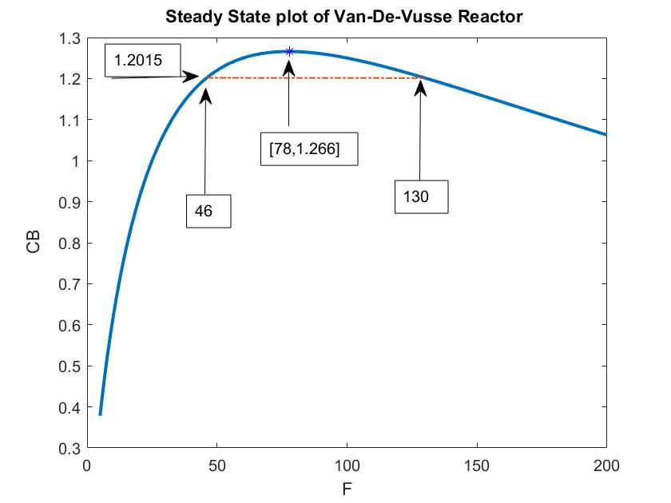
What is the Process Gain at these points ?

Slide 16
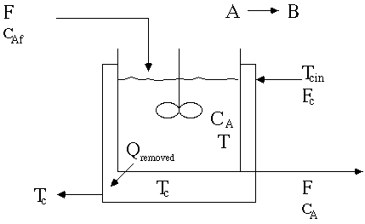
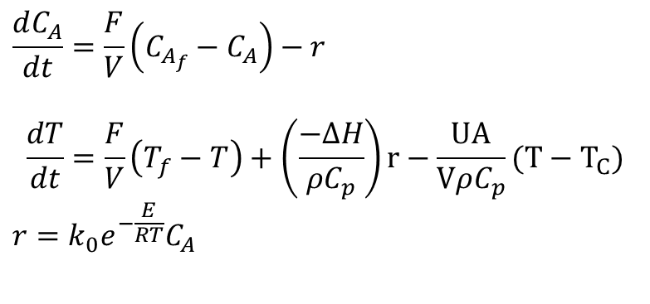
Non-Isothermal Jacketed CSTR
$$\frac{dC_{A}}{dt}=\frac{F}{V}\left(C_{A_{f}}−C_{A}\right)−r$$
$$\frac{dT}{dt}=\frac{F}{V}\left(T_{f}−T\right)+\left(\frac{−∆H}{ρC_{p}}\right)r−\frac{UA}{VρC_{p}}(T−T_{C})$$
$$r=k_{0}e^{−\frac{E}{RT}}C_{A}$$
parameter | case 1 | case 2 | case 3
F/V, hr-1 | 1 | 1 | 1
k₀, hr-1 | 14,825*3600 | 9,703*3600 | 18,194*3600
(−ΔH), kcal/kgmol | 5215 | 5960 | 8195
E, kcal/kgmol | 11,843 | 11,843 | 11,843
ρcp, kcal/(m^{3 o}C) | 500 | 500 | 500
T_{f}, ºC | 25 | 25 | 25
C_{Af}, kgmol/m3 | 10 | 10 | 10
UA/V, kcal/(m^{3 o}C hr) | 250 | 150 | 750
T_{C}, ºC | 25 | 25 | 25

Slide 17
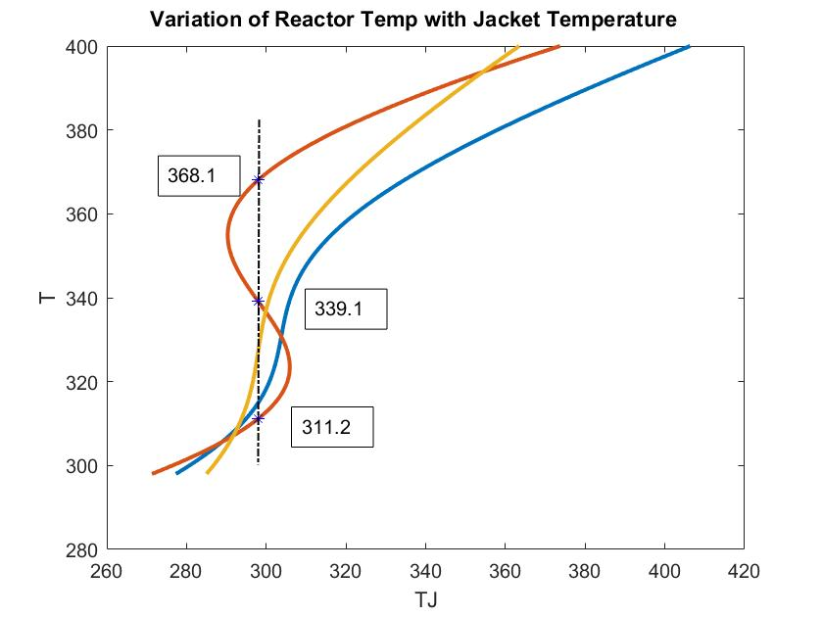
Case 2
Case 1
Steady State for case 2
C_{A} T
1 8.564 311.2
2 5.518 339.1
3 2.359 368.1

Slide 18
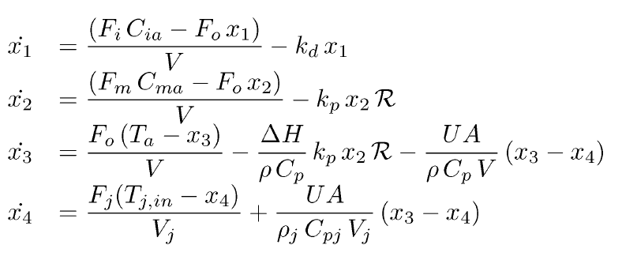
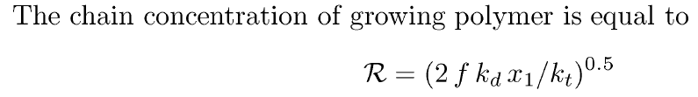
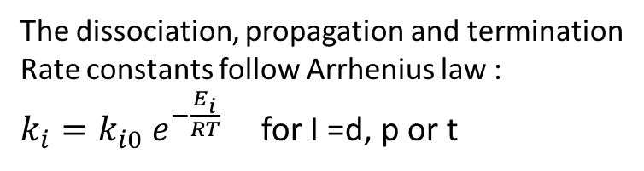
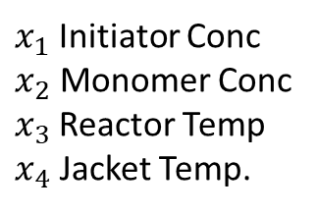
Styrene Polymerization Reactor
$x_{1}$Initiator Conc
$x_{2}$ Monomer Conc
$x_{3}$Reactor Temp
$x_{4}$ Jacket Temp.
The dissociation, propagation and termination
Rate constants follow Arrhenius law :
$k_{i}=k_{i0} e^{−\frac{E_{i}}{RT}}$ for I =d, p or t

Slide 19
Steady State Heat Power vs Reactor Temperature
2
3
1

Slide 20
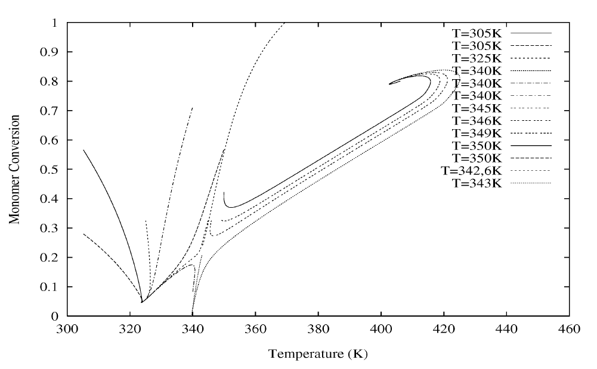
Phase Portrait
3
1
2 (unstable)

