Slide 1
Process Dynamics & Control

Slide 2
Development of Mathematical Model
Motivation:
Develop understanding of process
Build a mathematical hypothesis of process mechanisms
Match observed process behavior
useful in design, optimization and control of process

Slide 3
Development of Mathematical Model
Motivation:
Develop understanding of process
Build a mathematical hypothesis of process mechanisms
Match observed process behavior
useful in design, optimization and control of process
Control:
Interested in description of process dynamics
Dynamic model is used to predict how process responds to given input
Tells us how to react

Slide 4
Development of Mathematical Model
Mathematical Modeling of a process require
Understanding of the process
Writing conservation balance for Mass, Momentum and Energy
Writing closure equations, i.e, constitutive relationships defining equilibrium and rate parameters
Devising solution technique

Slide 5
What kind of model do we need?
Dynamic vs. Steady-state
Steady-state
Variables not a function of time
useful for design calculation

Slide 6
What kind of model do we need?
Dynamic vs. Steady-state
Steady-state
Variables not a function of time
useful for design calculation
Dynamic
Variables are a function of time
Control requires dynamic model

Slide 7
What kind of model do we need?
Experimental vs Theoretical
Experimental
Derived from tests performed on actual process
Simpler model forms
Easier to manipulate

Slide 8
What kind of model do we need?
Experimental vs Theoretical
Experimental
Derived from tests performed on actual process
Simpler model forms
Easier to manipulate
Theoretical
Application of fundamental laws of physics and chemistry
more complex but provides understanding
Required in design stages

Slide 9
What kind of model do we need?
Empirical vs. Mechanistic models
Empirical Models
only local representation of the process (no extrapolation)
model only as good as the data
do not rely on underlying mechanisms
Fit specific function to match process

Slide 10
What kind of model do we need?
Empirical vs. Mechanistic models
Empirical Models
only local representation of the process (no extrapolation)
model only as good as the data
do not rely on underlying mechanisms
Fit specific function to match process
Mechanistic Models
Rely on our understanding of a process
Derived from first principles
Observing laws of conservation of
Mass
Energy
Momentum
Useful for simulation and exploration of new operating conditions
May contain unknown constants that must be estimated

Slide 11
What kind of model do we need?
Linear vs Nonlinear
Linear
basis for most industrial control
simpler model form, easy to identify
easy to design controller
poor prediction, adequate control

Slide 12
What kind of model do we need?
Linear vs Nonlinear
Linear
basis for most industrial control
simpler model form, easy to identify
easy to design controller
poor prediction, adequate control
Nonlinear
Reality
more complex and difficult to identify
need state-of-the-art controller design techniques to do the job
better prediction and control

Slide 13
What kind of model do we need?
In existing processes, we rely on
Dynamic models obtained from experiments
Usually of an empirical nature
Linear
In new applications (or difficult problems)
Focus on mechanistic modeling
Dynamic models derived from theory
Nonlinear

Slide 14
General modeling procedure
Identify modeling objectives
end use of model (e.g. control)
Identify fundamental quantities of interest
Mass, Energy and/or Momentum
Identify boundaries
Apply fundamental physical and chemical laws
Mass, Energy and/or Momentum balances
Make appropriate assumptions (Simplify)
ideality (e.g. isothermal, adiabatic, ideal gas, no friction, incompressible flow, etc,…)
Write down energy, mass and momentum balances
develop the model equations

Slide 15
General modeling procedure
Check model consistency
do we have more unknowns than equations
Determine unknown constants
e.g. friction coefficients, fluid density and viscosity
Solve model equations
typically nonlinear ordinary (or partial) differential equations
initial value problems
Check the validity of the model
compare to process behavior

Slide 16
Benchmark Systems to be used for the course
Tank Level System
3 tank in series
Quadruple Tank
Continuous Stirred Tank Heater
Continuous Stirred Tank Reactor system
Isothermal Reactor (Van de Vusse reaction)
Non-isothermal Reactor
Polymerization Reactor
Distillation Column
MATLAB / SIMULINK model will be developed based on nonlinear model

Slide 17
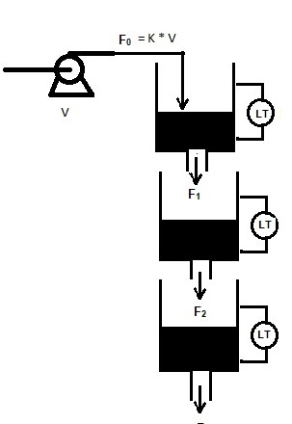
Mathematical Model of tank level system
Control objective:
Control the 3rd tank level by manipulating pump voltage V, where F₀ = K V
Add q₂ input flow on the tanks 2 and set q₂ as manipulated variable.
Which one is difficult to control?
Data for Simulation in Matlab/Simulink
A₁, A₃ = 28 cm² A₂ = 32 cm² V^{s} = 3 V
a₁ = 0.06725 cm² a₂ = 0.05683 cm² a₃ = 0.07089 cm² K=3.14

Slide 18
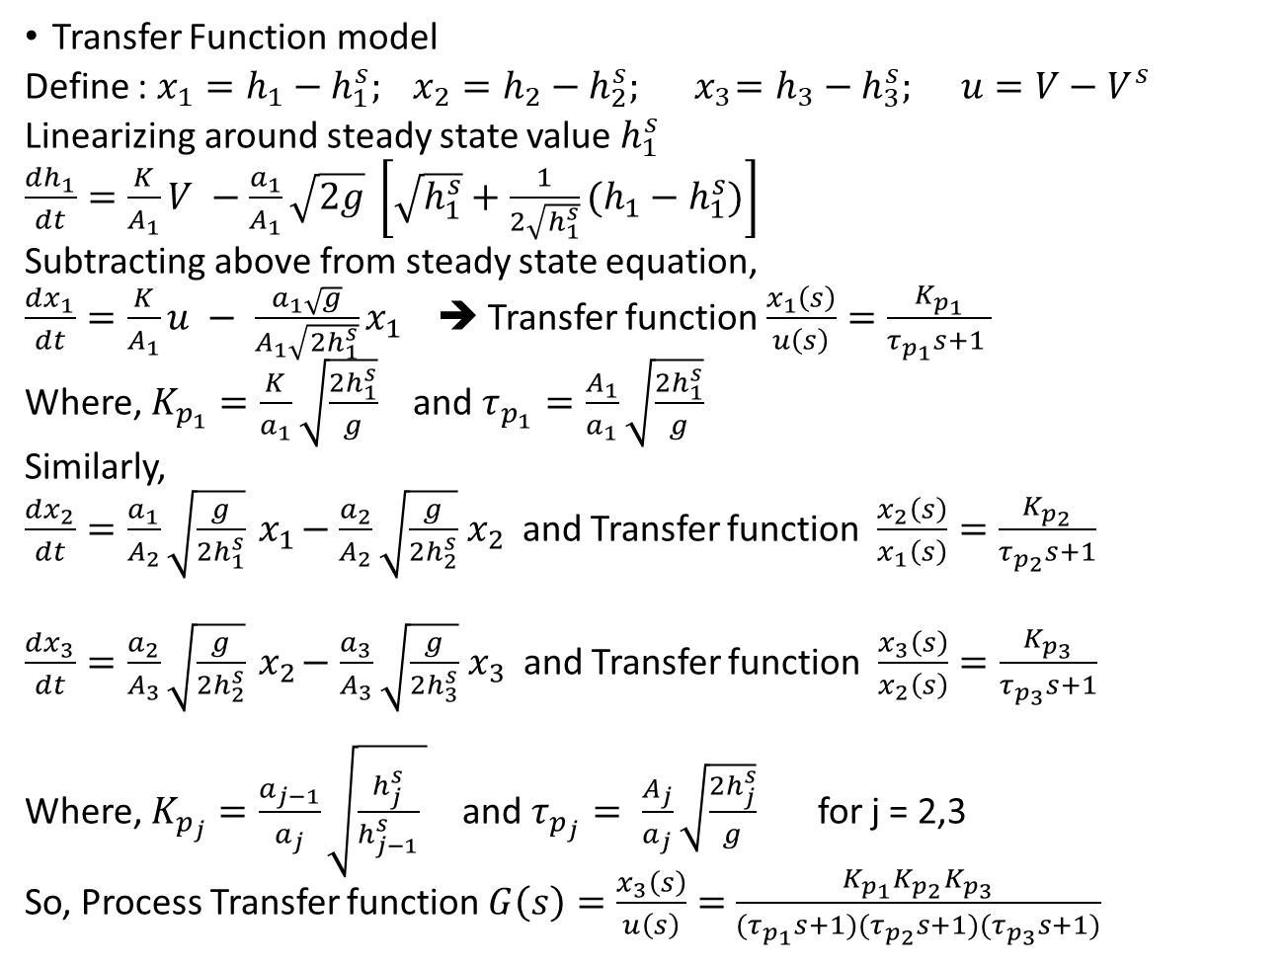
Transfer Function model
Define : $x_{1}=h_{1}−h_{1}^{s}; x_{2}=h_{2}−h_{2}^{s};{ x}_{3}=h_{3}−h_{3}^{s}; u=V−V^{s}$
Linearizing around steady state value $h_{1}^{s}$
$\frac{dh_{1}}{dt}=\frac{K}{A_{1}}V −\frac{a_{1}}{A_{1}}\sqrt{2g} \left[\sqrt{h_{1}^{s}}+\frac{1}{2\sqrt{h_{1}^{s}}}(h_{1}−h_{1}^{s})\right]$
Subtracting above from steady state equation,
$\frac{dx_{1}}{dt}=\frac{K}{A_{1}}u − \frac{a_{1}\sqrt{g}}{A_{1}\sqrt{{2h}_{1}^{s}}}x_{1}$ ➔ Transfer function $\frac{x_{1}\left(s\right)}{u\left(s\right)}=\frac{K_{p_{1}}}{τ_{p_{1}}s+1 }$
Where, $K_{p_{1}}=\frac{K}{a_{1}}\sqrt{\frac{2h_{1}^{s}}{g}}$ and $τ_{p_{1}}=\frac{A_{1}}{a_{1}}\sqrt{\frac{2h_{1}^{s}}{g}}$
Similarly,
$\frac{dx_{2}}{dt}=\frac{a_{1}}{A_{2}}\sqrt{\frac{g}{2h_{1}^{s}}}{ x}_{1}−\frac{a_{2}}{A_{2}}\sqrt{\frac{g}{2h_{2}^{s}}}{ x}_{2}$ and Transfer function $\frac{x_{2}\left(s\right)}{x_{1}\left(s\right)}=\frac{K_{p_{2}}}{τ_{p_{2}}s+1}$
$\frac{dx_{3}}{dt}=\frac{a_{2}}{A_{3}}\sqrt{\frac{g}{2h_{2}^{s}}}{ x}_{2}−\frac{a_{3}}{A_{3}}\sqrt{\frac{g}{2h_{3}^{s}}}{ x}_{3}$ and Transfer function $\frac{x_{3}\left(s\right)}{x_{2}\left(s\right)}=\frac{K_{p_{3}}}{τ_{p_{3}}s+1}$
Where, $K_{p_{j}}=\frac{a_{j−1}}{a_{j}}\sqrt{\frac{h_{j}^{s}}{h_{j−1}^{s}} }$ and $τ_{p_{j}}= \frac{A_{j}}{a_{j}}\sqrt{\frac{2h_{j}^{s}}{g}}$ for j = 2,3
So, Process Transfer function $G\left(s\right)=\frac{x_{3}\left(s\right)}{u\left(s\right)}=$ $\frac{{K_{p_{1}}K}_{p_{2}}K_{p_{3}}}{(τ_{p_{1}}s+1)(τ_{p_{2}}s+1)(τ_{p_{3}}s+1)}$

Slide 19
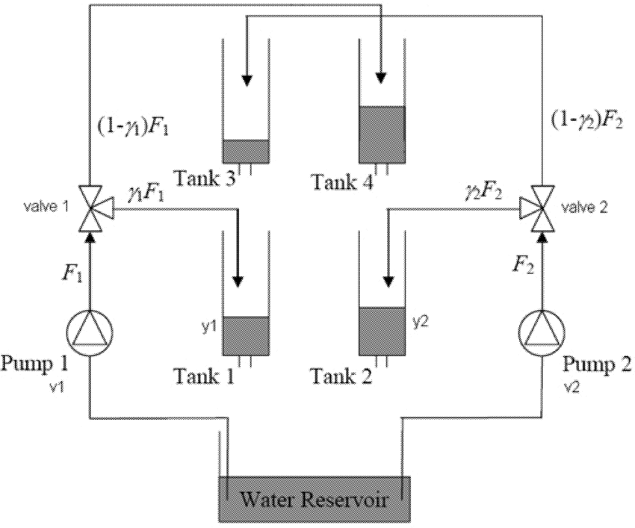
Quadruple Tank problem

Slide 20
Quadruple Tank problem
Control Objective
Both the levels of tank1 and tank2 should be controlled by manipulating voltages to the pumps.
Data for simulation:
A₁, A₃ = 28 cm²
A₂, A₄ = 32 cm²
a₁, a₃ = 0.071 cm²
a₂, a₄ = 0.057 cm²
k₁, k₂ = 3.33, 3.35
v₁, v₂ = 3.0, 3.0
γ₁, γ₂ = 0.7, 0.6

Slide 21
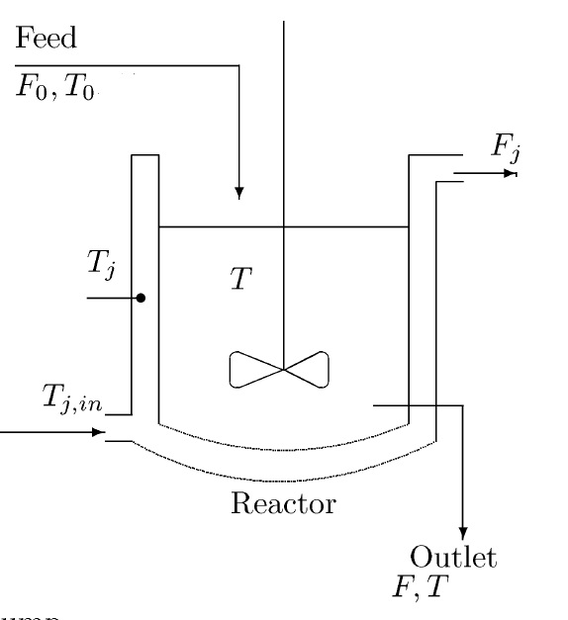
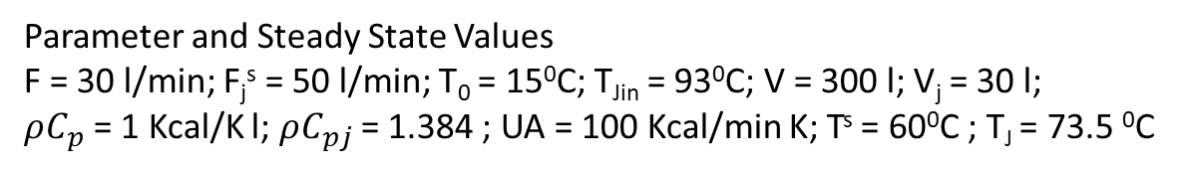
Jacketed heated stirred tank
Assumptions:
Constant hold-up in tank and jacket
Constant heat capacities and densities
Incompressible flow
Parameter and Steady State Values
F = 30 l/min; F_{j}^{s} = 50 l/min; T₀ = 15⁰C; T_{Jin} = 93⁰C; V = 300 l; V_{j} = 30 l;
$ρC_{p}$ = 1 Kcal/K l; $ρC_{pj}$ = 1.384 ; UA = 100 Kcal/min K; T^{s} = 60⁰C ; T_{J} = 73.5 ⁰C

Slide 22
Continuous Stirred Tank Reactor
F_{in}
F_{out}
Assumption:
Exit Condition = Reactor Condition
Isothermal Reaction
Constant volume, i.e, F_{in} = F_{out}=F
Only reactant A in feed is consumed, i.e, other reactant is in large excess. No product in the feed

Slide 23
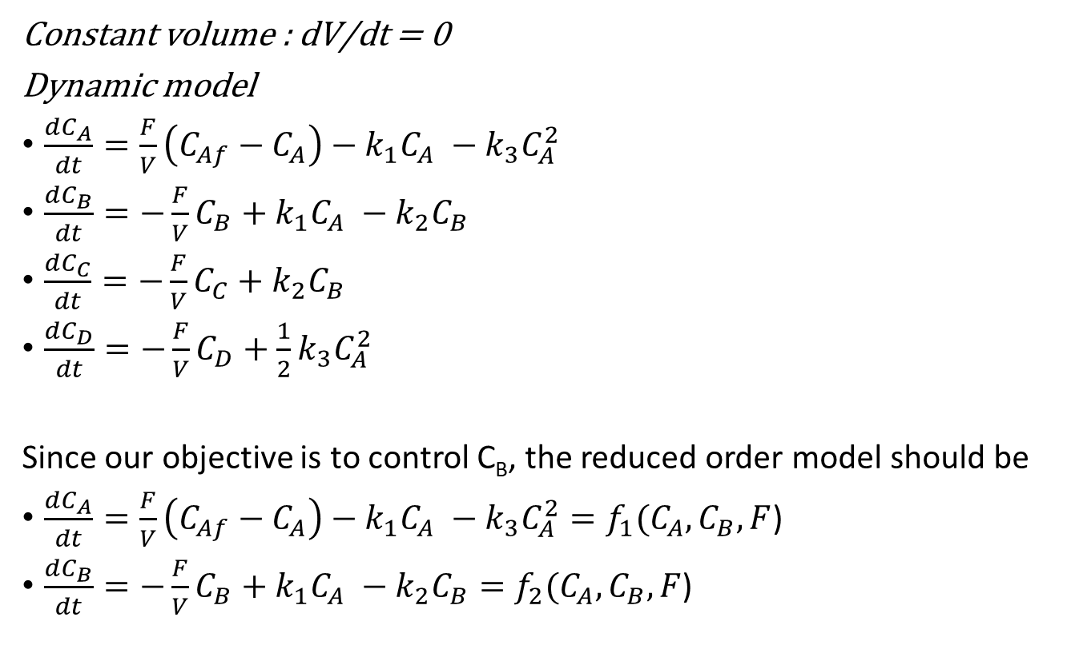
Continuous Stirred Tank Reactor
Constant volume : dV/dt = 0
Dynamic model
$\frac{dC_{A}}{dt}=\frac{F}{V}\left(C_{Af}−C_{A}\right)−k_{1}C_{A} −k_{3}C_{A}^{2}$
$\frac{dC_{B}}{dt}=−\frac{F}{V}C_{B}+k_{1}C_{A} −k_{2}C_{B}$
$\frac{dC_{C}}{dt}=−\frac{F}{V}C_{C}+k_{2}C_{B}$
$\frac{dC_{D}}{dt}=−\frac{F}{V}C_{D}+{\frac{1}{2}k}_{3}C_{A}^{2}$
Since our objective is to control C_{B}, the reduced order model should be
$\frac{dC_{A}}{dt}=\frac{F}{V}\left(C_{Af}−C_{A}\right)−k_{1}C_{A} −k_{3}C_{A}^{2}=f_{1}(C_{A},C_{B},F$)
$\frac{dC_{B}}{dt}=−\frac{F}{V}C_{B}+k_{1}C_{A} −k_{2}C_{B}=f_{2}(C_{A},C_{B},F$)
Data for the CSTR
V = 1 l
F = 78 l/h
C_{Af} = 10 mol/l
kl = 50 h-1
k2 = 100 h-1
k3 = 10 l.mol-1.h-1

Slide 24
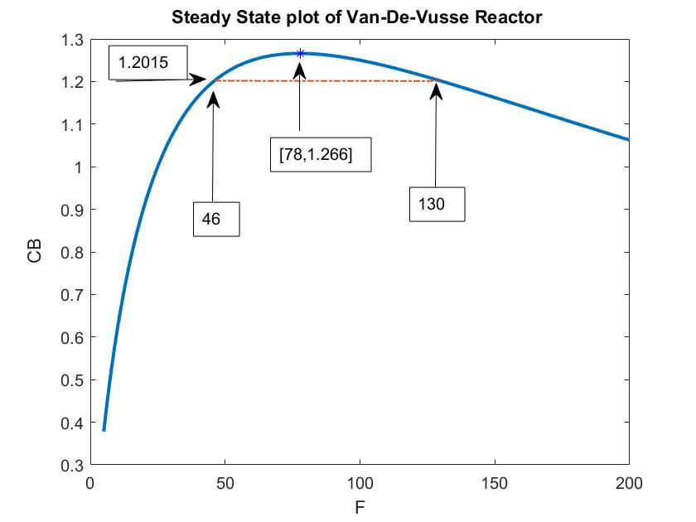
What is the Process Gain at these points ?

Slide 25
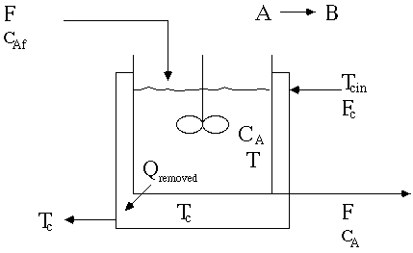
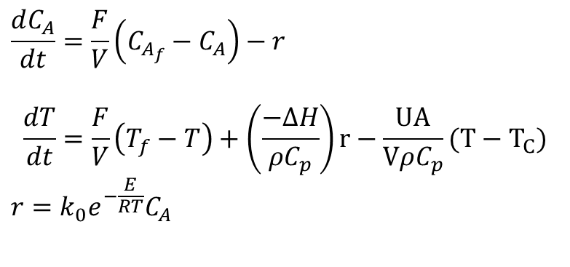
Non-Isothermal Jacketed CSTR
$$\frac{dC_{A}}{dt}=\frac{F}{V}\left(C_{A_{f}}−C_{A}\right)−r$$
$$\frac{dT}{dt}=\frac{F}{V}\left(T_{f}−T\right)+\left(\frac{−∆H}{ρC_{p}}\right)r−\frac{UA}{VρC_{p}}(T−T_{C})$$
$$r=k_{0}e^{−\frac{E}{RT}}C_{A}$$
parameter | case 1 | case 2 | case 3
F/V, hr-1 | 1 | 1 | 1
k₀, hr-1 | 14,825*3600 | 9,703*3600 | 18,194*3600
(−ΔH), kcal/kgmol | 5215 | 5960 | 8195
E, kcal/kgmol | 11,843 | 11,843 | 11,843
ρcp, kcal/(m^{3 o}C) | 500 | 500 | 500
T_{f}, ºC | 25 | 25 | 25
C_{Af}, kgmol/m3 | 10 | 10 | 10
UA/V, kcal/(m^{3 o}C hr) | 250 | 150 | 750
T_{C}, ºC | 25 | 25 | 25

Slide 26
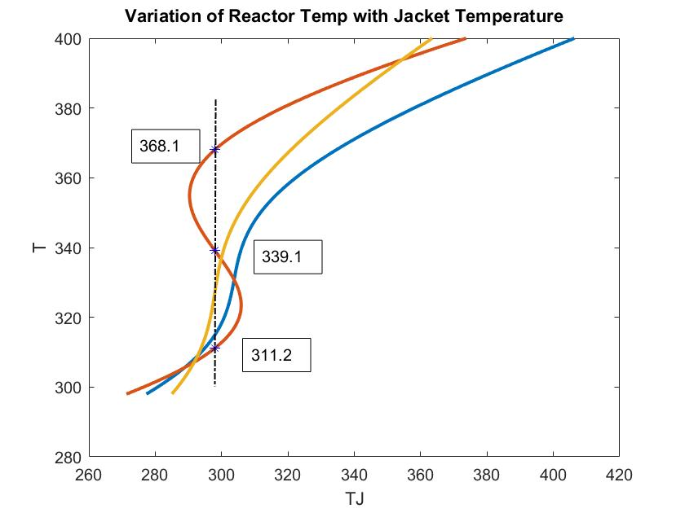
Case 2
Case 1
Steady State for case 2
C_{A} T
1 8.564 311.2
2 5.518 339.1
3 2.359 368.1

Slide 27
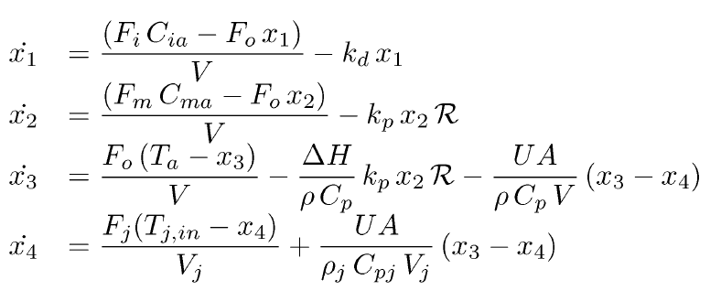
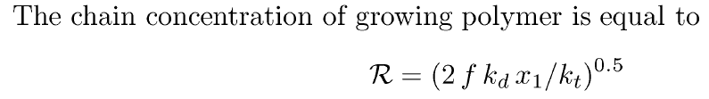
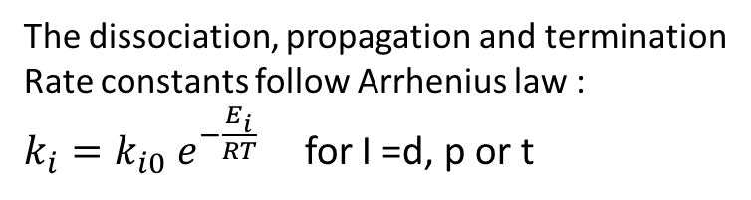
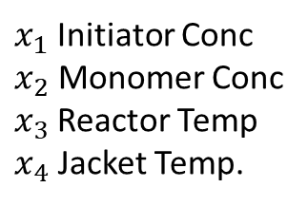
Styrene Polymerization Reactor
$x_{1}$Initiator Conc
$x_{2}$ Monomer Conc
$x_{3}$Reactor Temp
$x_{4}$ Jacket Temp.
The dissociation, propagation and termination
Rate constants follow Arrhenius law :
$k_{i}=k_{i0} e^{−\frac{E_{i}}{RT}}$ for I =d, p or t

Slide 28
Steady State Heat Power vs Reactor Temperature
2
3
1

Slide 29
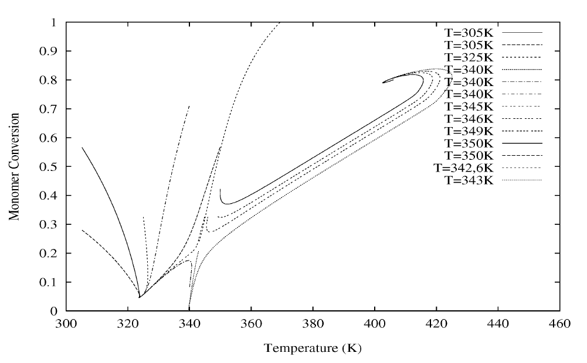
Phase Portrait
3
1
2 (unstable)

