Slide 1
Process Dynamics & Control

Slide 2
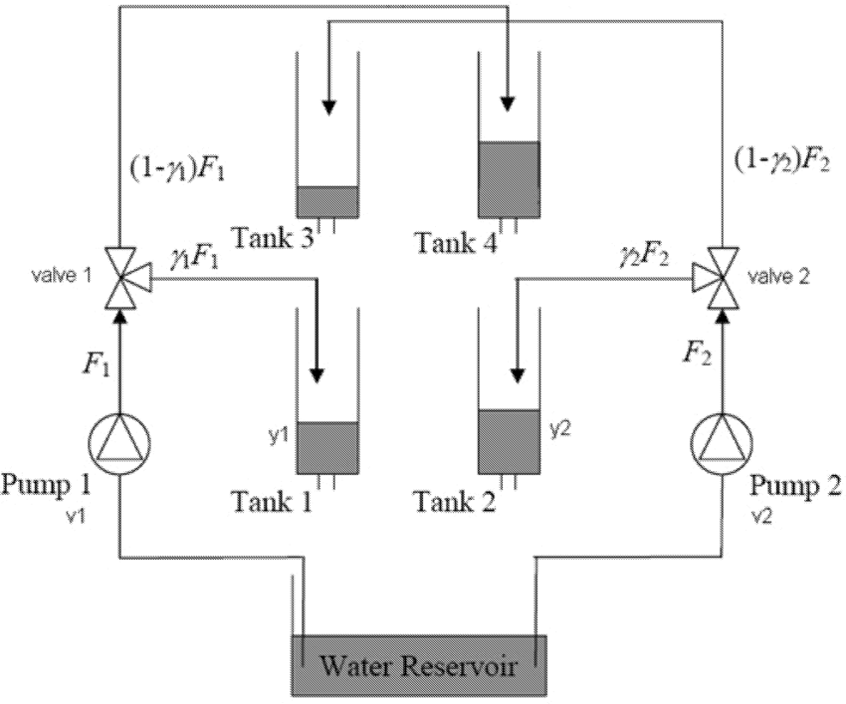
Quadruple Tank problem
Control Objective
Both the levels of tank1 and tank2 should be controlled by manipulating voltages to the pumps.

Slide 3
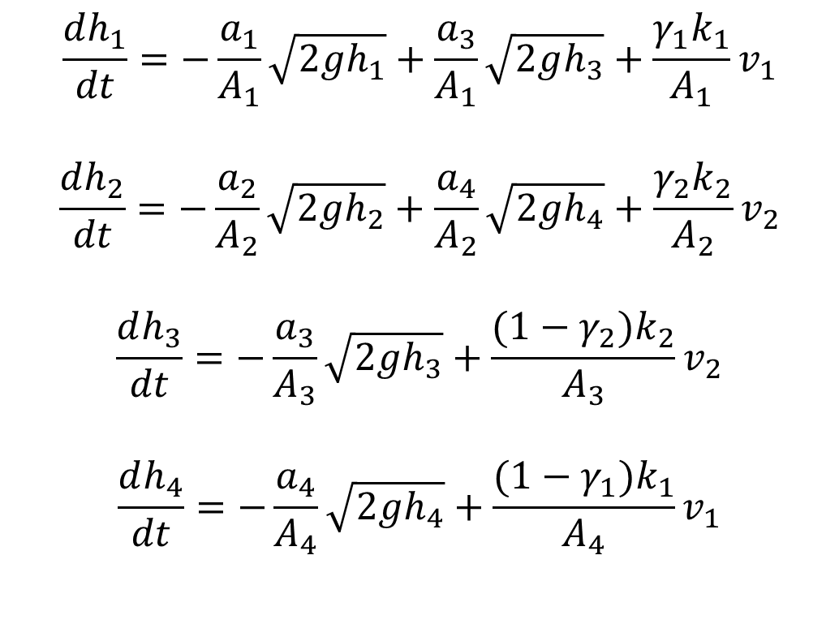
Quadruple Tank problem (Dynamic Model)
$$\frac{dh_{1}}{dt}=−\frac{a_{1}}{A_{1}}\sqrt{2gh_{1}}+\frac{a_{3}}{A_{1}}\sqrt{2gh_{3}}+\frac{γ_{1}k_{1}}{A_{1}}v_{1}$$
$$\frac{dh_{2}}{dt}=−\frac{a_{2}}{A_{2}}\sqrt{2gh_{2}}+\frac{a_{4}}{A_{2}}\sqrt{2gh_{4}}+\frac{γ_{2}k_{2}}{A_{2}}v_{2}$$
$$\frac{dh_{3}}{dt}=−\frac{a_{3}}{A_{3}}\sqrt{2gh_{3}}+\frac{(1−γ_{2})k_{2}}{A_{3}}v_{2}$$
$$\frac{dh_{4}}{dt}=−\frac{a_{4}}{A_{4}}\sqrt{2gh_{4}}+\frac{(1−γ_{1})k_{1}}{A_{4}}v_{1}$$
Data for simulation:
A₁, A₃ = 28 cm²
A₂, A₄ = 32 cm²
a₁, a₃ = 0.071 cm²
a₂, a₄ = 0.057 cm²
k₁, k₂ = 3.33, 3.35
v₁, v₂ = 3.0, 3.0
γ₁, γ₂ = 0.7, 0.6

Slide 4
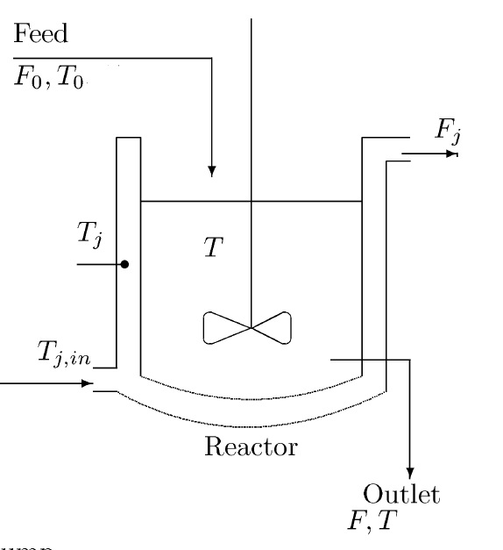

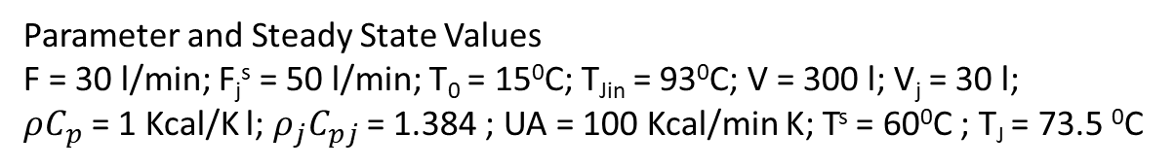
Jacketed heated stirred tank
Assumptions:
Constant hold-up in tank and jacket
Constant heat capacities and densities
Incompressible flow
$$\frac{dV}{dt}=F_{0}−F=0$$
$$\frac{dT}{dt}=\frac{F}{V}(T_{0}−T)+\frac{UA}{ρC_{P}V}(T_{j}−T)$$
$$\frac{dT_{j}}{dt}=\frac{F_{j}}{V_{j}}(T_{ji}−T_{j})−\frac{UA}{ρ_{j}C_{Pj}V_{j}}(T_{j}−T)$$
Control Objective
Control T by manipulating F_{j}
Parameter and Steady State Values
F = 30 l/min; F_{j}^{s} = 50 l/min; T₀ = 15⁰C; T_{Jin} = 93⁰C; V = 300 l; V_{j} = 30 l;
$ρC_{p}$ = 1 Kcal/K l; $ρ_{j}C_{pj}$ = 1.384 ; UA = 100 Kcal/min K; T^{s} = 60⁰C ; T_{J} = 73.5 ⁰C

Slide 5
Continuous Stirred Tank Reactor
F_{in}
F_{out}
Assumption:
Exit Condition = Reactor Condition
Isothermal Reaction
Constant volume, i.e, F_{in} = F_{out}=F
Only reactant A in feed is consumed, i.e, other reactant is in large excess. No product in the feed

Slide 6
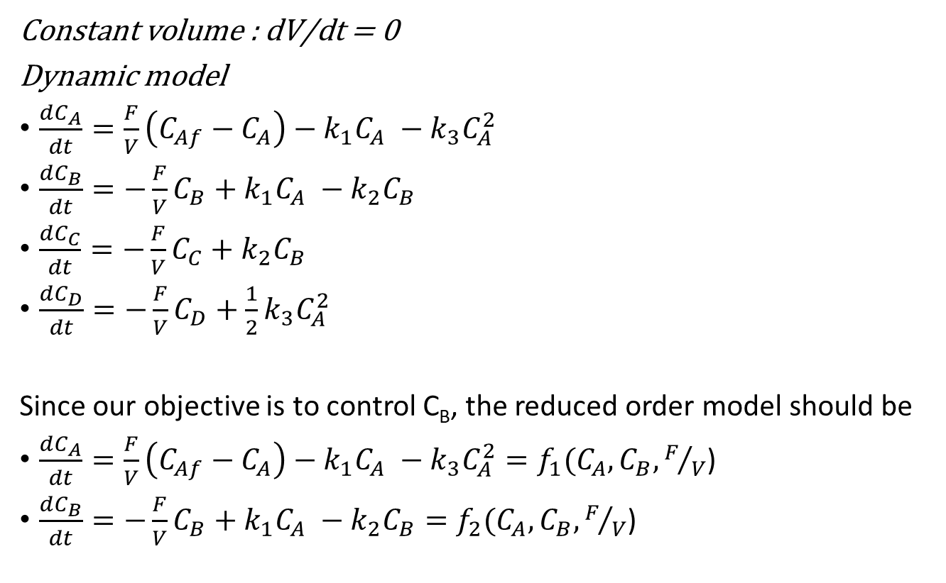
Continuous Stirred Tank Reactor (model)
Constant volume : dV/dt = 0
Dynamic model
$\frac{dC_{A}}{dt}=\frac{F}{V}\left(C_{Af}−C_{A}\right)−k_{1}C_{A} −k_{3}C_{A}^{2}$
$\frac{dC_{B}}{dt}=−\frac{F}{V}C_{B}+k_{1}C_{A} −k_{2}C_{B}$
$\frac{dC_{C}}{dt}=−\frac{F}{V}C_{C}+k_{2}C_{B}$
$\frac{dC_{D}}{dt}=−\frac{F}{V}C_{D}+{\frac{1}{2}k}_{3}C_{A}^{2}$
Since our objective is to control C_{B}, the reduced order model should be
$\frac{dC_{A}}{dt}=\frac{F}{V}\left(C_{Af}−C_{A}\right)−k_{1}C_{A} −k_{3}C_{A}^{2}=f_{1}(C_{A},C_{B},F/V$)
$\frac{dC_{B}}{dt}=−\frac{F}{V}C_{B}+k_{1}C_{A} −k_{2}C_{B}=f_{2}(C_{A},C_{B},F/V$)
Data for the CSTR
k₁ = 5/6; k₂ = 5/3
K₃ = 1/6; C_{af} = 10

Slide 7
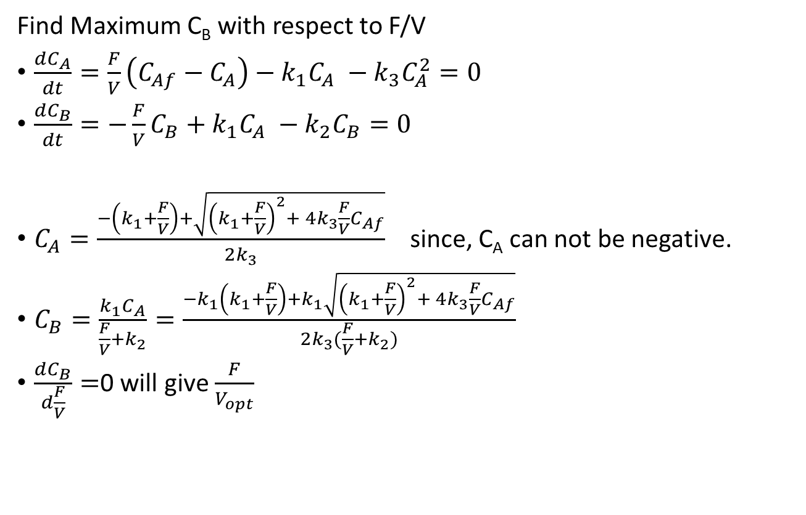
Continuous Stirred Tank Reactor
Find Maximum C_{B} with respect to F/V
$\frac{dC_{A}}{dt}=\frac{F}{V}\left(C_{Af}−C_{A}\right)−k_{1}C_{A} −k_{3}C_{A}^{2}=0$
$\frac{dC_{B}}{dt}=−\frac{F}{V}C_{B}+k_{1}C_{A} −k_{2}C_{B}=0$
$C_{A}=\frac{−\left(k_{1}+\frac{F}{V}\right)+\sqrt{{\left(k_{1}+\frac{F}{V}\right)}^{2}+ 4k_{3}\frac{F}{V}C_{Af}}}{2k_{3}}$ since, C_{A} can not be negative.
$C_{B}=\frac{k_{1}C_{A}}{\frac{F}{V}+k_{2}}=\frac{−k_{1}\left(k_{1}+\frac{F}{V}\right)+k_{1}\sqrt{{\left(k_{1}+\frac{F}{V}\right)}^{2}+ 4k_{3}\frac{F}{V}C_{Af}}}{2k_{3}(\frac{F}{V}+k_{2})}$
$\frac{dC_{B}}{d\frac{F}{V}}=$0 will give $\frac{F}{V_{opt}}$

Slide 8
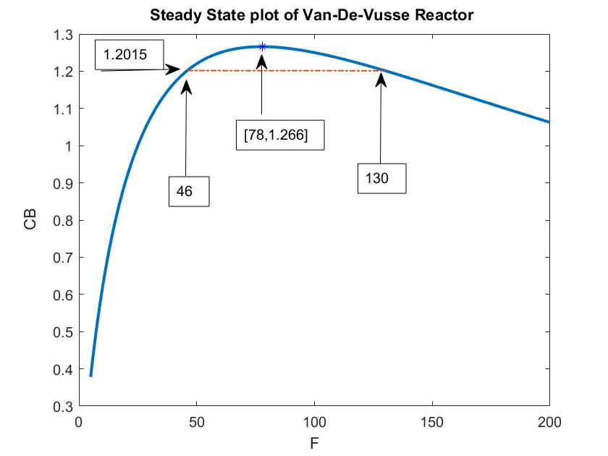
What is the Process Gain at these points ?

Slide 9
Biochemical Reactor
Substrate
F, x_{2f}
Cells /
Biomass
F, x₁, x₂
x₁ is mass of cells per unit volume in the reactor
x₂ is mass of substrate per unit volume in the reactor
x_{2f} is mass of substrate per unit volume in the feed stream
Assumption:
Exit Condition = Reactor Condition
Isothermal Reaction
Constant volume, i.e, F_{in} = F_{out}=F
No cell/biomass is present in the feed stream.

Slide 10
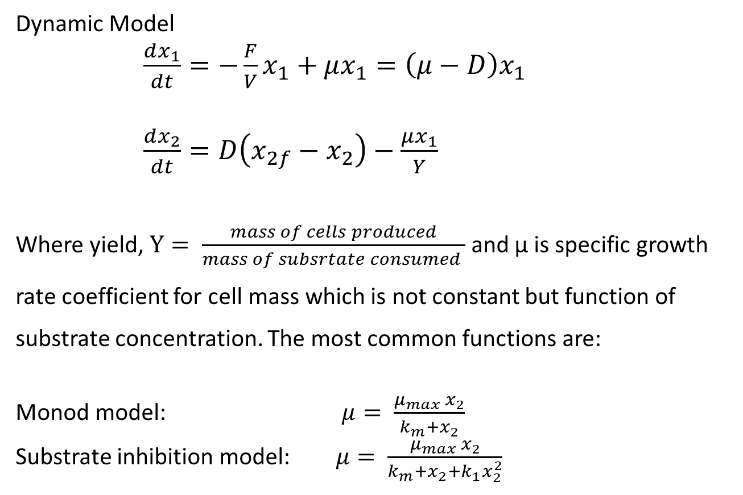
Biochemical Reactor (Dynamic Model)
Dynamic Model
$\frac{dx_{1}}{dt}=−\frac{F}{V}x_{1}+μx_{1}=\left(μ−D\right)x_{1}$
$\frac{dx_{2}}{dt}=D\left(x_{2f}−x_{2}\right)−\frac{μx_{1}}{Y}$
Where yield, $Y= \frac{mass of cells produced}{mass of subsrtate consumed }$ and μ is specific growth rate coefficient for cell mass which is not constant but function of substrate concentration. The most common functions are:
Monod model: $μ= \frac{μ_{max} x_{2}}{k_{m}+x_{2}}$
Substrate inhibition model: $μ= \frac{μ_{max} x_{2}}{k_{m}+x_{2}+k_{1}x_{2}^{2}}$

Slide 11
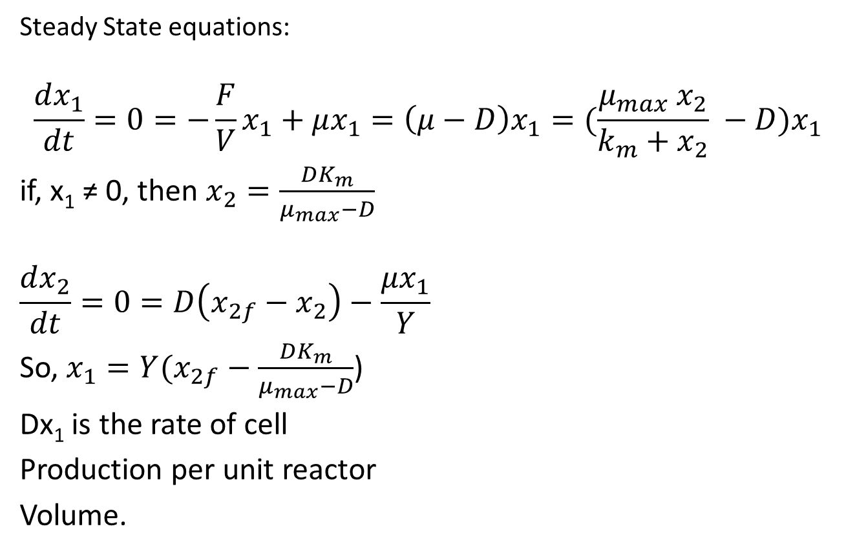
Biochemical Reactor
Steady State equations:
$$\frac{dx_{1}}{dt}=0=−\frac{F}{V}x_{1}+μx_{1}=\left(μ−D\right)x_{1}=(\frac{μ_{max} x_{2}}{k_{m}+x_{2}} −D)x_{1}$$
if, x₁ ≠ 0, then $x_{2}=\frac{DK_{m}}{μ_{max}−D}$
$$\frac{dx_{2}}{dt}=0=D\left(x_{2f}−x_{2}\right)−\frac{μx_{1}}{Y}$$
So, $x_{1}=Y(x_{2f}−\frac{DK_{m}}{μ_{max}−D}$)
Dx₁ is the rate of cell
Production per unit reactor
Volume.
x₁
Dx₁
x₂

Slide 12
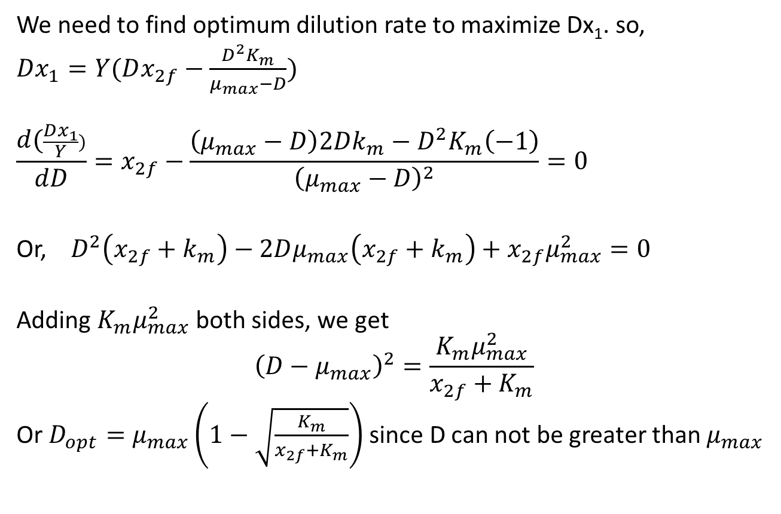
Biochemical Reactor
We need to find optimum dilution rate to maximize Dx₁. so,
$Dx_{1}=Y(Dx_{2f}−\frac{D^{2}K_{m}}{μ_{max}−D})$
$$\frac{d(\frac{Dx_{1}}{Y})}{dD}=x_{2f}−\frac{\left(μ_{max}−D\right)2Dk_{m}−D^{2}K_{m}\left(−1\right)}{{\left(μ_{max}−D\right)}^{2}}=0$$
Or, $D^{2}\left(x_{2f}+k_{m}\right)−2Dμ_{max}\left(x_{2f}+k_{m}\right)+x_{2f}μ_{max}^{2}=0$
Adding $K_{m}μ_{max}^{2}$ both sides, we get
$${\left(D−μ_{max}\right)}^{2}=\frac{K_{m}μ_{max}^{2}}{x_{2f}+K_{m}}$$
Or $D_{opt}=μ_{max}\left(1−\sqrt{\frac{K_{m}}{x_{2f}+K_{m}}}\right)$ since D can not be greater than $μ_{max}$

Slide 13
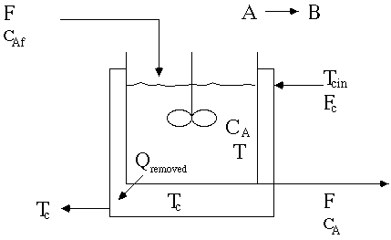
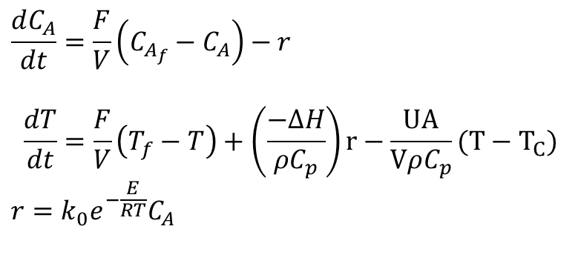
Non-Isothermal Jacketed CSTR
$$\frac{dC_{A}}{dt}=\frac{F}{V}\left(C_{A_{f}}−C_{A}\right)−r$$
$$\frac{dT}{dt}=\frac{F}{V}\left(T_{f}−T\right)+\left(\frac{−∆H}{ρC_{p}}\right)r−\frac{UA}{VρC_{p}}(T−T_{C})$$
$$r=k_{0}e^{−\frac{E}{RT}}C_{A}$$
parameter | case 1 | case 2 | case 3
F/V, hr-1 | 1 | 1 | 1
k₀, hr-1 | 14,825*3600 | 9,703*3600 | 18,194*3600
(−ΔH), kcal/kgmol | 5215 | 5960 | 8195
E, kcal/kgmol | 11,843 | 11,843 | 11,843
ρcp, kcal/(m^{3 o}C) | 500 | 500 | 500
T_{f}, ºC | 25 | 25 | 25
C_{Af}, kgmol/m3 | 10 | 10 | 10
UA/V, kcal/(m^{3 o}C hr) | 250 | 150 | 750
T_{C}, ºC | 25 | 25 | 25

Slide 14
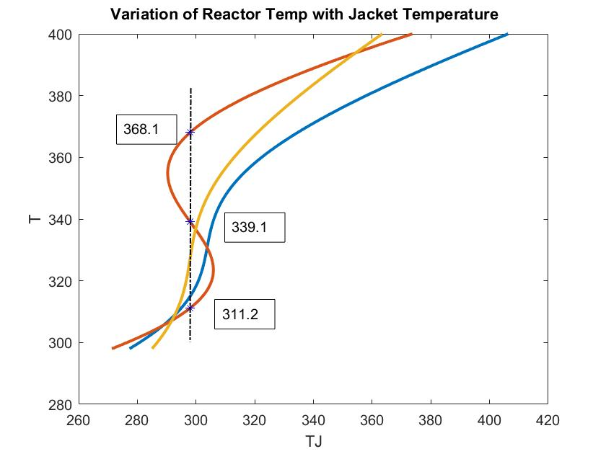
Case 2
Case 1
Steady State for case 2
C_{A} T
1 8.564 311.2
2 5.518 339.1
3 2.359 368.1

Slide 15
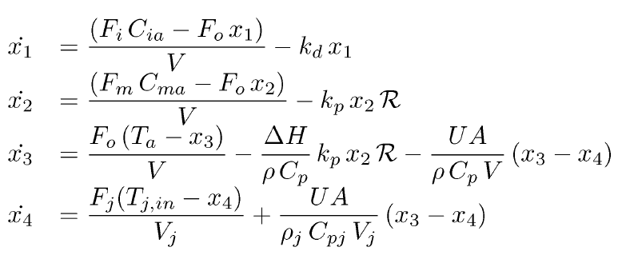
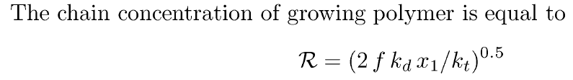
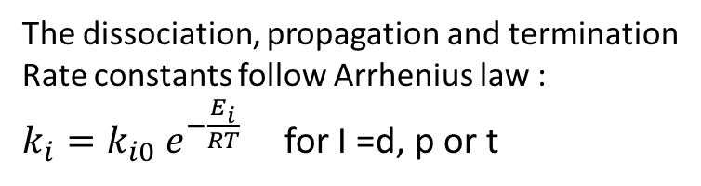
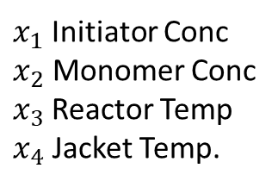
Styrene Polymerization Reactor
$x_{1}$Initiator Conc
$x_{2}$ Monomer Conc
$x_{3}$Reactor Temp
$x_{4}$ Jacket Temp.
The dissociation, propagation and termination
Rate constants follow Arrhenius law :
$k_{i}=k_{i0} e^{−\frac{E_{i}}{RT}}$ for I =d, p or t

Slide 16
Steady State Heat Power vs Reactor Temperature
2
3
1

Slide 17
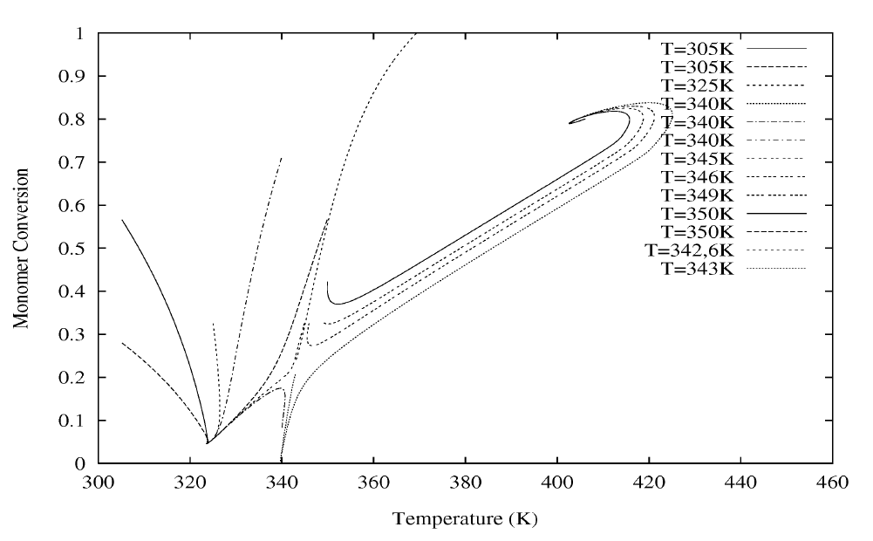
Phase Portrait
3
1
2 (unstable)

